Slide 1
Bell TEXTRON’s NEXT GEN AIRFRAME Composite Repair Concepts / Overview
JCAMS 2023
Notes:
When we first set out to give this presentation, we wanted to talk more specifically about the composite repair philosophies as they related to the FVL programs. However, since the V-280 program has just gotten under way, the overall repair philosophies have not been fully discussed nor finalized. Therefore, the program office requested we make our discussion more general to next generation aircraft manufactured with various types of composite materials.
But, for the record, both programs have been briefed multiple times on these concepts and way forward
In the end, Bell will adjust the overall repair / maintenance philosophy to match the US Army desires as they are put forth in contractual requirements.
One last item, this presentation does not include those processes that Bell is working on that have the potential to be patented

Slide 2
Composite Repair – Overall Approach
Start with Proven Concepts / Philosophy
Continue to Build on those Proven Methods and Technologies
Add Some Additional Capabilities
Push The Envelope
Continue Supporting the Fleet

Slide 3
Start with the Current Repair Philosophy
Provide repair capability for all maintenance levels
Focusing on providing lowest level of maintenance with ability to affect a significant number of full life repairs (no periodic inspections required)
Provide repair capability for all operational environments
Peacetime → Full Life Repairs, no periodic inspections required
Wartime → 24-hour max. repair time, repairs good for 100 flight hours or 30 elapsed days (based on the use of aluminum)
Only static analysis required for 100 flight hours, no fatigue testing required
Elapsed time could be extended by using CRES
Notes:
Peacetime repairs can be executed within ABDR time requirements for smaller damage
V-22 ABDR requirements were 24 hour completion time, 100 flight hours or 30 days (elapsed since repair), whichever comes first.
Metallic repairs: stainless steel and aluminum (corrosion implications)
Bolted repairs to complex aircraft structure (joints, co-cured stiffeners, etc.)

Slide 4
Continue to Build Capabilities Using Proven Methods & Technologies
30+ years of V-22 fielded fleet success (w/ Govt approval)
Common set of general application repair processes
Highly portable tool set
Room temperature storable materials
Commonality with existing DLA inventories
Notes:
* SMPs / SRPs – Building Block approach, simplified document maintenance and process training

Slide 5
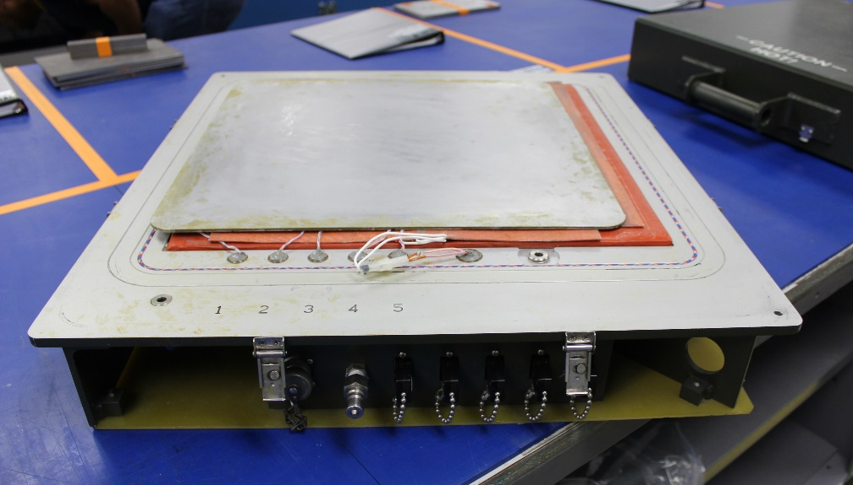
Composite Repair Equipment – Double Vacuum Debulk (DVD) Tool, 4920-01-470-1453
DVD Tool, With Lid On
Easily Portable, w/ Handles (35 #)
External Gauges and Vacuum Control Valves
DVD Tool, With Lid Off
Internal Heater Blanket, Caul Plate & Thermocouples
External Power, Vacuum and Thermocouple connections
See US Army TM 1-1500-204-23-11, Figure 3-6 (DVD tool schematic) and Section 7-11 (DVD Process)
Notes:
Visited Ft. Eustace (128th) – training site
Tool not currently being used / taught

Slide 6
DOD Temperature Vacuum Controller – Single Zone (COTS)
Current US Army identified Single Zone temperature / vacuum controller
Single Zone – 1 repair only
Easily portable, with handles
Approx 20# depending on items stored in lid
Army tool lists Single Zone, 4920-01-462-4658, or a Dual Zone, 4920-01-445-4529, Controllers

Slide 7
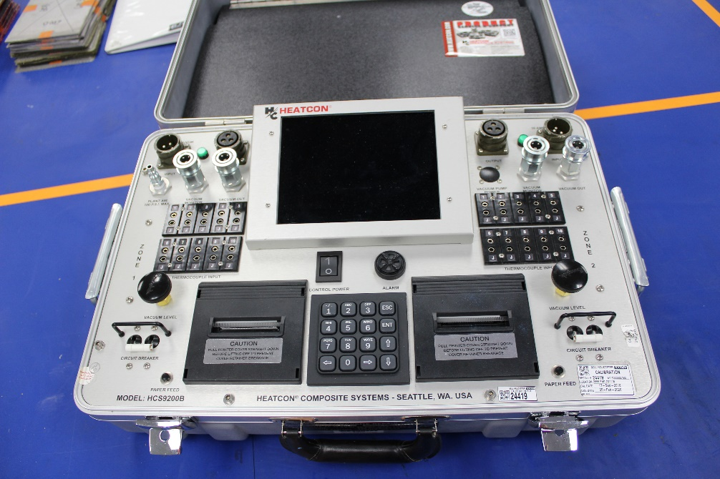
Composite Repair Equipment – Temperature Vacuum Controller (COTS) HCS9200B-AV Dual Zone [Bell Use]
Easily portable, with handles
35-45# depending on items stored in lid
Dual Zone Controller
Can perform 2 smaller repairs at same time
Can combine zones to facilitate one large repair
Army tool lists Single Zone, 4920-01-462-4658, or a Dual Zone, 4920-01-445-4529, Controllers

Slide 8
Composite Repair Equipment – Temperature Vacuum Controller (USN, USMC, USAF) HCS9200N-2.5
Dual Zone Controller
Used by USN, USMC and USAF for V-22 repairs
EMI Hardened
Explosion Proof

Slide 9
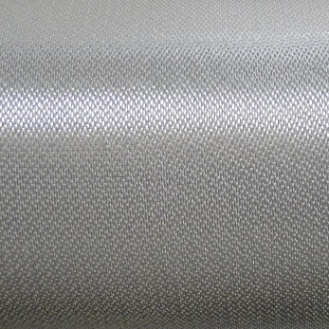
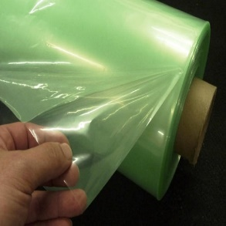
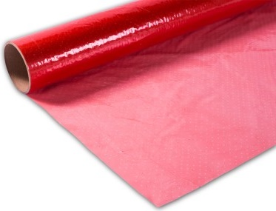
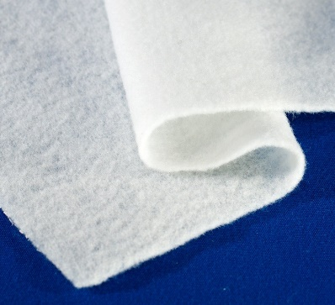
Composite Repair Materials – Common to US Army Inventory
PW Carbon Fiber Fabric
(Structural Patch)
5335-01-474-4593
Reemay Scrim Cloth
(Bond Line Thickness Control)
Copper Mesh
(Lightning Strike)
5340-01-474-6601
Porous Teflon Coated Fiberglass Fabric (Peel Ply)
8305-01-391-9980
120 Style Fiberglass
(Bleeder Plies)
8302-015-03-9690
© 2023 Bell Textron
Vacuum Bag Film
9330-01-381-4647
FEP Release Film
9330-01-569-0226
Breather Cloth
(Vacuum Path / Insulation)
9330-01-179-2974
Notes:
Jerry will discuss this slide
FVL programs are using more advanced materials than V-22, specifically higher modulus carbon fibers in both tape and fabric forms, therefore additional material qualifications will have to be performed to develop repair allowables for those fibers and material types
However, wet layup panels using newer fabric forms have been successfully processed using the method used by V-22 program – tweeks to the process might be required if resin system changes. Currently we recommend the Magnolia 7590 as the impregnation resin (starting point)

Slide 10
Common Repair Adhesives
RESIN | EA9309.3 | EA9390 | EA9394 | EA9396 | Mag 6363 | Mag 7590 | BH200
Mix Ratio | 100:22 | 100:56 | 100:17 | 100:30 | 100:35 | 100:54 | 100:15
Max Mix Amt (g) | 200 | 200 | 100 | 100 | 100 | 200 | 100
Pot Life | 35 | 120 | 90 | 75 | 90 | 120 | 30
NSN | 8040-01-641-5618 | 8040-01-388-2930 | 8040-01-490-5417 | 8040-01-209-1286 | 8040-01-449-3552 | 8040-01-620-6577 | 6810-01-561-4541
Applications:
Click Studs: EA9309.3 or EA9394
Precured Patches: EA9394 or Magnobond 6363
Wet Lay-Up Patches:
Structural: Mag7590 preferred (EA9390 is acceptable alternate)
Cosmetic: EA9396
Honeycomb Core: BH200 (acceptable for use in blades)
© 2023 Bell Textron
Notes:
EA9390 is currently used on V-22 and is an acceptable resin system, but history has shown a wide variability in the processing of panels made with this adhesive/resin.
Magnolia 7590 has been qualified as an alternative and is offered as the preferred impregnation resin for 250F capable patches.
Newer material
Longer processing window, if needed
Less variability since dedicated repair resin specification was created.

Slide 11
Composite Repair – Fleet Implementation
All repair data contained in and available to the maintainer in appropriate Integrated Electronic Technical Manual (IETM)
Graphic of part (Zone Map) details where specific types of damages are allowed
Interactive evaluation process allows quick determination of course of action
Repair Negligible Damage – cosmetic, typically fill & fair, or maybe just blending
Repair Structural Damage – data provided on number of plies, orientation and critical repair parameters (edge distance, ply overlap requirements, etc.)
Remove and replace part / component
Provides step by step instructions

Slide 12
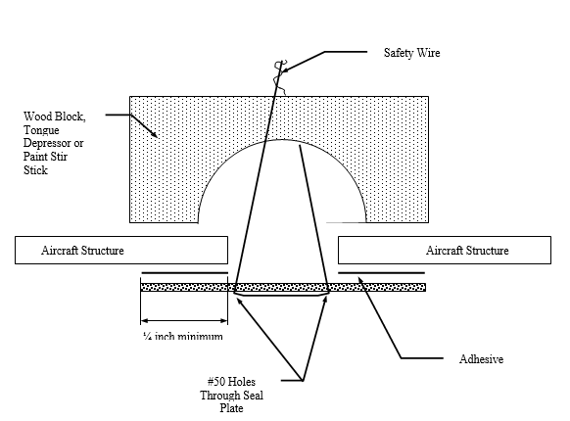
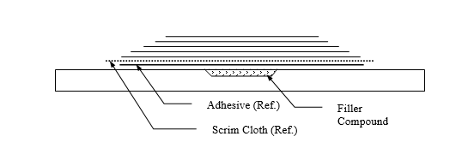
Repair Examples
Repairs can be performed on and off the aircraft, with access to only one or both sides of the component
Repair of major skin from outside of aircraft
(w/o part removal)
Typical 1-Sided Wedding Cake Repair Patch
Over Partial Thickness Damage

Slide 13
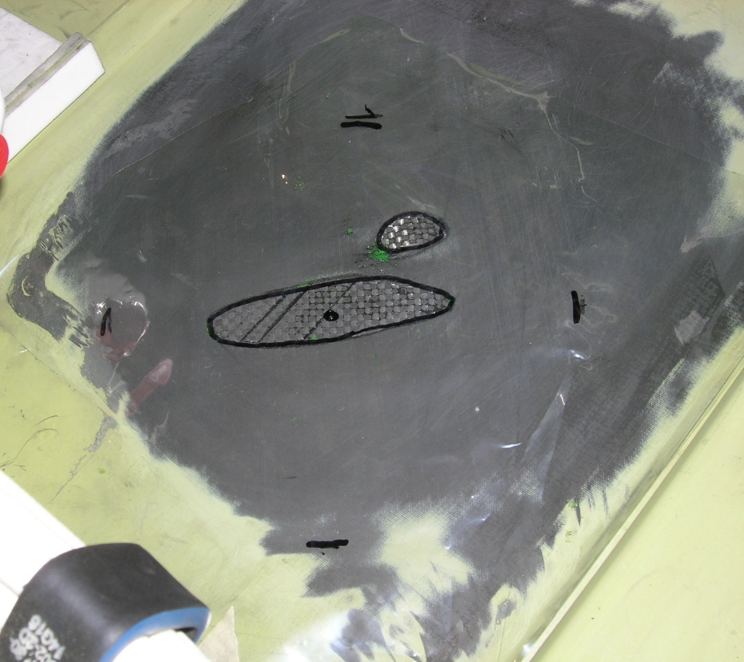
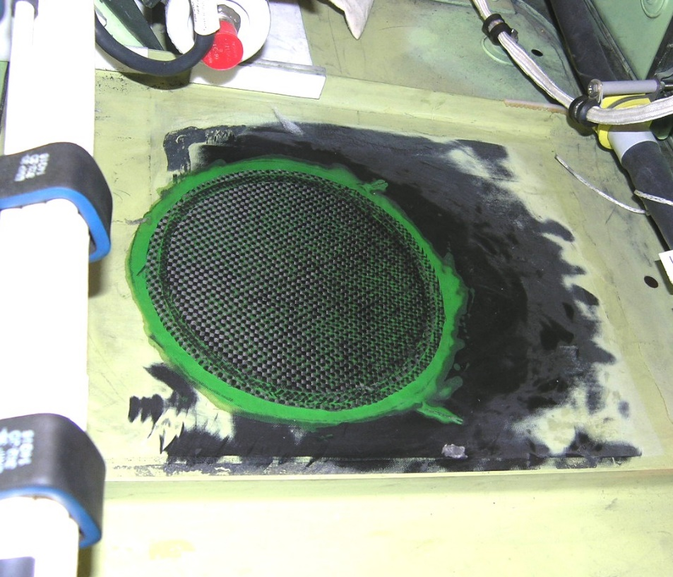
Wing Fixed Trailing Edge Repair [Field Level]
Damage, 2 areas close to each other
Completed Repair

Slide 14
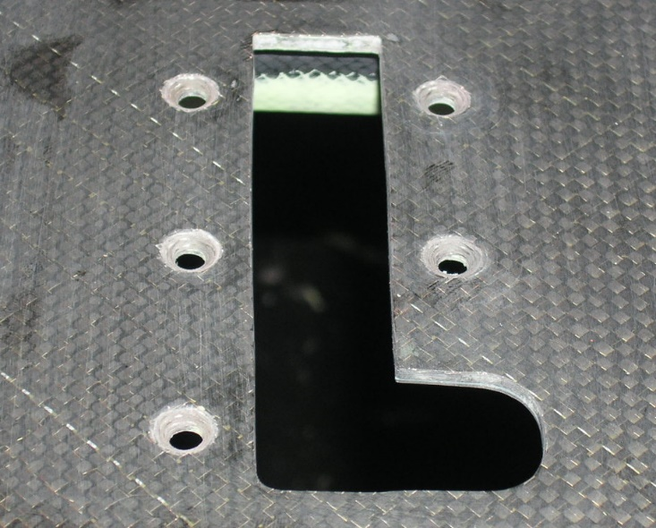
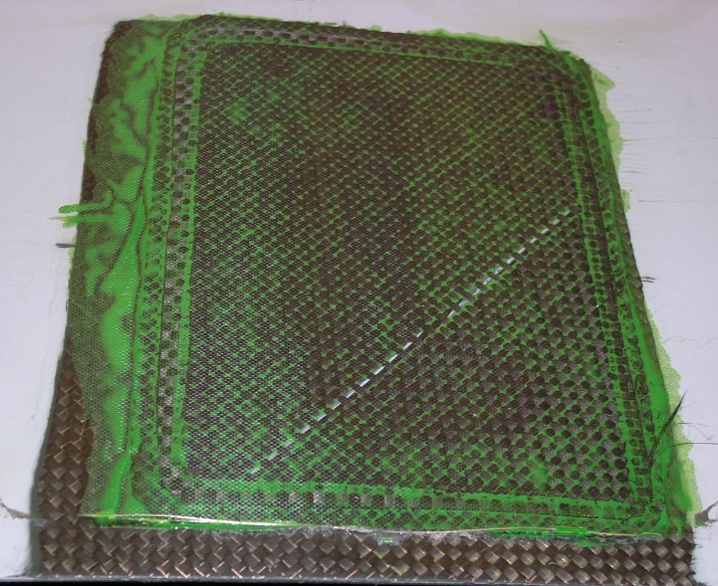
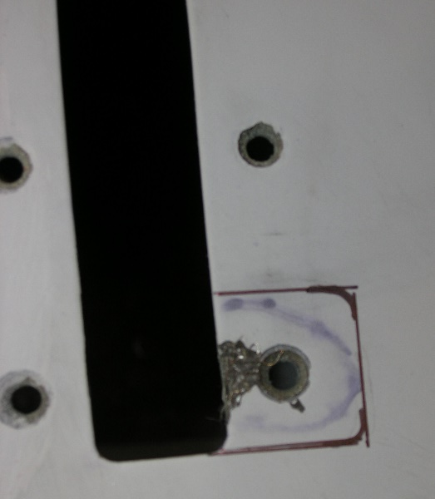
Belly Door, Latch Attachment Area [Field Level]
To be Removed
Damage to Latch Area,
Near Fastener Hole
Damaged Area Removed
Bonded Repair
Plug and Inside /
Outside Patches

Slide 15
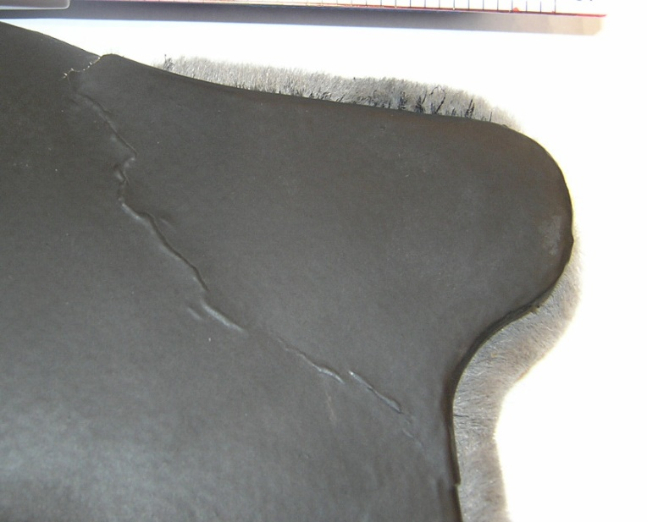
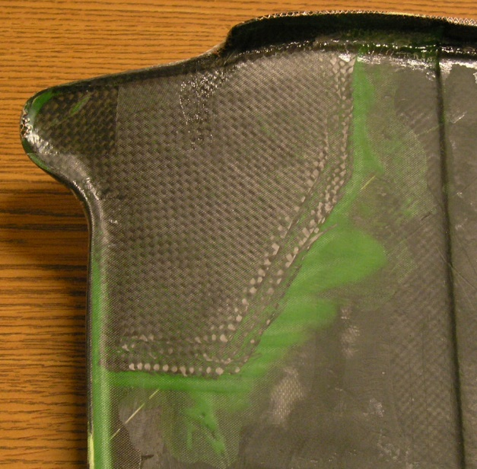
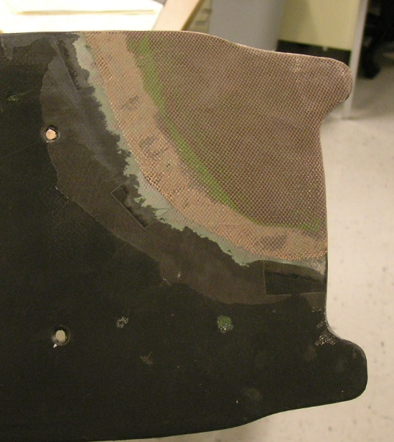
Center Grip Fairing, Scarf Repair W/ Copper Mesh [Field Level]
Bend / Crack
Tab Cracked Completely Through
Inner Patch, DVD
Outer Patch, DVD
Lightning Strike Material Applied

Slide 16
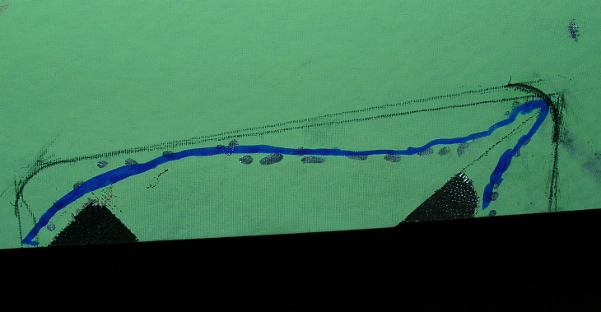
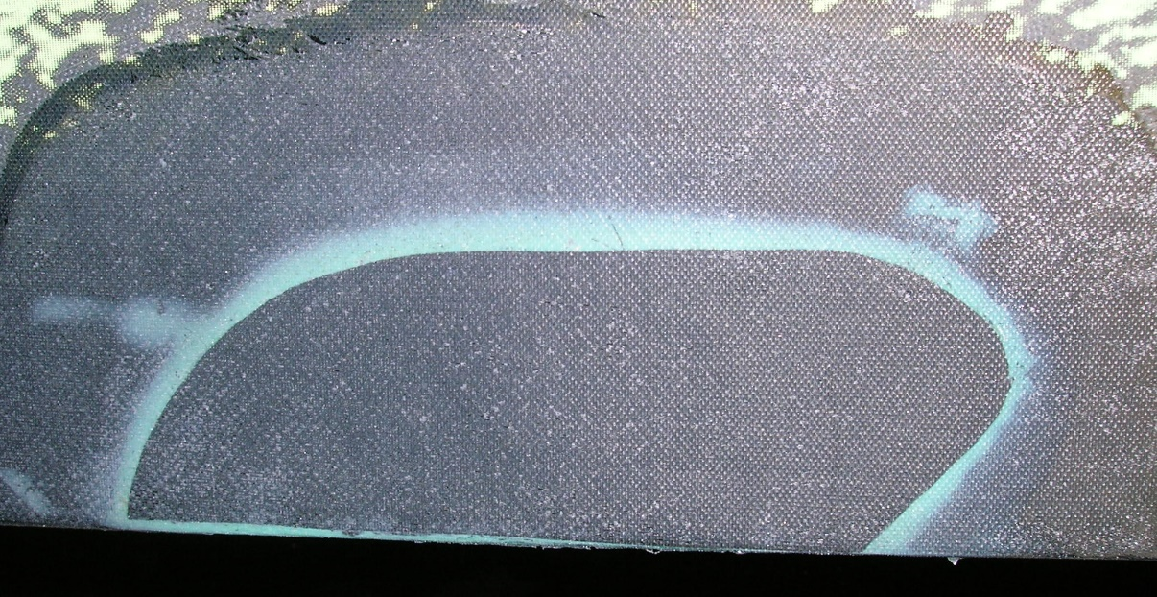
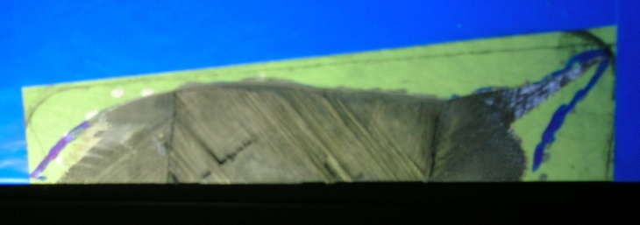
Wing Skin Delamination Flush Patch Repair [Field Level]
Damage Indication
Completed Flush Repair Patch
Damage Removal
Note: Scarf repair shown using unidirectional prepreg tape

Slide 17
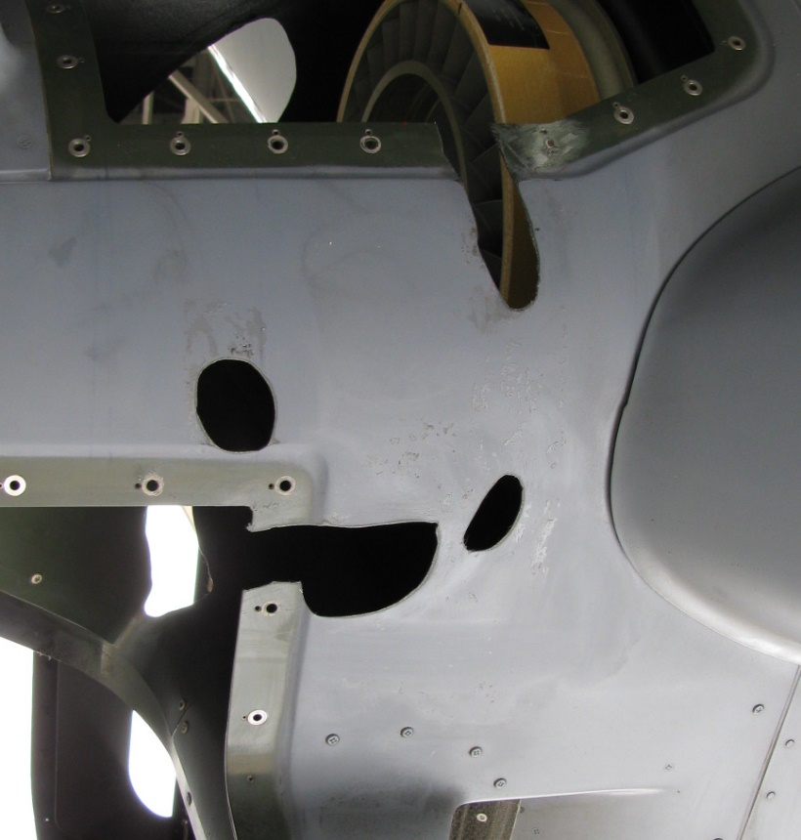
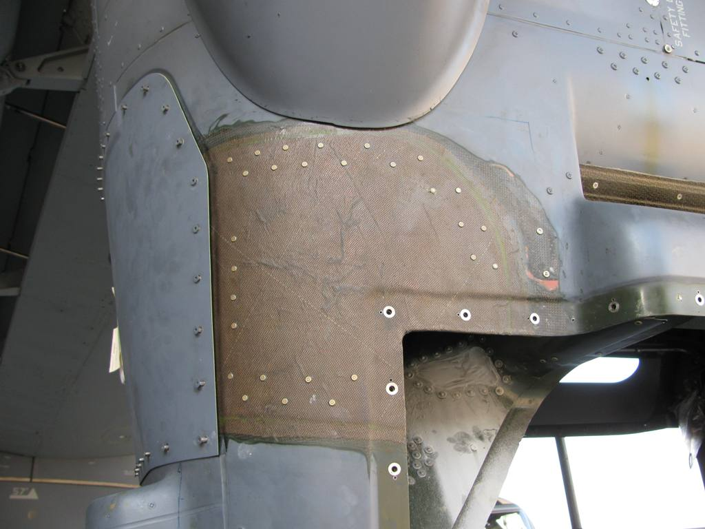
Aft Nacelle Damage, Multiple, Blower Disintegration [Field Level]
Damage
Damage in Multiple Areas Due to Failure of Internal Rotating Part
Completed Repair with Lightning Strike Mesh

Slide 18
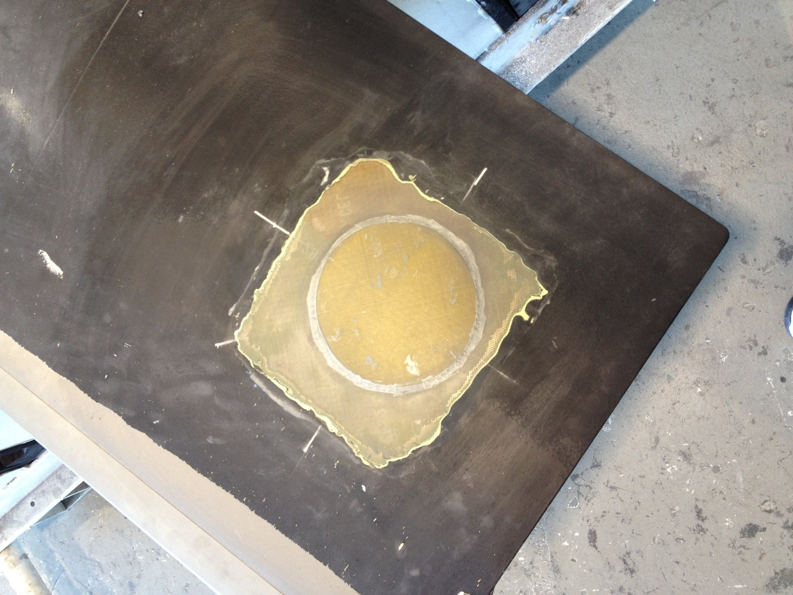
Blade Skin Patch [Field Level]
Blade Skin Patch
Precured Skin Material
Bonded and Aerodynamic Filler Applied Around Edges
On-Aircraft repair possible

Slide 19
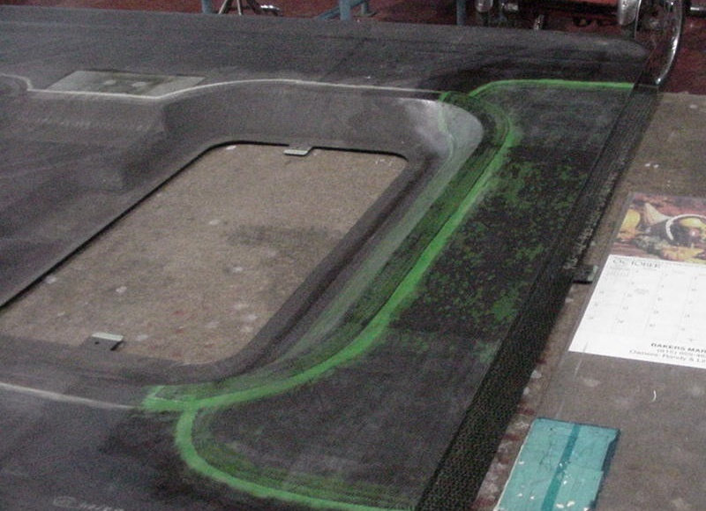
Ramp Door Repair [Field Level]
Ramp Door Repair
Double Vacuum Debulk Patches
Contoured Surface Around Opening

Slide 20
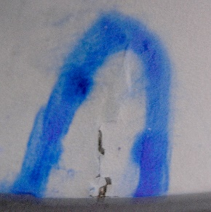
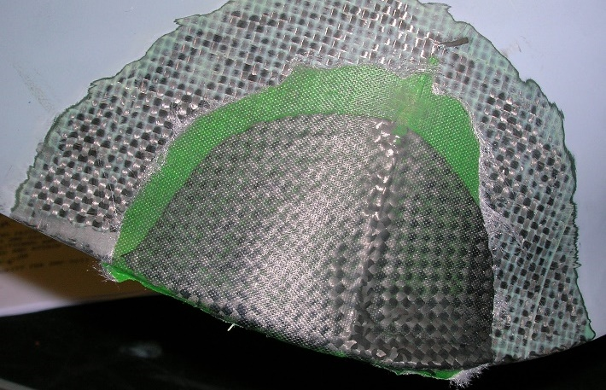
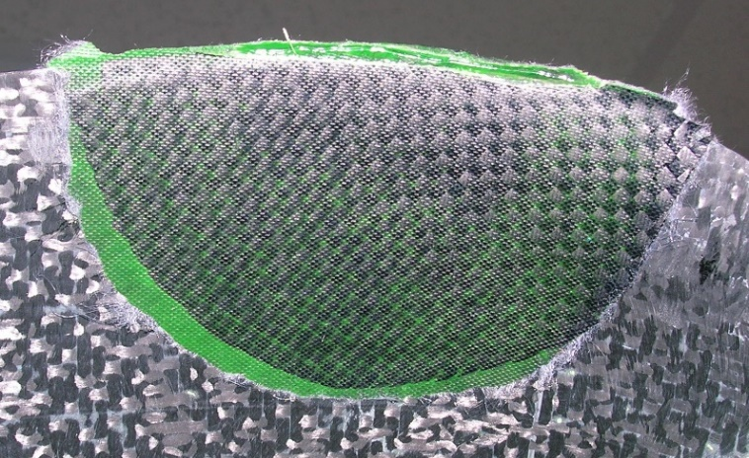
Removable Panel Repair [Field Level]
Through Crack
Outer Patch
Edge of Panel Cracked Through the Entire Thickness
Inner Patch

Slide 21
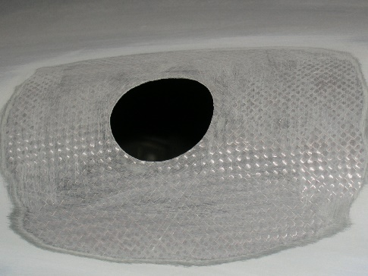
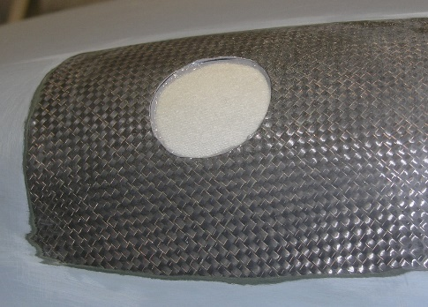
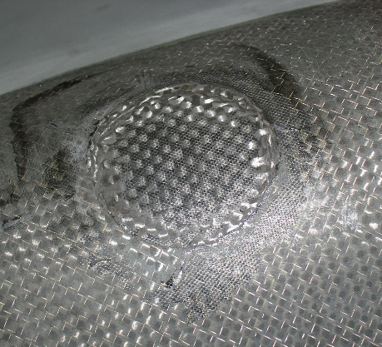
Fixed Panel Repair, Contoured Surface [Field Level]
1. Damage
Cleaned Up
2. Backside Seal Plate Installed
Puncture on Panel, Accessible From Exterior of Panel Only
3. Contoured Plug Cured In Place

Slide 22
BMI Structure – Current Repair Options (Bismaleimide) (Engine Exhaust Areas)
Based on time frame to execute a repair, two options are available:
Unit Level Repair
Metal, bolted patch (Ti or SS)
100 flight hour life *
Replace metal/fasteners and reset 100 life limit
Depot Level (see picture)
BMI Composite Bonded Repair
Unlimited Life, no periodic inspection required
Multi-step process, ~ 2 days
Stage Patch
Cure patch
Post-Cure patch
Secondary Bond of patch
* Based on V-22 Aircraft Battle Damage Repair philosophy
Notes:
* Using rapid prototype tooling, or another aircraft, patches can be fabricated at Depot or other maintenance facilities and then shipped forward to deployed location for final patch bonding.

Slide 23
Repair to Thermoplastic Strucure
Current State of the Art is bolted patches, no different from metallic patches
Difficulties in Field Level Repairs
Surface Preparation for Bonding extremely difficult

Slide 24
Add Some Additional Capabilities
Simplified composite panel hole repair
Modified vacuum bag cure process
Single stage to cure

Slide 25
Simplified Composite Panel Fastener Hole Damage
Bell patented process with government having limited rights
Uses COTS braided dry fiber reinforcements as well as two-part, RT storable epoxy adhesive
Restores nominal hole diameter to fastener holes larger than repairable with available oversize fasteners
Bearing (Fatigue) test program ongoing

Slide 26
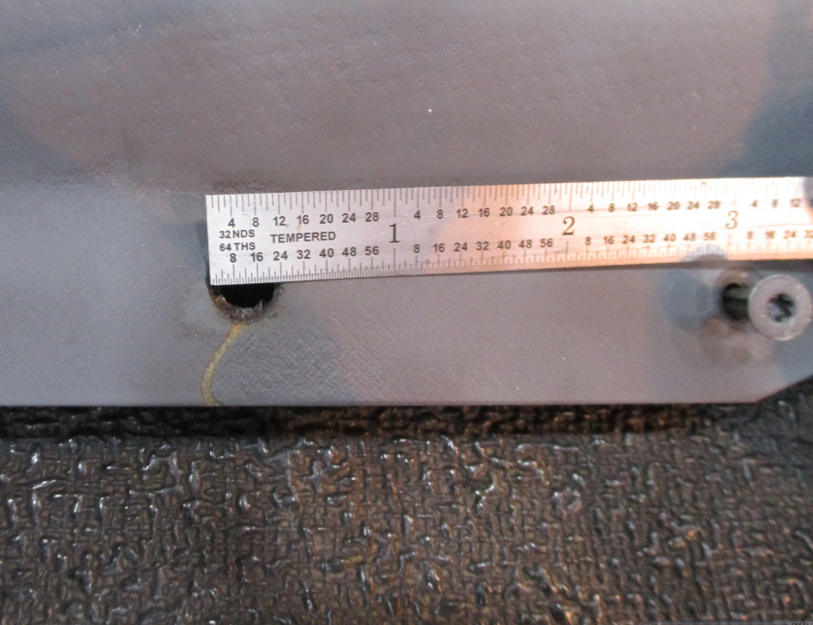
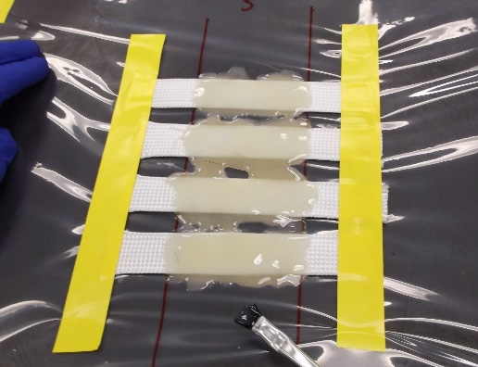
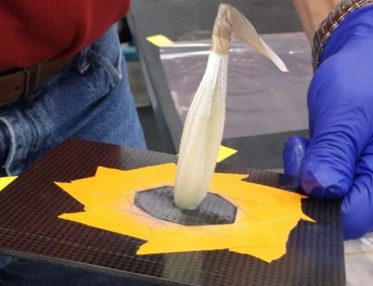
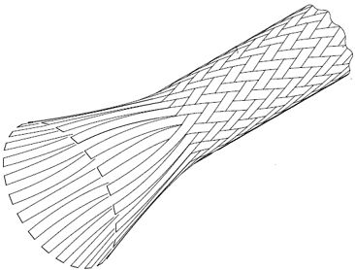
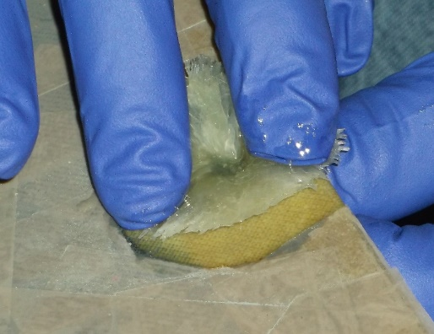
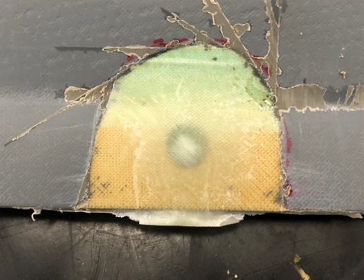
Fastener Hole Repair – Grommet Made/Bonded in Place [Field Level]
© 2023 Bell Textron Inc.
V-22 Composite Panel
Epoxy Resin
Braided Tube
Carbon, or
Fiberglass
Fastener Hole Damage
1. Prepare damaged hole
2. Prepare braided tubes
3. Insert tubes through hole
Replacement Fastener
Repair
4. Trim and flare
5. Cure in place
6. Re-install fastener
Bell patented process facilitates complex repair using commonly available tools / materials – successfully demonstrated during repair of CV-22 panel in Amarillo
Notes:
Current process, as written, uses single tube, wetted out and folded to obtain require number of “equivalent sections” of tubes inserted through the hole.
Simplified maintenance table provides hole size (damage removal) and required number of fiberglass or carbon braided sections required to fill the hole.

Slide 27
Modified Single Vacuum Debulk Process
© 2023 Bell Textron Inc.
Bell Patented Process – therefore, must be licensed or part of the contract
Uses only one vacuum bag
Can be used on-aircraft
Uses a two-step de-gass / compaction process like Double Vacuum Debulk process
Uses partial vacuum during initial (de-gass) portion of process
Transitions to full vacuum during compaction portion of the process
Time and temperature profile same as DVD (same cured properties)
Same material properties as patches cured via DVD process
Useful with composite wet lay-up patches up to 14 plies (.105” thick)
When impregnated with Mag7590
DVD Tool not needed for thin, complex contour repair patches

Slide 28
Single Stage to Cure
© 2023 Bell Textron Inc.
One cure sequence
Only bag repair patch once
No need to unbag after debulk/compaction and rebag for cure.
Uses modified vacuum sequence
To account for patch degass and compaction cycles
Additional dwell added to allow film adhesive degass as well
Process successfully demonstrated with thin laminates and certain film adhesives
Used to create and bond structural shims to V-22 Spindle prior to mating with V-22 Pylon Support Assembly.

Slide 29
Continue Pushing the Envelope
© 2023 Bell Textron Inc.
Looking at new ways to debulk impregnated fabric
Looking for new materials and process for field level bonded repairs to BMI Structure
Increased use of rapid prototyping (3D printing) tools for expediting contoured repairs.
Limited cases of using 3D printed replacement parts

Slide 30
Continue to Support the Fleet Through Composite Repair Training
© 2023 Bell Textron Inc.
Bell has conducted fleet training for composite repairs
Amarillo facility – units travel to facility for training
Fleet Sites (MV, CV and CMV) – we send all items there and conduct training
CONUS
California Florida
Maryland New Mexico
North Carolina
Virginia
OCONUS
UK
Japan (mainland and Okinawa)
Over 300 individual students and trainers trained since Q4 2019

Slide 31
Training Notes
© 2023 Bell Textron Inc.
Current composite repair materials and processes are being included in the Training System Requirements Analysis (TSRA)
US Army Training Site Visit (Ft. Eustis)
Verified that site trains composite repair and has all the materials needed
Discussed Double Vacuum Debulk (DVD) process; tool is not yet fielded by Army
Tool NSN: 4920-01-470-4593
DVD Tool and Process covered in TM 1-1500-204-23-11, Sections 3 and 7, Respectively
Aviation Unit Maintenance (AVUM) and Aviation Intermediate Maintenance (AVIM) Manual, Volume 11, Advanced Composite Material General Maintenance Practices

Slide 32
Composite Repair Training in Hangar
© 2023 Bell Textron Inc.
Training conducted in squadron hangar, doors wide open, right next to the aircraft they will be repairing.
© 2023 Bell Textron

Slide 33
Composite Repair Training in Hangar
© 2023 Bell Textron Inc.
Ten (10) maintainers trained each session (5 days)
© 2023 Bell Textron

Slide 34
Composite Repair Training in Hangar
© 2023 Bell Textron Inc.
Training covers repairs of solid laminates (panels) and honeycomb structure (blades).
© 2023 Bell Textron

Slide 35
Composite Repair Training in Hangar
© 2023 Bell Textron Inc.
Everybody participates, learning by doing (with written procedures at their side)
© 2023 Bell Textron

Slide 36
QUESTIONS?
Notes:
OEM repair (Depot Level) –
Damage cleaned up to roughly 13 inches along forward edge, extending 7 inches back from forward edge.
Damage through 3 distinct thicknesses with different ply layups, major structural attachment area (Wing plank to FWD Spar Cap)
Roughly 3 weeks to implement (reviewing ply layups, determining patch staging abilities (size, thickness) and implementation of repair (2-sided application using 2 patches applied in successive operations)

Slide 37
The end

