Slide 1
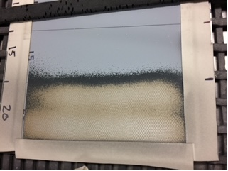
Type VII PMB Qualification For Paint Removal on Composite & Lightning Strike Protection Materials
June 13, 2023
Presented to: Joint Composite and Advanced Material Sustainment (JCAMS)
Presented by: Haripriya Nilakantan, MRO-E Materials Engineering Department FRCSW

Slide 2
Distribution Statement
Distribution Statement A: This technical brief is approved for public release. Distribution is unlimited.
Release Number: 23-0012

Slide 3
Presentation Overview
1.1Project Background/Overview
1.1. Current Composite Paint Removal Issues at FRCSW
1.2. Type VII Qualification Project Objective at FRCSW
1.3. Type VII Media Background
2. Type VII Media Evaluation Process at FRCSW
3. Test Specimen Design
3.1. Carbon Fiber/Epoxy Composites
3.2. Fiberglass/Epoxy Composites
3.3. Lightning Strike Protection Materials
4. Paint Removal Testing
4.1. Mechanical Sanding (Control Specimens)
4.2. Type VII PMB
5. Pre/Post-Paint Removal NDI
6. Mechanical Testing
6.1. Long Beam Flexure
6.2. Flatwise Tension
7. Optical Microscopy
8. Lightning Strike Material Electrical Resistivity Testing
9. Long Term Goals With Type VII Media

Slide 4
1. Project Background/Overview

Slide 5
1.1 Current Composite Paint Removal Issues at FRCSW
The only approved method for paint removal on composites currently for Naval aircraft at FRCSW is mechanical sanding.
Mechanical sanding can cause damage to composites when performed by inexperienced shop personnel, and when performed too aggressively.
Mechanical sanding is also highly labor intensive and time consuming, which results in significant delays in component turnaround times.
Additionally, mechanical sanding generates large amounts of hazardous waste, which poses a safety hazard to shop personnel.

Slide 6
1.2 Type VII Qualification Project Objective at FRCSW
Approve Type VII media for paint removal on thin aircraft components containing Carbon Fiber/Epoxy and Fiberglass/Epoxy composite materials
Approve Type VII media for paint removal on aircraft components containing lightning strike protection materials (typically paste adhesives embedded with a metal mesh)

Slide 7
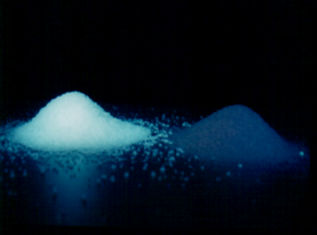
Type VII Media Background

Slide 8
2. Type VII Evaluation Process at FRCSW
Test Specimen Design
Specimen Material Procurement
Test Specimen Fabrication
NDI of Test Specimens
Painting Test Specimens
Paint Removal Testing With Type VII PMB & Mechanical Sanding
Post Paint Removal NDI of Test Specimens
Mechanical Testing of Specimens
Specimen Microstructural Evaluation/Electrical Testing

Slide 9
3. Test Specimen Designs

Slide 10
3.1 Carbon Fiber/Epoxy Composites
Long Beam Flexure
9 total 24” x 14” sandwich panels
Facesheet: AS4/3501-6 Carbon/Epoxy, 5 plies, (+45, -45, 0)s
Honeycomb Core: 5052-H39-1/8-0.002N-8.1 pcf (1.5” thick)
Film Adhesive: FM300-2
Flatwise Tension
6 total 12” x 6” sandwich panels
Facesheet: AS4/3501-6 Carbon/Epoxy, 4 plies, (0,90)s
Honeycomb Core: 5056-H39-3/16-0.001N-3.1 pcf (0.625” thick)
Film Adhesive: FM300-2

Slide 11
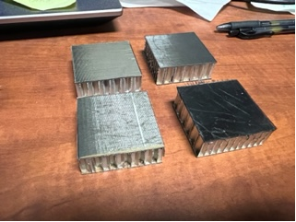
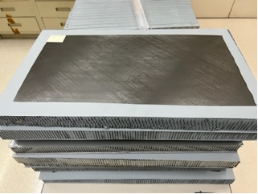

Slide 12
3.2 Fiberglass/Epoxy Composites
Long Beam Flexure
9 total 24” x 14” panels
Facesheet: Style 7781 Fiberglass, 2 ply (0,-45)
Honeycomb Core: 5052-H39-1/8-0.002N-8.1 pcf (1.5” thick)
Film Adhesive: AF163-2OST
Flatwise Tension
6 total 12” x 6” panels
Facesheet: Style 7781 Fiberglass, 2 ply (0,-45)
Honeycomb Core: HTP-3/8-2.5 (1” thick)
Film Adhesive: AF163-2OST

Slide 13
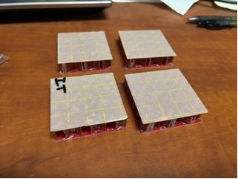

Slide 14
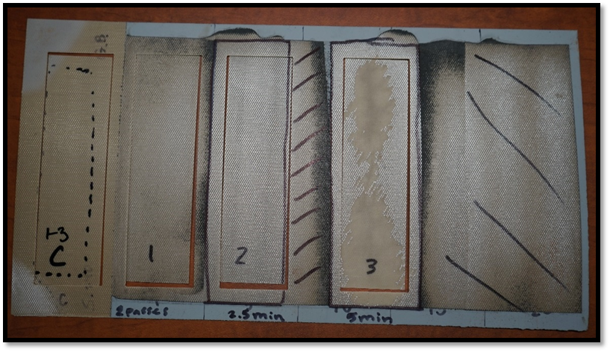
3.3 Lightning Strike Protection Materials
1 13” x 13” panel
1 ply of FM300-2HT Lightning Protection Film (epoxy embedded with aluminum mesh)
2 plies of Style 7781 Fiberglass (0,-45)

Slide 15
4. Paint Removal Testing

Slide 16
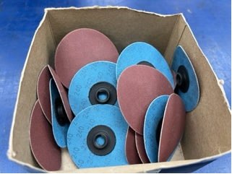
4.1 Mechanical Sanding

Slide 17
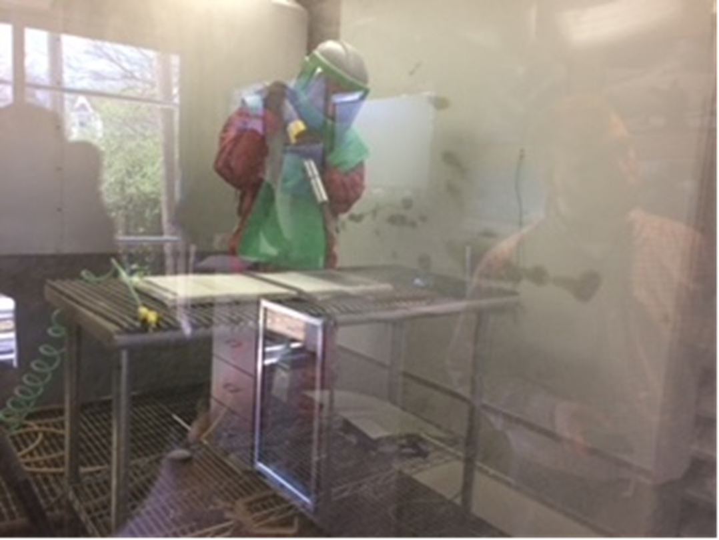
4.2 Type VII PMB

Slide 18
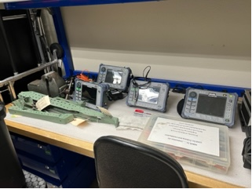
5. Pre/Post Paint Removal NDI (Non-destructive Inspection)

Slide 19
6. Mechanical Testing

Slide 20
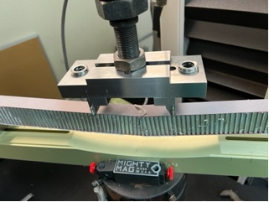
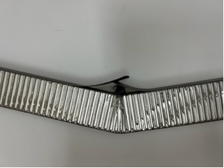
6.1 Long Beam Flexure

Slide 21
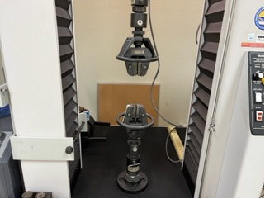
6.2 Flatwise Tension

Slide 22
Initial Observations/Assessments of Type VII Media From FWT Data
No conclusive effects observed from the paint removal methods on the FWT failure loads/stresses
No differences observed between Type VII media and mechanical sanding, in terms of impact on FWT failure loads/stresses
Skin-to-core tensile bond strength is more so a function of skin/core/film adhesive material properties and bonding surface preparation quality
Breakage was observed between plies of the facesheets, within core, and between film adhesive and core

Slide 23
7. Optical Microscopy
Characterize surface fiber and skin-to-core microscopic damage (porosity, delamination, fiber breakage/microcracking)
Fiberglass/Epoxy (Fg/Ep) FWT specimens sanded with 80 grit abrasive experienced the most surface fiber damage.
Fiber damage was not observed on the Fg/Ep specimens blasted with Type VII media, or sanded with 180 grit abrasive. This was due to the fact that the fibers were in a woven configuration, therefore having an increase in structural integrity compared to the unidirectional arrangement on the Carbon Fiber/Epoxy (C/Ep) specimens.
Mechanical sanding with 80 grit abrasive and Type VII media at 20 cycles (worst case aircraft paint removal scenarios) inflicted the most surface fiber damage on C/Ep specimens

Slide 24
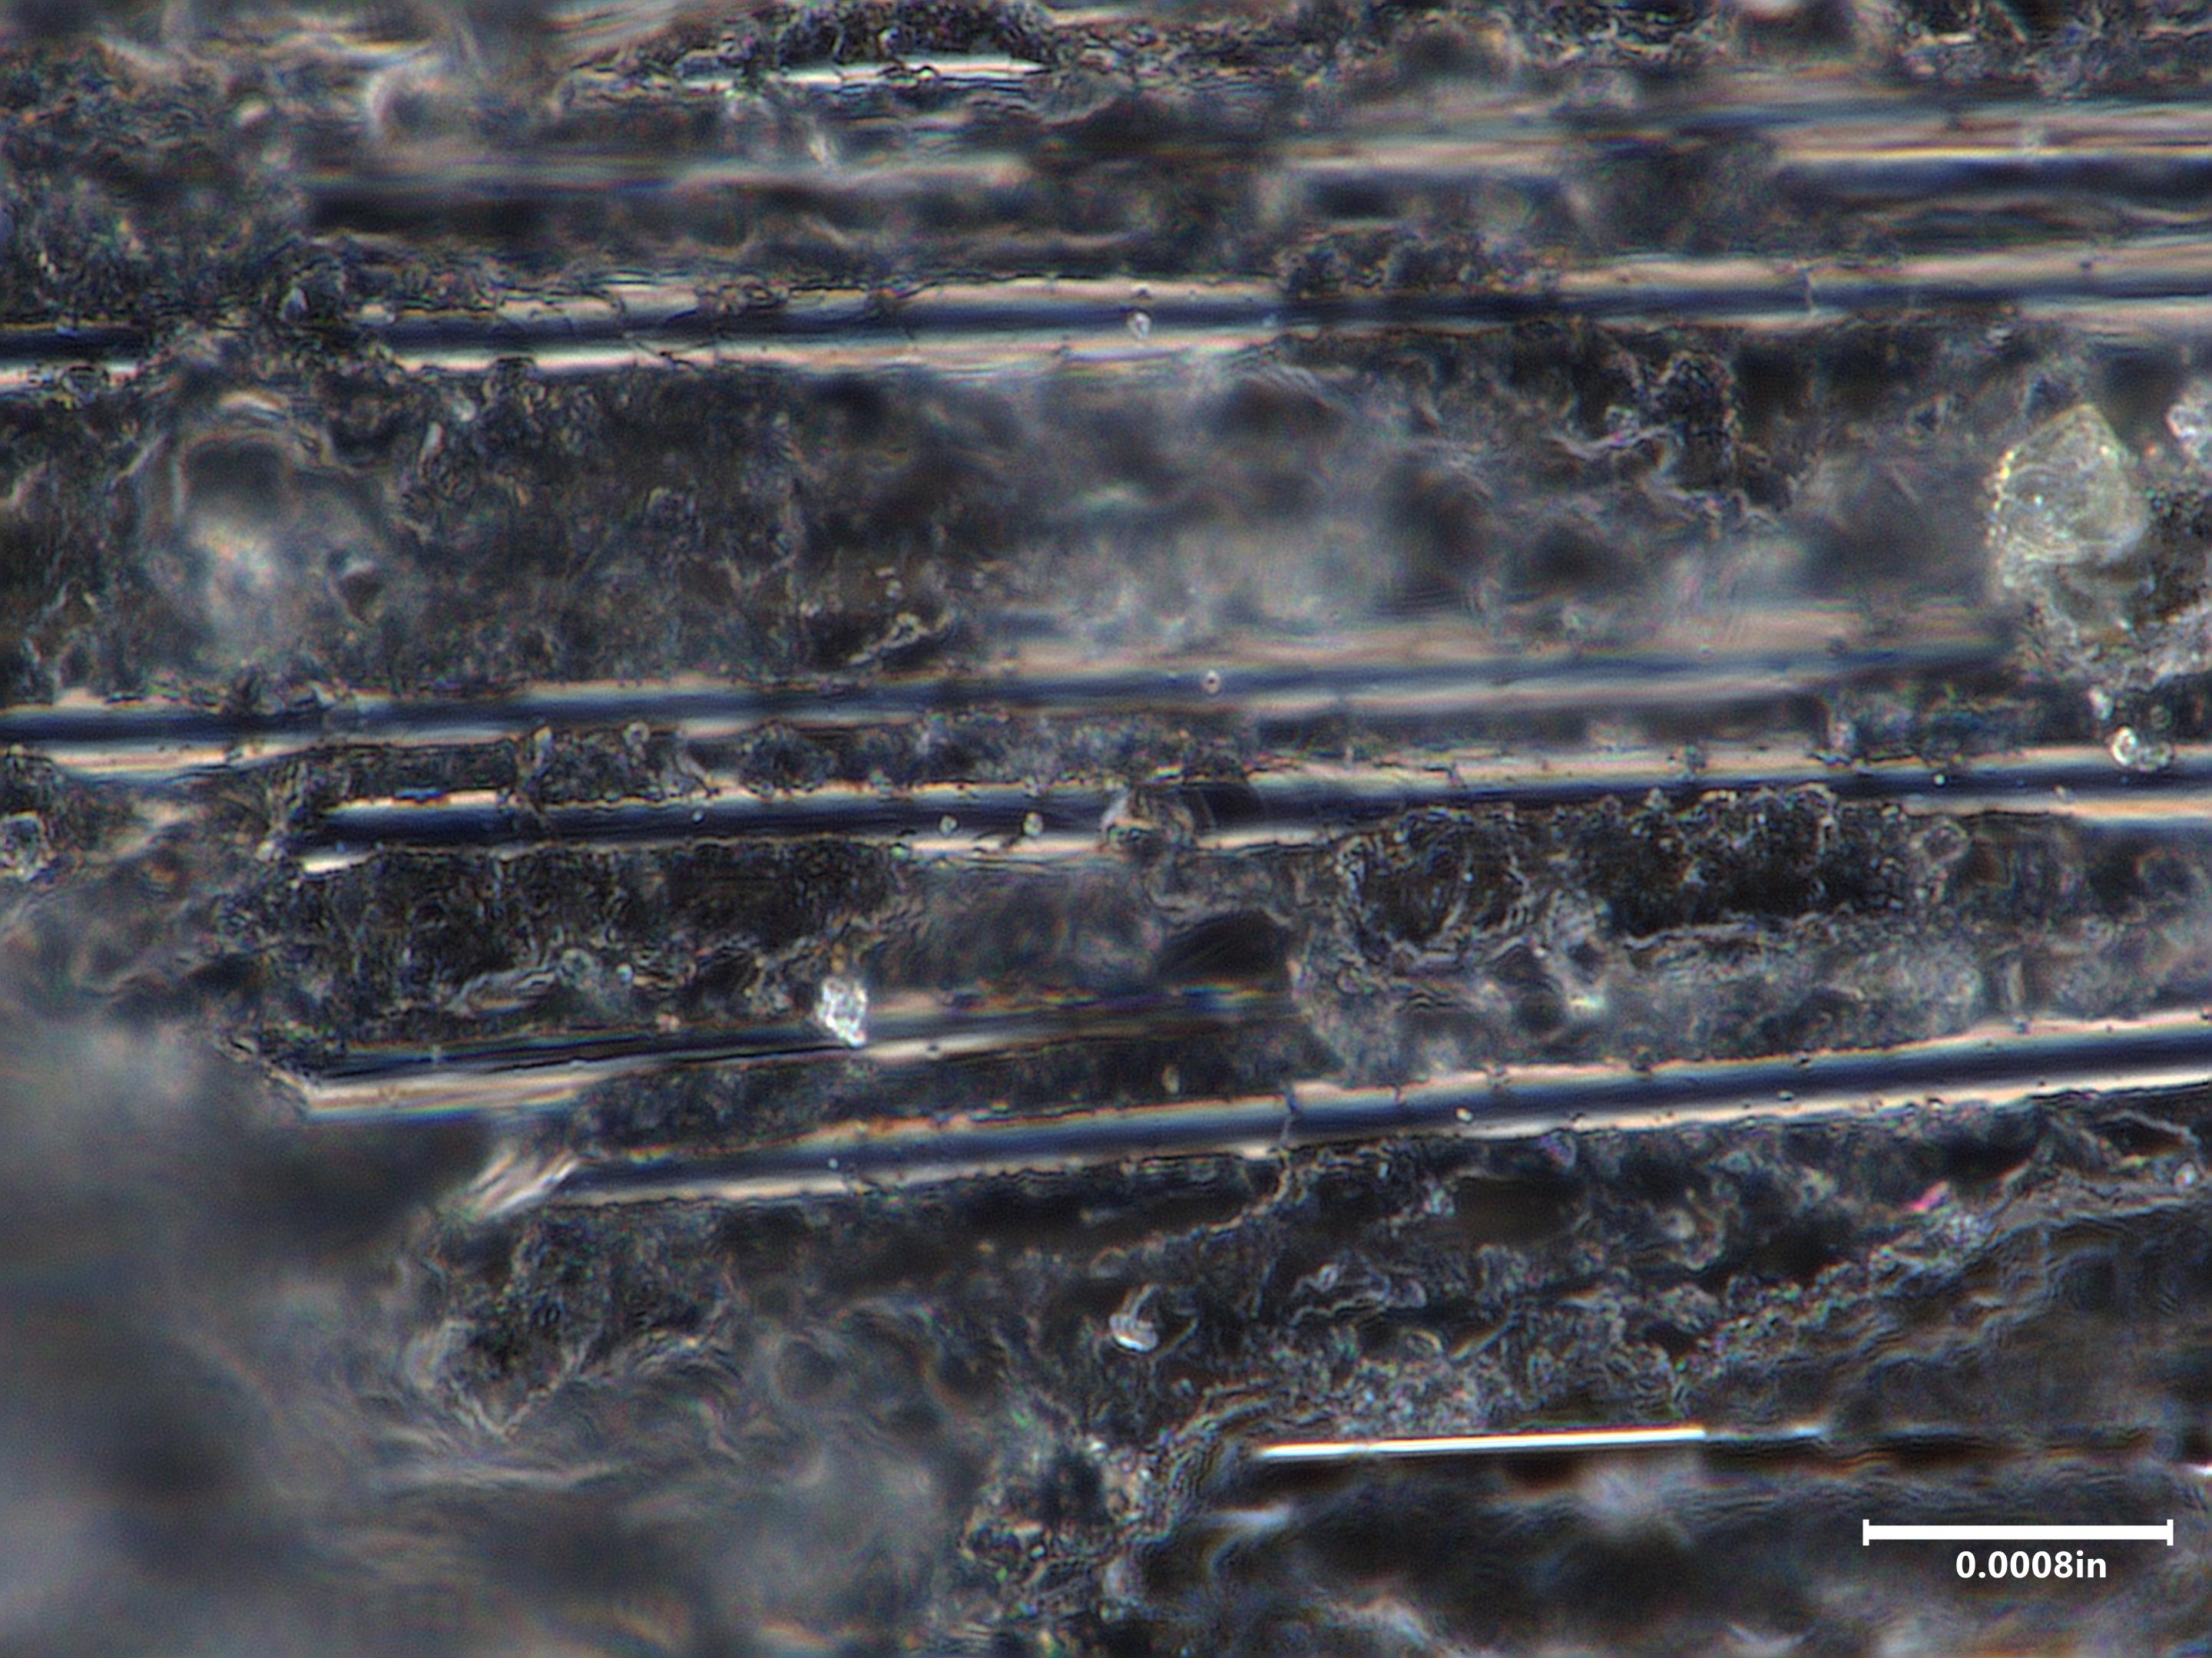
C/Ep Specimen Surface Topography
Hand Sand 80 grit
Fiber Breakage

Slide 25
Fiber microcracking/breakage
Hand Sand 180 grit

Slide 26
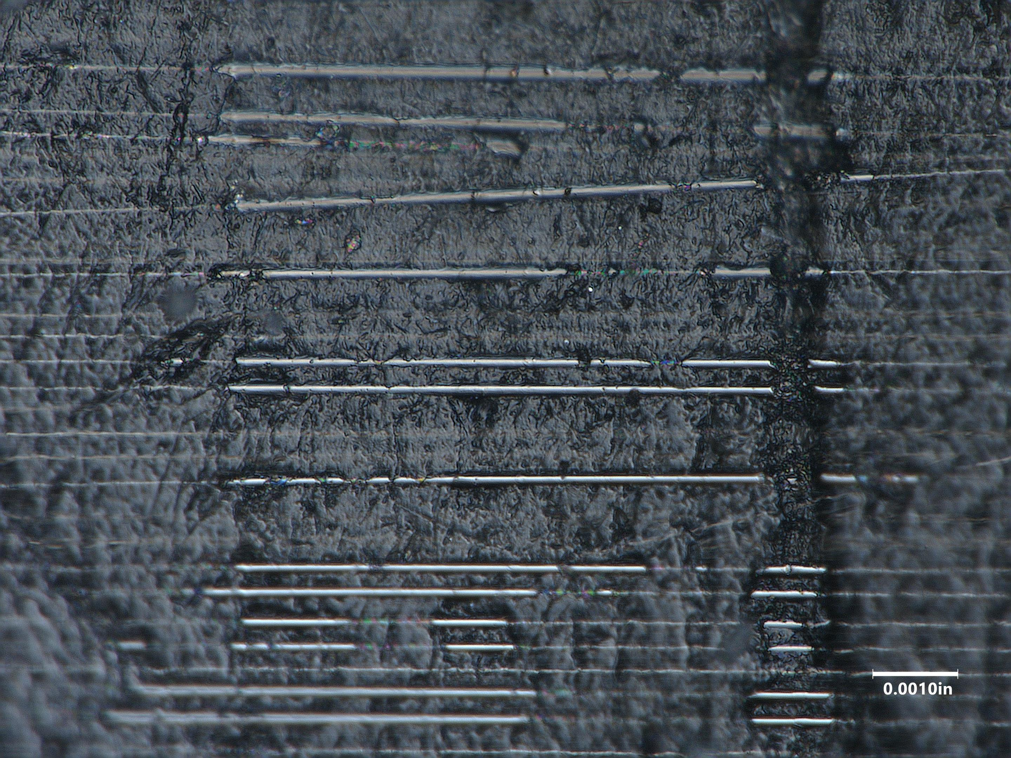
Resin
10 Cycles Type VII

Slide 27
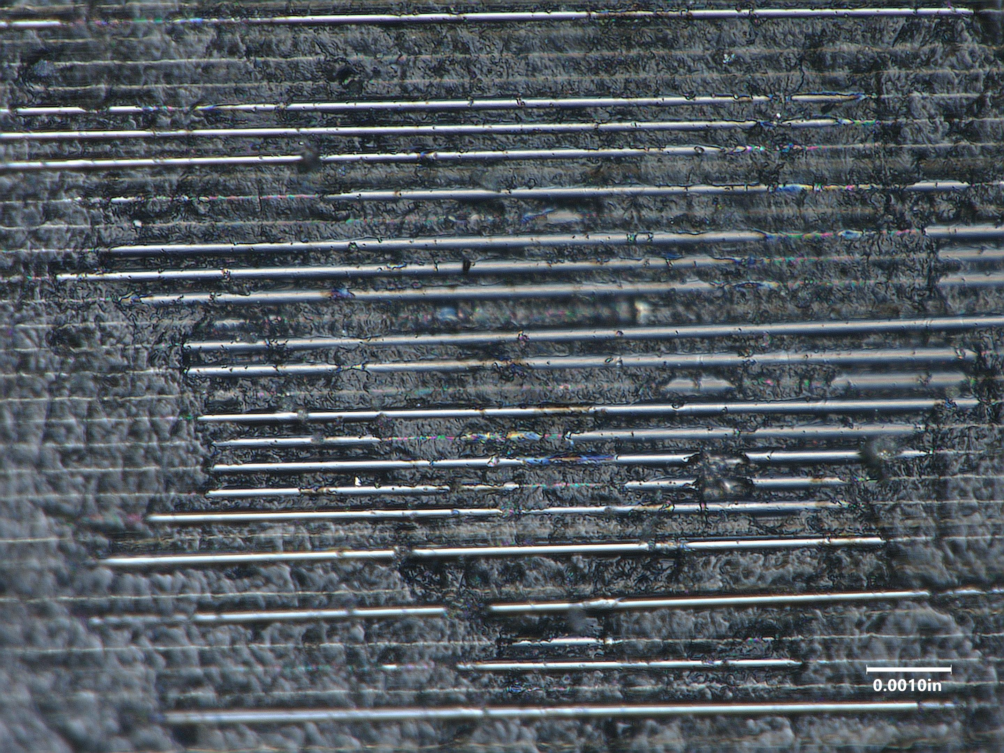
Fiber breakage/microcracking
20 cycles Type VII

Slide 28
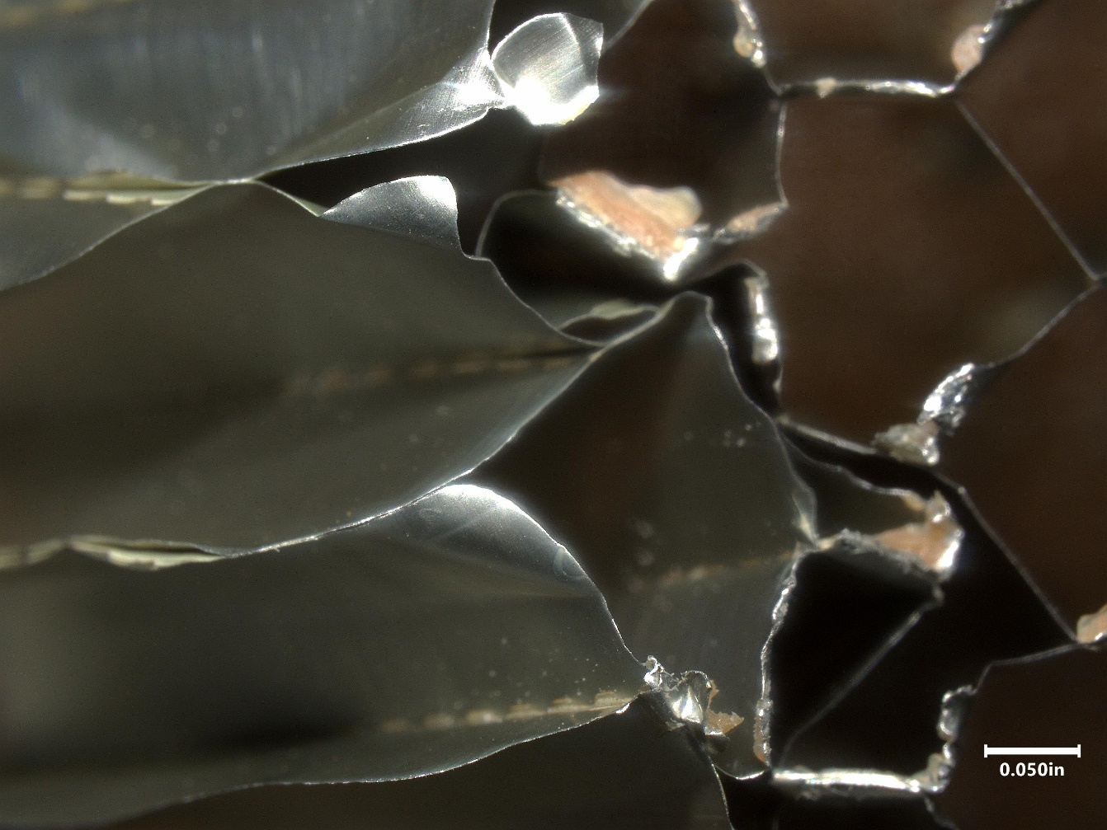
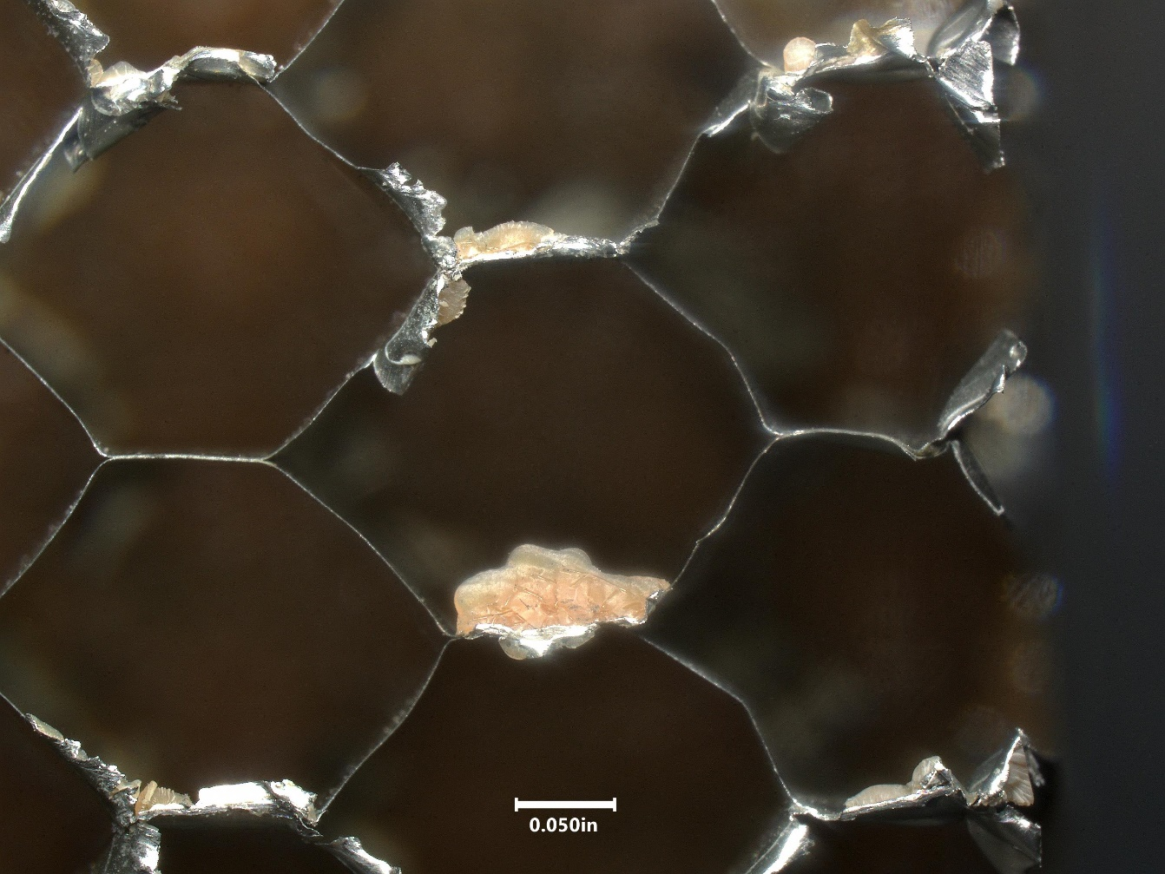
C/Ep Fracture Surfaces
Core Failure

Slide 29
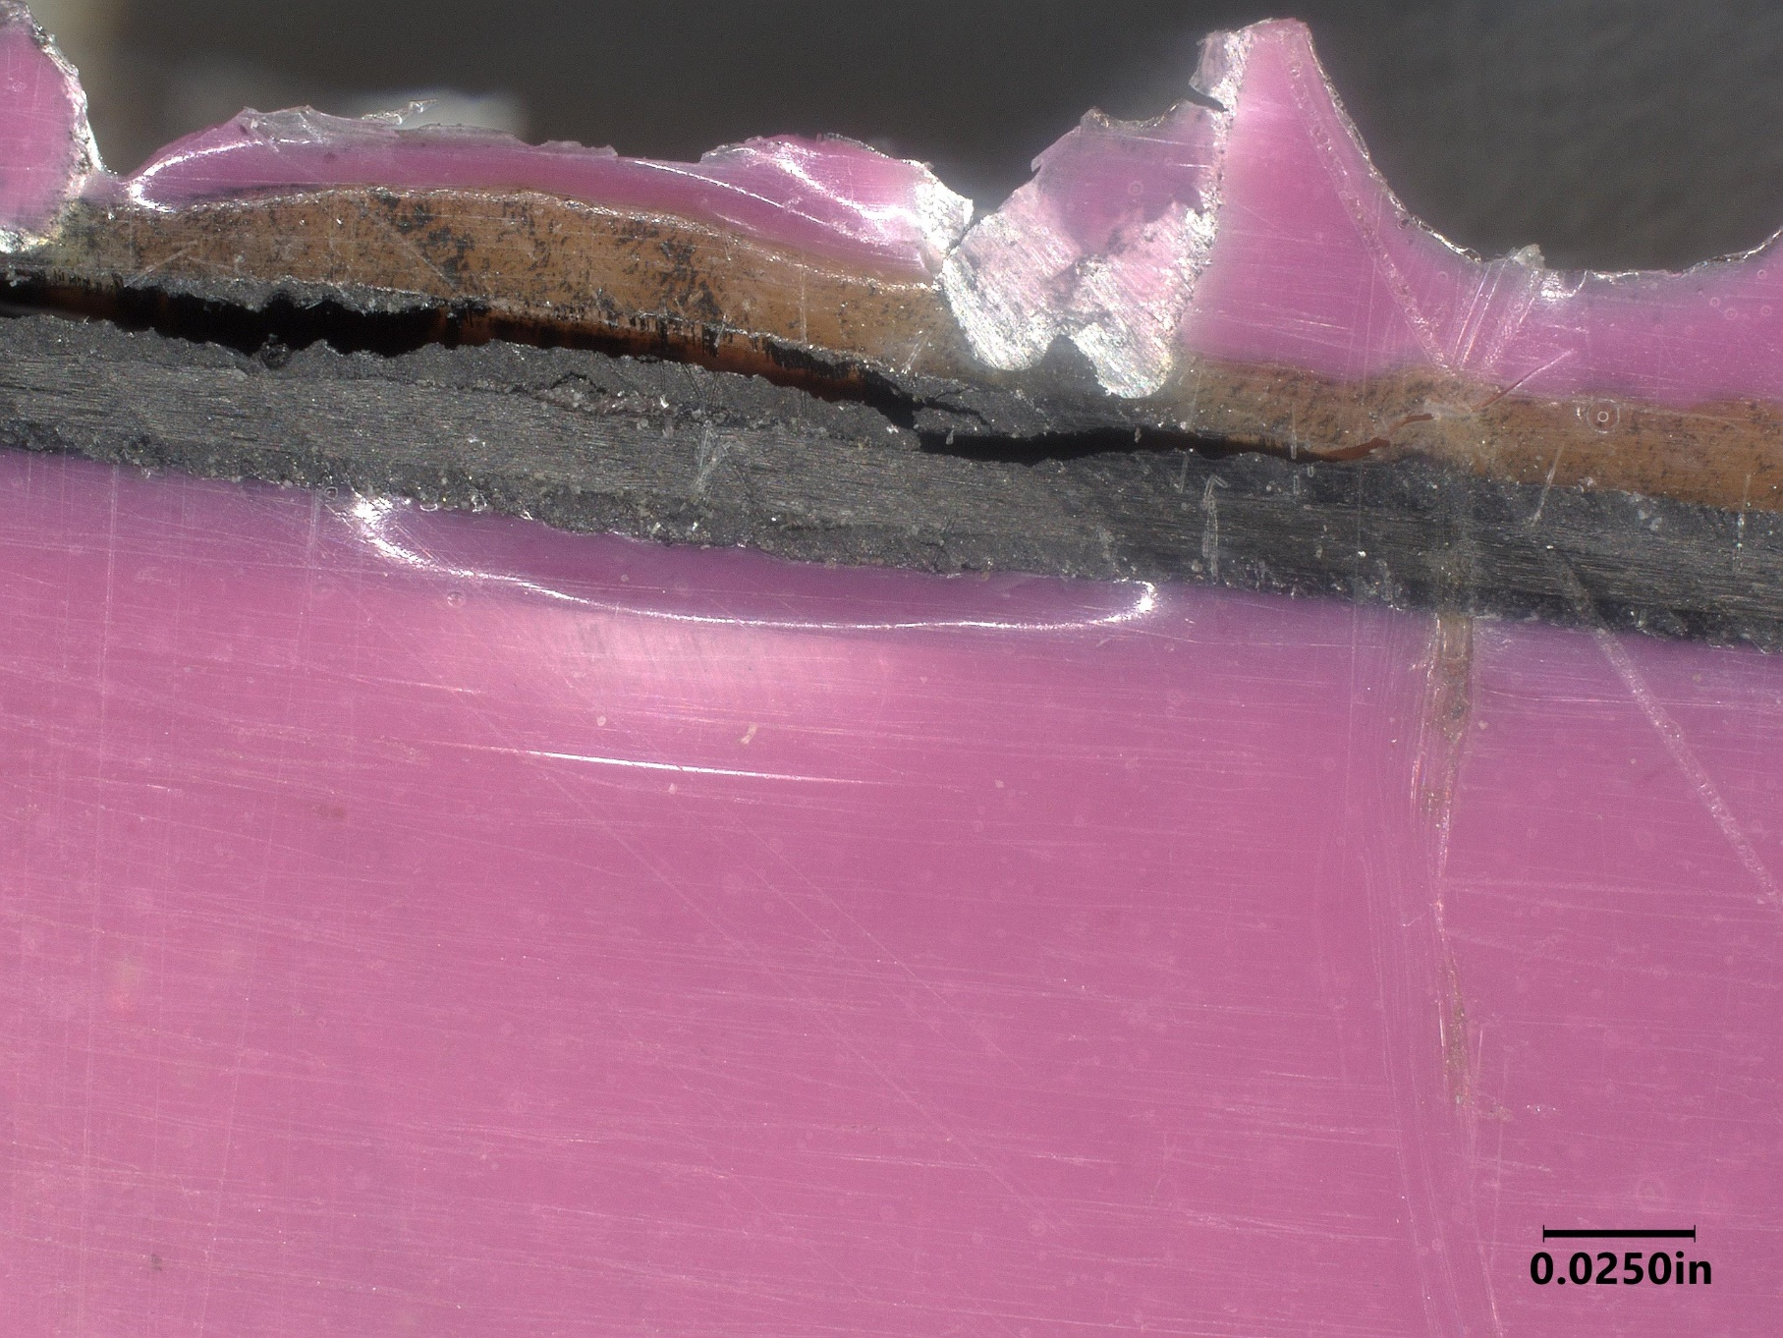
Laminate/FM300-2 Crack

Slide 30
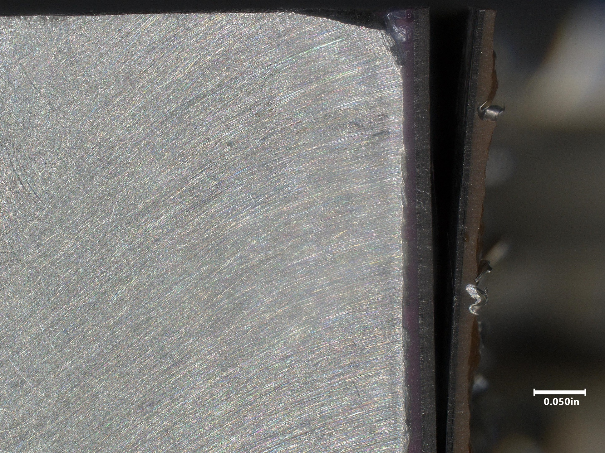
Facesheet Delamination

Slide 31
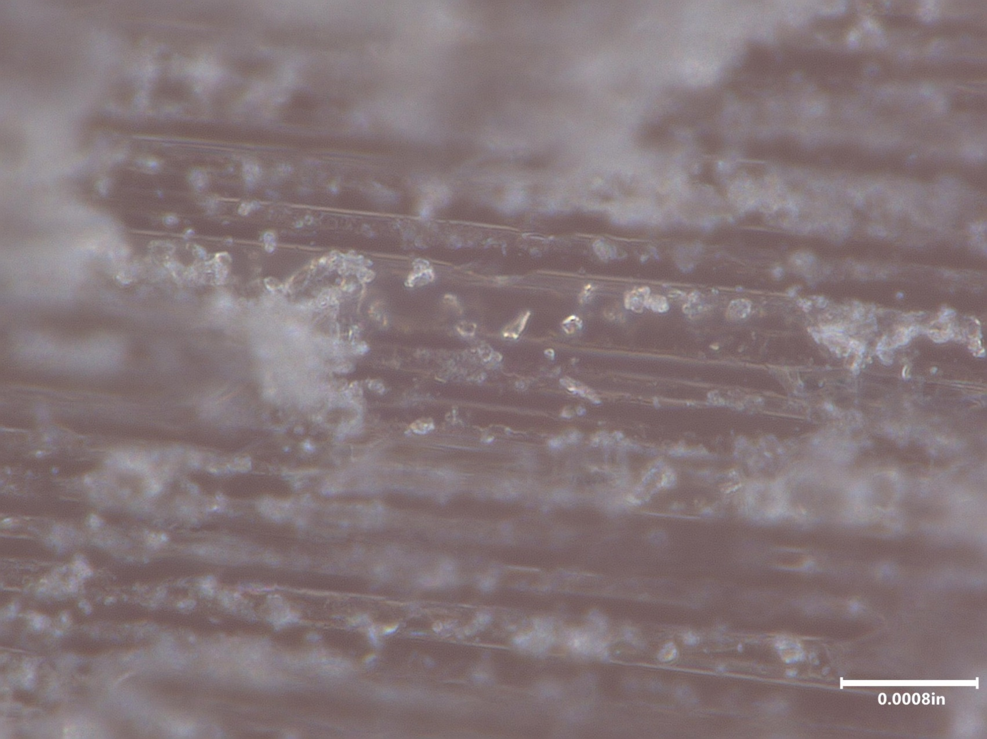
Fg/Ep Surface Topography
Hand Sand 80 Grit
Fiber Microcracks

Slide 32
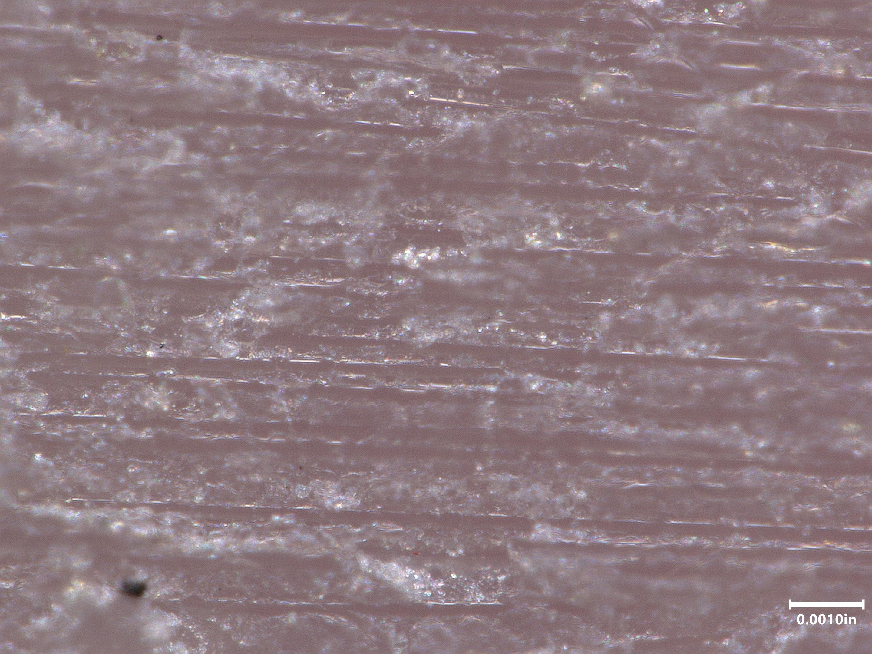
Hand Sand 180 Grit

Slide 33
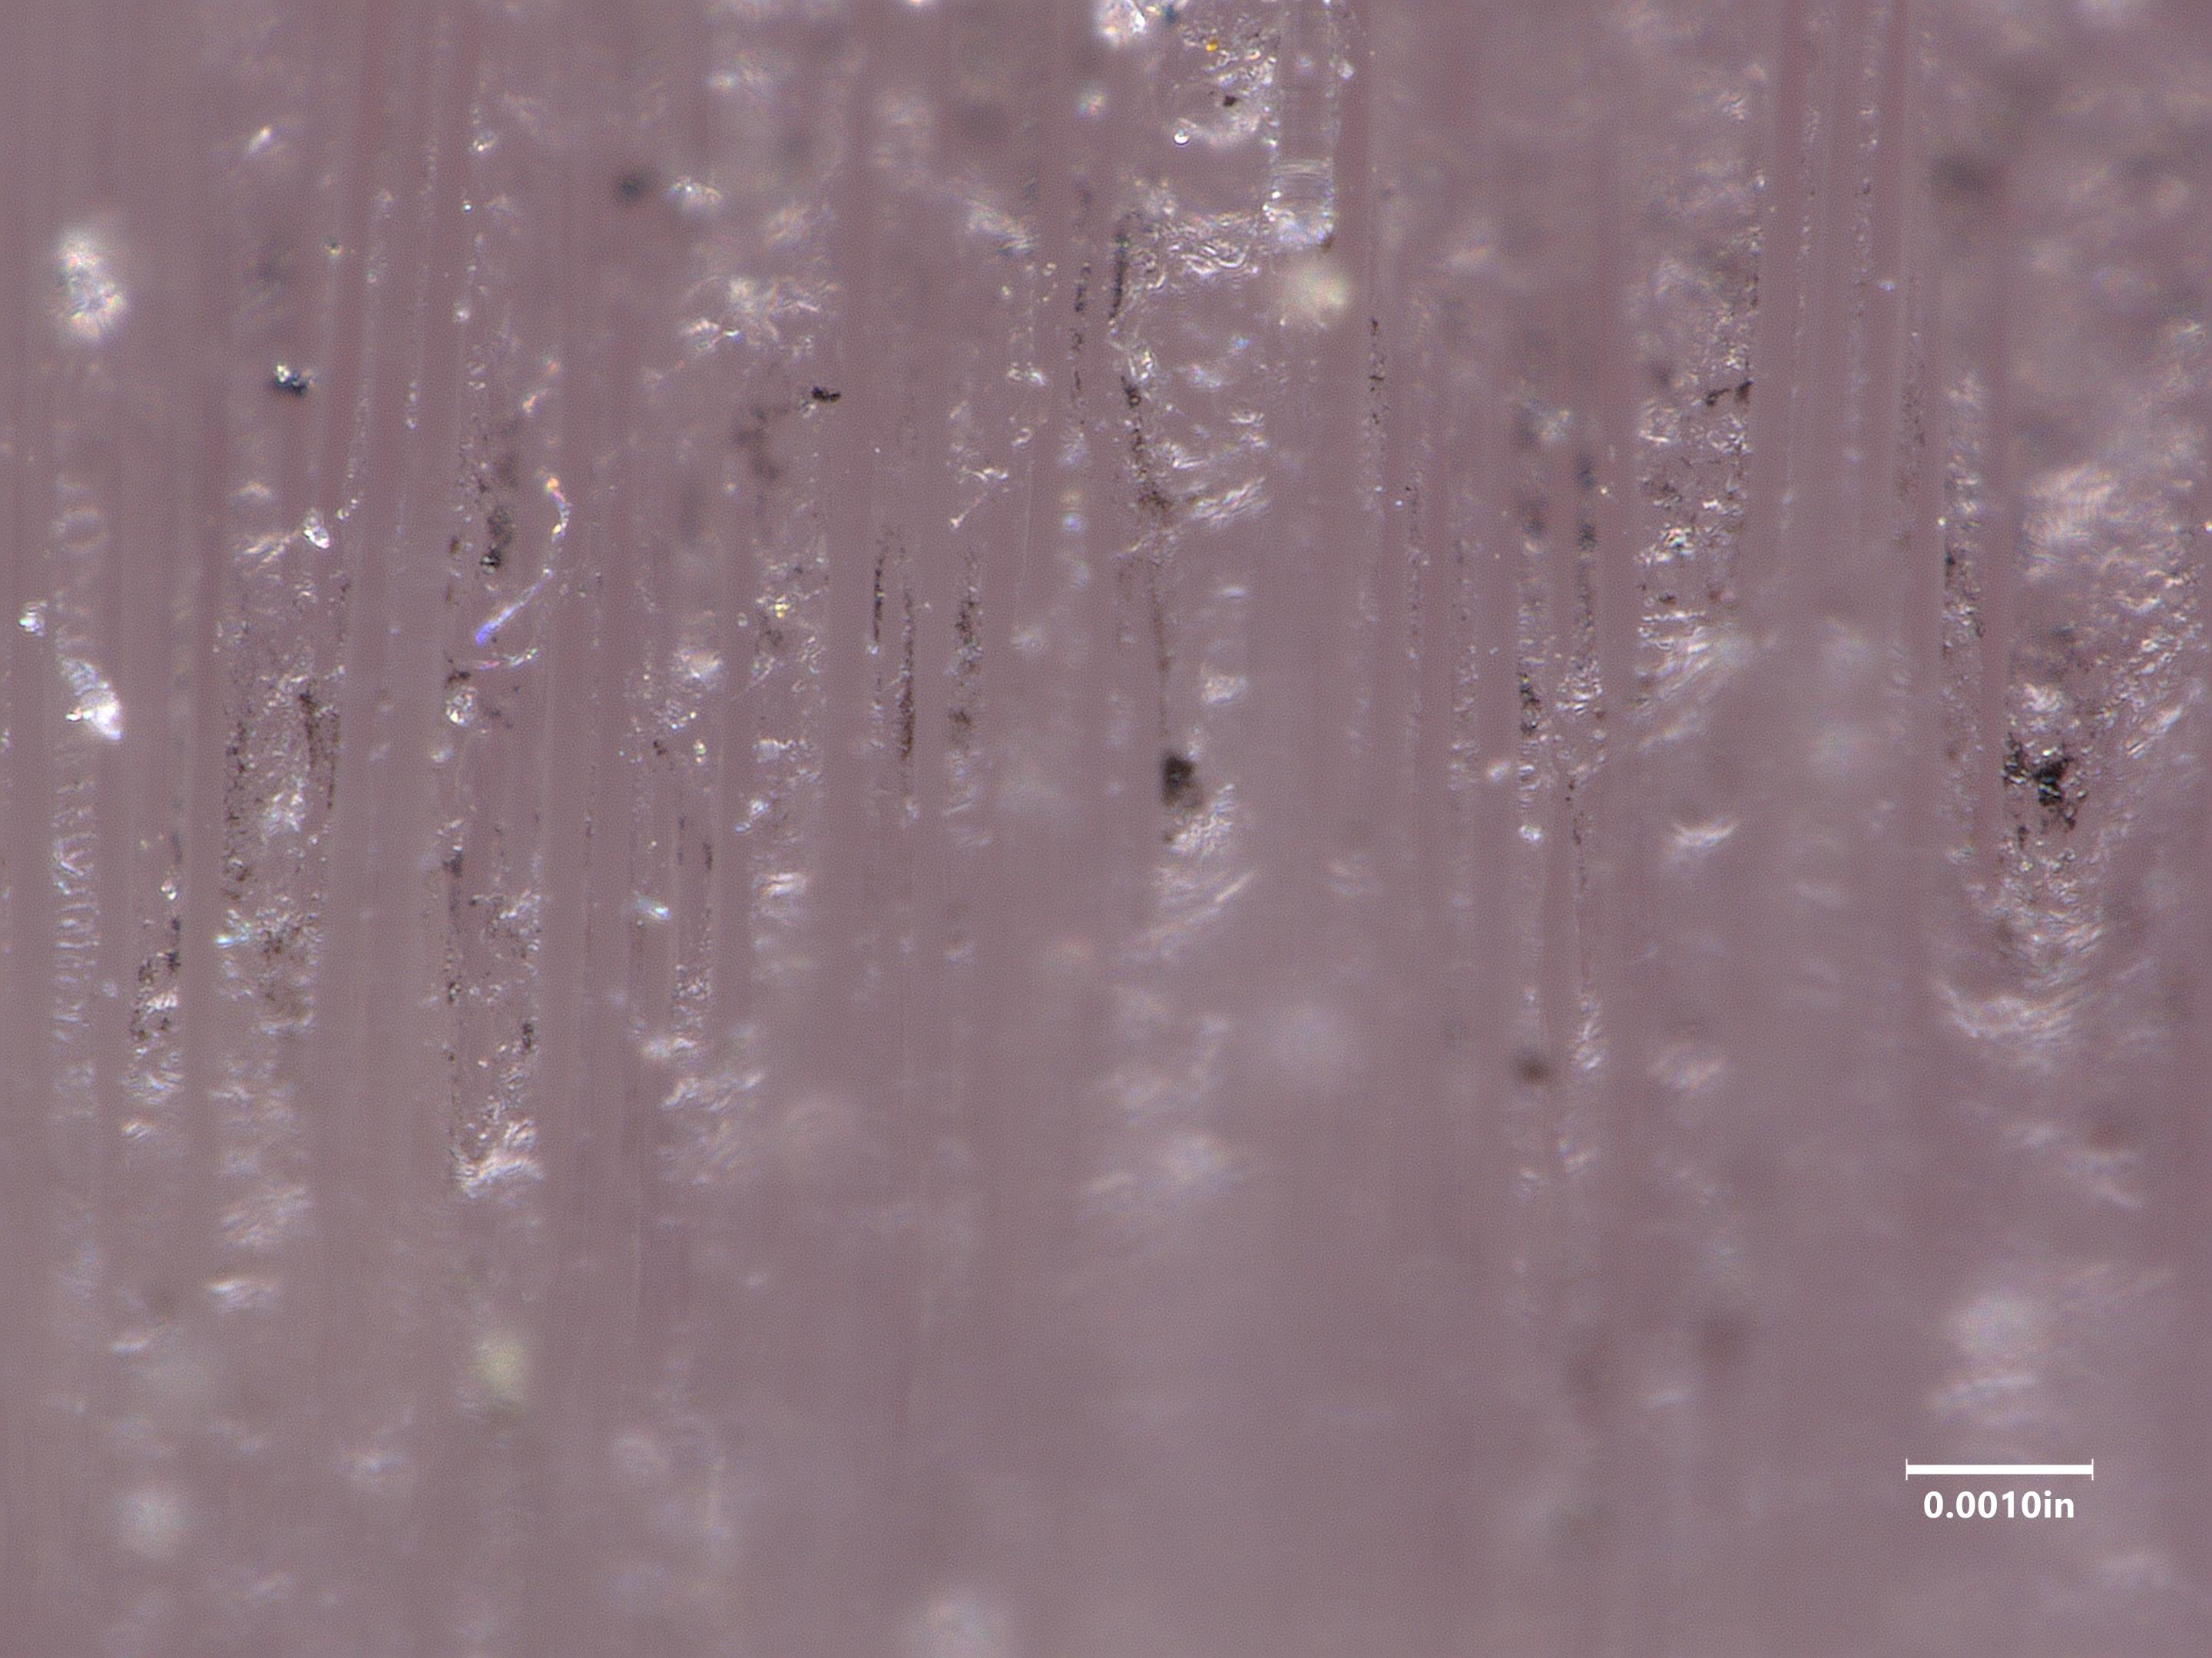
10 Cycles Type VII

Slide 34
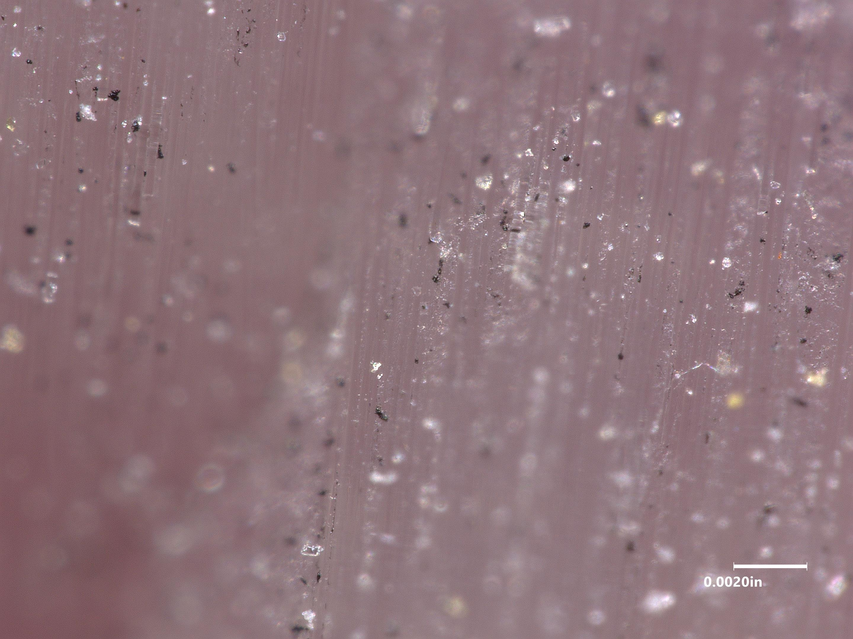
20 Cycles Type VII
Resin

Slide 35
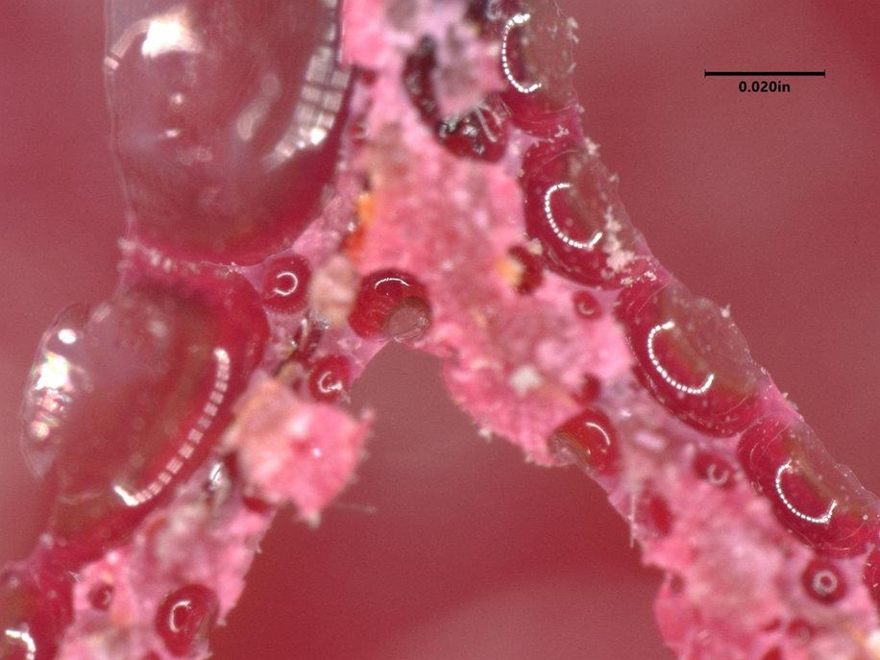
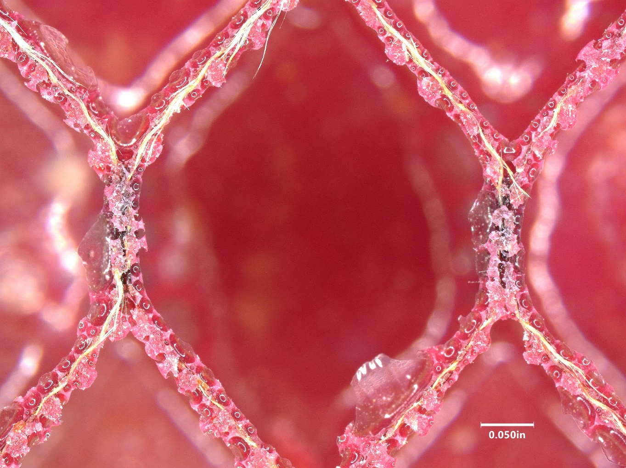
Fg/Ep Fracture Surfaces
Core Failure, Extensive Porosity

Slide 36
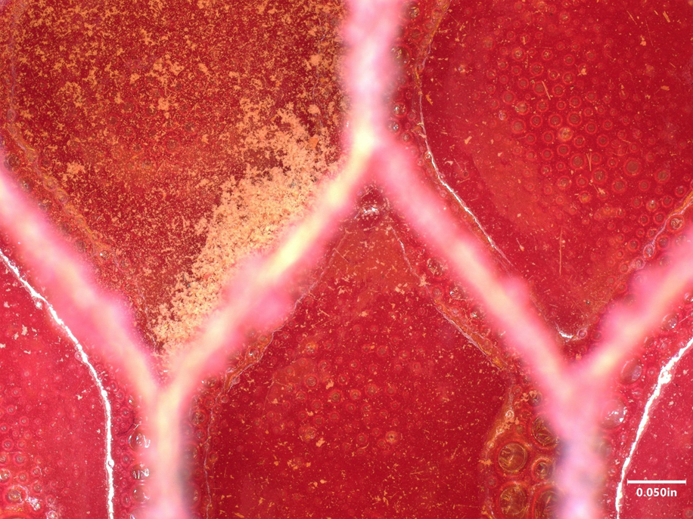
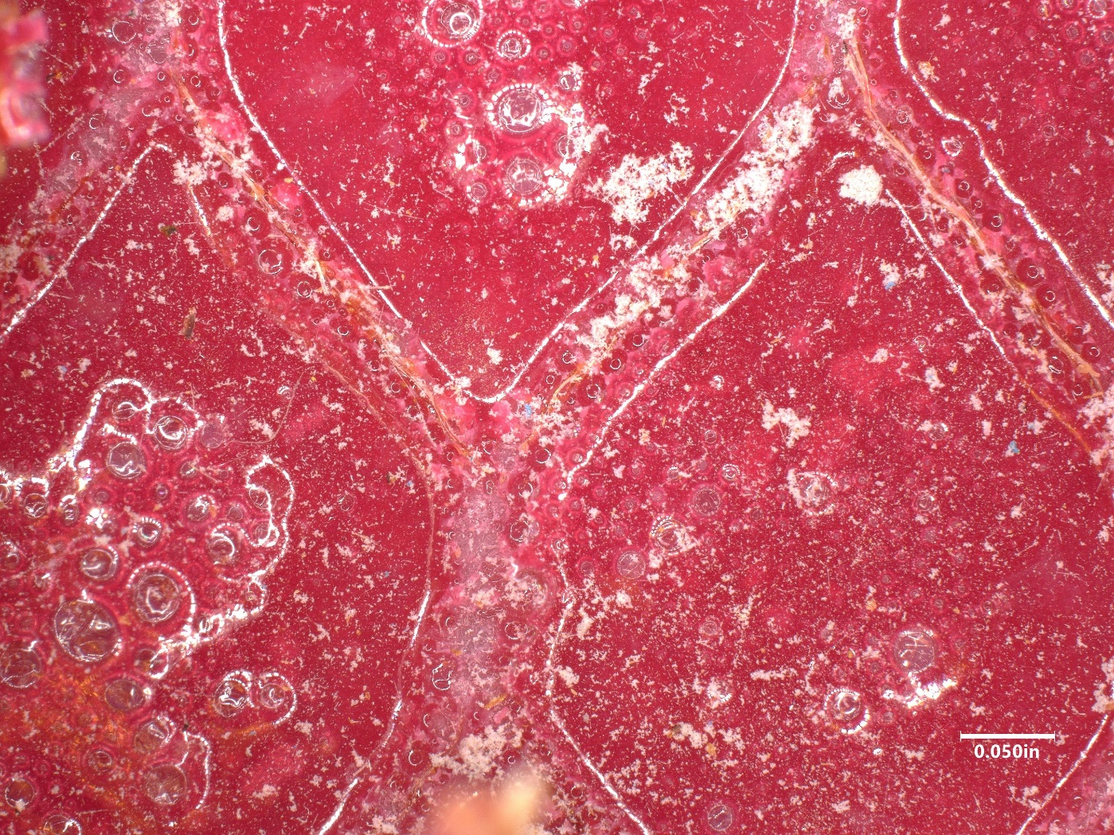
Film Adhesive Failure Surface, High Porosity Content

Slide 37
8. Lightning Strike Material Electrical Testing
Evaluate effects of paint removal on electrical conductivity/resistivity of aircraft lightning strike protection (LSP) materials
Performed paint removal testing using standard and worst-case sanding and blasting parameters

Slide 38
Resistivity measurements were taken on the specimens using multi-meter probes & alligator clips
Weight measurements were also taken to quantify resulting mass loss from paint removal
Type VII | 2 cycles Standard paint & Primer removal | 5 cycles Blasting with aggressive force, removing a thicker coating with strong adhesion | 10 cycles Worst case, inexperienced personnel, excessive dwelling/force
Mechanical Sanding | 120-180 grit Standard for paint & primer removal | 80 grit Worst case, excessive force/inexperienced personnel

Slide 41
Probe measurements displayed that electrical resistivity of the specimens decreased with increased blast times and coarser sanding paper
Initially expected an increase in resistivity with increased damage to the conductive mesh resulting from aggressive blasting/sanding parameters
Decreased resistance was likely caused by increased exposure of the mesh due to epoxy resin removal, which resulted in increased electrical contact with the test probes
The alligator clips did not display the above trend since the clips were placed on multiple locations on the metal mesh, epoxy, and residual primer while the probes were only placed on the metal mesh. Different conductivity pathways were being utilized.

Slide 42
The data from the probes displayed more realistic effects of paint removal on LSP materials, as typically there is little residual coating remaining on aircraft components.
More research needs to be conducted to identify optimal methods for measuring electrical properties.
Visual inspections of the specimens revealed increased deformation of the mesh and removal of epoxy material with increased blast time and coarser sand paper
Specimens that underwent paint removal with standard Type VII parameters (2 cycles) experienced the least amount of mass loss
Overall, Type VII media has great potential for use on LSP materials. More experimentation needs to be conducted to develop the optimal blast parameters that will inflict minimal damage.

Slide 45
Control LSP Specimen

Slide 46
2 Blast Cycles
Deformation of Mesh

Slide 47
5 blast cycles, increased mesh deformation
10 cycles, removal of mesh

Slide 48
120-180 grit mechanical sanding
80 grit mechanical sanding

Slide 49
9. Long Term Goals With Type VII Media
Full implementation on all Naval aircraft
Significant cost savings generated in terms of component repair/replacement
Increased safety of personnel due to lack of hazardous material waste exposure from mechanical sanding
Improved component repair turnaround times
Significant decrease in damage of composite aircraft components

