Slide 1
Army Aviation Composite WG
Version Number As of 10 May 2023
Forrest Nault
Action Officer / Facilitator
Axient / AMCOM, Redstone AL

Slide 2
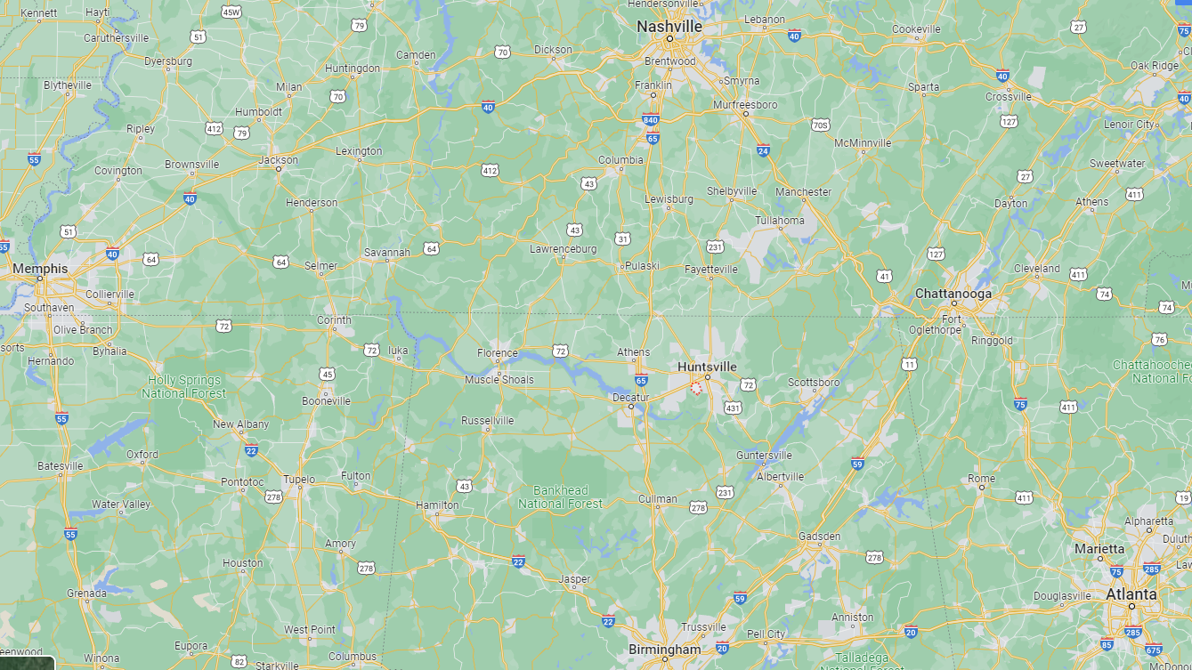
AMCOM (Aviation and Missile Command) Redstone Arsenal, AL
UNCLASSIFIED

Slide 3
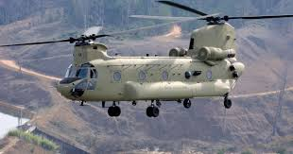
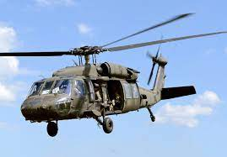
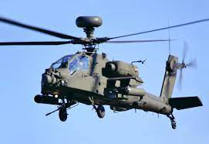
Army’s Previous/Current Acft Are Primarily Sheet Metal
UNCLASSIFIED

Slide 4
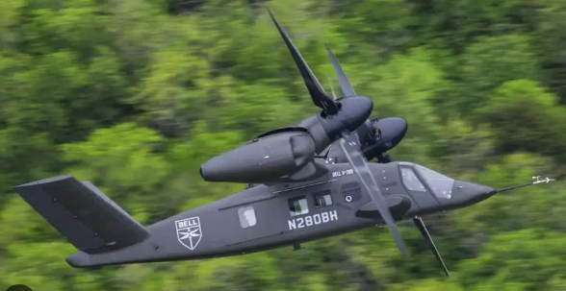
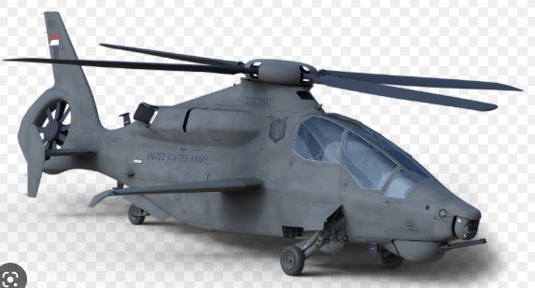
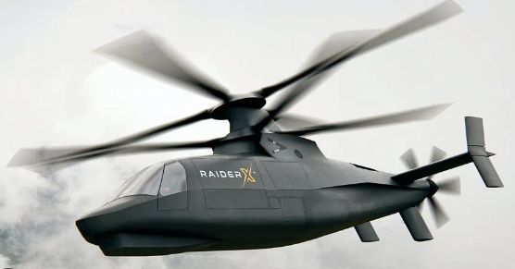
Future Acft Are Planning To Be Primarily Composites
UNCLASSIFIED

Slide 5
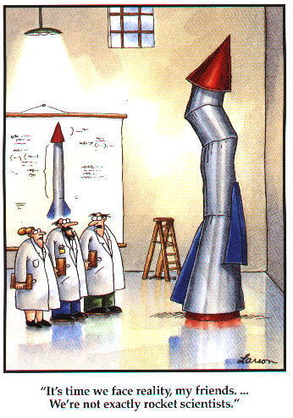
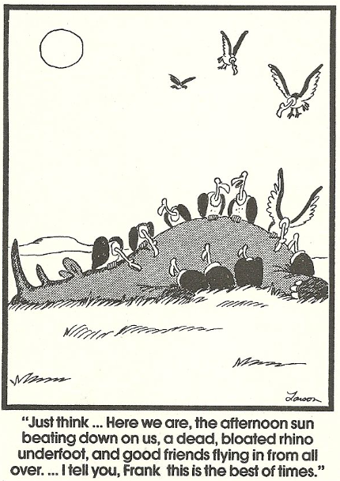
Army Aviation Composites Working Group
TEAM (Together Everyone Achieves More)
Please Join Us…
forrest.f.nault.ctr@army.mil
UNCLASSIFIED

Slide 6
Welcome and Thank You!!
Thank you all very much for taking YOUR time to support and help this effort and working group!
Our Purpose: to join and connect the different organizations within the Army that are working with composites to share knowledge and experience to the benefit of all. (other services are welcome as well)
Our goal: to provide a resource/location where anyone working with composites (Soldier or Civilian maintainer, Flightline to Depot), can reach out with problems, questions, suggestions or ideas, and get support and help.
At every meeting we will try to identify something that needs focus or attention (training, tools, processes, etc.), and work to resolve it.
Monthly meetings. (2nd Thursday, 10:00 Central)
UNCLASSIFIED

Slide 7
Admin
Please let me know of anyone else we should add that could provide value, or receive value from this team!! (forrest.f.nault.ctr@army.mil)
Do not discuss FARA/FLRAA specifics – NDA & RCP
(Non Disclosure Agreement) and (Restricted Communications Period)
Events since last meeting and upcoming events
Training nugget
Questions/Thoughts from the Team, since last meeting
Open Discussion, please feel free to jump in with any thoughts or questions! This is a Working Group, your thoughts are important!
UNCLASSIFIED

