Slide 1
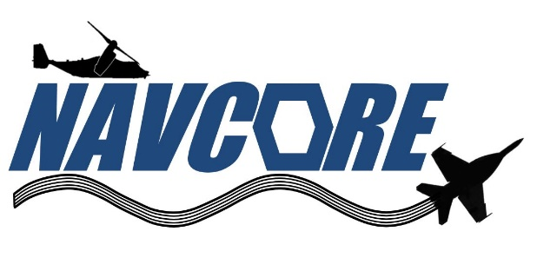
NAVAIR Composite Repair Working Group Overview & Milestones
June 2023
Presented to: 2023 JCAMS Annual Meeting
Presented by: Justin Massey & Chris Rethmel
NAVAIR Public Release 22-0008
Distribution Statement A – “Approved for public release, distribution is unlimited”

Slide 2
Outline
Overview of Working Group
  Mission
  Site Leads & Locations
  Topic Summary
Topic Breakdown (A thru P)
  Background
  Objective
  Latest Milestones

Slide 3
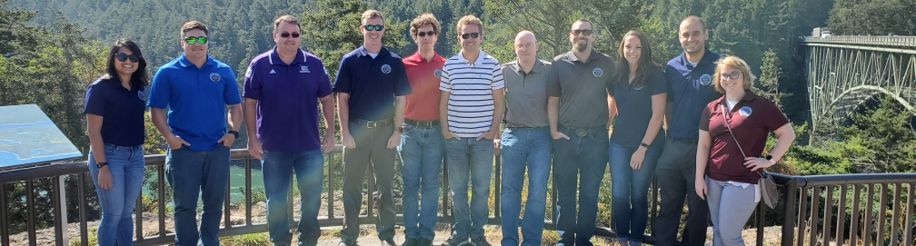
NAVAIR Composite Repair Working Group (NAVCoRe)
NAVCoRe is a national team of composite engineers from Fleet Readiness Centers (FRC) and Naval Aviation Warfare Centers (NAWC) who address materials and processing issues related to composite repair across all Naval aircraft platforms. First meeting was held in 2018 at NAS North Island in San Diego, CA.
The mission of the group is to ensure that the Navy is well aligned technically and logistically for repair of composite aircraft. The goal of the group is to facilitate national consolidation or consensus on topics related to: training, materials, and repair processes, and inspection processes.
Various teammates are also members of public committees such as CMH-17, Composite Maintainers WG’s, SAE, and CACRC.
Meetings: Semi-Annual 2-3 day meetings (Winter & Summer); Monthly phone conferences; Ad hoc sub-working group meetings

Slide 4
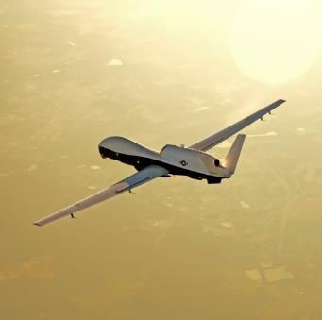
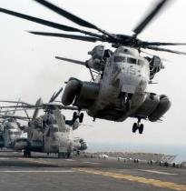

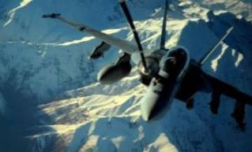
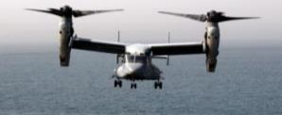
SITE LEADS & LOCATIONS
SITES LEADS
NORTH ISLAND: Alyssa Zamora
CHINA LAKE: Frederick Henderson
LAKEHURST: Chris Mahendra
PAX RIVER: Chris Rethmel
CHERRY POINT: Rob Thompson
JACKSONVILLE: Steve Starnes
Lakehurst
NAWCAD
Patuxent River
NAVAIR HQ, PEOs, NAWCAD
China Lake
NAWC-Weapons Division
Cherry Point
Fleet Readiness Center East
North Island
Fleet Readiness Center Southwest
Jacksonville
Fleet Readiness Center Southeast

Slide 5
TOPIC SUMMARY
Composite Tooling
Shelf Life Consolidation
Material Consolidation
Process Consolidation
General Series Manuals
Depot/Fleet/Engineer Training
Composite Cleanroom
Composite Repair Kits
Site Surveys
Common Repair Materials
Material Substitution Database
Joint Topics w/ Composite Structures Working Group (CSWG)
Surface Preparation Quality Assurance
Mechanical Testing Standardization
Composite NDI Standards
Thermal Damage Evaluation

Slide 6
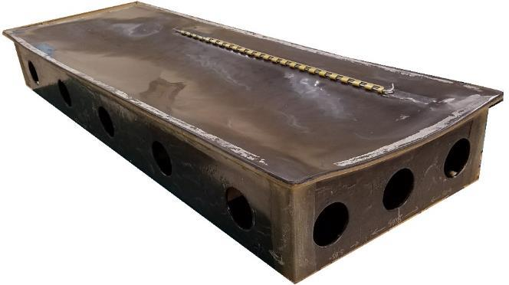
A. COMPOSITE TOOLING
Chairperson: Rob Thompson (FRCE)
Background: Composite tooling for repair and low rate or one-off manufacturing is often expensive and time consuming to produce. NAVAIR has differing approaches and technologies that are site specific.
Objective(s): Identify standardized approaches to design, material selection, fabrication, and inspection for tooling for use at FRC’s via a NAVCORE National Guidance Document (NGD).
Milestones:
  Consolidation and sharing of current FRC tooling fabrication processes including additive manufacturing techniques/materials, machinable foam, and tooling pre-impregnated materials.
  Integration of tooling engineering into FRCs.
  Collaboration of testing fabrication methods with additive manufactured tooling.

Slide 7
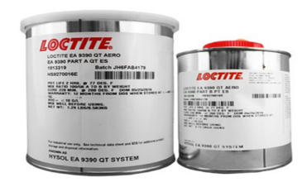
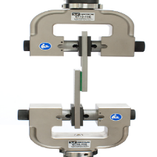
B. SHELF LIFE CONSOLIDATION
Chairperson: Steve Starnes (FRCSE)
Background: Consolidate and share shelf-life extension and induction/reception policies for NAVAIR repair sites with regards to Hazardous Materials (HazMat) used for composite and polymeric repair.
Objective(s): Determine what deficiencies are found by each site for shelf-life extension and how NAVAIR could align and standardize shelf-life extension of HazMat related to polymers and composites.
Milestones:
  Consolidation of shelf-life extension procedures from each FRC for polymers and pre-impregnated composite materials.
  In-work to evaluate chemical and thermal analysis techniques to use in lieu of mechanical test methods for shelf-life extension testing.
  Completed initial aging investigation of EA9390.
  Inputs for the DoD shelf life program.

Slide 8
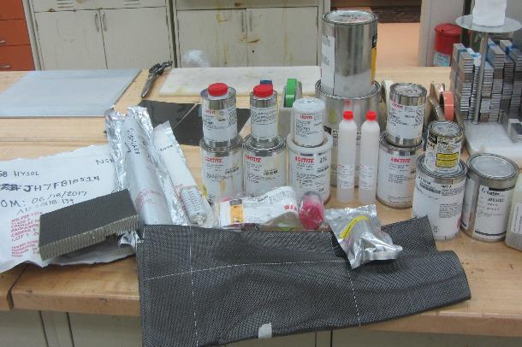
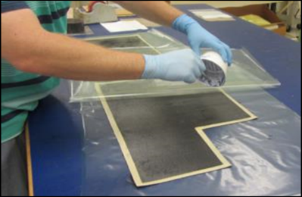
C. MATERIALS CONSOLIDATION
Chairperson: Justin Massey (FRCSW)
Background: As new aircraft programs have been adopted by the Navy, new bonded repair materials are being implemented with each program. The amount of different repair materials used to perform similar purposes are trending towards an unsupportable future for composite repair.
Objective(s): Consolidate common repair materials with their respective alternatives, properties, and allowables to authorize use in common repair methods in various TMS aircraft. Provide a path forward with common repair materials.
Milestones:
  Task closed.
  NAVCORE released white paper released to acquisition and fleet support teams which lists recommended repair materials such as repair fabrics, repair adhesives, film adhesives, foam adhesives, and laminating resins (Distribution D).

Slide 9
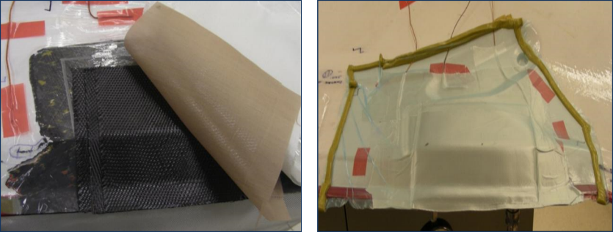
D. PROCESS CONSOLIDATION
Chairperson: Rob Thompson (FRCE)
Background: Polymeric and composite repair processes are performed at each site with differences depending on site location and supported platform.
Objective(s): Evaluate processes for differences and similarity among all sites and if they are feasible for consolidation and standardization.
Milestones:
  Created a shared repository of processes from each FRC.
  Created a cross-reference spreadsheet to identify the sites that perform each process and the process differences.
  Current NGD’s in work:
    Sol-Gel Metallic Bond Preparation (Final Review)
    Vacuum Bag Fabrication (Final review)
    Wedge Crack Testing and Evaluation
    Bonding of Nut Plates and Studs
  Released: Composite Cleanroom (See Topic G).

Slide 10
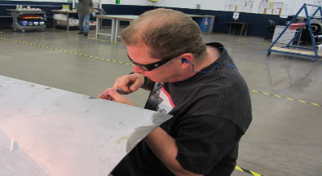
E. GENERAL SERIES MANUALS
Chairperson: Justin Massey (FRCSW)
Background: Technical manuals are often created or revised by one site and could use input from each site for best practice for multiple airframes.
Objective(s): Discuss and implement changes to technical manuals that reflect the repair materials and processing from multiple aircraft programs and repair sites including Organizational, Intermediate, and Depot level maintenance.
Milestones:
  Submitted draft of NAVAIR 01-1A-21 (O-/I-Level Composite Repair) to Technical Publications group for review and release.
    FY24 full revision.
  Performed initial consolidation of comments for revision of NAVAIR 01-1A-22 (O-/I-Level Radome Repair).
    FY23 full revision.
  Provided comments for sol-gel preparation and bonding for NAVAIR 01-1A-01 (General Structural Repair) in collaboration with USAF.

Slide 11
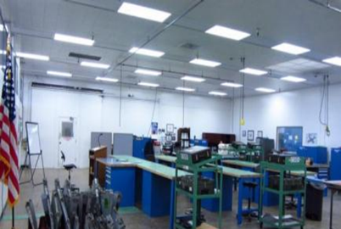
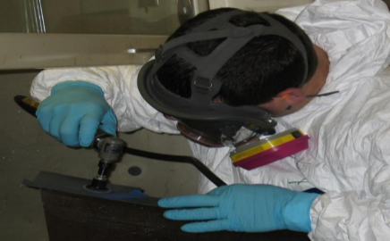
F. TRAINING
Chairperson: Steve Starnes (FRCSE)
Background: Standard training for artisans and engineers did not exist at a national level. Fleet training is not sustainable as sailors/marines are moved to different areas of duty.
Objective(s): (1) For depot artisans, consolidate training programs from other sites/platforms to a more generic certification program. (2) Enable fleet maintainers to hold repair certifications and possible new MOS. (3) Create a national training curriculum for FRC engineers.
Milestones:
  Standardized depot training courses across all FRC’s and released requirements via COMFRC Job Qualification Requirements (JQRs) documents.
  Development of NGD for recommended engineering training for composite engineers in FRCs and NAWCs.
  Established pilot program with Fleet maintainers to receive Depot level certifications.
  Submitted technical comments to current AM school courses and recommendations for changes to CNATT/NETC.

Slide 12
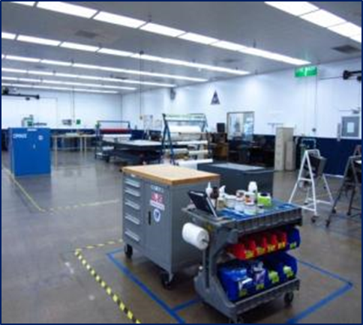
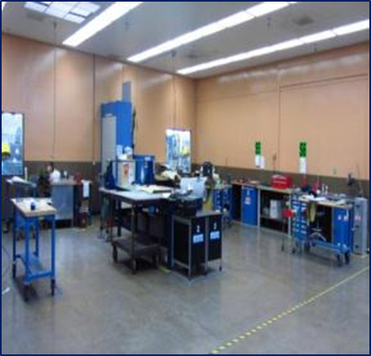
G. COMPOSITE CLEANROOMS
Chairperson: Rob Thompson (FRCE)
Background: All FRC’s had locally established, site-specific requirements for composite layup and bonding areas within production facilities.
Objective(s): Develop nationally aligned guidance specification for composite cleanroom requirements.
Milestones:
  Task closed.
  NAVCORE NGD for Composite Cleanroom Requirements has been released (Distribution D).

Slide 13
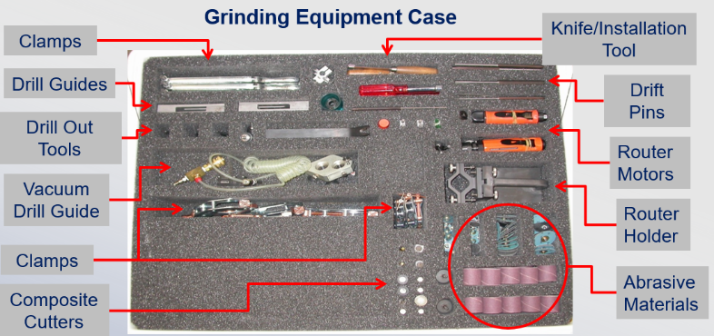
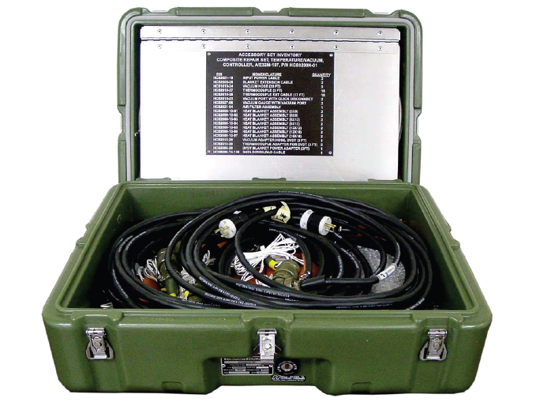
H. COMPOSITE REPAIR KITS
Chairperson: Chris Mahendra (NAWC-AD Lakehurst)
Background: Various USN aircraft platforms have designed and released TMS-specific composite repair kits. Most kits include the same or similar tools and accessories. Fleet is required to purchase, store, and inventory multiple kits for each aircraft.
Objective(s): Consolidate commonly used composite repair equipment into a universal (cross-platform) repair kit.
Milestones:
  Consolidated tools from platform-specific repair kits and down-selected tools for universal kit.
  Continue coordination with NAWC Lakehurst to develop and implement kit into Common Support Equipment program. Implementation anticipated for FY23.

Slide 14
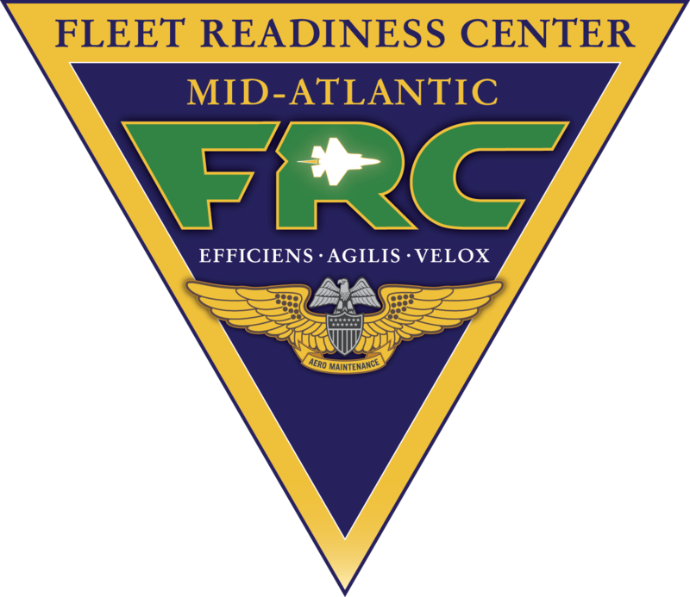
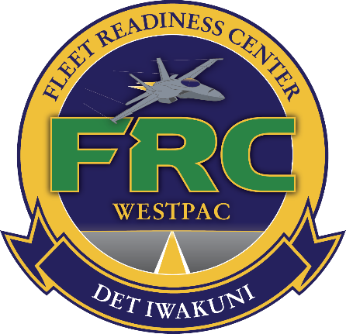
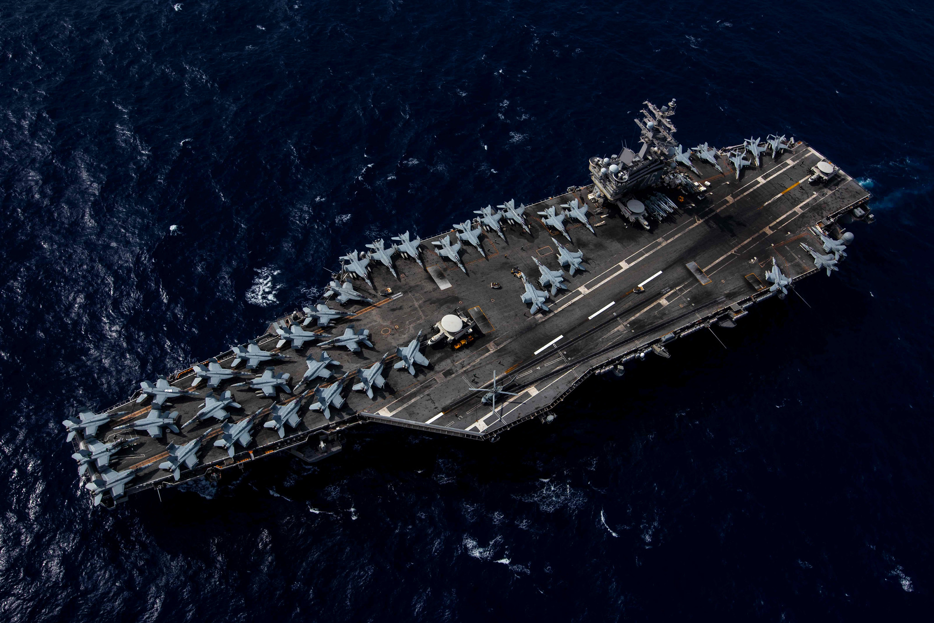
I. SITE SURVEYS
Chairperson: Alyssa Zamora (FRCSW)
Background: I-Level and BCMI shops (Depot-level detachments) that perform composite repair are required to maintain the requirements for facilities, materials, and equipment as FRCs.
Objective(s): Perform periodic visits to various I-level composite repair shops to identify and address challenges to fleet readiness related to materials, equipment, training, and other repair capabilities.
Milestones:
  Co-located semi-annual meetings at FRC detachments to perform site surveys (FRC-Northwest Whidbey Island).
  Coordinated with Fleet support team (FST) engineering to perform carrier and I-level visits (USS Vinson, FRC-WP Iwakuni, USS Reagan, FRC-Mid Atlantic Oceana).
  All site visit reports provided to FST and maintenance officers to improve fleet readiness.

Slide 15
J. COMMON REPAIR MATERIALS
Chairperson: Kate Thorn (NAWC-AD PAX)
Background: Currently materials are approved for composite repairs on individual platforms. Repair material allowable data is not shared between platforms. Logistical and procurement challenges occur frequently. Commercial aircraft available repair materials (i.e. SAE spec) have published allowables, however gaps in data need to be identified and testing performed to qualify use on military aircraft.
Objective(s): Identify and evaluate commercially available repair materials for use in cross-platform repair methods. This task led to development of Common Repair Materials Working Group.
Milestones:
  Created focused working group in collaboration with NAVAIR Composite Structures Working Group.
  Received POM24 funding to evaluate commercially available materials and generate repair data for use on Naval aircraft.
  Performed cross-site initial screening of AMS 3970 out-of-autoclave prepreg.
Aircraft Specific Materials
Pre-preg Composite
Film Adhesives
Wet Lay-up Composite
Common Repair Materials

Slide 16
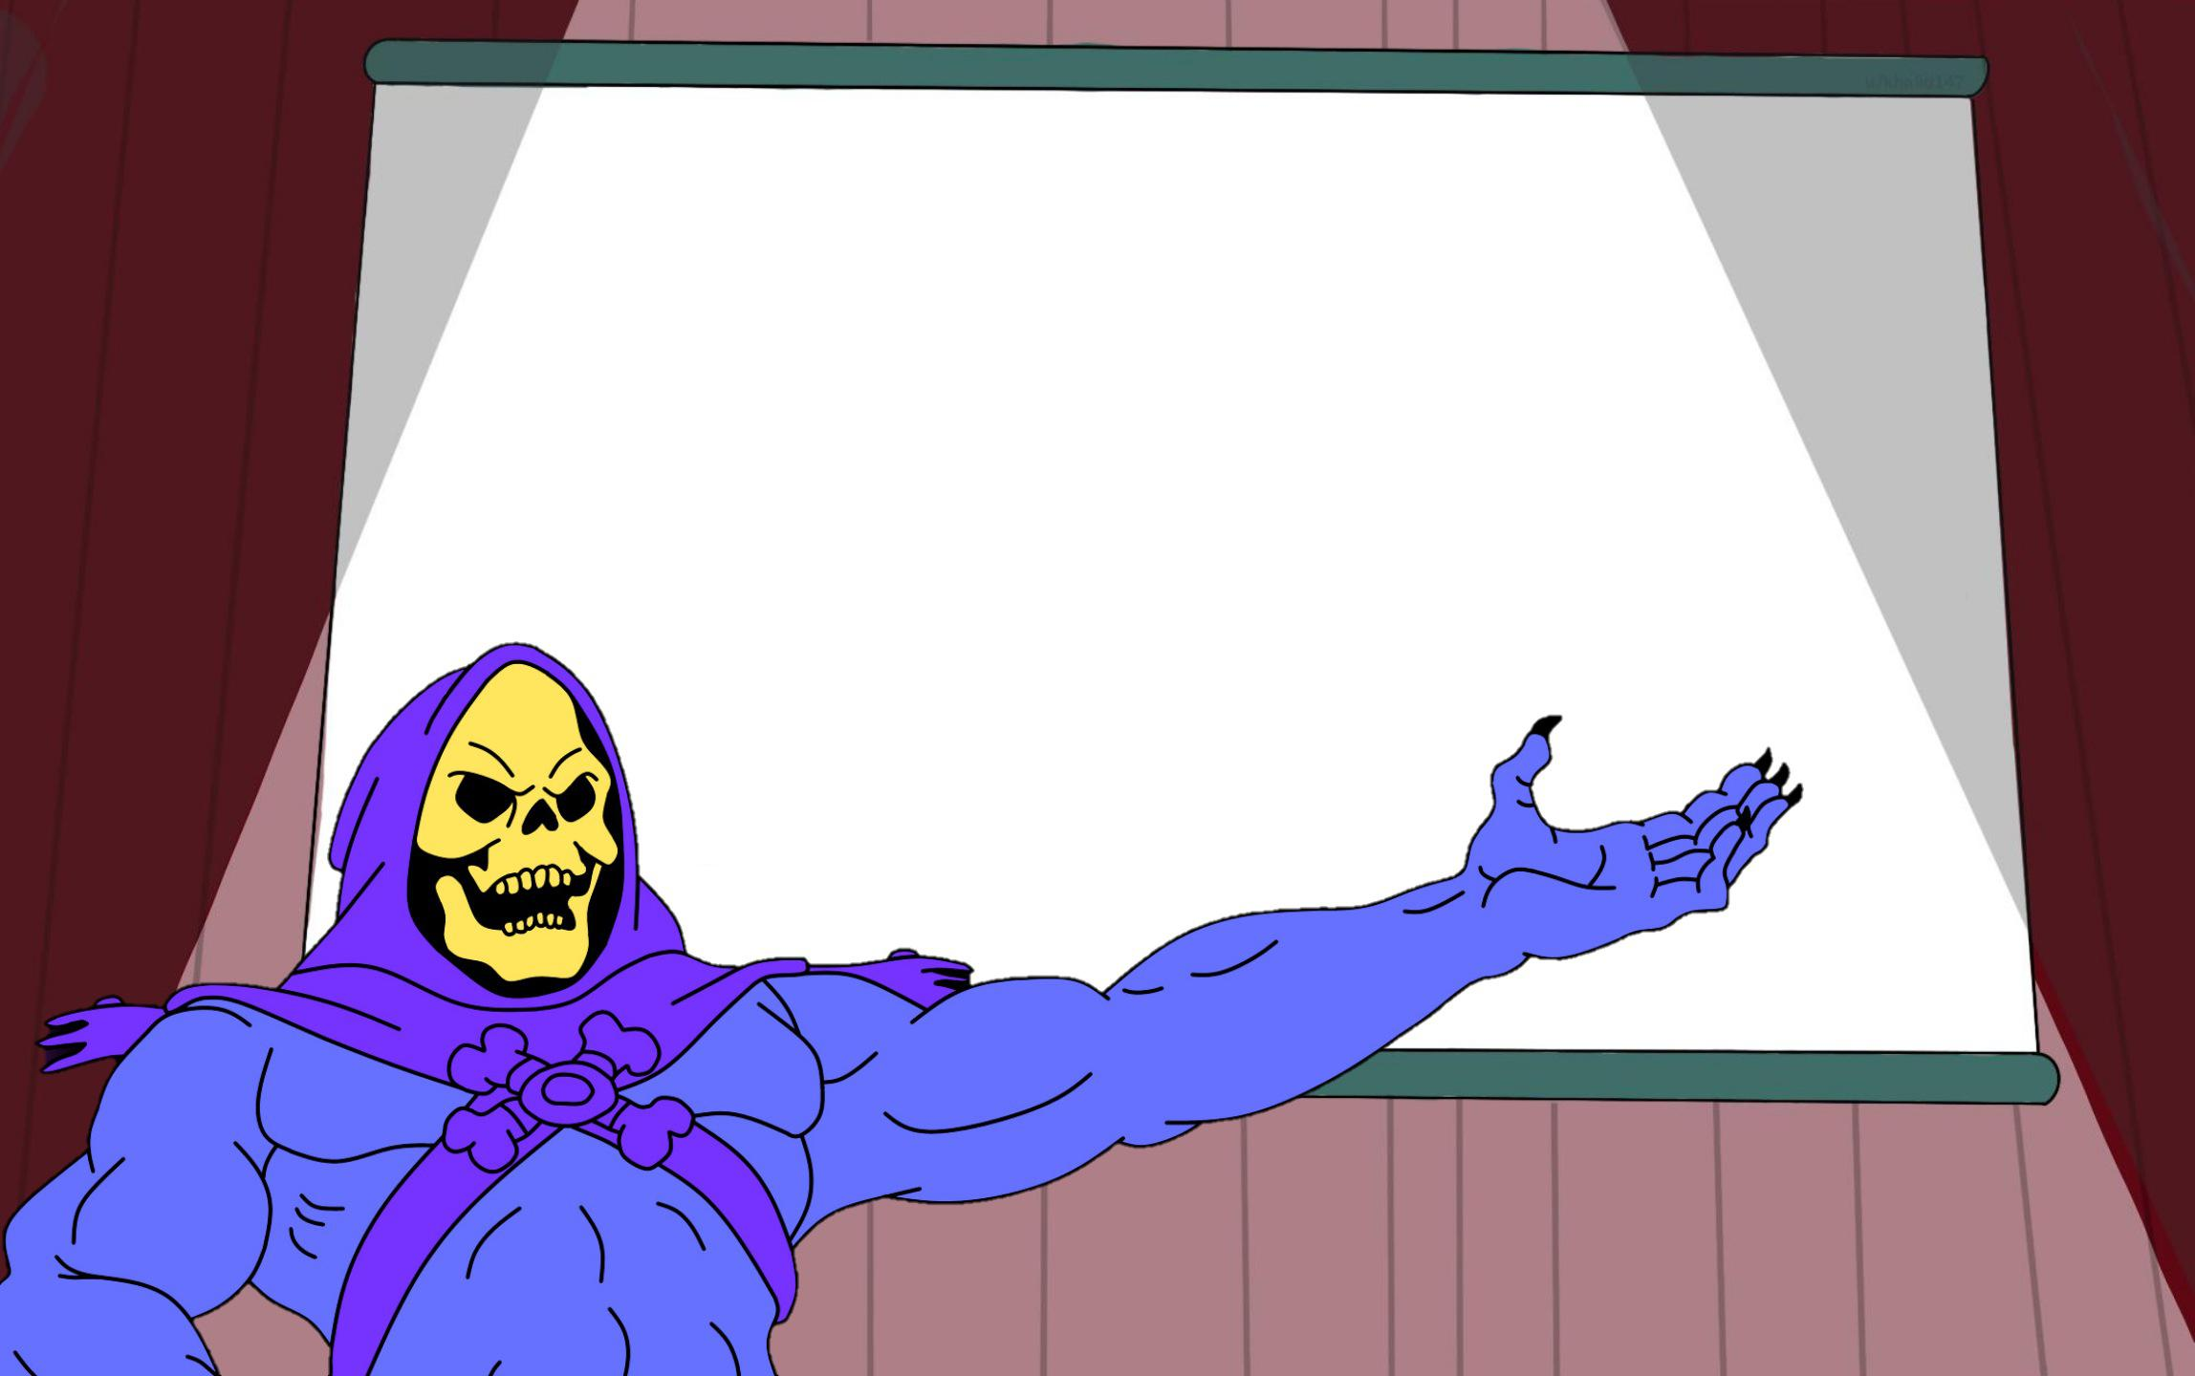
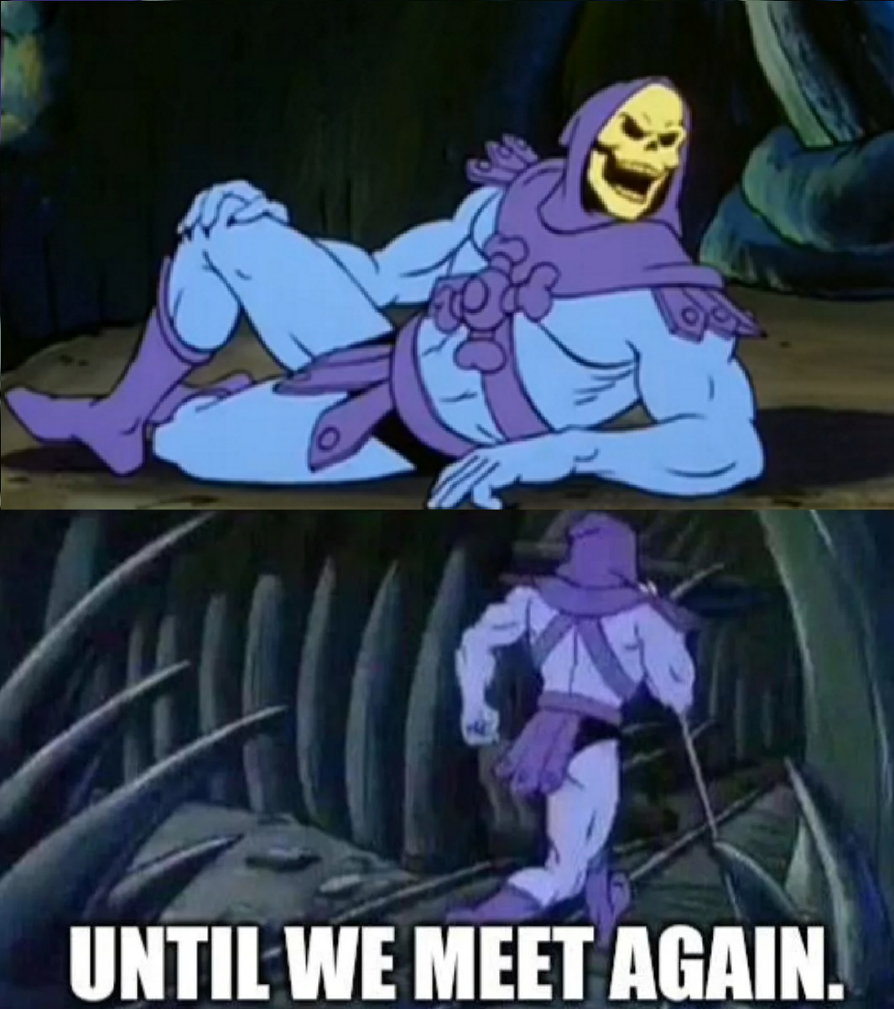
K. MATERIAL SUBTITUTIONS
Chairperson: Rob Thompson (FRCE)
Background: Consolidation of common material alternatives and history of requests will aid to decrease turnaround time when evaluating materials for substitution requests.
Objective(s): Develop repository of material substitutions as reference tool for all FRCs. Address recurring substitution requests as needed.
Milestones:
  Topic closed.
  Database integrated into NAVCORE sharepoint site. Database is updated periodically as substitutions occur.
Not all composites are created equal. Ask a Materials Engineer for a sub.

Slide 17
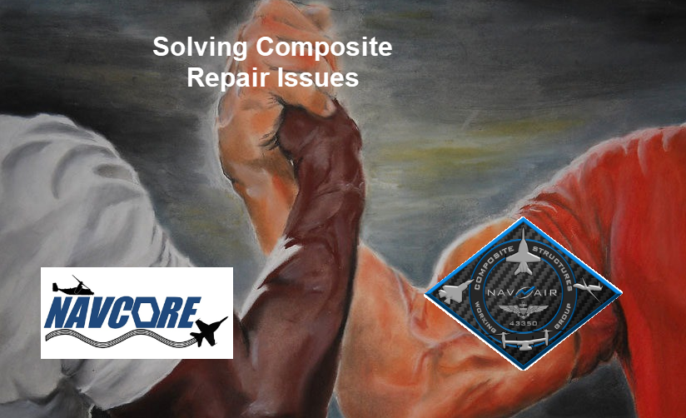
L. JOINT TOPICS W/ CSWG
Background: Various NAVCORE and CSWG efforts require cross collaboration among both groups. This includes evaluation and implementation of new technologies, repair processes, and repair materials.
Objective(s): Collaborate with CSWG on overlapping efforts to address fleet readiness needs and technology advancement.
Milestones:
  Collaborated on the development of the NAVAIR Materials Allowables for Repair of Composites (NMARC) database.
  Collaboration of Aircraft Damage Repair Development (ADRD) framework.
  Co-coordination of Common Repair Materials Working Group.
  Continued collaboration on test plan development for evaluation of LUNA SBIR.

Slide 18
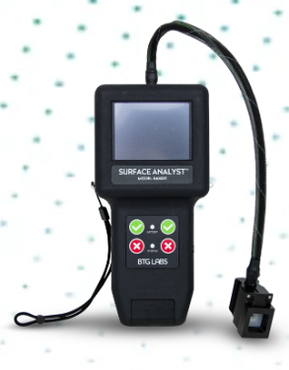
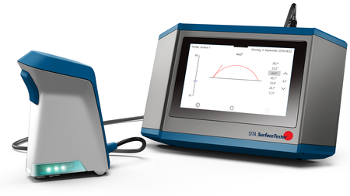
M. SURFACE PREP QUALITY ASSURANCE
Chairperson: Mikaleen Morrell (FRCSE)
Background: FRCs and NAWCs have individually evaluated various surface preparation technologies and methods. Collaborative efforts will allow application of technologies to multiple Naval aircraft platforms.
Objective(s): Consolidate efforts for improvement of surface preparation methods for bonded repairs.
Milestones:
  Created repository of surface preparation quality assurance efforts.
  Bonded Nut Plate and Studs (BoNuS) working group developed to specifically address surface preparation challenges for bonded nut plates.
  NAVCORE National Guidance Document (NGD) in-work for bonded nut plate preparation and application.

Slide 19
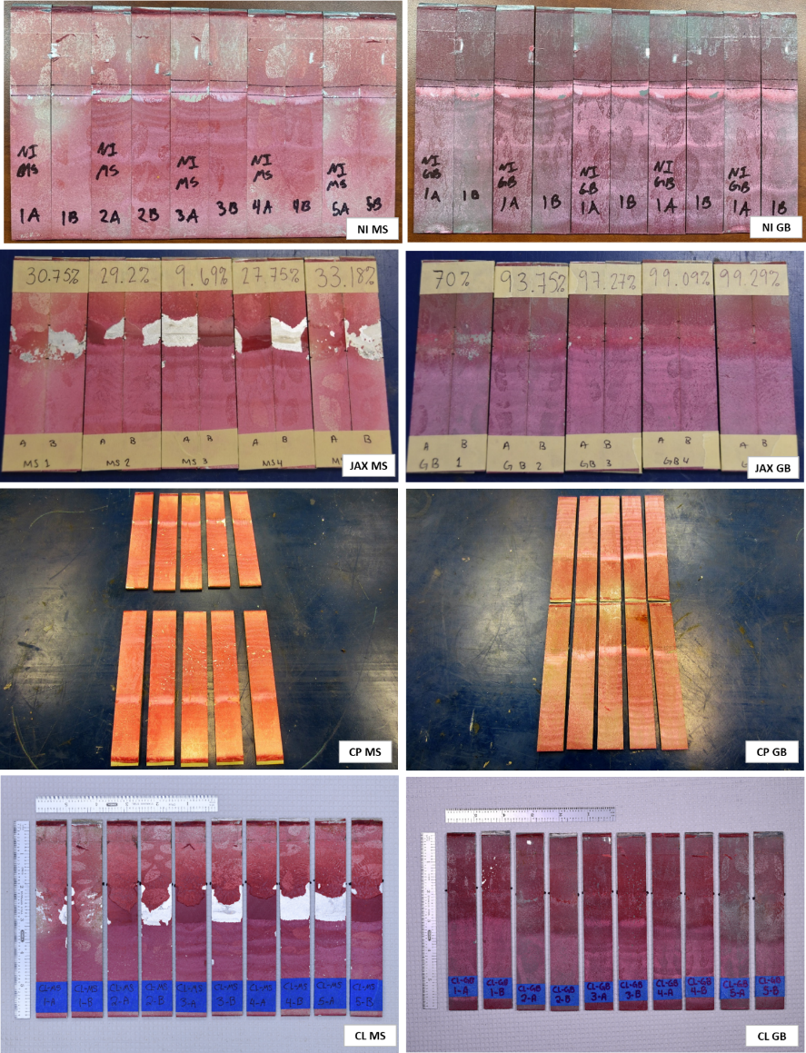
N. MECH TEST STANDARDIZATION
Chairperson: Chris Rethmel (NAWC PAX)
Background: Each site has individual local procedures for test coupon fabrication, mechanical testing, and evaluation. Shared knowledge of lessons learned, best practices and troubleshooting will allow team to standardize test methods when performing cross-site testing.
Objective(s): Standardize mechanical test processes across all sites for material evaluation.
Milestones:
  Initiated round robin testing for standardization of wedge crack test and evaluation procedures. NAVCORE National Guidance Document (NGD) is in-work.
  Single lap shear round robin test plan is in-work.

Slide 20
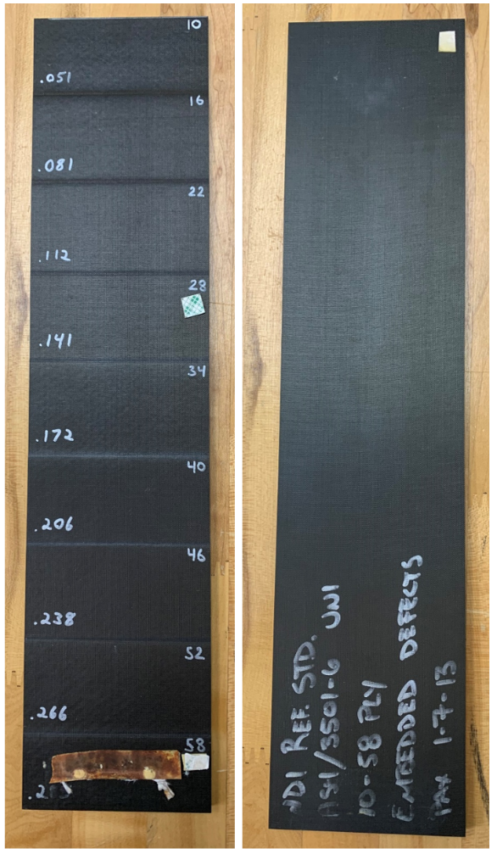
O. COMPOSITE NDI STANDARD MANF.
Chairperson: Frederick Henderson (NAWC-WD China Lake)
Background: Currently FRCs and NAWCs do not have standardized procedures for the fabrication of composite NDI reference standards. Sites rely on OEMs for fabrication.
Objective(s): Establish standard procedures for fabricating and qualifying composite non-destructive inspection reference standards for use in repairs and manufacturing. Serve as a joint topic to continue collaboration with NDIT Working Group on composite-related efforts.
Milestones:
  New topic established in Feb 2022 NAVCORE Winter meeting.
  Kick-off meeting with NDIT working group to discuss common practices for reference standard fabrication.
  Future plan to release white paper on best practices.
  C/Ep to Titanium bond inspection.

Slide 21
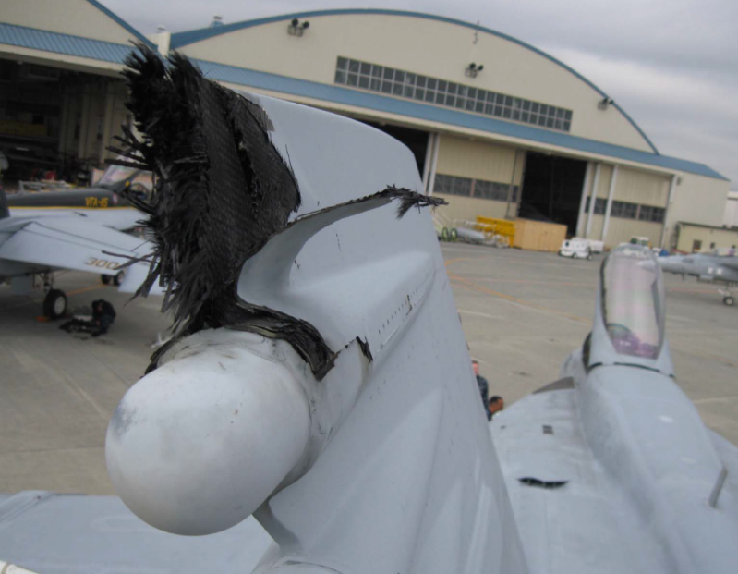
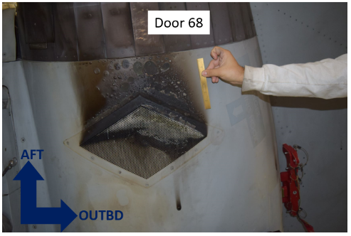
P. THERMAL DAMAGE EVALUATION
Chairperson: Justin Massey (FRCSW)
Background: Advanced capability to evaluate and characterize thermal damage is needed in order to reduce scrap rate due to extreme thermal exposure and lightning strikes.
Objective(s): Evaluate non-destructive inspection technologies (i.e. FTIR) and methodologies for thermal damage inspection. Collaborate with structural engineering to characterize thermally damaged materials for repair analysis.
Milestones:
  New topic established in summer 2022 as an extension of collaborative efforts to develop FTIR calibration methods and standards.
  CSWG-NAVCORE joint team sub group created for thermal damage of NAVAIR aircraft.
    Curtis Sharkey (Team Leader)
    Justin Massey (M&P lead)
  Gathered fleet data to determine economic effect of lightning strike on composites.

Slide 22
Questions?
Thank you!

