Slide 1


Application of Progressive Failure Analysis for Predicting Ultimate & Residual Strength of Composite Bonded Repairs
John Lin, Michael Fleming, Erick Espinar-Mick, The Boeing Company
Reewanshu Chadha, John Bakuckas, FAA Technical Center
June 16, 2023
@JCAMS

Slide 2
Outline
Introduction
  Boeing-FAA Collaborative Research Agreement
  Regulatory Requirements for Composite Bonded Repair
Progressive Failure Analysis Fundamentals
  Composite Failure Theory & Models
  Adhesive Characterization & Modeling
  Automated Model Generation Tool
Application Cases
  Thermoset CFRP scarf repair with intact repair patch
  Thermoset CFRP scarf repair without repair patch
  Fiber oriented repair static strength
Conclusions & Future Work

Slide 3
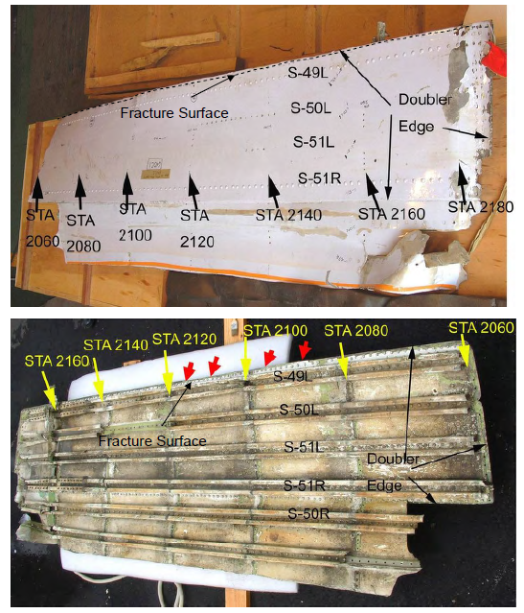
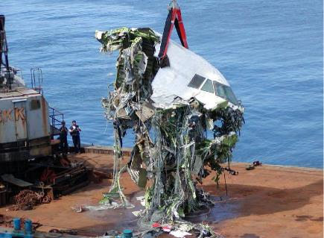
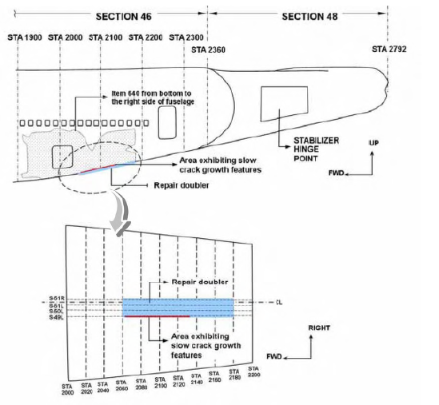
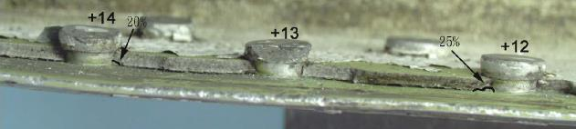
Introduction – Importance of Repair
Ref: ASC-AOR-05-02-001
China Airline Flight Cl611 In-Flight breakup over the Taiwan Strait, May 25, 2002
Boeing 747-200, B-18255
Cause:
  Tail strike (in Year 1980) damage in Section 46 was NOT removed (trimmed)
  Repair doubler did NOT extend sufficiently beyond the entire damaged area
  C/D Checks did not find cracks in 22 years
.063 2024-T3
Bolted doubler repair
Safety of Flight Depends on Proper Repair, Substantiation & Inspection

Slide 4
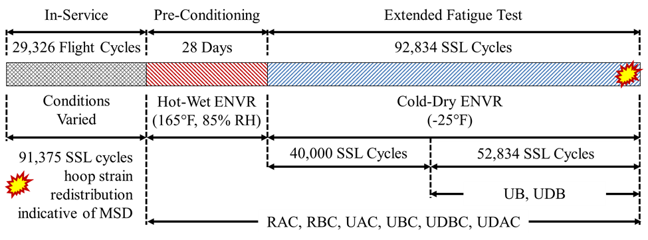
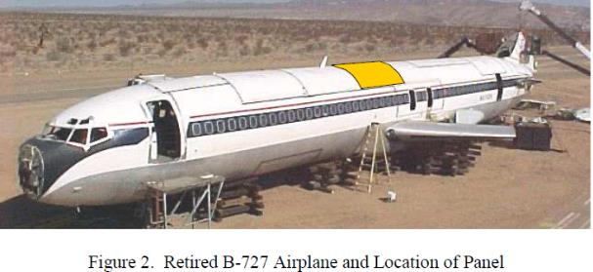
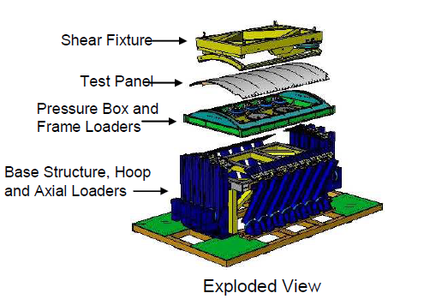
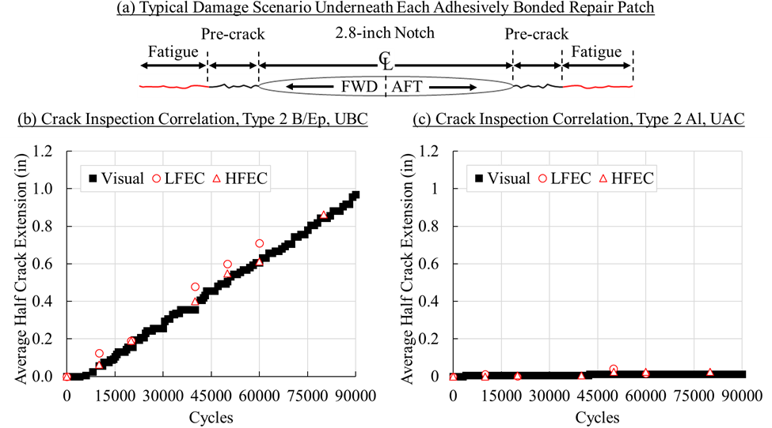
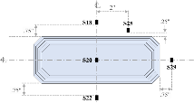
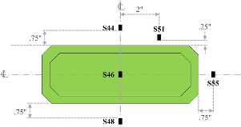
FAA-Boeing CRADA
2007 – 2017: Bonded Repair on Metallic Structures
Joint FAA-Boeing FASTER Test Fixture
Well Designed & Executed Bonded Repair Can Suppress Crack Growth Rate to Zero

Slide 5
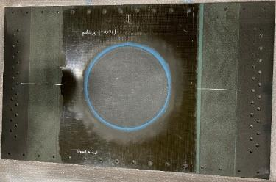
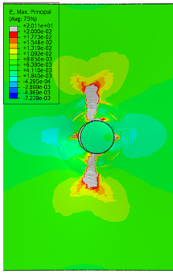
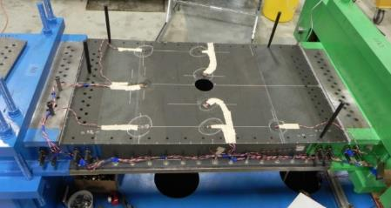
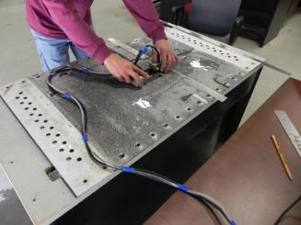
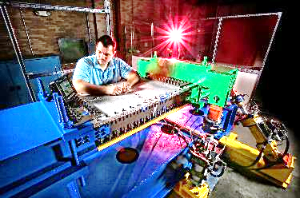
Bonded Repairs to Primary Composite Panels
2018-Present
Bonded Repairs
Objective
  Study fatigue and residual strength performance of bonded repairs to representative composite structures
Tasks
  Assess damage tolerance capabilities and long-term airworthiness of bonded repairs
  Assess the ability of Structural Health Monitoring (SHM) and Non-Destructive Inspection (NDI) technologies to monitor repair integrity
  Verify and calibrate analysis methods used to analyze and design bonded repairs
Work Split
  FAA Tech Center: Test Fixture Design & Fab, Testing, NDI
  Boeing: Test Article Fab, Analysis, NDI Support, Post-Test inspection
  Publication: FAA & Boeing
Testing & Analysis
Inspections

Slide 6
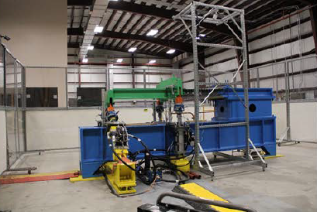
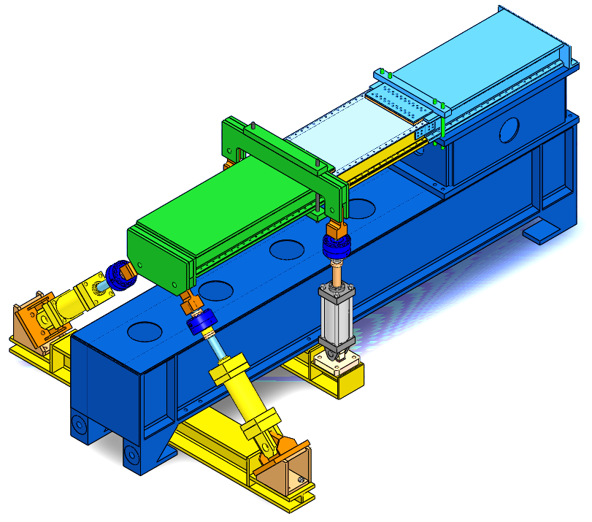
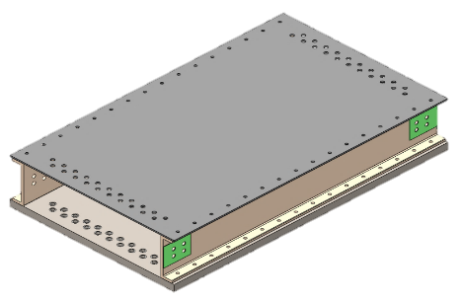
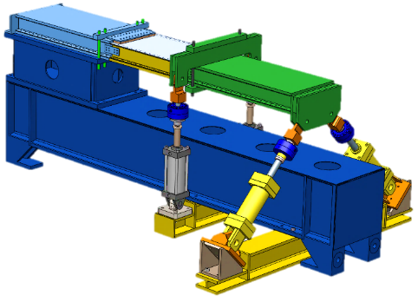
Airframe Beam Structural Test (ABST) Fixture Description
Wingbox Assembly
Carbon Fiber Reinforced Polymer (CFRP) Test Panel
Wingbox Assembly
Wing skin test panel (24” x 40”)
Loading Module
Reaction structure
Intentional Damage
Re-usable Steel/Fiberglass Substructure
Fiberglass channels allows effective load transfer to wing skin test panel
Achievable Limit:
6,000 micro-strain
under tension for laminates up to 45 plies
Central Actuators (50 kip capacity), A1 and A2
End Actuators (50 kip capacity), A3 and A4
Combined Tension/Compression & Shear Capability, Static & Fatigue (0.5 HZ)

Slide 7
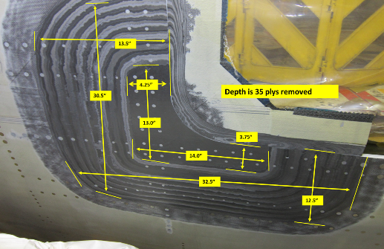
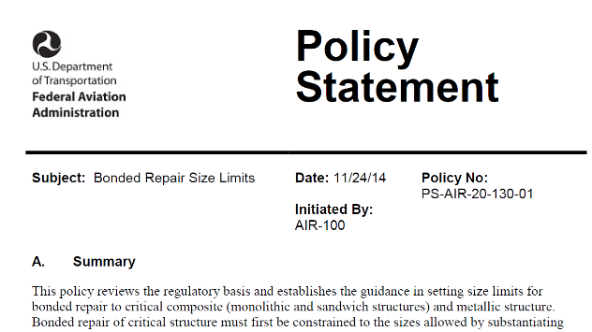
Regulatory Requirements for Composite Bonded Repair
Bonded repairs (Advantages)
  Desirable due to superior fit and finish
  Aerodynamically and structurally efficient
  Eliminates the region of high stress concentrations near the rivet holes
Bonded repairs (Challenges)
  Improve inspection methods to detect weak bonds that result in failure
  Repair processes are specialized and requires properly trained/qualified individuals
Major bonded repairs need to restore ultimate static strength (AC 25.1529-1A, AC20-107B)
  Fail-safety
  Damage Tolerance with Inspection
Critical structure (PSE for transport category) must have limit load strength capability in the case of failed repair for aircraft TC’ed after 11/24/2014 (PS-AIR-20-130-1)

Slide 8
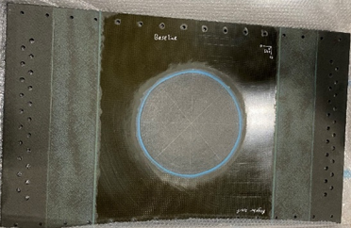
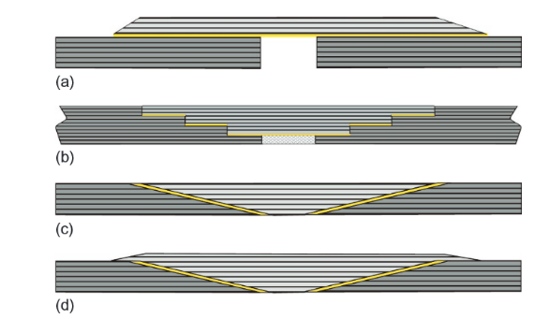
Generic Composite Bonded Repair
Parent Composite Structure/Substrate
Repair Patch (Doubler or Scarf)
Adhesive (Film, Paste, or Resin (wet-layup))
Circular Scarf Repair Example

Slide 9
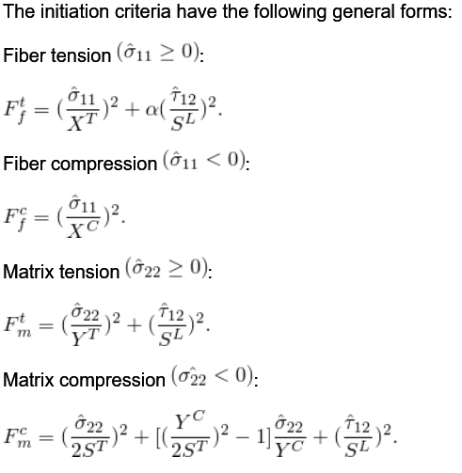
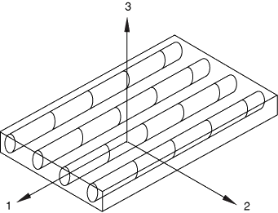
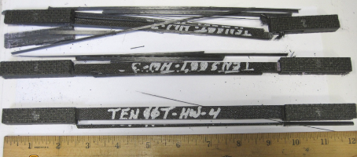
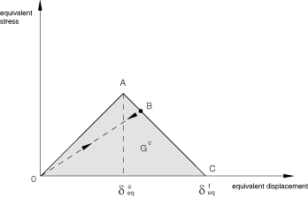
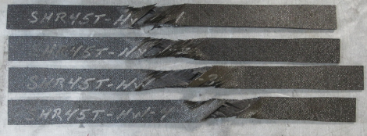
Hashin Failure Criteria – 6 Parameter Model
Shear Strength S^{L}, S^{T}
Fiber Strength X^{C}, X^{T}
Matrix Strength Y^{C}, Y^{T}
Energy-Based Damage Evolution

Slide 10
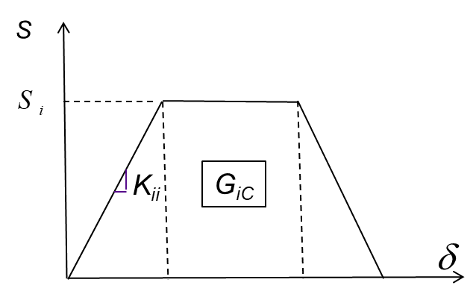
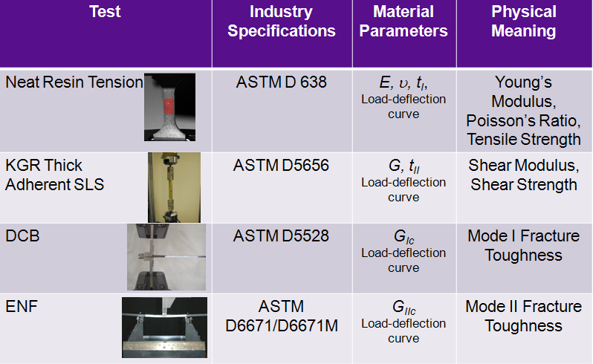
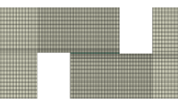
Adhesive Modeling
Traction-Separation Cohesive Model
Ref. Lin & Duong, American Society for Composites (ASC) 28th Technical Conference Proceedings, 2013

Slide 11
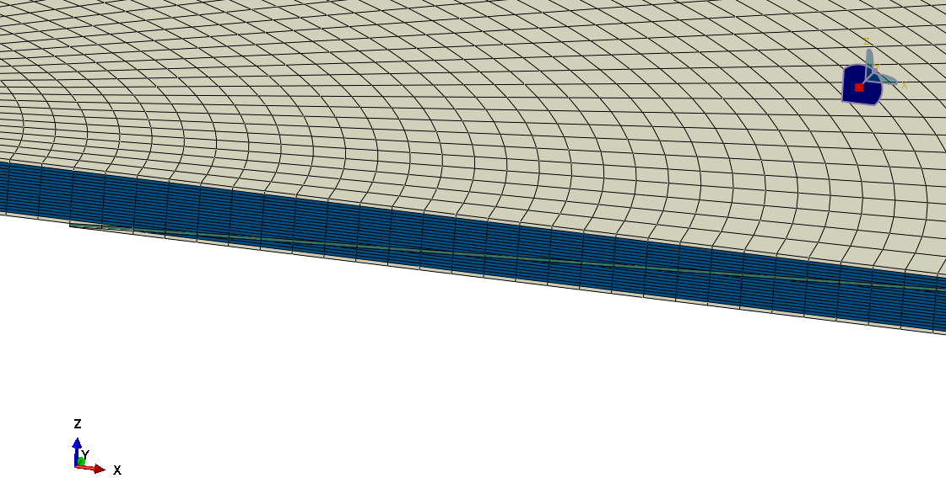
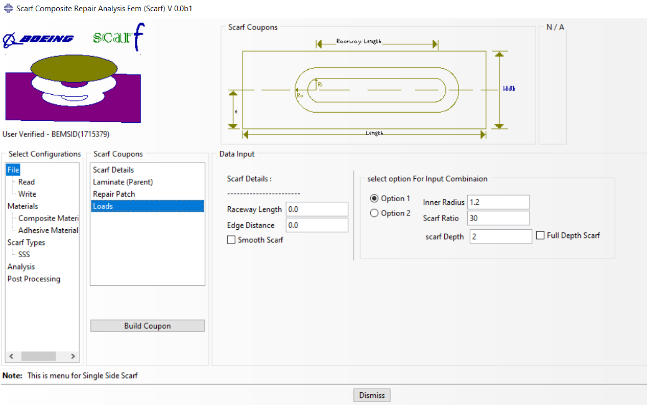
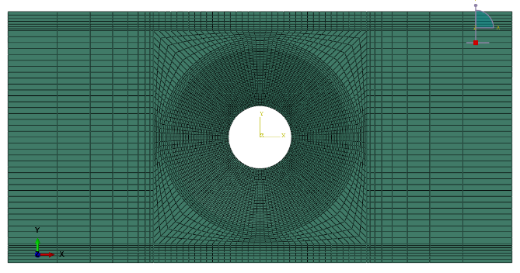
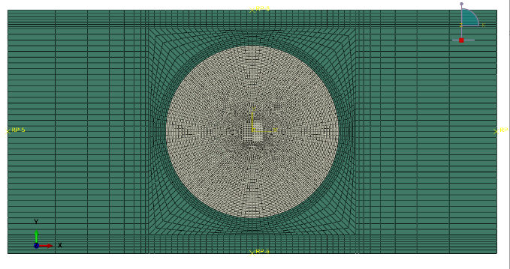
Automated Scarf Repair Modeling Tool
Implemented as an ABAQUS Plugin
Circular, Race-track
Full or Partial Depth
Single-sized or Double-Sided
Adhesive Bondline

Slide 12
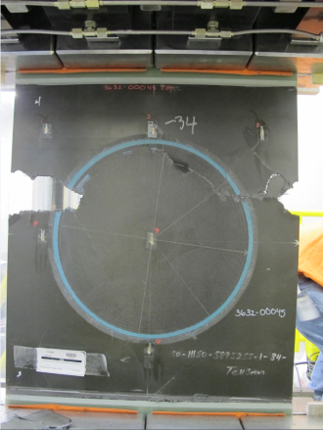
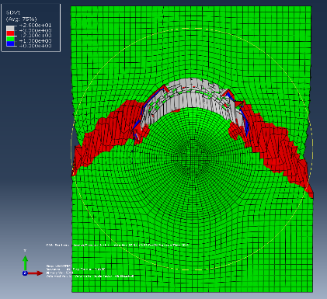
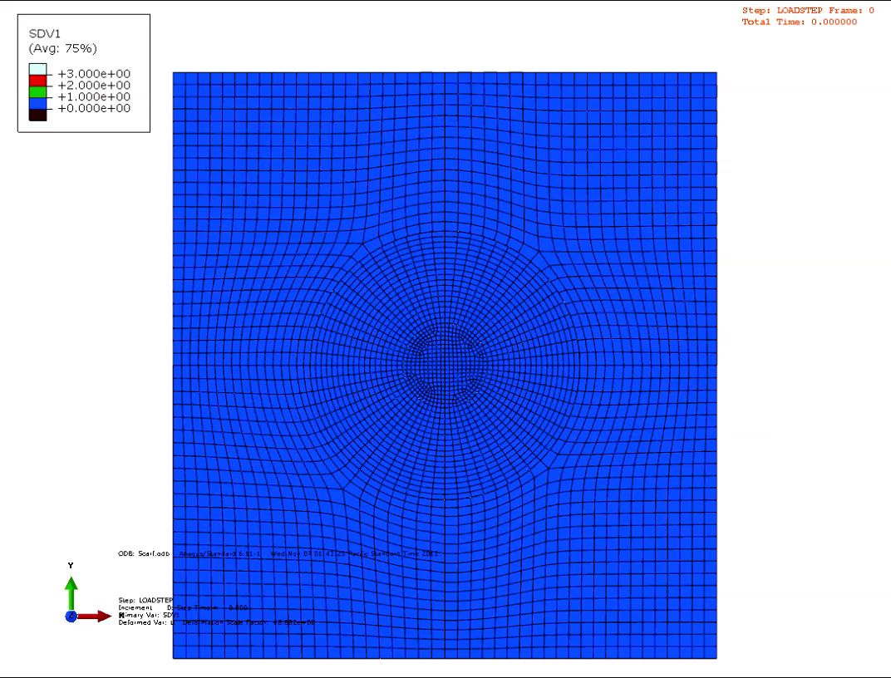
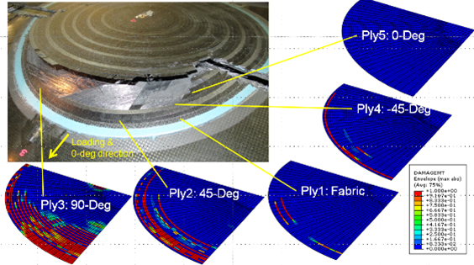
Static Strength Prediction with Intact Repair Patch

Slide 13
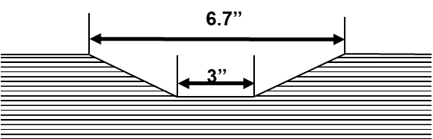
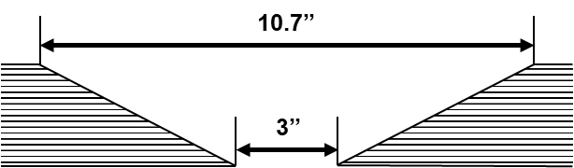
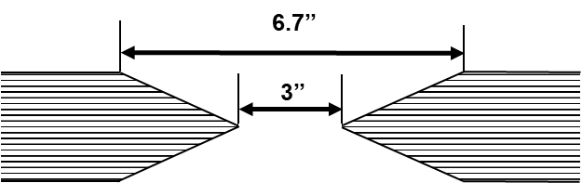
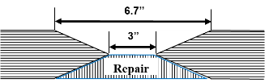

Summary of Residual Strength Tests (without repair patch)
Typical CFRP Panels
[±45_{fabric}/-45°/90°/45°/0°/-45°/90°/45°/0°]_{s}
Partial Depth (50%)
Open Hole (3”)
Static
Fatigue
Double-Sided Scarf
Full Depth
w/o Patch Patch
Patch
Static
Fatigue
Static
Static
Static
Fatigue
Open-hole
Partial-Depth Scarf (Panels 3, 5)
Full-Depth Scarf (Panels 4, 6)
Double-Sided Scarf (Panels 7, 8)
Double-Sided Scarf with Repair (Panels 9,10)

Slide 14
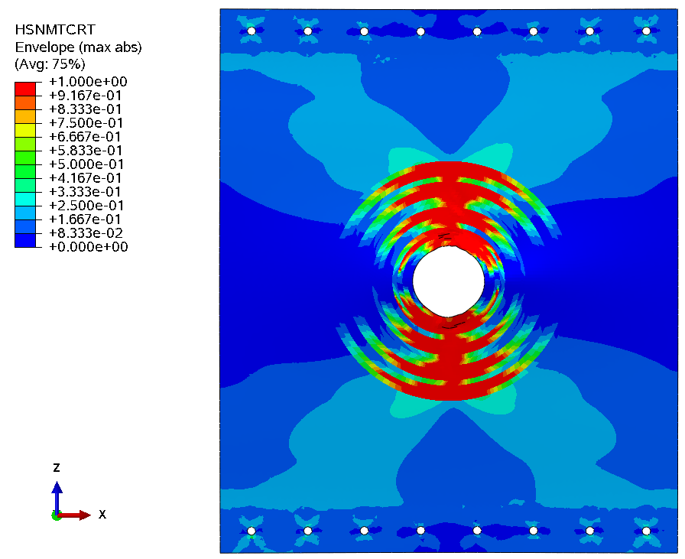
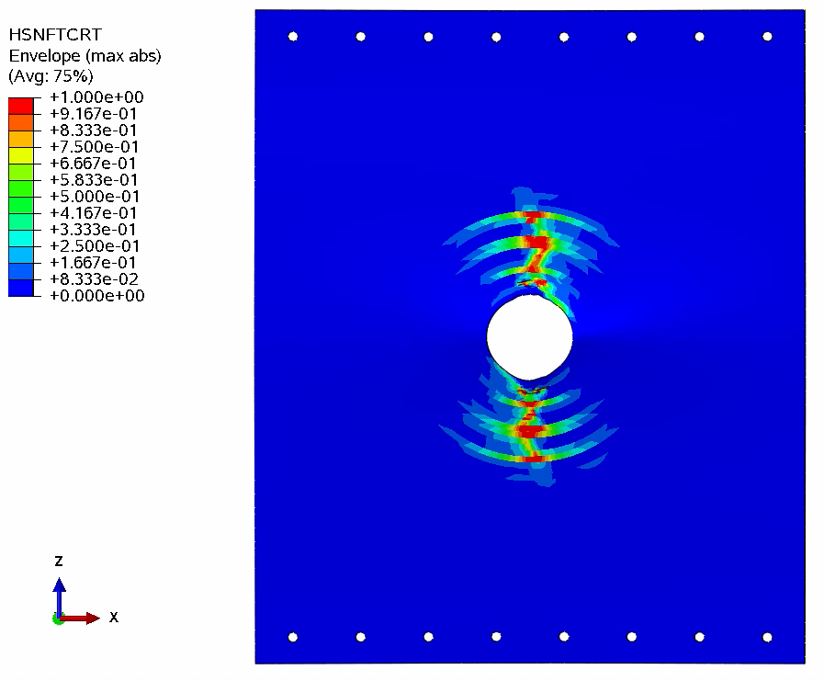
Failure Index Contour at the onset of 100%
Predicted Critical Load for Full Scarf Panel = 11370 lbs
Matrix Tensile Failure Index
Fiber Tensile Failure Index

Slide 15
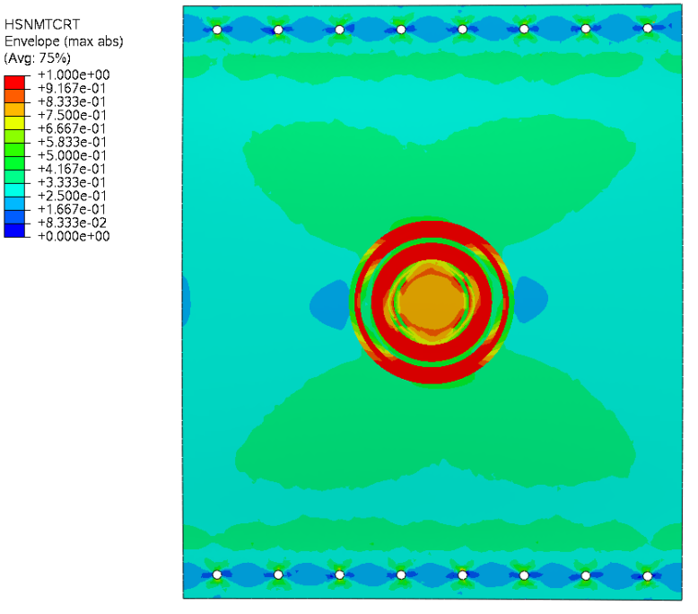
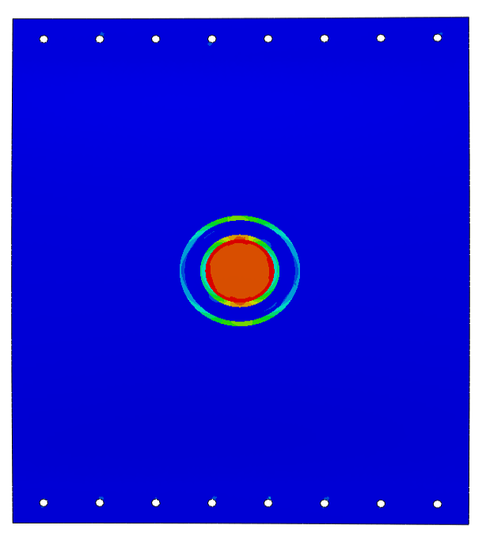
Failure Index Contour at the onset of 100%
Predicted Critical Load for Partial Scarf Panel = 20117 lbs
Matrix Tensile Failure Index
Fiber Tensile Failure Index

Slide 16
Partial-Depth Scarf vs Double Side Scarf
Single-Sided Partial-Depth Scarf
(B) Double-Sided Scarf with One-side Repair
Prying Moment Induced by Eccentricity
→ High peel stress in bondline

Slide 17
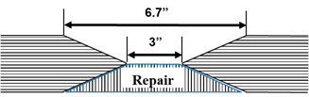
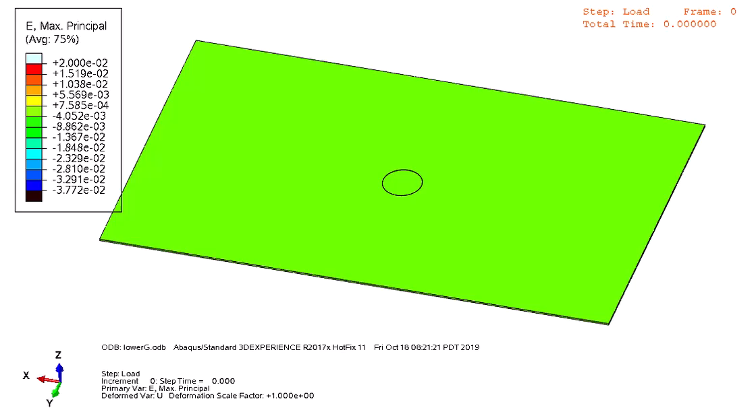
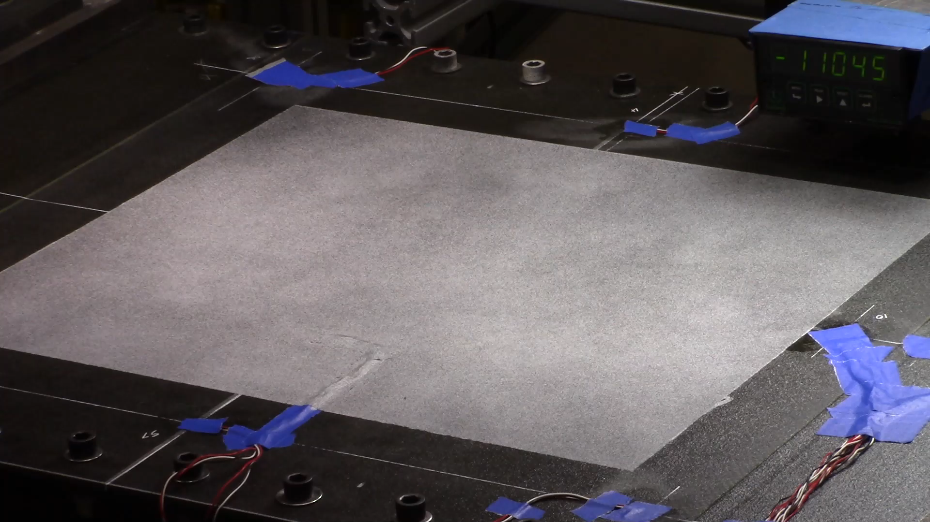
Double-Sided Repair
One-side repair patch remaining

Slide 18


Failure Mode Correlation
Double-sided scarf with partial repair

Slide 19

Bondline Progressive Failure Animation
Double-sided scarf with partial repair

Slide 20

Test Results
IS6
IS5, IS11

Slide 21

Strain Gage Correlation (Gages 6, 5, 11)
Double-sided scarf with partial repair
IS6
IS5, IS11
100% Applied Strain = 12,500 με
fraction of applied far-field Strain

Slide 22
Automated Fiber-Oriented Repairs
Remove only overlap plies in the fiber direction
Results in ~40% reduction in the tapered area of the scarf
Being investigated by European aerospace companies/consortiums
Limited published work shows potential strength equivalence to conventional taper scarfs (joint coupon tests)
Use of automated material removal processes for reduced footprint
Reduces skill level needed to perform high quality scarf
Increases accuracy and speed of material removal

Slide 23



[±45_{fabric}/-45°/90°/45°/0°/-45°/90°/45°/0°]_{s}
Automated Fiber Oriented repair testing
Demonstrate equivalency between fiber oriented scarf and traditional scarf - proof of concept
Panel 1
Panel 2
Panels 3 and 4
Taper Repair Geometry
Stepped Repair Geometry
Fiber-Oriented Repair Geometry

Slide 24
Stepped vs. Taper, Conventional vs Fiber-Oriented Repairs
Conclusion: Fiber-oriented repair is viable. It restores panel strength to120% of OHT
Open-hole
Conventional Taper Repair Geometry
Stepped Repair Geometry
Fiber-Oriented Repair Geometry

Slide 25





Panel 2, Stepped Scarf with Repair: Failure Mode Comparison
OML Side
IML Side
Damage Sequence Predicted By PFA:
Bondline Failure → Fiber Breakage → Net-Section Panel Failure

Slide 26

Conclusions and Future Work
Progressive failure analysis (PFA) correlated well with composite bonded repairs with or without repair patch.
With the aid from building block composite ply-level testing and adhesive testing, PFA can be utilized to enable smart testing. In applying Hashin failure criteria, be aware:
  Lamina level strength testing required
  Delamination not explicitly accounted for (can be incorporated albeit computationally expensive)
Future Work: Safety and Durability of Configured Composite Structural Repair
  152” x 60” , 5- stringer Test Panel Capability
  Shear, Bending and Torsion loading capability
  Up to 3,390,000 lbs anticipated load in the panel
  Based on typical wide body mid-span wing panel
  Sized for residual strength testing up to
  10,000 microstrain compression
  10,000 microstrain tension axially
  6,000 microstrain shear
  Fatigue spectrum test capability

