Slide 1
Advanced Composite
Repair Analysis – 2023 Update
by Greg Kress
Top Flight Aerostructures & Abaris Training

Slide 2
Introductions . . .
Greg Kress
Co-owner of Top Flight Aerostructures (formerly Vision Composites).
  Repair, overhaul, and spares manufacturing for the USAF C-5, B-2, B-52, A-10, UH-60M, Gray Eagle . . . . and DLA.
Former Lead Composite Structures engineer for Delta Airlines.
Retired Commander in the US Navy (USNR).
  Started composite repair interest on USS Theodore Roosevelt (CVN-71) in 1993.
Master’s Degree in Aeronautical Engineering
  United States Naval Postgraduate School, Monterey, CA.
  Studied composites under Dr. Ed Wu.
27 years of experience teaching composite repair analysis 5-day short courses for Abaris Training, Reno, NV.
  Students from all major airlines, all military services, all major manufacturers.

Slide 3
Last year’s discussion . . .
Scope of Abaris Training engineering course curriculum.
  OEM composite design & analysis courses.
  Operator/Repair Station/OEM repair design & repair analysis courses.
Composite Repair metholodogy.
  Tapered sanded, flush, co-cured repairs.
  Non-taper sanded, overlay (scab patch), co-cured repairs.
  Precured doubler, secondarily bonded, repairs.
Secondary structure repair analysis.
  Original –vs– Repair: Stiffness, Strength, & Bonded Joint.
Primary structure repair analysis.
  Advanced Stiffness, Strength, & Bonded joint analysis . . . very advanced!

Slide 4
Previous Abaris & Top Flight effort
Advanced hole and bonded repair analysis.
  Lekhnitskii, Potential Theory, Stress Field Solution, Method.
  Complex Boundary Displacement (CBD) Method.
Finite Element Analysis.
  Femap/Nastran: Flat panel, laminated, shell analysis.
Mechanical testing.
  6” x 13” panels, 5-ply thick, reinforced edgeband.
  With 2” diameter straight sided and tapered hole (BRSL).
  Co-cured, flush & overlay, USDWC & RSUWC.
  Precured patch, secondarily bonded.
  Uniaxial tension. 15,000 lb UNT failure load.
  Digital Image Correlation (DIC).

Slide 5
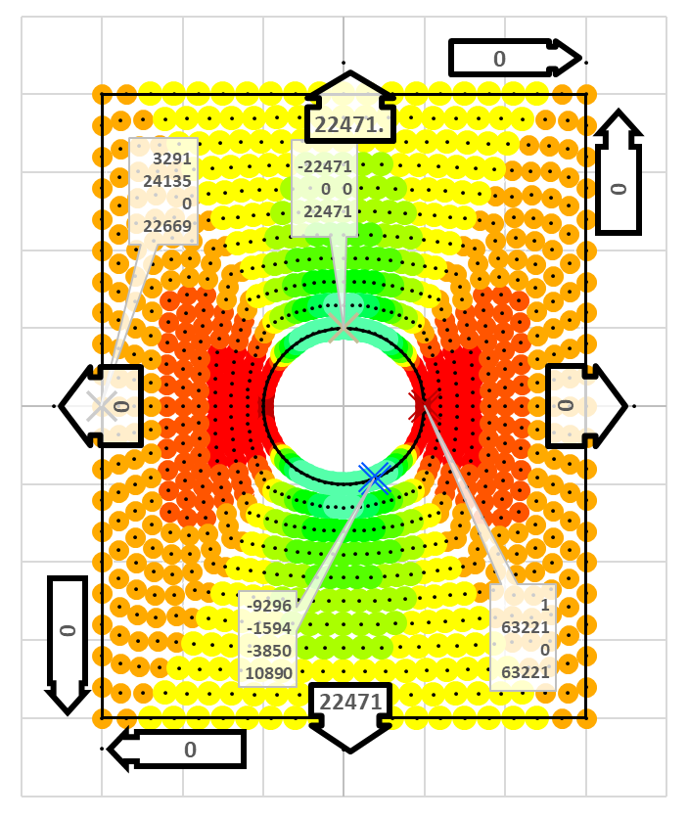
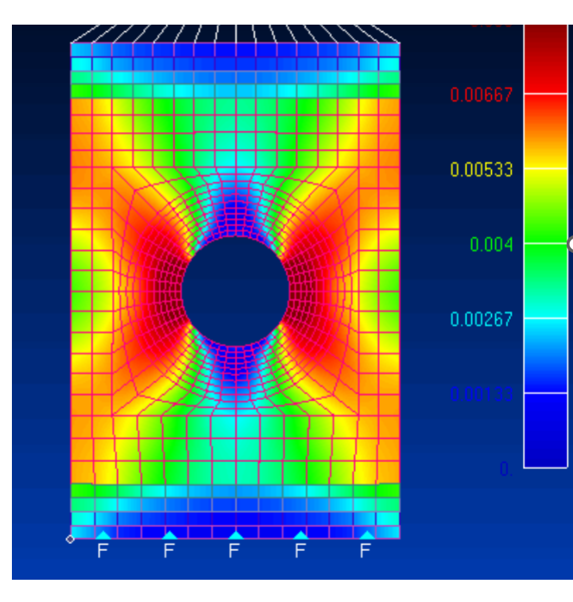
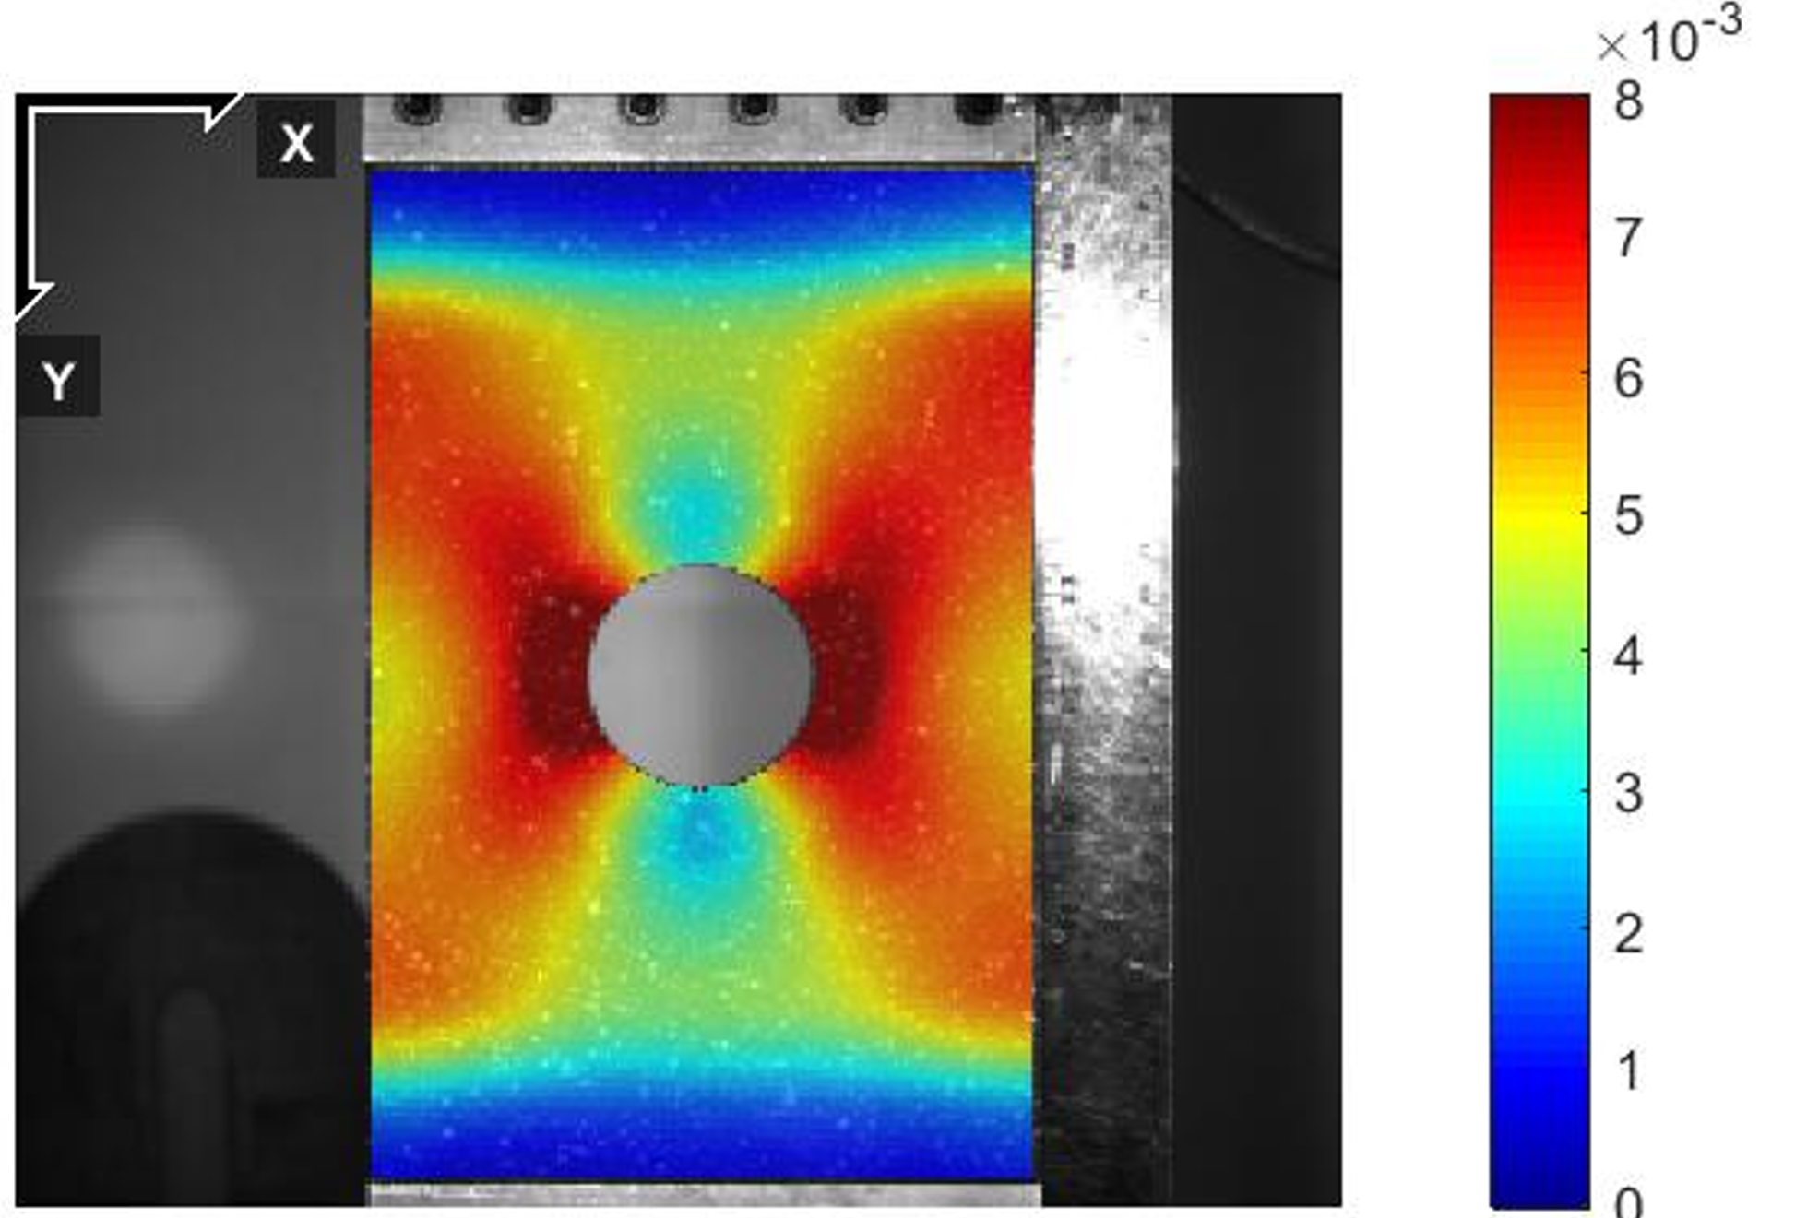
Lekhnitskii Method hole analysis

Slide 6
What is JCAMS all about.
Collaboration between DoD, governments, OEMs, and operators.
Guess what happened after last years meeting:
  Collaboration with:
    FAA. Larry Ilcewicz, John Bakuckas, & Rewanshu Chadha.
    Boeing. John Lin.
    CMH-17. Larry Gintert.
    US Army. Ft Eustis & Huntsville, DEVCOM, AVMC.
  Validate advanced repair analysis repair analysis methodology.
    Initial effort: Bonded Repair Size Limits (BRSL).
I opened ONE HUGE CAN OF WORMS!!

Slide 7
FAA & Boeing BRSL testing & analysis.
DOT/FAA/TC-21/17
  Bonded Repairs to Composite Wing Panel Structure, Phase 2, Baseline Study.
  ABST fixture description & operation.
  3” diameter damage.
  Panel 1: Pristine panel, no hole or damage removal.
  Panel 2: Non-tapered damage removal, straight sided hole.
DOT/FAA/TC-21/27
  Bonded Repairs to Composite Wing Panel Structure: Phase 3—Bonded Repair Size Limits Study
  Panel 3: Partial-depth damage removal, 30:1 taper ratio.
  Panel 4: Full-depth damage removal, 30-1 taper ratio.
  Panels 5 & 6 were used for fatigue testing.

Slide 8
Aircraft Beam Structural Test (ABST) fixture
FAA Tech Center.
  Test panel shown in light blue.
  Achieve tension in test panel via beam bending.
  Tension on the top.
  Compression on the bottom.

Slide 9
TC-21/17 ABST Panel 1 & 2 testing.
Panel configuration:
  24” x 40” panels size.
  18-ply test area.
  32-ply reinforced edgeband with 2 edgeband config.
  Toray 3900-2, Gr 190 UD tape, 3K-PW woven fabric.
Strain gauges on all panels.
Digital Image Correlation on all holes.
FEA (on 3” diameter straight sided hole only).
  Represents a disbonded precured doubler repair.

Slide 10
Pristine Panel 1 drawing.
No hole.
No damage.

Slide 11
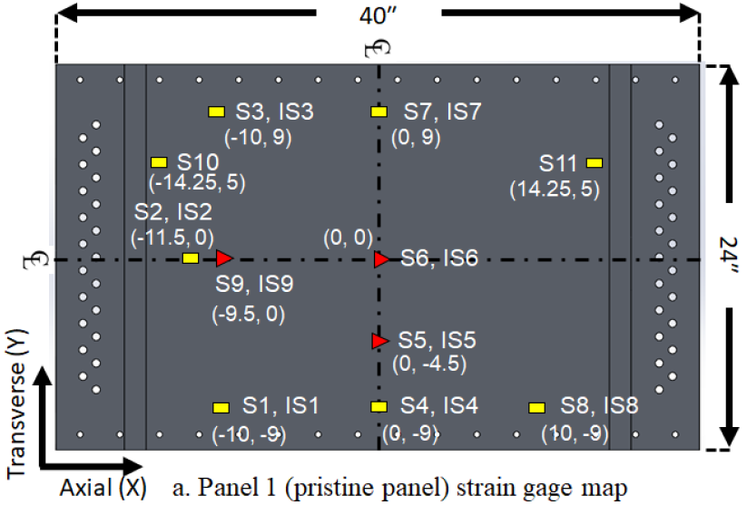


Panel 1 strain gauges

Slide 12
DOT/FAA/TC-17/21 Phase 2 FEA.
24” x 40” panel with 3” diameter hole.

Slide 13
Pristine Panel 2 drawing.
3.0” hole.
Disbonded overlay or precured doubler repair.
Note 21” x 24” test area.

Slide 14
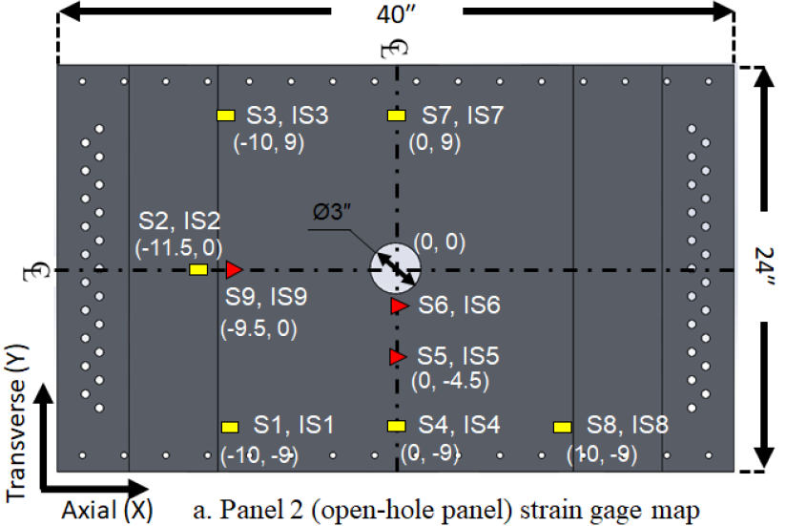
Panel 2 strain gauges

Slide 15
DOT/FAA/TC-17/21 Phase 2 (Cont)
Panel 2.
FEA and DIC microstrains around the hole.

Slide 16
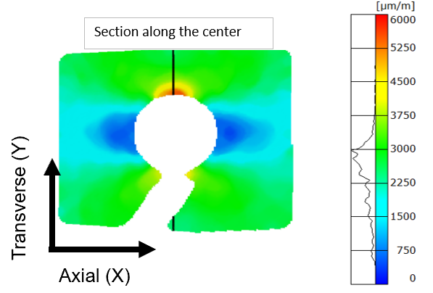
DOT/FAA/TC-17/21 Panel 2 Dic
Microstrain measured along the vertical black line.
  Y-distance from the center of the hole

Slide 17
TC-21/27 ABST Panel 3 & 4 testing.
Same panel configuration:
  24” x 40” panels size.
  18-ply test area.
  32-ply reinforced edgeband, both with 5.150 edgeband ply drop-off region.
  Toray 3900-2, Gr 190 UD tape, 3K-PW woven fabric.
Strain gauges on all panels.
Digital Image Correlation on all holes.
No FEA presented on tapered holes.
  Represents a disbonded tapered flush repair.

Slide 18
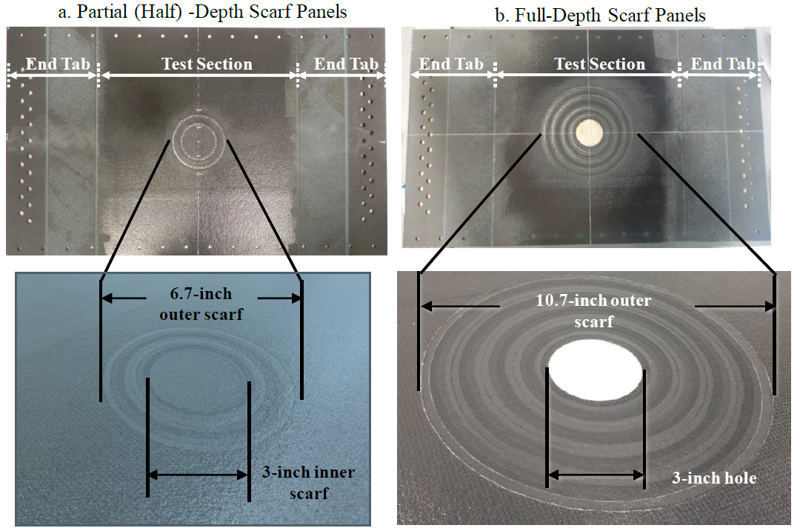
DOT/FAA/TC-27/17 Phase 3
Panel 3.
  Partial-depth damage removal.
  9-plies damaged.
  30:1 taper ratio.
  6.7” outer scarf.
  3.0” inner scarf.
Panel 4.
  Full-depth damage removal.
  30:1 taper ratio.
  10.7” outer scarf.
  3.0” inner hole.

Slide 19
Panel 3 drawing
3.0” damage removal.
6.7” dia top of taper.
Disbonded flush, partial-depth repair.
Note 21” x 24” test area.

Slide 20
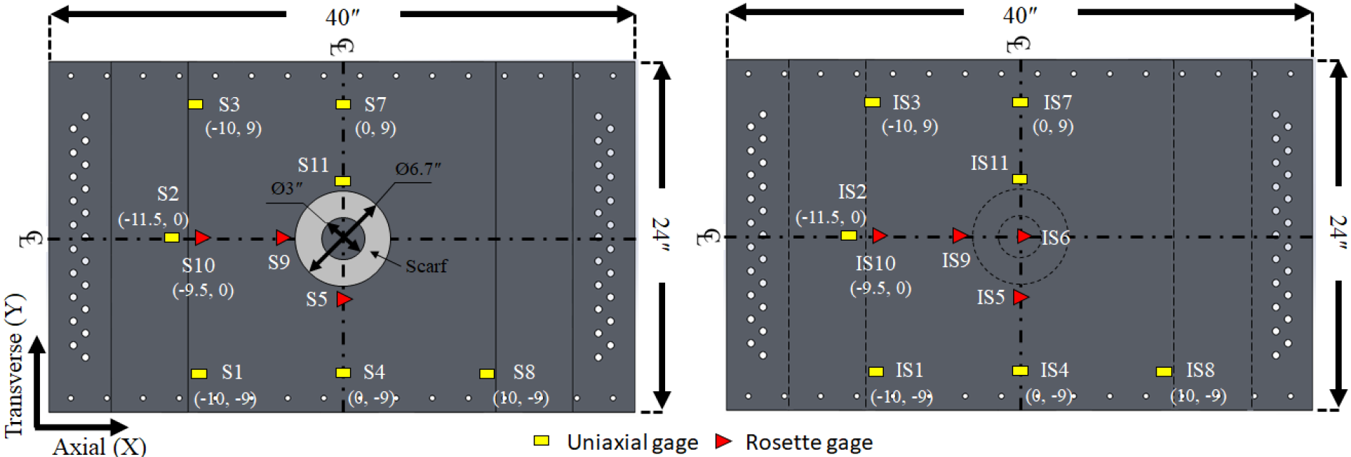
Panel 3 details.
Strain gauges on the top and bottom of the panel to evaluate the differences to do bending.
Taper applied to top of panel.
Greater strains on top of panel.

Slide 21
Panel 4 drawing
3.0” damage removal.
10.7” dia top of taper.
Disbonded flush, full-depth repair.
Note 21” x 24” test area.

Slide 22
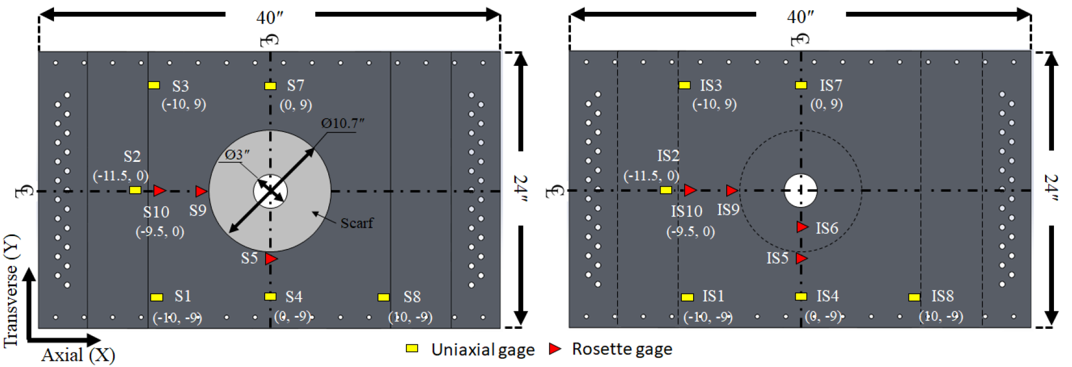
Panel 4 strain gauges

Slide 23
Wow!! That was a lot!
DOT/FAA/TC-21/17 and DOT/FAA/TC-21/27.
  Provide a lot of information to replicate the results.
  Have a lot of data of data for comparison.
Monthly or bi-weekly meetings since Fall 2022.
Initial effort was with analytical validation.
  Lekhnitskii Method for 3.0” straight-sided hole.
  CBD Method for partial-depth & full-depth tapered hole.
Most recent effort is with FULL FEA validation.

Slide 24
Remember:
The Lekhnitskii Method for advanced hole analysis in composites
. . . from last year.

Slide 25
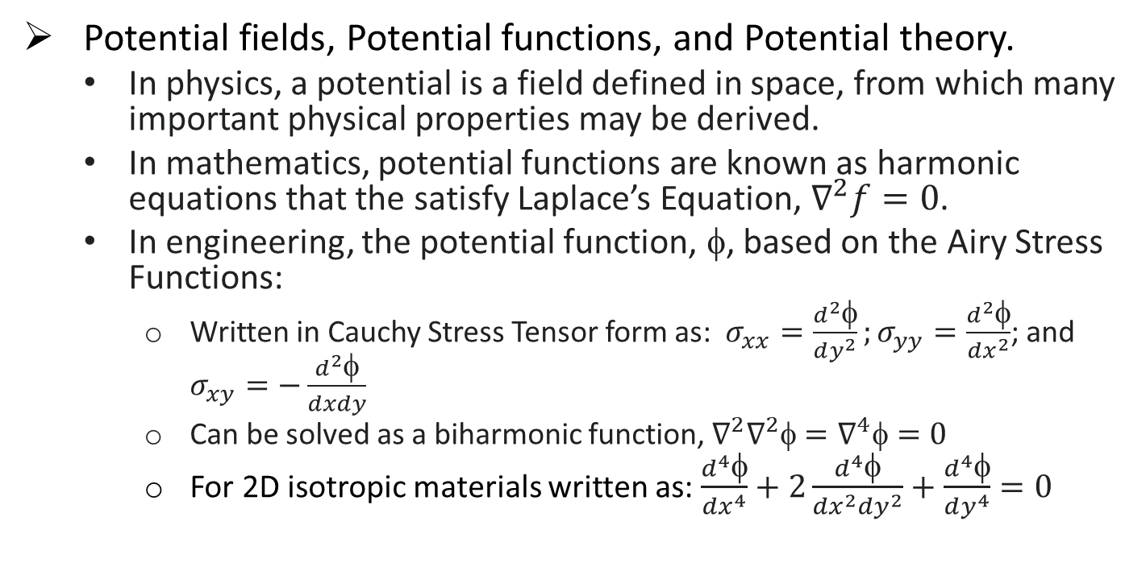
Large holes: Lekhnitskii Method
Potential fields, Potential functions, and Potential theory.
  In physics, a potential is a field defined in space, from which many important physical properties may be derived.
  In mathematics, potential functions are known as harmonic equations that the satisfy Laplace’s Equation, $∇^{2}f=0$.
  In engineering, the potential function, φ, based on the Airy Stress Functions:
    Written in Cauchy Stress Tensor form as: $σ_{xx}=\frac{d^{2}φ}{dy^{2}};σ_{yy}=\frac{d^{2}φ}{dx^{2}}$; and $σ_{xy}=−\frac{d^{2}φ}{dxdy}$
    Can be solved as a biharmonic function, ${∇^{2}∇}^{2}\text{φ}=∇^{4}\text{φ}=0$
    For 2D isotropic materials written as: $\frac{d^{4}φ}{dx^{4}}+2\frac{d^{4}φ}{dx^{2}dy^{2}}+\frac{d^{4}φ}{dy^{4}}=0$

Slide 26
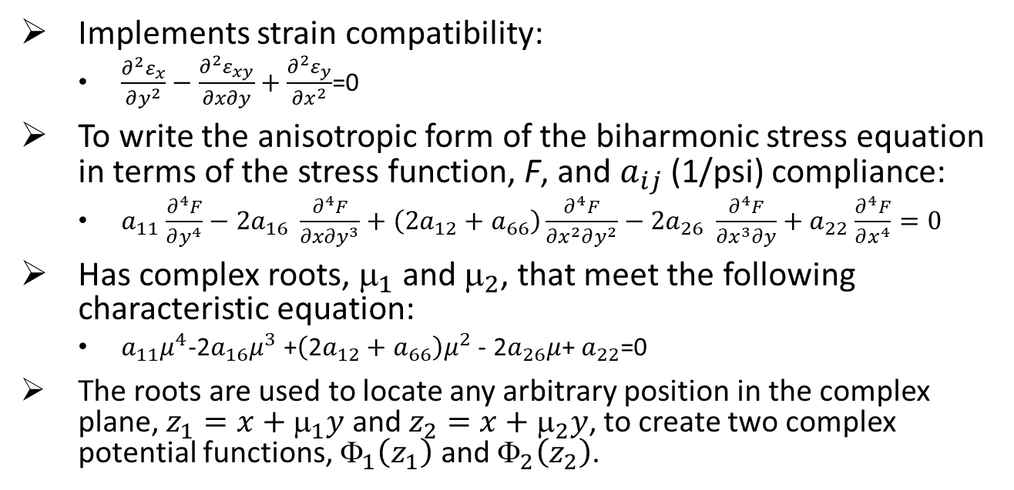
Lekhnitskii Stress Function
Implements strain compatibility:
  $\frac{∂^{2}ε_{x}}{∂y^{2}}−\frac{∂^{2}ε_{xy}}{∂x∂y}+$ $\frac{∂^{2}ε_{y}}{∂x^{2}}$=0
To write the anisotropic form of the biharmonic stress equation in terms of the stress function, F, and $a_{ij}$(1/psi) compliance:
  $a_{11}$ $\frac{∂^{4}F}{∂y^{4}}−{2a}_{16} \frac{∂^{4}F}{{∂x∂y}^{3}}+\left({2a}_{12}+a_{66}\right)\frac{∂^{4}F}{{∂x}^{2}∂y^{2}}−{2a}_{26} \frac{∂^{4}F}{{∂x}^{3}∂y}+a_{22}$ $\frac{∂^{4}F}{∂x^{4}}=0$
Has complex roots, $_{1}$ and $_{2}$, that meet the following characteristic equation:
  $a_{11}μ^{4}$-2$a_{16}μ^{3}$+$\left(\text{2}a_{12}+a_{66}\right)μ^{2}$- 2$a_{26}μ$+ $a_{22}$=0
The roots are used to locate any arbitrary position in the complex plane, $z_{1}=x+_{1}y$ and $z_{2}=x+_{2}y$, to create two complex potential functions, ${\text{}}_{1}\left(z_{1}\right)$ and ${\text{}}_{2}\left(z_{2}\right)$.

Slide 27
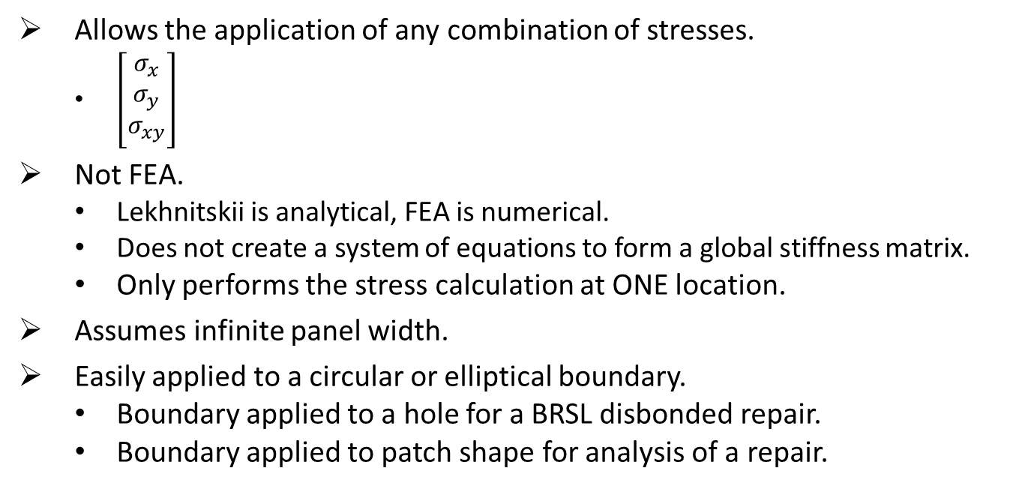
Lekhnitskii Method summary
Allows the application of any combination of stresses.
  $\left[\begin{matrix}σ_{x} \\ σ_{y} \\ σ_{xy}\end{matrix}\right]$
Not FEA.
  Lekhnitskii is analytical, FEA is numerical.
  Does not create a system of equations to form a global stiffness matrix.
  Only performs the stress calculation at ONE location.
Assumes infinite panel width.
Easily applied to a circular or elliptical boundary.
  Boundary applied to a hole for a BRSL disbonded repair.
  Boundary applied to patch shape for analysis of a repair.

Slide 28
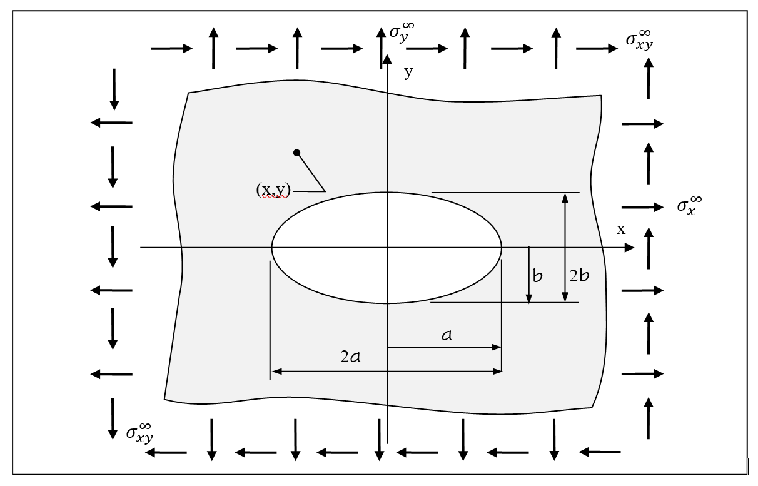
Lekhnitskii stress results at a hole (BRSL)
Any applied far-field stresses,
Calculate the stress and strain at any (x,y) location.
Based on an infinite panel width and any elliptical or circular hole.

Slide 29
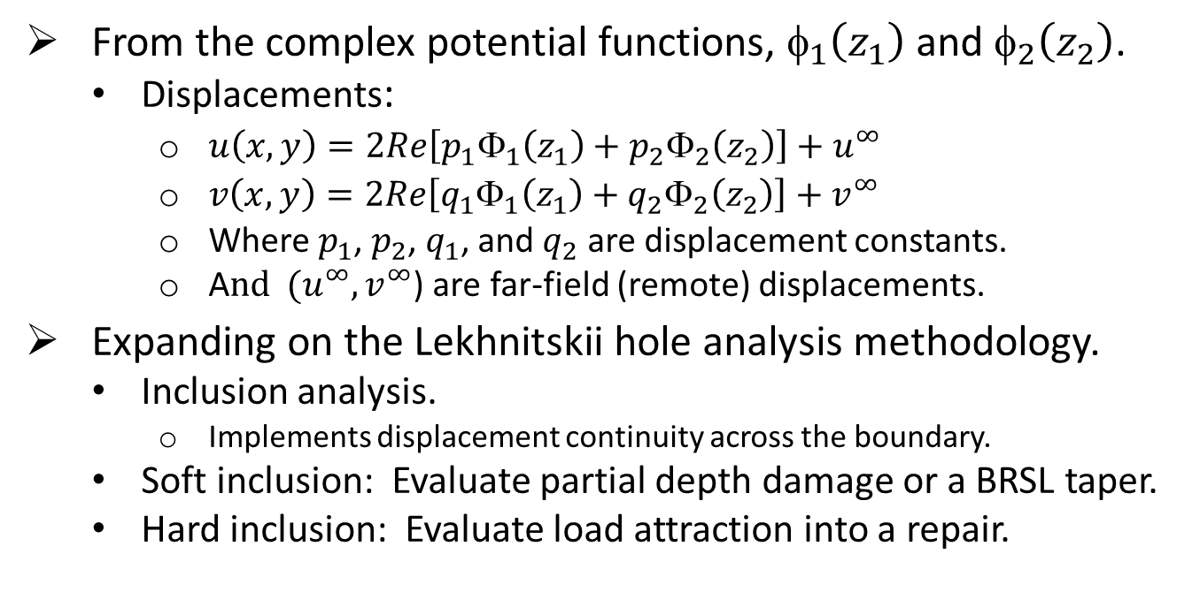
Utilizing the concepts of a Stress Potential
From the complex potential functions, $_{1}\left(z_{1}\right)$ and $_{2}\left(z_{2}\right)$.
  Displacements:
    $u\left(x,y\right)=2Re\left[p_{1}{\text{Φ}}_{1}\left(z_{1}\right)+p_{2}{\text{Φ}}_{2}\left(z_{2}\right)\right]+u^{∞}$
    $v\left(x,y\right)=2Re\left[q_{1}{\text{Φ}}_{1}\left(z_{1}\right)+q_{2}{\text{Φ}}_{2}\left(z_{2}\right)\right]+v^{∞}$
    Where $p_{1}$, $p_{2}$, $q_{1}$, and $q_{2}$ are displacement constants.
    A$nd { (u}^{∞},v^{∞}$) are far-field (remote) displacements.
Expanding on the Lekhnitskii hole analysis methodology.
  Inclusion analysis.
    Implements displacement continuity across the boundary.
  Soft inclusion: Evaluate partial depth damage or a BRSL taper.
  Hard inclusion: Evaluate load attraction into a repair.

Slide 30
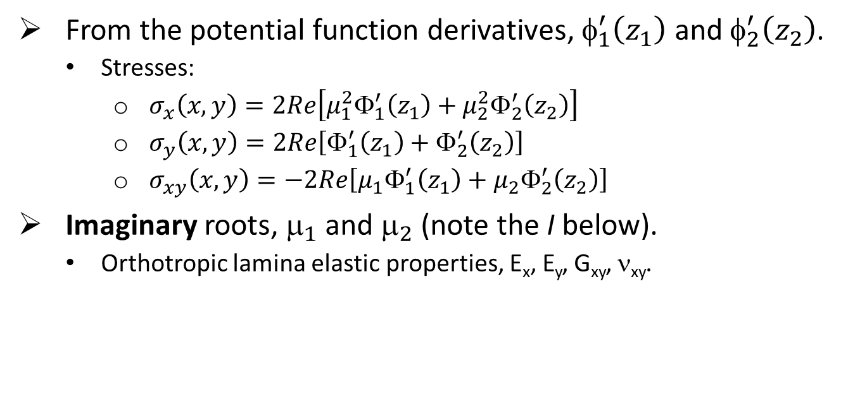
Lekhnitskii stress calculation
From the potential function derivatives, $_{1}^{′}\left(z_{1}\right)$ and $_{2}^{′}\left(z_{2}\right)$.
  Stresses:
    $σ_{x}\left(x,y\right)=2Re\left[{μ_{1}^{2}\text{Φ}}_{1}^{′}\left(z_{1}\right)+{μ_{2}^{2}\text{Φ}}_{2}^{′}\left(z_{2}\right)\right]$
    $σ_{y}\left(x,y\right)=2Re\left[{\text{Φ}}_{1}^{′}\left(z_{1}\right)+{\text{Φ}}_{2}^{′}\left(z_{2}\right)\right]$
    $σ_{xy}\left(x,y\right)=−2Re\left[{μ_{1}\text{Φ}}_{1}^{′}\left(z_{1}\right)+{μ_{2}\text{Φ}}_{2}^{′}\left(z_{2}\right)\right]$
Imaginary roots, $_{1}$ and $_{2}$ (note the I below).
  Orthotropic lamina elastic properties, E_{x}, E_{y}, G_{xy}, ν_{xy}.

Slide 31
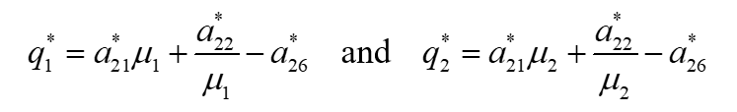
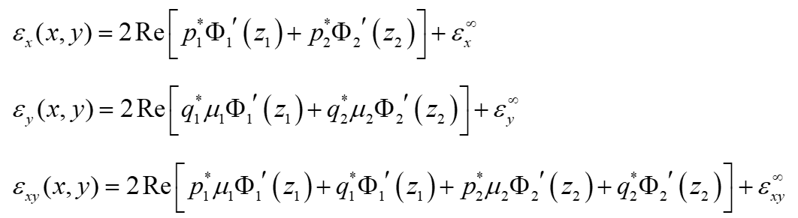
. . . even more fun math to calculate strains.
Resulting in equations for displacement, stress, and strain.

Slide 32
The remember:
The CBD Method for advanced repair analysis in composites
. . . from last year.

Slide 33
CBD Method analysis background
CBD is an acronym for Complex Boundary Displacement.
  Short for Complex Potential Function Boundary Displacement Continuity.
Based on the Lekhnitskii Stress Function solution.
  Uses complex potential functions and their derivatives to solve the Airy Stress Functions written for the generalized biharmonic anisotropic equation.
Previous wasted efforts with Bonded Joint and Repairs to Composite Airframe Structures.
  Stroh Formalism didn’t work.
  Duong and Wang’s 2-Stage complex Eigenvalue process was too confusing.

Slide 34
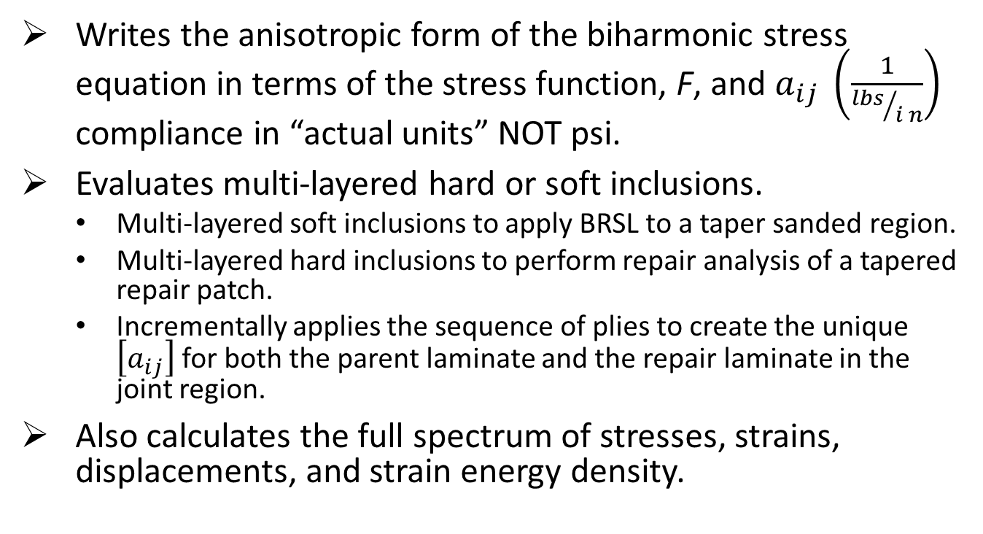
CBD Method variation
Writes the anisotropic form of the biharmonic stress equation in terms of the stress function, F, and $a_{ij} \left(\frac{1}{{lbs}/{i n}}\right)$ compliance in “actual units” NOT psi.
Evaluates multi-layered hard or soft inclusions.
  Multi-layered soft inclusions to apply BRSL to a taper sanded region.
  Multi-layered hard inclusions to perform repair analysis of a tapered repair patch.
  Incrementally applies the sequence of plies to create the unique $\left[a_{ij}\right]$ for both the parent laminate and the repair laminate in the joint region.
Also calculates the full spectrum of stresses, strains, displacements, and strain energy density.

Slide 35
Enough background
Here is where the comparison begins . . .
  First of all, I am calling Lekhnitskii the CBD Method due to the analytical differences mentioned above.
  Lekhnitskii and CBD calculations are very similar for a straight-sided hole.

Slide 36
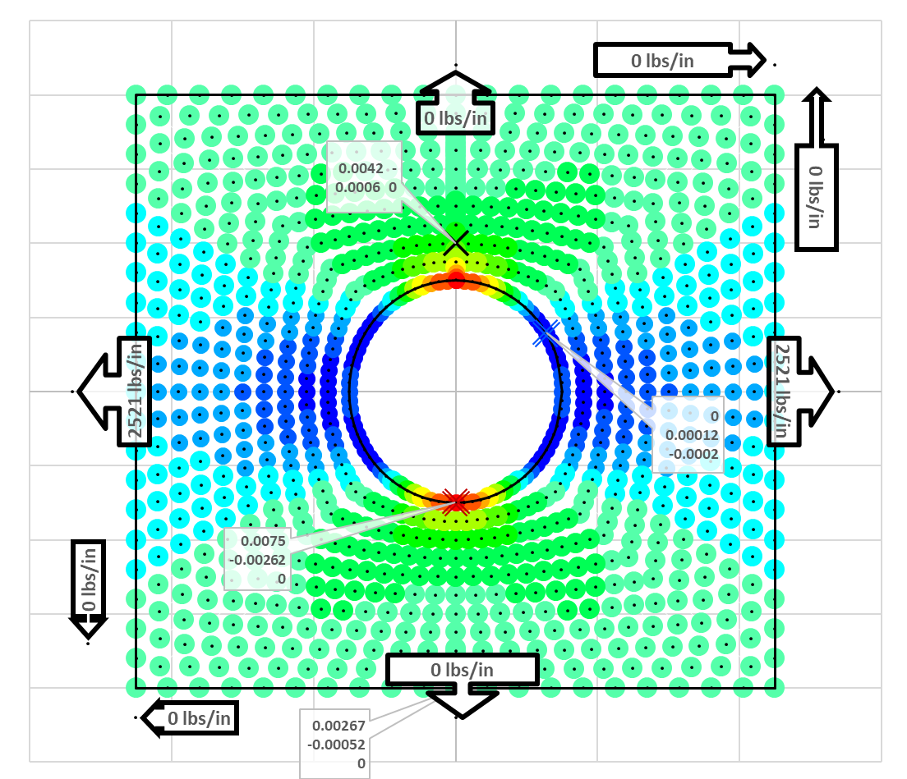
Panel 2 CBD results close to the hole
2nd run at Nx = 2,521 lbs/in.
  Close-in 9” x 8” analysis area.
  Nx solved for, to result in 7500 μin/in at the edge of the hole.
  Results in farfield strain of 2575 μin/in.

Slide 37
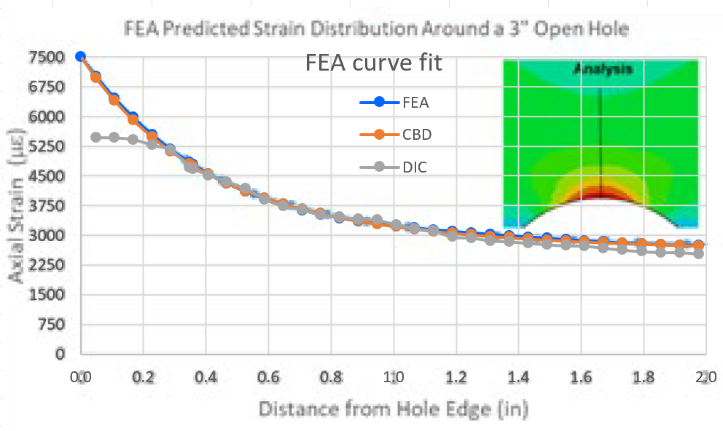
Pane 2 DIC, CBD, and FEA comparison
Detailed results for Nx = 2,521 lbs/in.

Slide 38
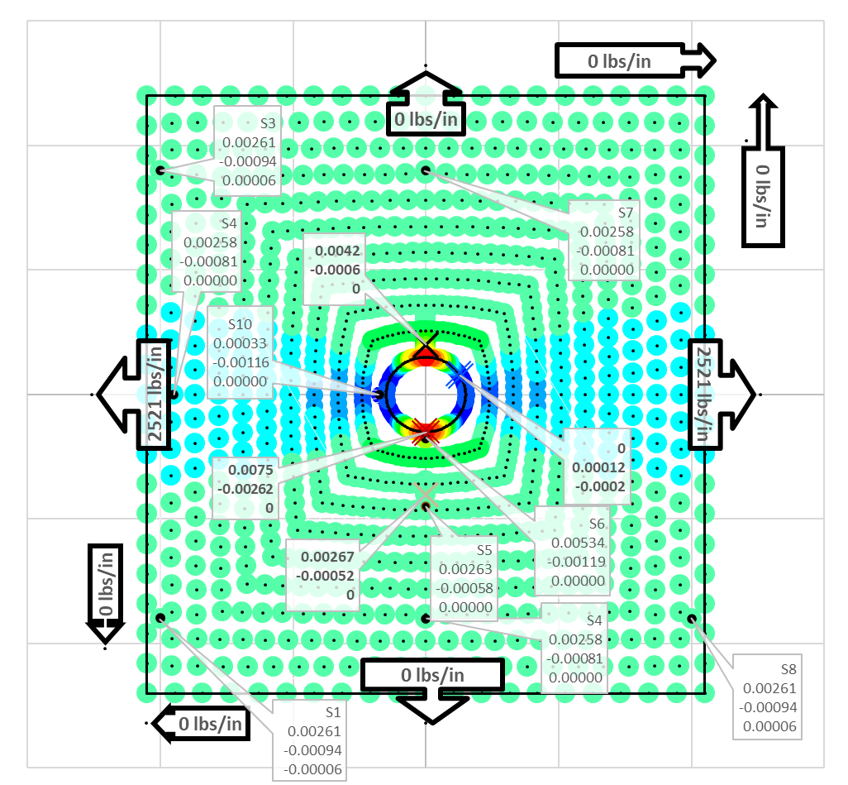
Panel 2 DIC, CBD, and FEA comparison
Strain gauge results for Nx = 2,521 lbs/in.

Slide 39
Conclusion for Panel 2 straight-sided hole
CBD calculations are able to replicate FEA results exactly at 0”-2.0” from the edge of the hole.
  Excellent results considering that all loads and laminate properties are reverse engineered.
DIC results vary from both CBD and FEA at 0”-0.3” from the edge of the hole due to inaccuracies in the DIC results.
Far-field strain gauge results vary between CBD and DIC due to the stress redistribution caused by the ABST test panel edgeband build-up.

Slide 40
The true essence of the CBD Method
Lekhnitskii can evaluate both a hole and a single inclusion. Examples of an inclusion are:
  A circular or oval repair.
  A partial depth damage removal.
However, Lekhnitskii can only accommodate one boundary.
The intent of CBD is to account for layered boundaries.
  Tapered partial-depth damage removal (multiple boundaries).
  Tapered full-depth damage removal (multiple boundaries).
  Tapered flush repair (multiple boundaries).
  Precured doubler repair (two boundaries).
There is an issues with using multiple boundaries based on the proximity of subsequent boundaries to the previous.
  This is the true intent of the R&D effort.

Slide 41
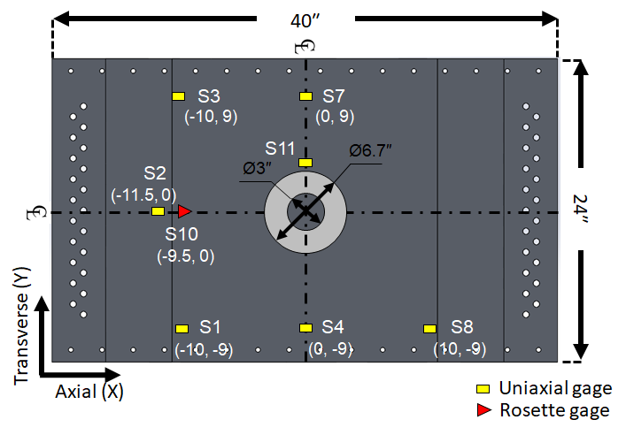
Panel 3 upper surface strain gauge results.
Locations of interest highlighted in yellow.

Slide 42
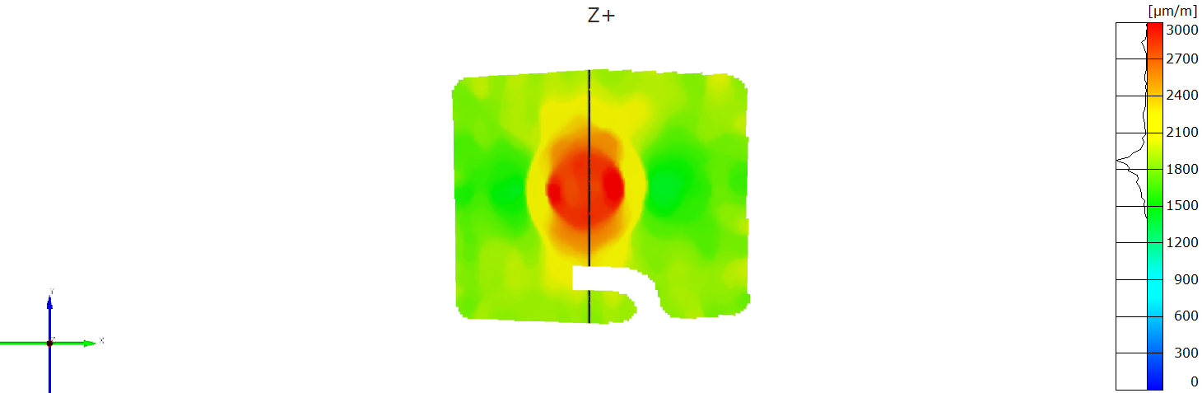
Panel 3 DIC results
Microstrain measured along the vertical black line.
  Y-distance from the center of the hole

Slide 43
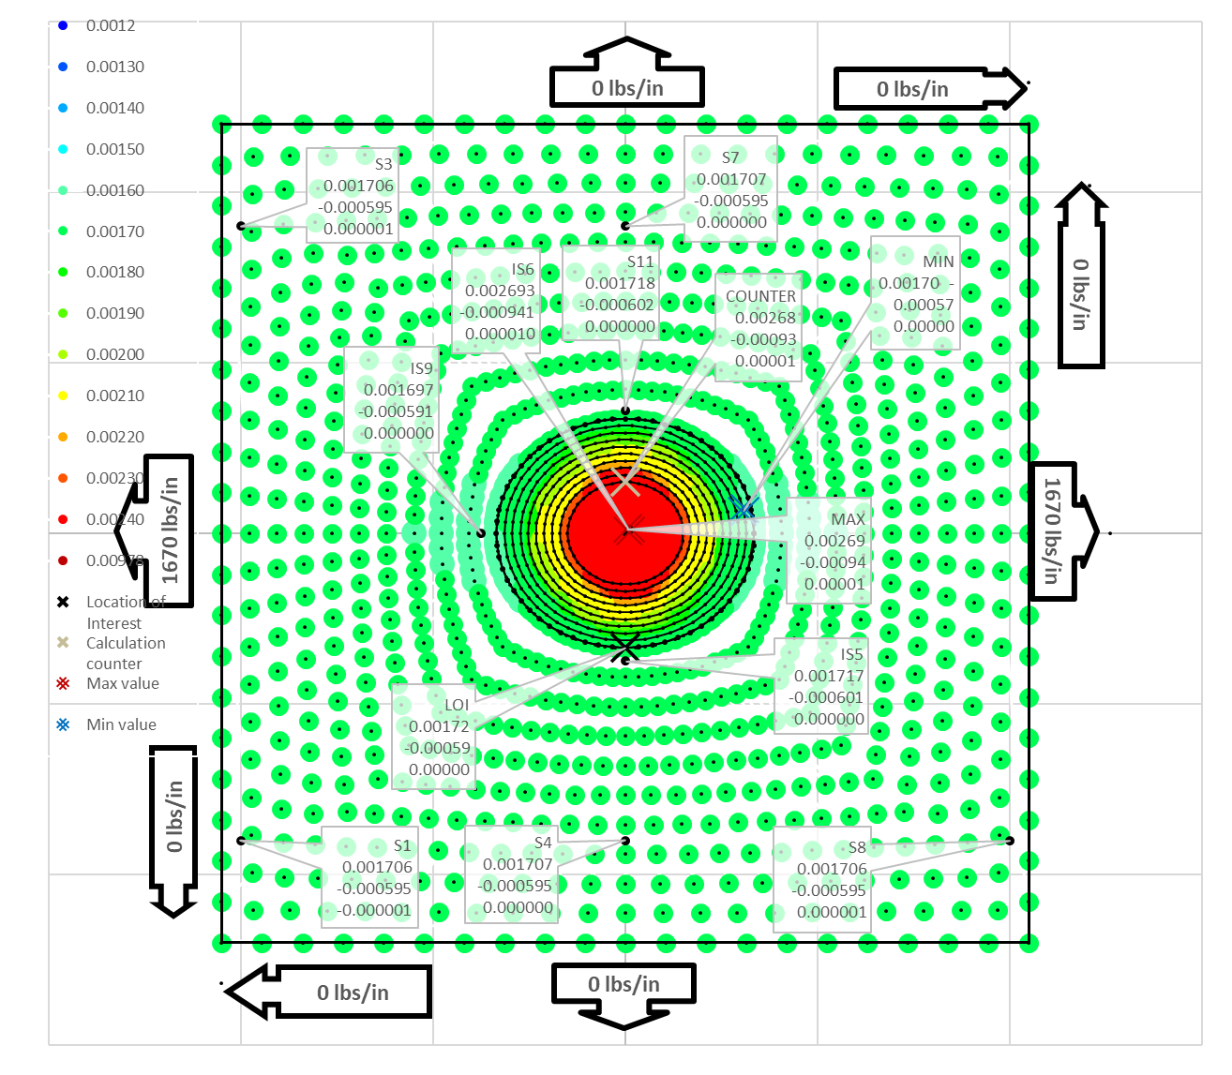
Panel 3 CBD to strain gauge results
Nx = 1,670 lbs/in to achieve ε∞ = 1,760 μin/in.

Slide 44
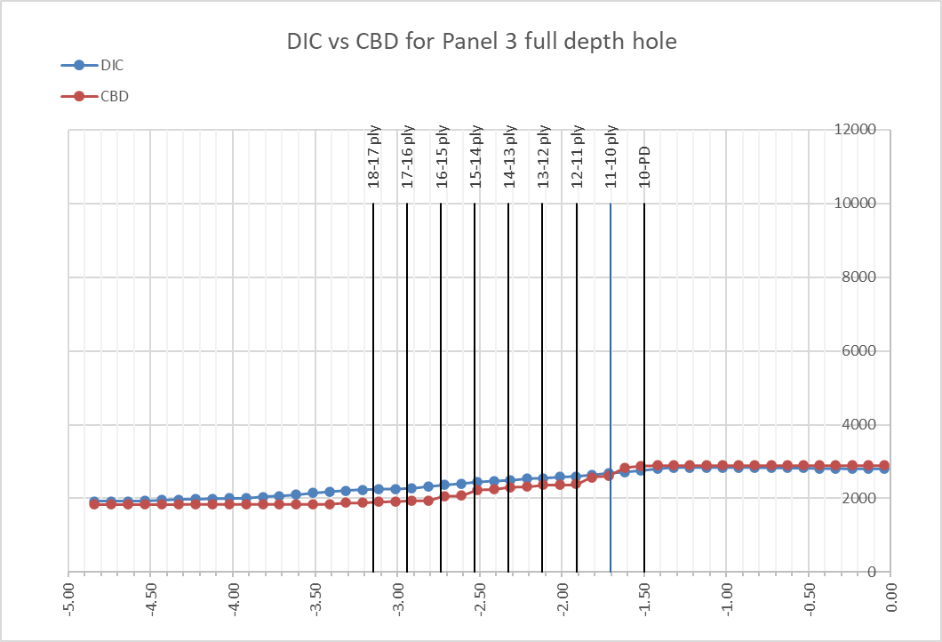
CBD to DIC results from Panel 3 spreadsheet
Good comparison in the inclusion and away from the taper.
Y-distance from the center of the hole.
Excellent results at the peak strain locations.
Far field and inclusion strains distribution requires a closer look?

Slide 45
Panel 3 DIC to CBD direct comparison.
DIC CBD

Slide 46
Conclusion for Panel 3 partial-depth hole
CBD calculations are able to replicate DIC results exactly at within the inclusion.
CBD calculations replicate DIC results very well at the bottom of the taper.
CBD calculations start to deviate from DIC results approaching the top of the taper.
CBD calculations move back to DIC results approaching the moving away from the tapered region.
Slight irregularity in overall strain distribution from the middle to the top of the taper.
  CBD should have more yellow in the upper portion of the taper, and more red at the 12:00 and 6:00 locations.

Slide 47
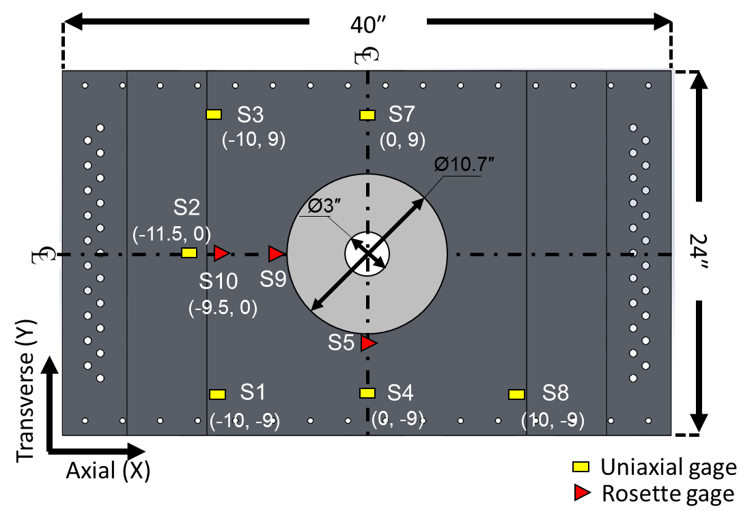
Panel 4 strain gauge results
Locations of interest highlighted in yellow.

Slide 48
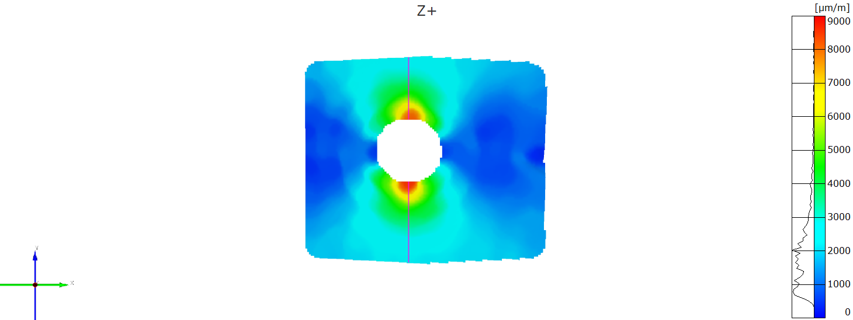
DIC results from Panel 4 spreadsheet
Microstrain measured along the vertical black line.
  Y-distance from the center of the hole.
Transverse (Y)
Axial (X)

Slide 49
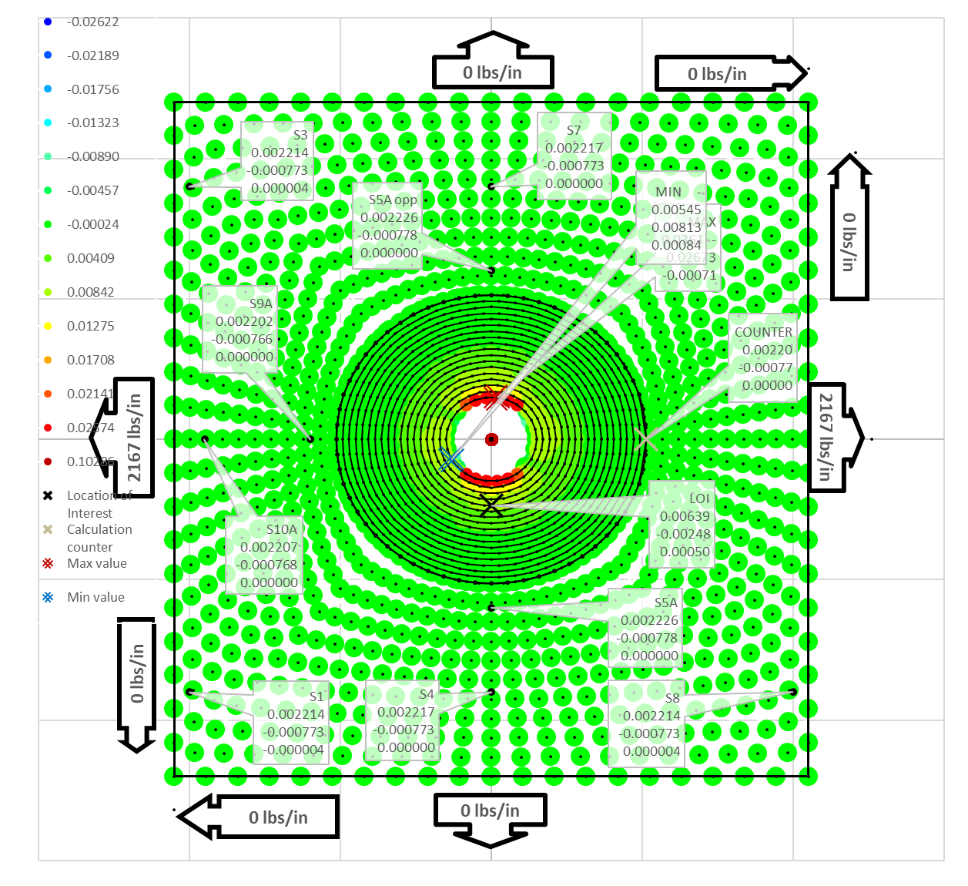
Panel 4 CBD to strain gauge results
Increased load to 2,167 lbs/in to achieve ε∞ = 2,213 μin/in.
50% of top ply thickness.

Slide 50
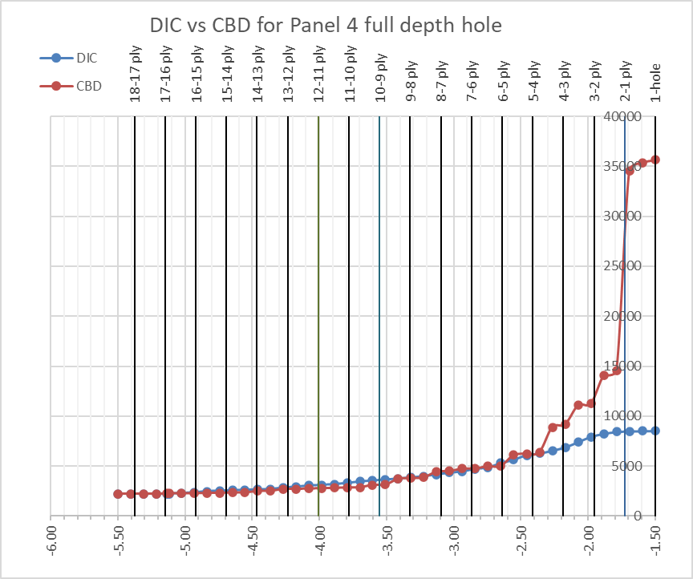
CBD to DIC results from Panel 4 spreadsheet
Microstrain measured along the vertical black line.
  Y-distance from the center of the hole.
  50% of top ply thickness.

Slide 51
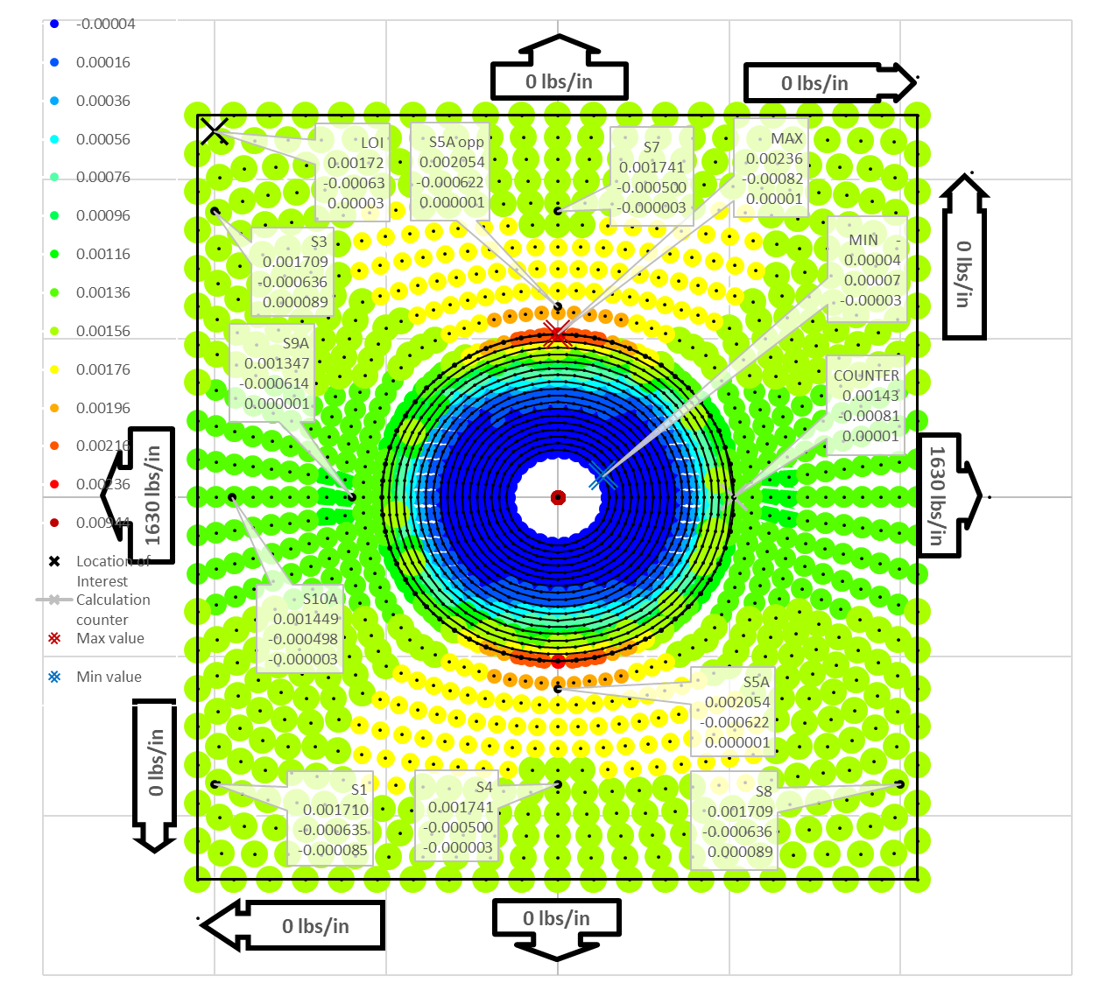
Panel 4 CBD to strain gauge results
1,630 lbs/in remote load to achieve ε∞ = 1,665 μin/in.
Area ratioed inclusion laminate.

Slide 52
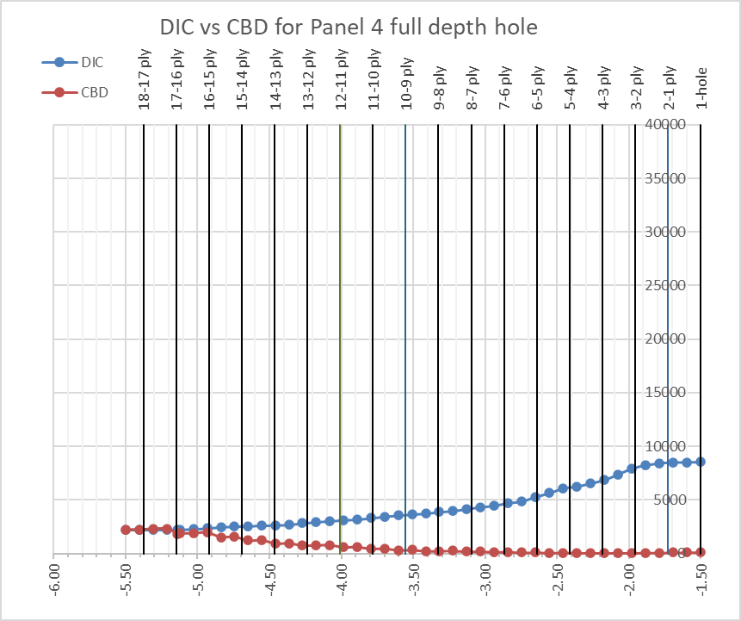
CBD to DIC results from Panel 4 spreadsheet
Full stiffness of segment directly outside of the boundary.
Area ratioed taper stiffness inside the boundary.
100% of top ply thickness.

Slide 53
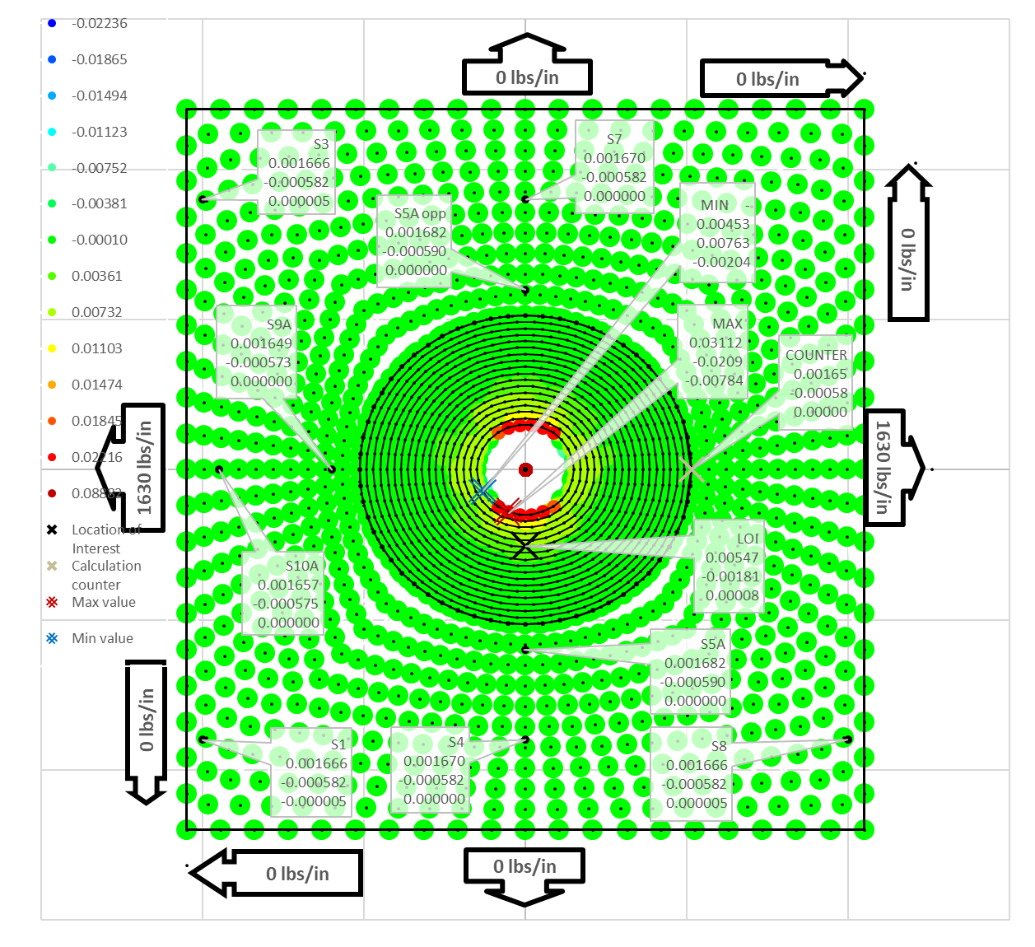
Remote/inclusion laminate variations
1,630 lbs/in remote load to achieve ε∞ = 2,213 μin/in.
Immediate laminate stiffness on both sides of the boundary.
Area ratioed stiffness inclusion laminate only.

Slide 54
Remote/inclusion laminate variations
Correct stress concentration location.
Incorrect far-field stress distribution.
Too compliant inside the boundary.

Slide 55
Conclusion for Panel 4 straight-sided hole
The boundary induced irregularity was much more obvious for the full-depth taper.
  Unmodified CBD uses actual stiffness on either side of the boundary. Resulted in:
    High strain concentration at the bottom of the taper.
    Strain concentration too low at top of the taper.
  Modified CBD calculations was adjusted to use ratio the stiffness on either side of the boundary. Resulted in:
    Strain concentration too low at top of the taper.
    High strain concentration at the bottom of the taper.
R&D needed to find the middle ground.

Slide 56
Apples to apples comparison?
The BRSL panels tested on the ABST fixture provide phenomenal results.
The ABST fixture represents “real-world” wing beam bending.
Beam bending does not quite reflect true in-plane, axial loading.
Current state of CBD does reflect pure in-plane axial loading.
CBD does not account for edgeband reinforcements effects.
True CBD validation requires taking the analysis to the next level . . .
  In-plane, axial loaded, FEA modelling.
It is time for the FEA games to begin.

Slide 57
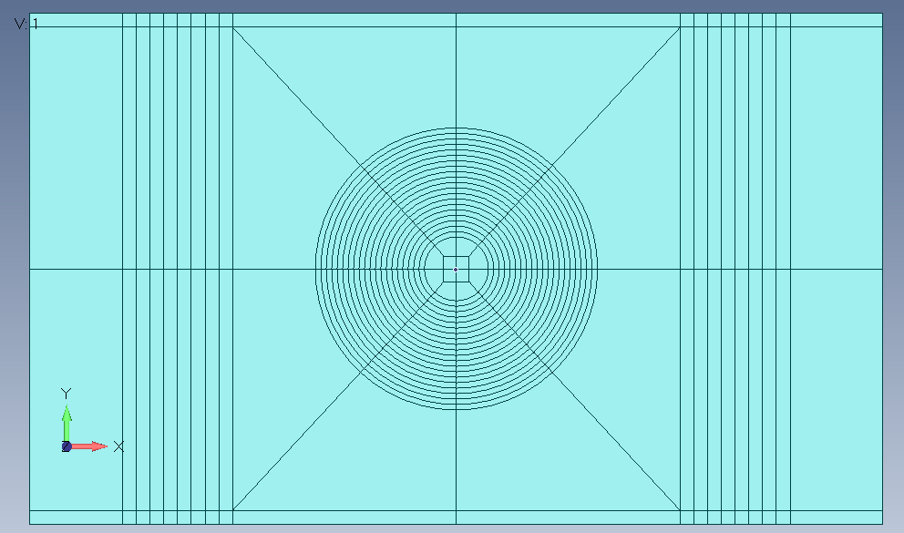
FEA model configuration for all panels.
Multiple meshing options.
CBD mesh surface.

Slide 58
FEA model configuration for all panels.
Allows inplane loading to replicate the CBD Method.
Multiple meshing options for R&D.
  Undamaged ,all 18-ply panel to use as true baseline.
  Allows 36-ply tapered build-up to allow edgeband effects to be evaluated.
  Full-depth 18-ply taper.
  Partial-depth, 9-ply taper.
Future R&D to validate flush and precured repairs.

Slide 59
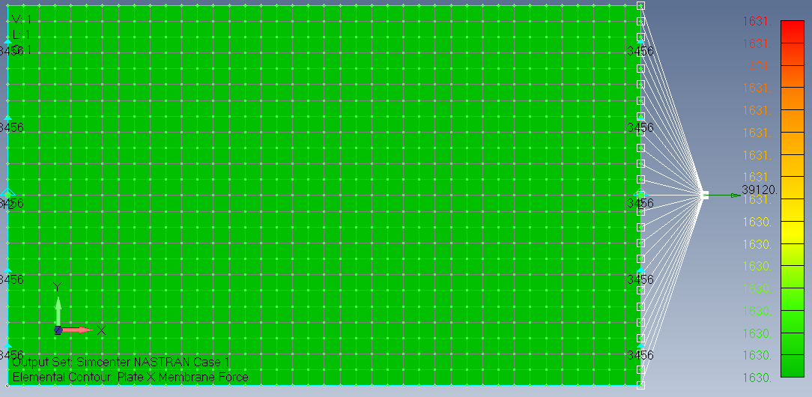
Pristine 24” x 40” 18-ply panel.
True baseline to validate Classical Laminate Plate Theory.
Square mesh.

Slide 60
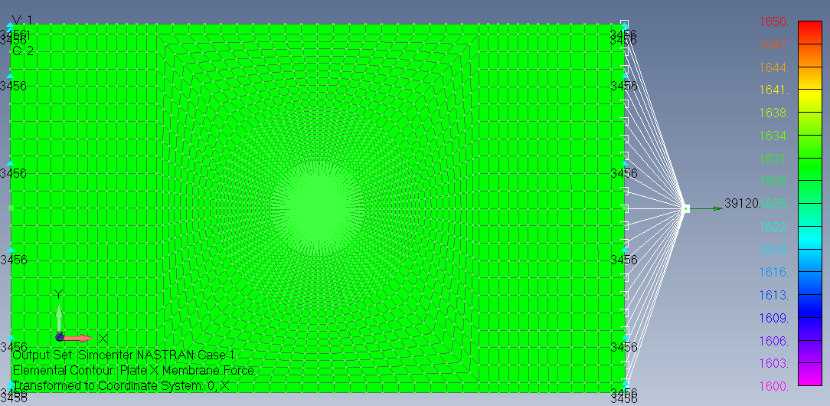
Pristine 24” x 40” 18-ply with CBD mesh.
Baseline to validate mesh configuration.
No hole.

Slide 61
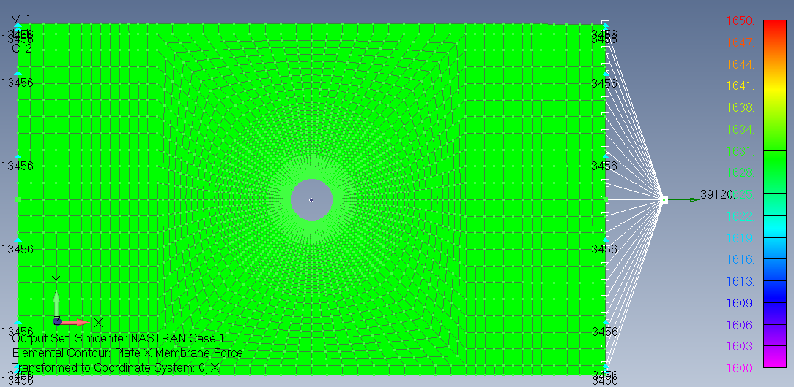
BRSL 24” x 40” 18-ply with CBD mesh.
Baseline to validate mesh configuration.
3” hole.

Slide 62
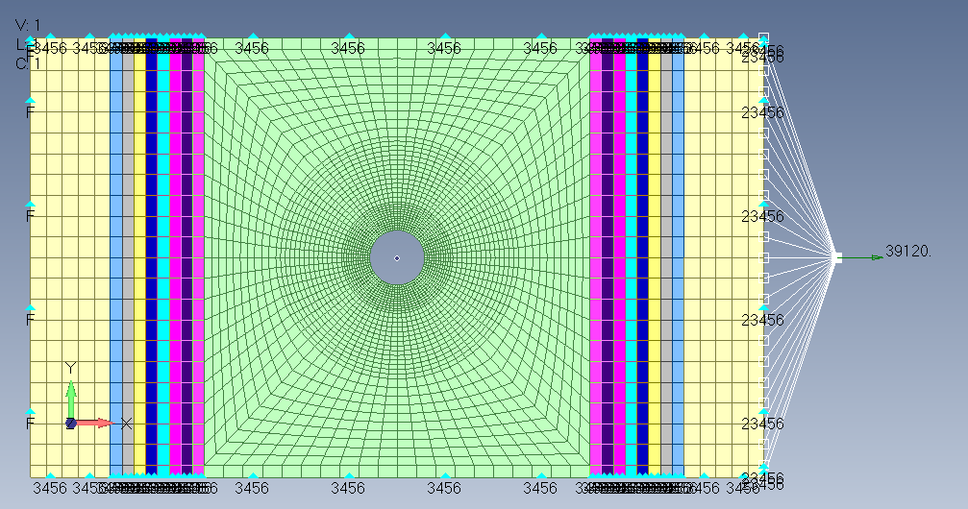
BRSL 24” x 40” full panel with CBD mesh.
Panel 2 with edgeband configuration.
3” hole.
No taper.

Slide 63
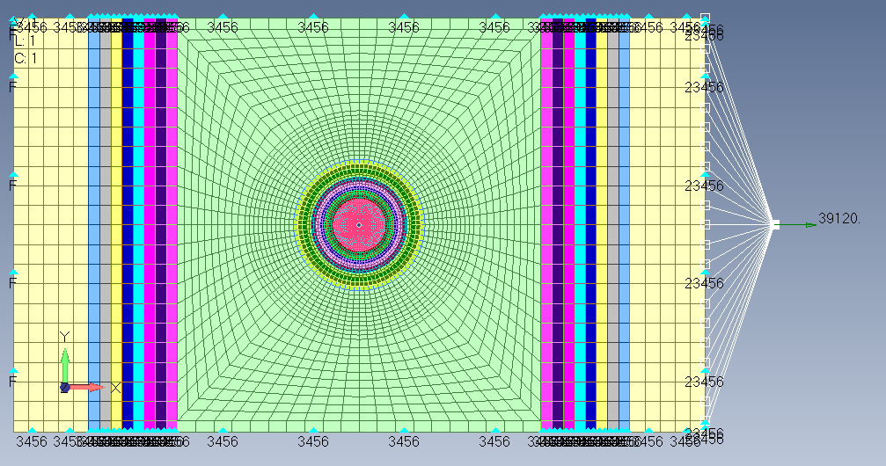
BRSL 24” x 40” 18-ply with CBD mesh.
Edgeband and Panel 3 partial-depth taper.
3” hole.

Slide 64
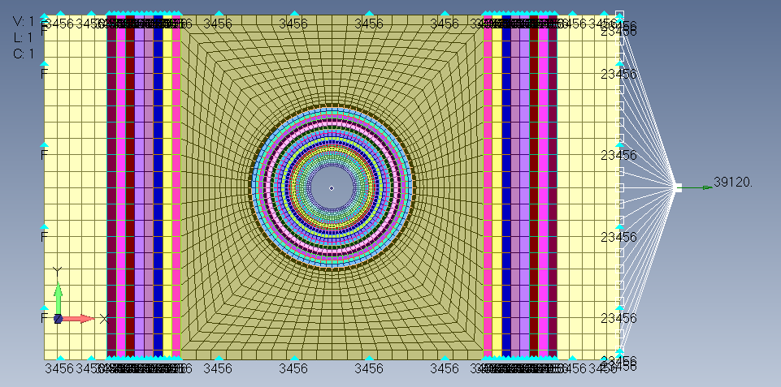
BRSL 24” x 40” 18-ply with CBD mesh.
Edgeband and Panel 4 full-depth taper.
3” hole.

Slide 65
Future efforts . . .
Continuing CBD validation and modification for layered inclusions methodology.
Continuing FEA evaluation for inplane analysis.
Receiving donated material to fabricate additional test panels.
In the process of FAA coordination to utilize ABST fixture.
Fabricate, test, and analyze repair panels.
Continuing discussion with US Army for possible SBIR program.
  Looking for other interested parties.
SBIR will continue R&D with the deliverable being standalone software.
  FEA is HARD, takes significant experience, takes days and weeks to perform.
  CBD can be run in minutes to hours.
  Software will auto generate an FEA model for validation
Composites are the future . . . Repair analysis is a MUST!!

Slide 66
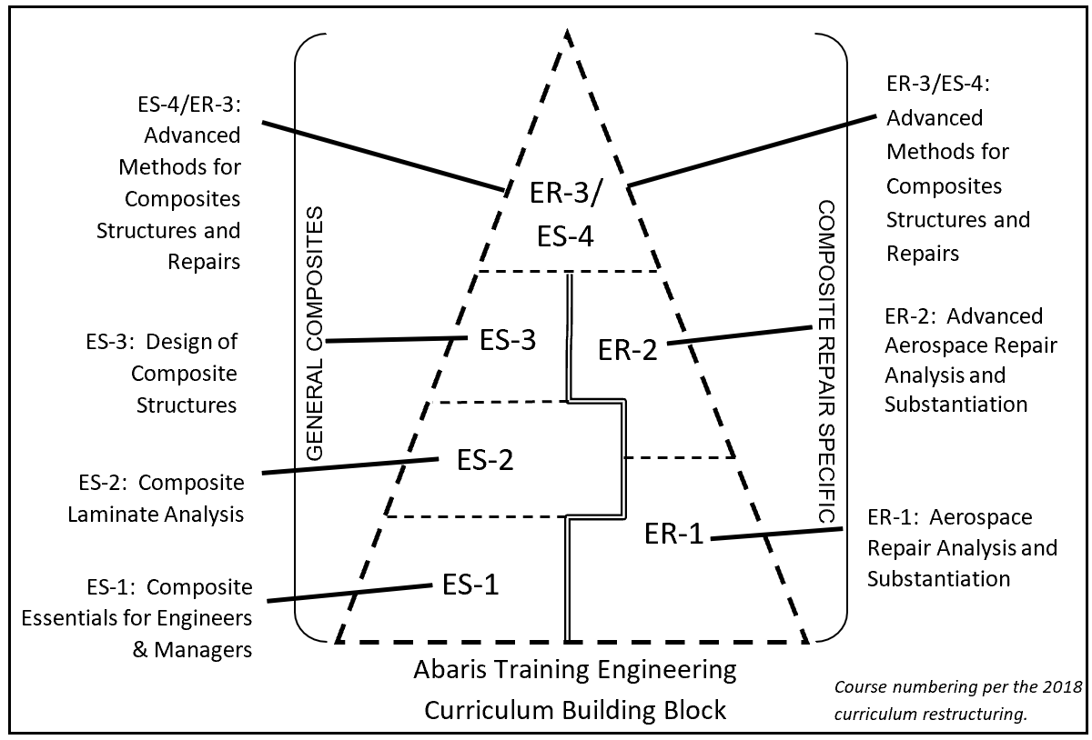
Abaris Training engineering training
Composite repair analysis falls under the ER curriculum, E for engineering, R for repair.
ER-1 is introductory repair analysis.
The CBD Method is presented in ER-2.
FEA analysis is presented in ER-3.

Slide 67
Contact information
Greg Kress
Top Flight Aerostructures
351 Cadillac Parkway
Dallas, GA 30157
678-378-7750
greg.kress@topflightaero.com
www.topflightaero.com
Greg Kress
Abaris Training
5401 Longley Lane, Suite 49
Reno, NV 89511
775-827-6568
greg.kress@topflightaero.com
www.abaris.com

