Slide 1
15 June 2023 Ronald Klomp – de Boer
BMI Repair Method
Notes:
Aanpassing van classificatie in de footer: ga naar ‘insert’ en klik op ‘header & footer’. Handhaaf verder het format.

Slide 2
This NLR document is company confidential to its recipients and should not be copied, distributed or reproduced in whole or in part, nor passed to any third party without prior written consent of NLR.
Use, intentionally or unintentionally of any of the content, information, or services in this document in a manner contrary to the objective of this document is not allowed.
Notes:
Het NLR wil als organisatie het risico minimaliseren dat er imago- of andere schade ontstaat, veroorzaakt door het vrijgeven/publiceren van 'gevoelige informatie' in NLR-presentaties
De nu ingevulde release statement is voor een minimale distributie van de informatie.
Deze bepaling kan verder verruimd en verbijzonderd worden volgens de onderstaande systematiek:
Aanwezige markeringen, rubriceringen en release statements van derden worden onverkort overgenomen bij de betreffende informatie;
Eventuele toestemmingen en vergunningsverplichtingen worden bij de betreffende informatie vermeld, met verwijzing naar eventuele referentienummer;
Na de titel pagina wordt de distributie bepaling opgenomen, samengesteld uit de volgende elementen:
1. Reden waarom de verspreiding van de informatie aan banden is gelegd;
2. Voor wie, welk publiek de NLR-uiting is opgesteld;
3. Vermelding van de Autoriteit die bevoegd is tot verlenen van toestemming/vergunning met vermelding van referentie; en,
4. Beperkingen t.a.v. het gebruik van de gevoelige informatie.
Zie: http://cockpit/Groups/Informatiebeveiliging/Richtlijn%20Beveiliging/Richtlijn%20Informatie%20Beveiliging/Werkinstructie%20NLR%20uitingen.aspx

Slide 3
NLR in brief
Notes:
Photo credits: pixabay (Free for commercial use, No attribution required)
Source: https://pixabay.com/en/plane-trip-journey-explore-841441/

Slide 4
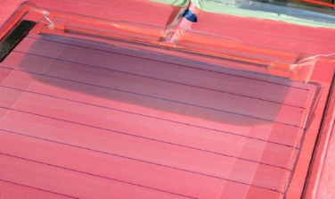
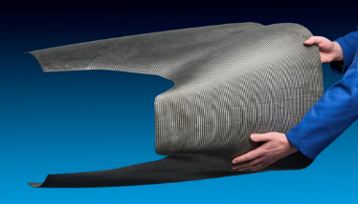
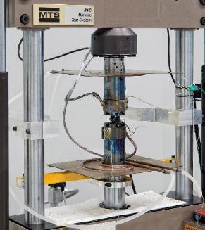
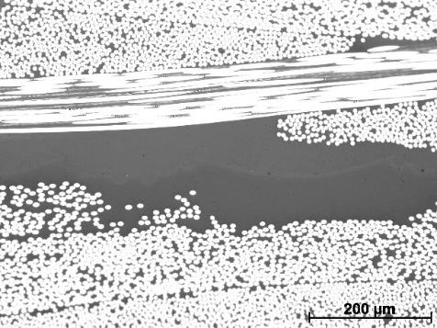
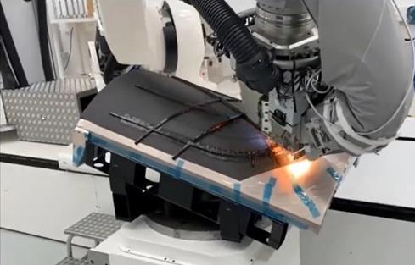
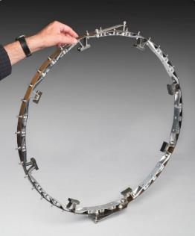
High Temp Composites @ NLR
Focus and Impact
NLR develops high temperate composite parts for a range of applications; nacelle, engine components, defense, tooling. The R&D activities are funded nationally, internationally (EU) and 100% commercial.
Activities
  Material characterization (DSC, viscosity, cure kinetics)
  Process development
  Design & analysis
  Manufacturing (coupons, sub-components, prototypes)
  Inspection (NDI, Microscopy)
  Testing
High Temperature Resins
  BMI (5250-4, RM3000, BMI-1/BMI-2, 353RTM-ST)
  Polyimide (TenCate RS51, PETI-333, RTM1100, MVK10, Skybond8500/9100, Neximid MHT-Rv2)
  Cyanate-ester (PT30)
  PFA
Project examples
ESPOSA BMI composite engine nacelle for Piaggio P180
E-Break Composite Hybrid Unison Ring (CHUR)
HITEC Process development of VARTM BMI resins and dry preform styles
SUCOHS NLR resp. i.a. for AFP, hot-drape & cure of PFA and CE composites
CHECKUP Polyimide composite engine component
TRAIL Exhaust nozzle cover development
Notes:
Header & footer aanpassen: ga naar ‘insert’ en klik op ‘header & footer’.
Layout veranderen: onder tab ‘Home ‘-> ‘Layout’ of
Rechtermuis klik op de betreffende slide en kies vervolgens Layout

Slide 5
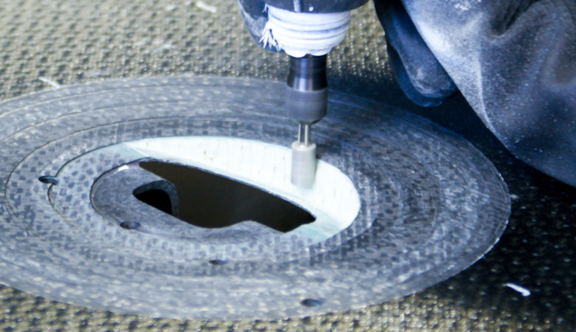
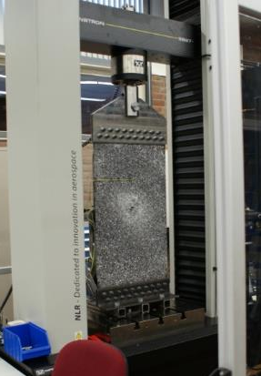
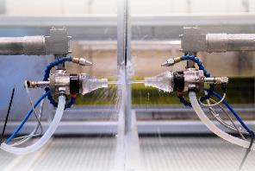
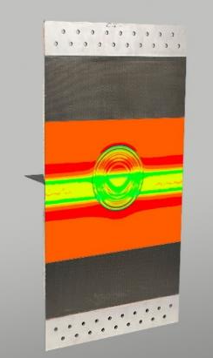
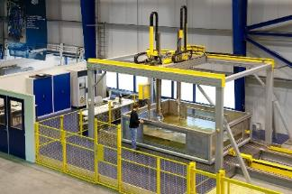
Introduction
Aim:
Develop vacuum infusion technology for BMI at aerospace level
Enabling vacuum infusion repairs of BMI structures with BMI resin
Enabling lower cost manufacture of BMI composite structures
Why:
Vacuum infusion allows for more flexible repair (following complex contours).
Lower cost.
Easier logistics.
How:
Building on past experience with repairs and infusion.
Collaboration with partners.
Multi-disciplinary.
https://www.youtube.com/watch?v=O06_PPc2WNo
Notes:
Header & footer aanpassen: ga naar ‘insert’ en klik op ‘header & footer’.
Layout veranderen: onder tab ‘Home ‘-> ‘Layout’ of
Rechtermuis klik op de betreffende slide en kies vervolgens Layout

Slide 6
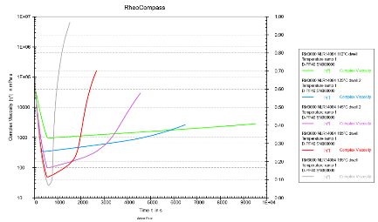
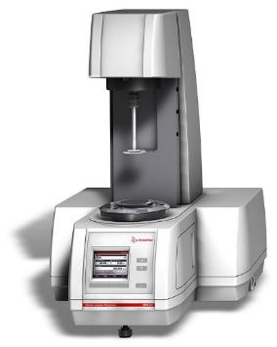
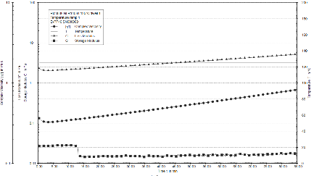
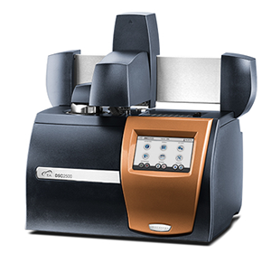
Material Characterisation
Resin: Renegade RM-3000
Viscosity
Cure
Fabric: 2x2 Twill HTA40 E13 204gsm
Permeability K1, K2, K3
Performed by Leibniz-Institut für Verbundwerkstoffe GmbH IVW
https://www.ibero-chemie.de/en/products/
https://www.tainstruments.com/dsc-2500/
Notes:
Header & footer aanpassen: ga naar ‘insert’ en klik op ‘header & footer’.
Layout veranderen: onder tab ‘Home ‘-> ‘Layout’ of
Rechtermuis klik op de betreffende slide en kies vervolgens Layout

Slide 7
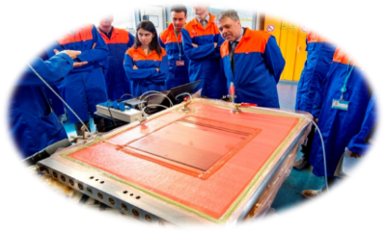
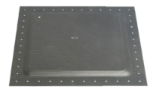
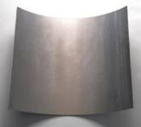
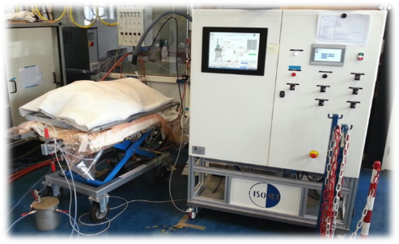
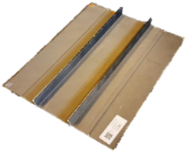
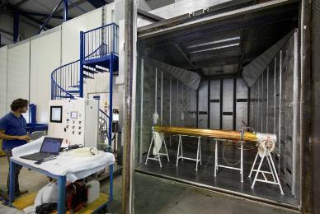
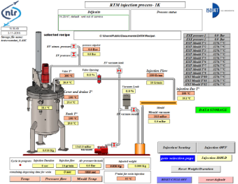
Injection development
On flat water heated flat tool and on flat plates in oven.
Experience with flat, sandwich, curved and stiffened panels infused with different epoxy and BMI resin systems.
Bagging similar to picture allowing visual monitoring & (video/picture) recording and different sensors.
IsoJet shows and records all relevant parameters; e.g. temperature resin in tank, vacuum in mould, etc.
Notes:
Header & footer aanpassen: ga naar ‘insert’ en klik op ‘header & footer’.
Layout veranderen: onder tab ‘Home ‘-> ‘Layout’ of
Rechtermuis klik op de betreffende slide en kies vervolgens Layout

Slide 8
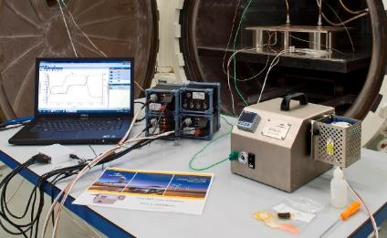
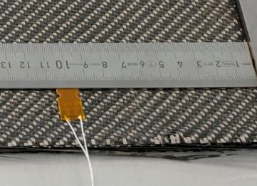
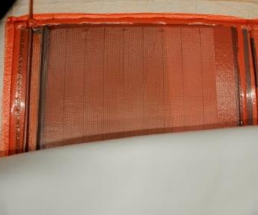
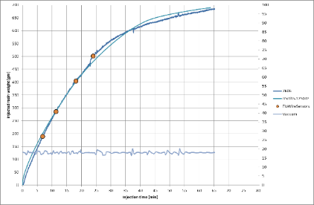
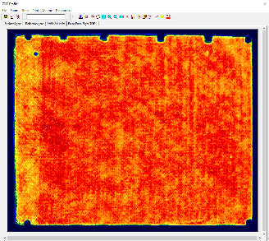
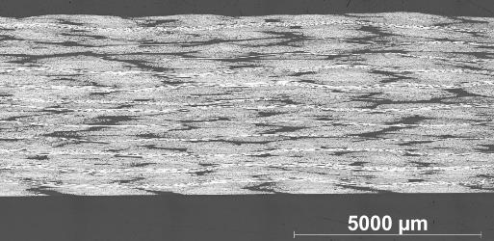
Injection development
Using Synthesites di-electric sensors; arrival and cure.
Flat panel infusions of quasi-isotropic 24 ply preforms (400 x 500 mm).
Recording all relevant data, also visually.
NDI C-scan immersion
Microscopy
Machining of test coupons.
Testing at different conditions
Resulting properties and quality comparable to benchmark material 5250-4.
Notes:
Header & footer aanpassen: ga naar ‘insert’ en klik op ‘header & footer’.
Layout veranderen: onder tab ‘Home ‘-> ‘Layout’ of
Rechtermuis klik op de betreffende slide en kies vervolgens Layout

Slide 9
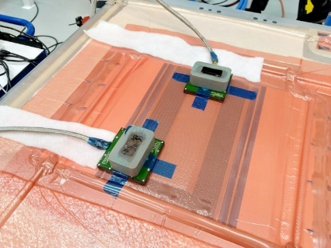
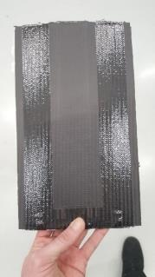
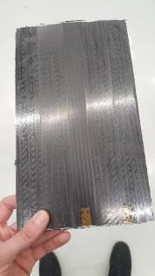
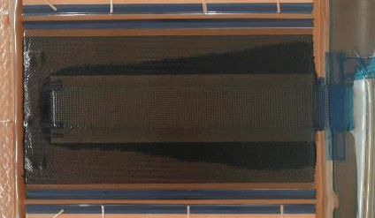
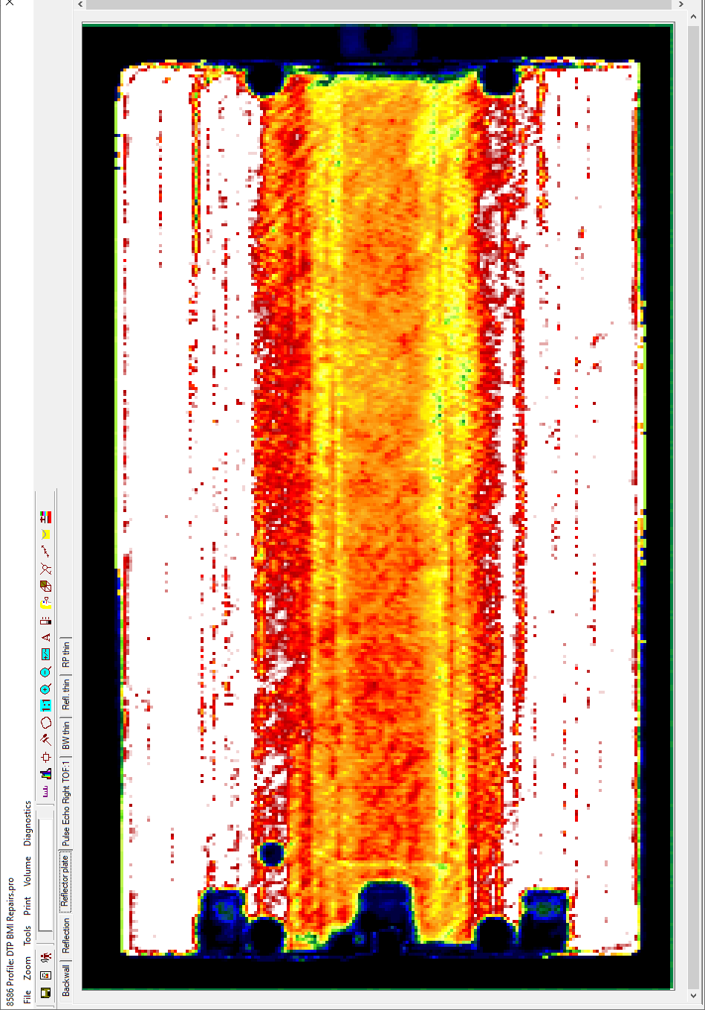
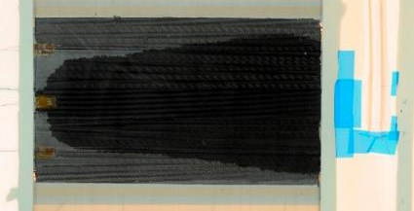
Injection development
TWENCO was partner in project with their contactless sensors.
Moving from flat panels to scarf repairs.
Starting with inlet and exit tubes and changing to breather strings in exit bay.
Test using room temperature resin system on glass plate for recording resin flow on both sides.
Visual and NDI inspection of injected scarf repair plies: Ok.
Notes:
Header & footer aanpassen: ga naar ‘insert’ en klik op ‘header & footer’.
Layout veranderen: onder tab ‘Home ‘-> ‘Layout’ of
Rechtermuis klik op de betreffende slide en kies vervolgens Layout

Slide 10
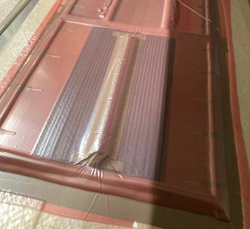
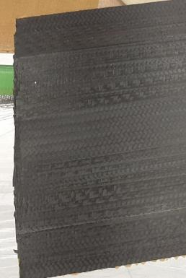
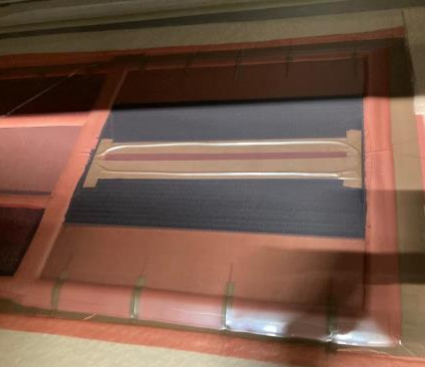
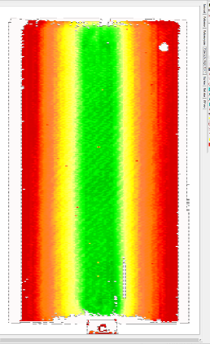
Envelop method
Challenge: actual round scarf repairs require only small amount of resin.
Infusion with injection machine and inlet tube is not an option.
Instead apply resin at centre of repair patch in “envelop”.
Key is rounded shape of resin bar.
BMI resin is solid at room temperature making handling easier of this resin bar.
Same process parameters (heat, vacuum) results in good result.
Notes:
Header & footer aanpassen: ga naar ‘insert’ en klik op ‘header & footer’.
Layout veranderen: onder tab ‘Home ‘-> ‘Layout’ of
Rechtermuis klik op de betreffende slide en kies vervolgens Layout

Slide 11
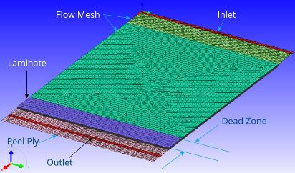
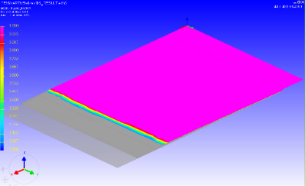
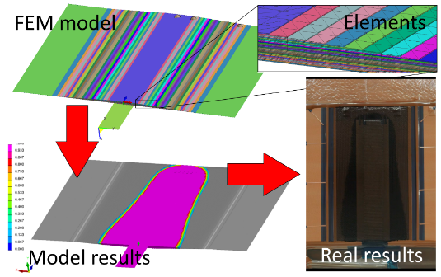
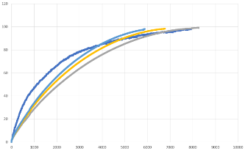
Simulations
Model created in ESI .
Model allows to check influence of viscosity, permeability, lay-up, flow mesh dimensions.
Useful (and less expensive) for getting more insight before starting actual infusion tests.
Viscosity → use actual data
Permeability fabric → okay
Permeability flow mesh → needs more work.
Uncertainties → plenty, e.g. capillary effects, fabric “defects”, etc.
Notes:
Header & footer aanpassen: ga naar ‘insert’ en klik op ‘header & footer’.
Layout veranderen: onder tab ‘Home ‘-> ‘Layout’ of
Rechtermuis klik op de betreffende slide en kies vervolgens Layout

Slide 12
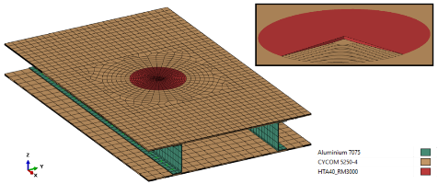
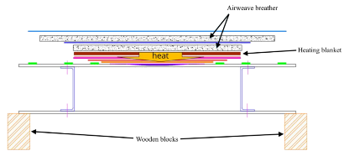
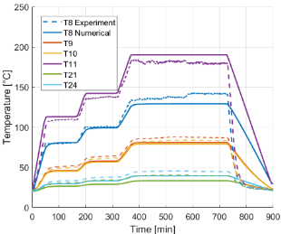
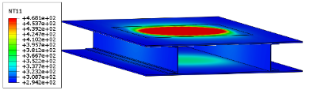
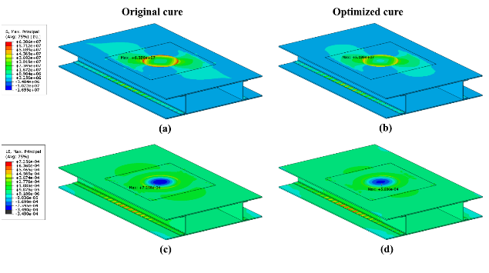
Simulations
Abaqus model
Cure kinetic model based on DSC data.
Model used for prediction of temperature distribution with heater blanket on top of skin.
Model correlates very well with recorded temperatures.
Cure cycle can be optimized using this model resulting in significant reduction process induced strains (36%).
Further mechanical testing required for validation.
Notes:
Header & footer aanpassen: ga naar ‘insert’ en klik op ‘header & footer’.
Layout veranderen: onder tab ‘Home ‘-> ‘Layout’ of
Rechtermuis klik op de betreffende slide en kies vervolgens Layout

Slide 13
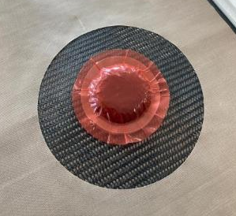
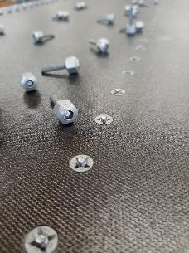
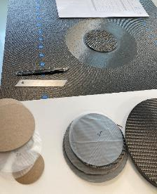




Repair demonstration
Generic wingbox
Cycom 5250-4 parent material
Aluminium spars
Titanium fasteners
Local repair method
Machine damaged area (scarf).
Place repair plies.
Resin in envelop on centre.
Infusion and (post) curing with heating blanket, vacuum bagging and hot-bonder.
Points of interest
Effect of underlying structure on heat balance.
Amount of stresses and strains due to repair cure.
Notes:
Header & footer aanpassen: ga naar ‘insert’ en klik op ‘header & footer’.
Layout veranderen: onder tab ‘Home ‘-> ‘Layout’ of
Rechtermuis klik op de betreffende slide en kies vervolgens Layout

Slide 14





Conclusions & future work
It is feasible to design and perform a BMI infusion repair, even on hybrid structure.
Infusion repairs require a different approach, such as the envelop method, because of the small resin amounts.
Simulations are very helpful and can help in creating an optimized lay-up as well as infusion strategy and cure schedule.
NLR is continuing this repair research in a new project.
Notes:
Header & footer aanpassen: ga naar ‘insert’ en klik op ‘header & footer’.
Layout veranderen: onder tab ‘Home ‘-> ‘Layout’ of
Rechtermuis klik op de betreffende slide en kies vervolgens Layout

Slide 15
NLR publications related to BMI infusion repair development
Thermal and Structural Modelling of Thermoset Composite Repairs Towards Optimization of the Cure Cycle for Minimum Distortion - NLR-TP-2022-244.pdf - Koenis, T.P.A., Hoorn, N. van, Moghadasi, S.M.
Development of an analysis tool for design of bonded composite repairs - NLR-TP-2008-349 - R.J.C. Creemers
R. Creemers, “Design guidelines and manufacturing techniques for the repair of composite structures,” Royal NLR, 2010.
Cure monitoring of a BMI resin for enhancing the manufacturing of high-temperature composite structures, Nikos Pantelelis, Wilco Gerrits, Ronald Klomp de Boer, Alan Johnston, Sam Wilson, Andrew McKibbin, Christian Brauner, Fabian Schadt, Lyaysan Amirova, Markus Grob, SAMPE Europe Conference, September 2019.
T. Koenis, N. v. Hoorn en W. v. d. Brink, „Calibration and Validation of a Numerical Curing Model Using AS4/8552 Asymmetric Laminated Composite Plates,” in Presentations to VIII Conference on Mechanical Response of Composites, Gothenburg, 2021
S. Evsyukov, R. Klomp-de Boer, H. Stenzenberger, T. Pohlmann and M. ter Wiel, “A new m-xylylene bismaleimide-based high performance resin for vacuum assisted infusion and resin transfer molding,” Journal of Composite Materials, vol. 53, no. 22, pp. 3062-3072, 2019.
Notes:
Header & footer aanpassen: ga naar ‘insert’ en klik op ‘header & footer’.
Layout veranderen: onder tab ‘Home ‘-> ‘Layout’ of
Rechtermuis klik op de betreffende slide en kies vervolgens Layout

Slide 16
Notes:
Photo Credits: Photo Credits: © CAVDKM (Ministerie van Defensie)
Eindsheets: 4 t/m 6 kies hieruit één afsluitende sheet.
Defensie eindslide

