Slide 1
AF Advanced Composites Office Composite Sustainment Efforts
Adam H. Kite
AFLCMC/EZPT-ACO
14 June 2023
Version – 1

Slide 2
Overview
AF Advanced Composite Office
Who we are and what we do
ACO lab and capabilities
Training
Current Sustainment Projects of Interest
SPO, Industry, and Academia support
Repair Material Database
Repair Engineering Allowable Generation
Composite De-paint
Repair Kits
Standardized Training
Site Assistance Visits

Slide 3
AF Advanced Composites Office (ACO)
Mission: Assure the supportability of advanced composites at field operational units & air logistics centers and develop & maintain engineering expertise to apply advanced composites to Air Force weapons systems
Hill AFB UT
9 ACO Personnel
Military: 0
Civilian: 7
Contractor: 2
Section Chief: Jason Rich
Technical Expert: Adam Kite
What do we do?
Recent Success
Extensive SPO and ALC Support, 107/202/NCR
Maintain a composite testing, repair, and training facility at Hill AFB
Provide lab/onsite composite engineering and maintenance training
Support Joint Composite and Advanced Materials Technical Interchange Meeting (JCAMS)
Manage general series T.O. 1-1-690 Advanced Composite Repair and T.O. 1-1-80C Crash Damaged and Disabled Aircraft Recovery
Lab upgrade
New training course “Advanced Composite Repair Engineering”
Composite Repair Material Database
Composite Repair Material Allowables Generation
Platform Wide Film Adhesive Substitution
Legacy systems Repair Materials Updates
A-10 Supplier Audits/assistance

Slide 4
Capabilities and Equipment

Slide 5
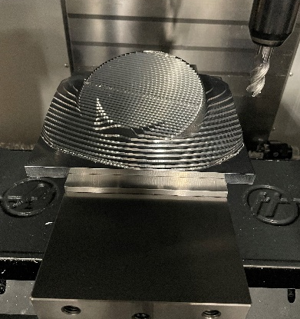
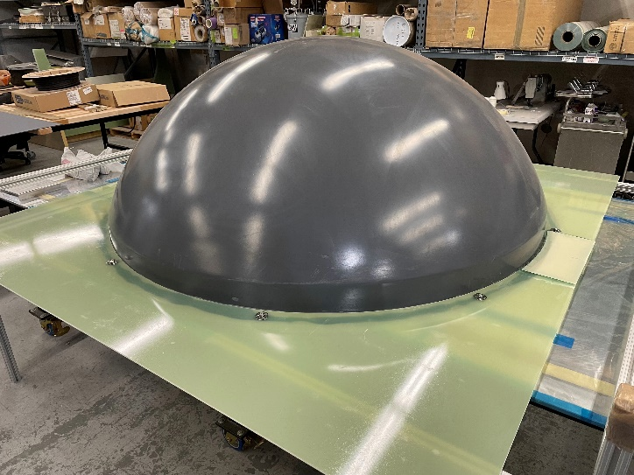
ACO Lab Space
Rapid support to the Program Offices & Air Logistic Centers
11,000 ft2, 2-autoclaves, 2-ovens, clean room, testing capability, 5-axis milling
Training Space
Process development
Reverse engineering of aircraft components
Composite testing
Repair process validation
Component fabrication

Slide 6
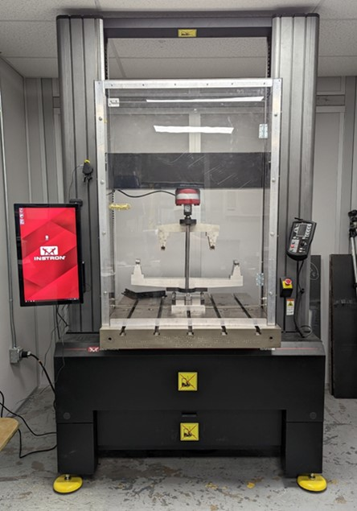
Instron Test Fixture
Short Beam Shear (ASTM D2344)
Wyoming Combined Loading Compression (ASTM D6641)
Sandwich Panel Edgewise Compression (ASTM C364)
Boeing Open-Hole Compression (ASTM D6484)
Three & Four-point Flexure (ASTM D790, D6272 or D7264)
Climbing Drum Peel (ASTM D1781 or MIL-STD-401 B)
Sandwich Panel Flatwise Tensile (ASTM C297)
Standard Tensile Wedge Grips (ASTM D3039, D3518 or D5766)
Aramis Digital Image Correlation

Slide 7
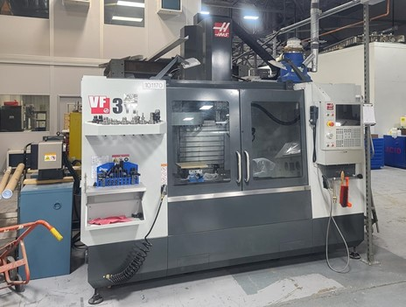
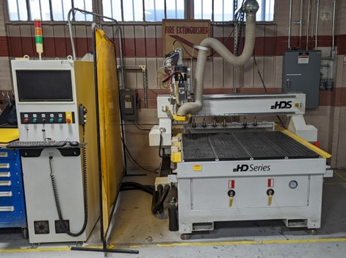
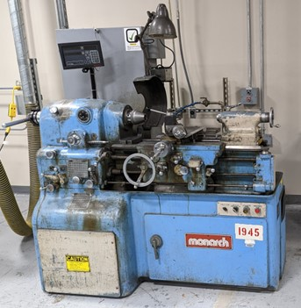
Machining
Haas VF-3 Mill
Techno CNC HDS 3-axis Router
Monarch Lathe

Slide 8
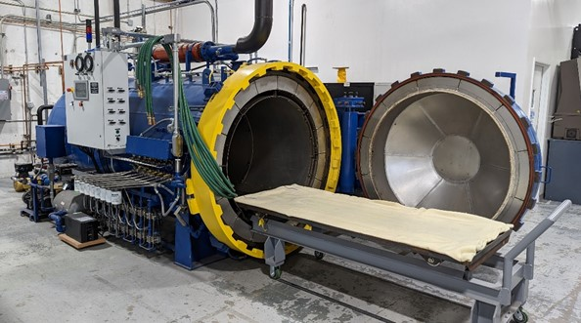
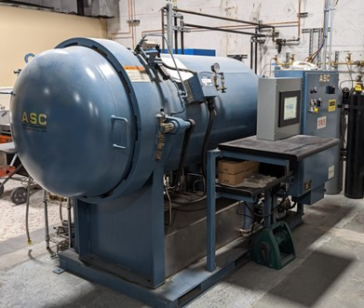
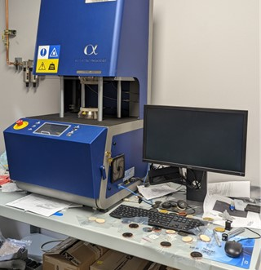
Fabrication and Process Control
4’ x 8’ Autoclave (500°F)
2’ x 4’ Autoclave (800°F)
Alpha Technologies Encapsulated Sample Rheometer

Slide 9
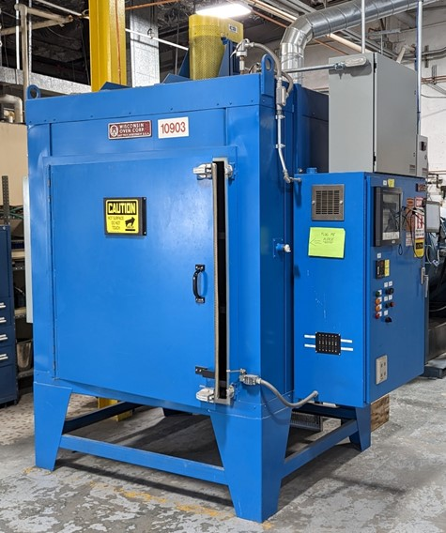
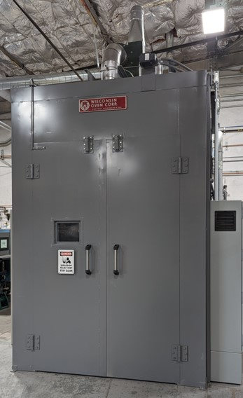
Fabrication and Process Control
4’ x 4’ Oven
5’ x 10’ Oven

Slide 10
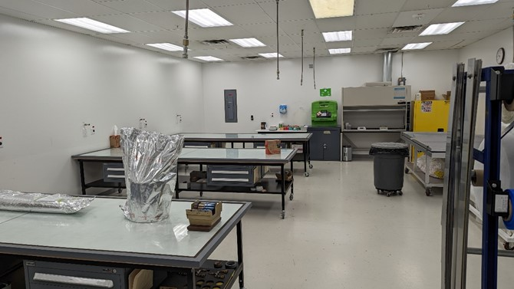
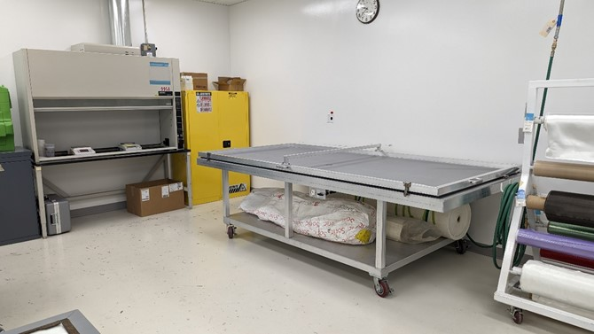
Fabrication and Process Control
Layup facility
Large tables for fabrication
Debulk table
Fume hood

Slide 11
Future Capabilities
Ply Cutting Machine
Create kits for training
Accurate cutting of complex shapes
Improved efficiency
5-axis Router
Upgraded capabilities over 3-axis
Complex honeycomb structures
Environmental Chamber for Instron
Conditioning Oven

Slide 12
Training

Slide 13
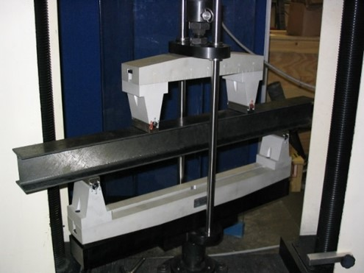
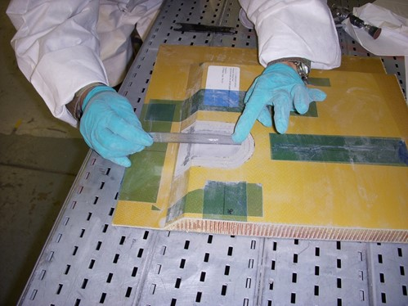
Training
Engineering Courses
Introduction to Advanced Composites for Engineers
Composite Repair Engineering
Technician Courses
TO 1-1-690 training for AF field units responsible for maintenance of composite weapon systems
Depot Technician Courses
Advanced Composite Repair Certification
Initial Bond Preparation Certification
Sol Gel Re-certification (Hill AFB)
Computer Based Training
Introduction to Advanced Composite
Program Managers, Equipment Specialists, Supervisors, Engineers

Slide 14
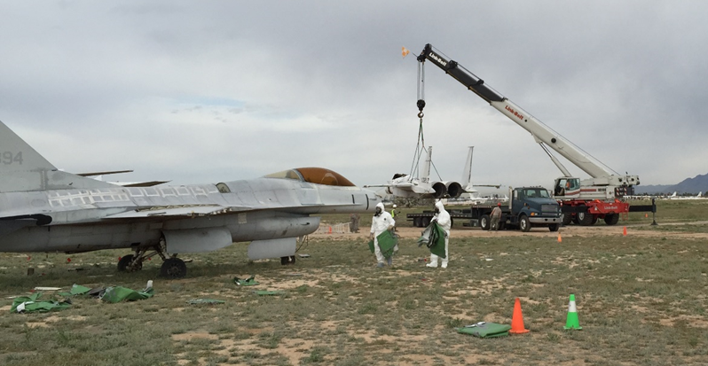
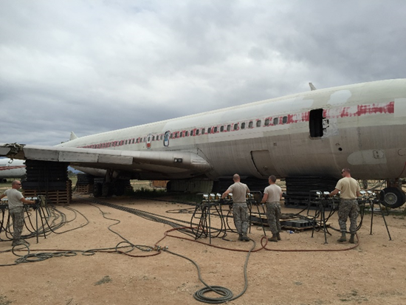
CDDAR
Technical Experts for T.O. 00-80C-1 Crash Damaged and Disabled Aircraft Recovery
Generated a large portion of the T.O. at inception
Periodic Technical Order updates
Provide training to units as required

Slide 15
Current Projects

Slide 16
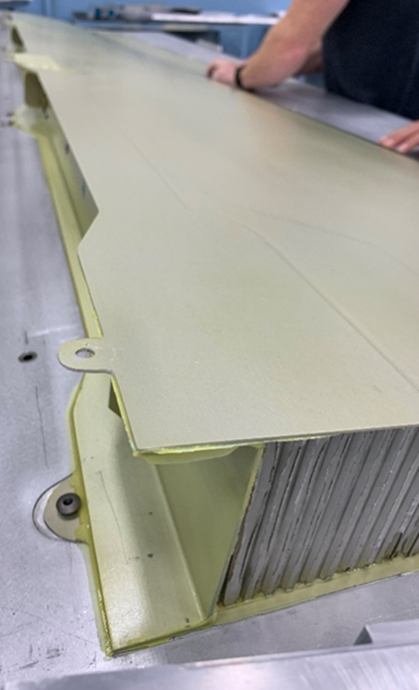
SPO, Depot, and Industry Support
Program Offices often do not have enough organic engineering expertise in composite materials
Provide subject matter expertise for all composite matters
Technical support for 107/202 dispositions
Processing specification revisions
Technical Order rewrites
Engineer mentoring
First article inspections
Nonconformance dispositions
On-site process analysis and correction at supplier facilities
MRB, ECCB, PCCB, PCA support as needed
Composite Material Handbook 17 (CMH-17) content assistance
Standardizing composite training across all three ALC’s

Slide 17
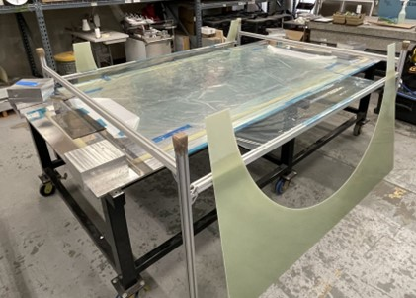
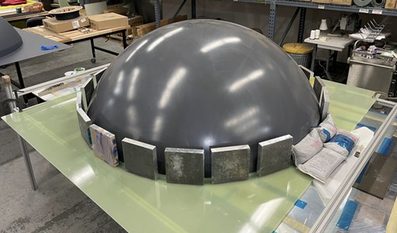
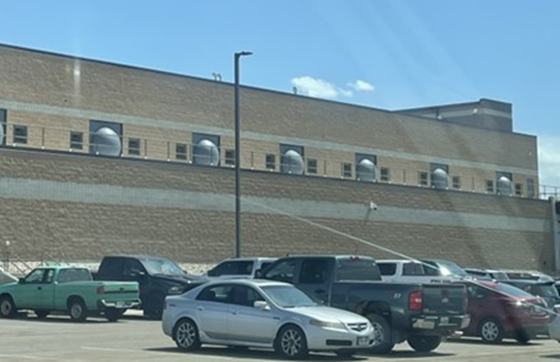
Radome Test Facility Project
Radomes built for maintenance facility

Slide 18
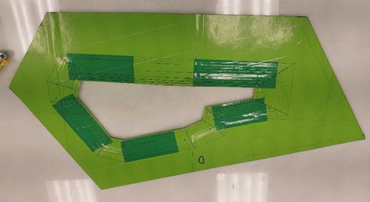
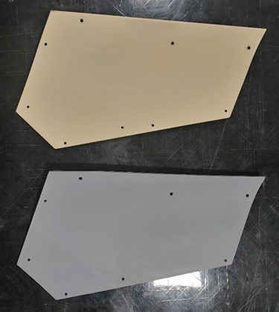
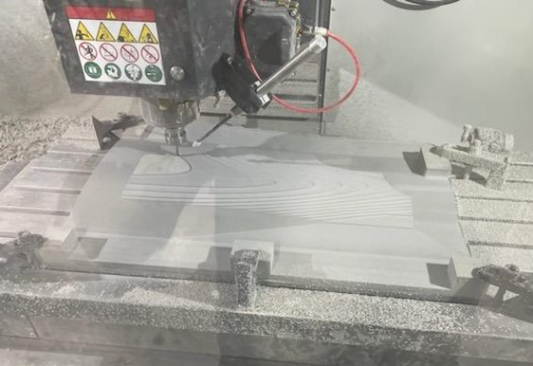
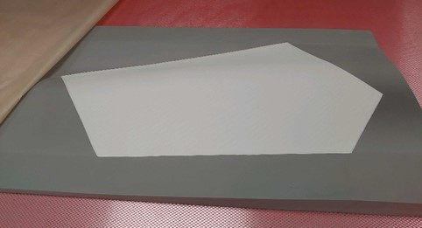
F-35 Fuel Shutoff Training Panel
388th Logistics Support Squadron
Fuel shutoff access panel trainer

Slide 19
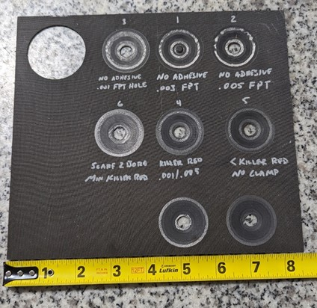
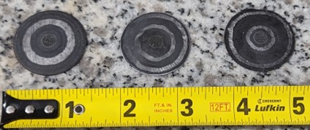
University Outreach
Viability of Tailored Composite Scarf-Joint Repairs for Aircraft Applications
Jason Hamburg PhD student at the University of Utah
ACO consulting on proper panel fabrication and bonding
Haas VF3 being used for scarfing and patch creation

Slide 20
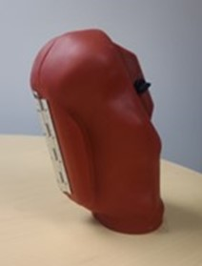
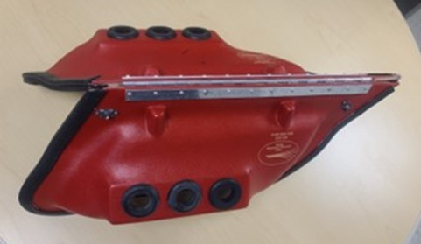
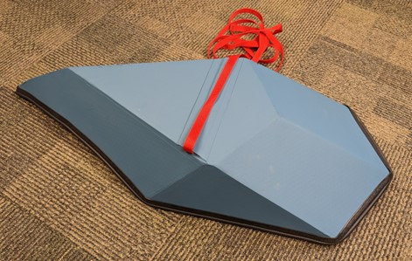
F-35 Depot Maintenance Covers
Throttle cover
Wing tip light cover
EOTS Cover

Slide 21
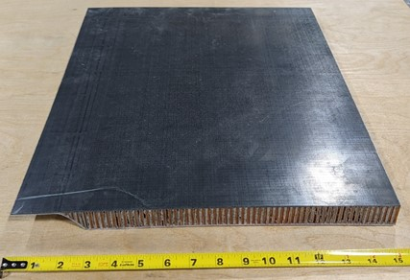
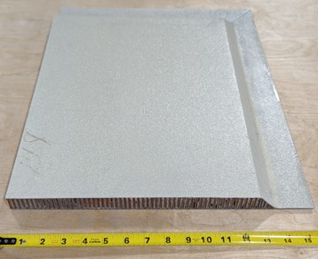
Training Panel Fabrication
Composite repair training panels
C-17
F-35
B-2
ACO classes
LO restoration panel

Slide 22
Materials Database
Composite Material Database
Create internal composite material database to improve sustainment efforts of AF weapon systems
Started with T.O. mining, move into TDPs as available
Digital transformation?
Assess each system and if applicable capture composite information
T.O.s reviewed: A-10, B-1, B-52, C-5, C-17, C-21, C-130J, KC-46, KC-135, E-3, E-4, F-15, F-16, T-1, T-6,T-38, UH-1N
Searchable by materials, material type, repair type, platform, etc
Possibilities
Address technical data deficiencies and process improvements as identified
Identify common repair materials and processes
Material obsolescence mitigation
Understand full material footprint

Slide 23
Composite Repair Allowables
Composite Repair Allowables
Generate repair allowables for selected repair materials and processes to substantiate repair designs
Candidate systems-F155-76/3K-70-PW carbon, F155-5/style 120 and 7781 fiberglass, F161-108/ 1581 fiberglass
NavCoRe (Navy) coordination to expand materials under review
CMH-17 reduced data test plan
Alternate to OEM Process Allowables
Part cannot undergo original processing again
Size limitations/ assembly state
Environmental repairs

Slide 24
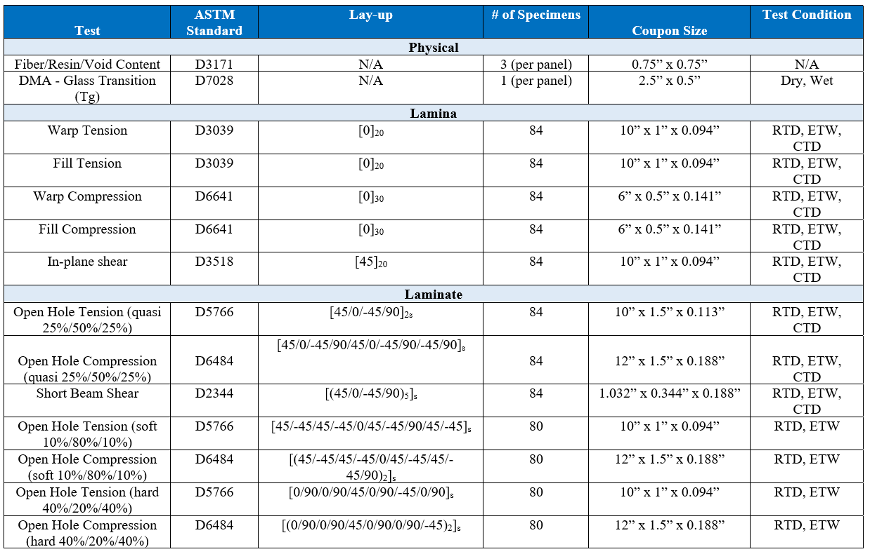
Typical Test Matrix

Slide 25
Current Projects
Chemical De-paint
Determine viability of Chemical de-paint processes for future life cycle management of advanced composites structures for applicable resin matrices.
Laser De-paint
Evaluate improved systems
Generate test plans
Review test results
Composite Shelf-Life Extension Study
How do materials age beyond the manufacturers shelf life?
Determine if alternate methods exist for recertifying material

Slide 26
Current Projects
Repair Material Kits
Identify key composite repair materials for a platform
Evaluate the cost for the ALC’s purchasing materials and condensing them into “right-sized” kits for distribution to usage locations
ALC’s may already be using the materials
Potential savings
Time- less delay waiting for DLA to source or drop ship
Waste- avoid minimum orders from suppliers for multiple locations
Decreases SPO engineering efforts, ie less substitute Form 107s
Help Needed
Ensure T.O. composite repair materials are listed with HAZ unit on base

Slide 27
Site Assistance Visits
Assist operating locations with composite efforts
Facilities guidance for stand-up
Repair equipment selection and nuances
Training suggestions
Material Sources
Problem solving

Slide 28
Questions?
ACO is a resource! Reach out!
How can we better help you?
Jason Rich, Section Chief, Jason.rich.3@us.af.mil
Adam Kite, Technical Expert, Adam.kite.1@us.af.mil

