Slide 1
Composite Laser Ablation for Surface Preparation (CLASP) Making light work of composite bond prep
Presenter: Jimmy John
Laser Research Engineer | Laser Manufacturing Technology Development
AMTD Group| Structural Materials Division
University of Dayton Research Institute (UDRI)
DISTRIBUTION STATEMENT A. Approved for public release: distribution unlimited. AFRL-2022-4992

Slide 2
Introduction – University or Dayton Research Institute (UDRI)
Established in 1956
Performs basic and applied research, engineering services, testing, & technology transition
Fully supported by external sponsors
Integral part of the University; reinforces UD’s mission
Over 800 research staff (250+ at WPAFB)
Among all colleges and universities:
1st in the U.S. for materials R&D
DISTRIBUTION STATEMENT A. Approved for public release: distribution unlimited. AFRL-2022-4992

Slide 3
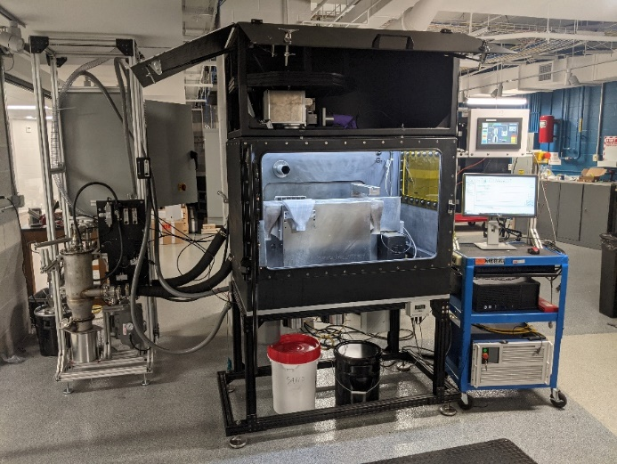
Additive and Laser Manufacturing Technology Development
20+ person research group that can rapidly mobilize to deliver Additive Manufacturing, Laser Manufacturing, and Application-driven solutions.
Laser Manufacturing Technology Development
Ultra-fast laser system development
Laser-material interaction
Laser Powder Bed Fusion Additive Manufacturing
Next Gen. Machine design and innovation
Operates AFRL Novel AM Lab (RXCM)
In-situ Laser Process Monitoring
AM Materials Science and Testing
Photopolymer AM
Application driven
Advanced Applications
Rapid application development across all UDRI technologies
DISTRIBUTION STATEMENT A. Approved for public release: distribution unlimited. AFRL-2022-4992

Slide 4
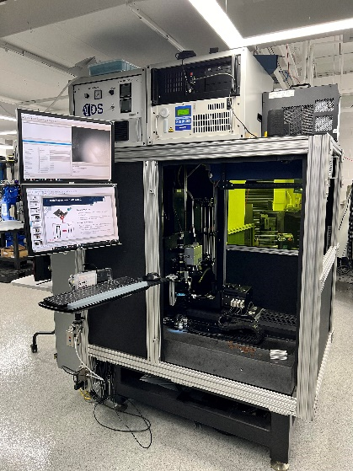
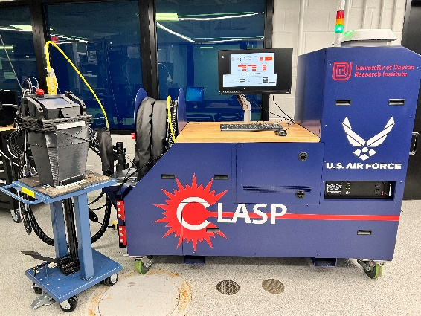
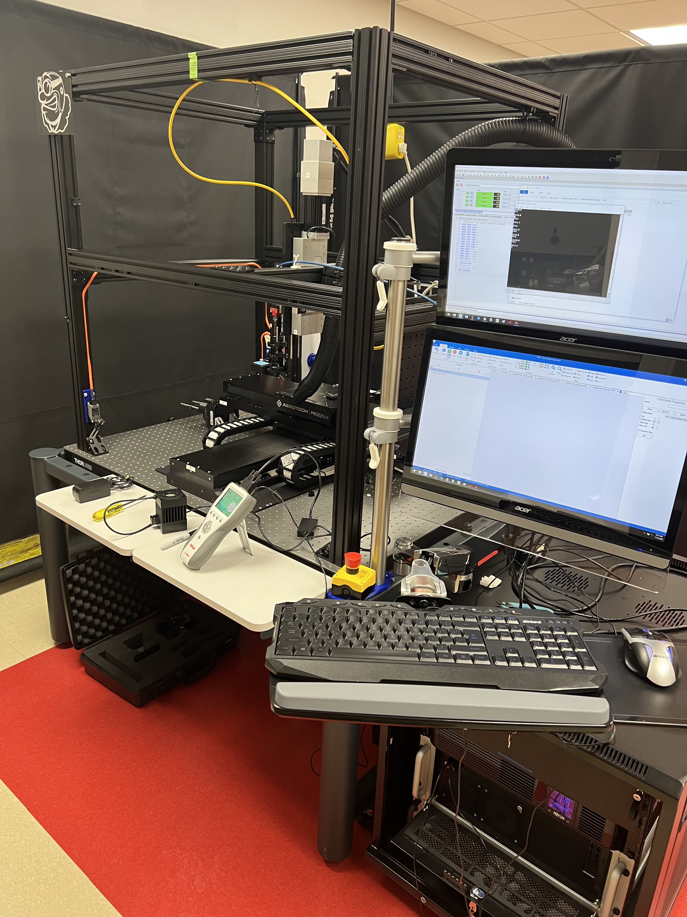
UDRI Ultrafast Laser Capabilities
20W Amplitude FS laser
Mobile fiber launch
20W IPG FS laser
On 5 axis Aerojet workstation
30W IPG Nanosecond (NS) laser
Supports STT "Enterprise Product"
50W Amplitude FS laser
With harmonic generator
100W Amplitude FS laser
Hybrid LPBF
300W Amplitude FS
In negotiation, ETA 2024
DISTRIBUTION STATEMENT A. Approved for public release: distribution unlimited. AFRL-2022-4992

Slide 5
Composites Processing Case Study
Composite bond preparation can be a complicated process depending on the application. Current methods of hand sanding (Sand-to-Black) have many challenges:
Variable efficiency by operator
Requires multiple steps to ensure preparation for bond is complete
Manually intensive
Time consuming
A more efficient, quality replacement for manual sanding is desired.
DISTRIBUTION STATEMENT A. Approved for public release: distribution unlimited. AFRL-2022-4992

Slide 6
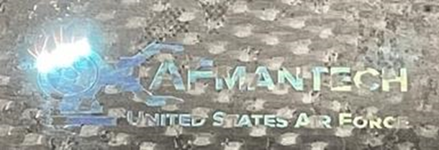
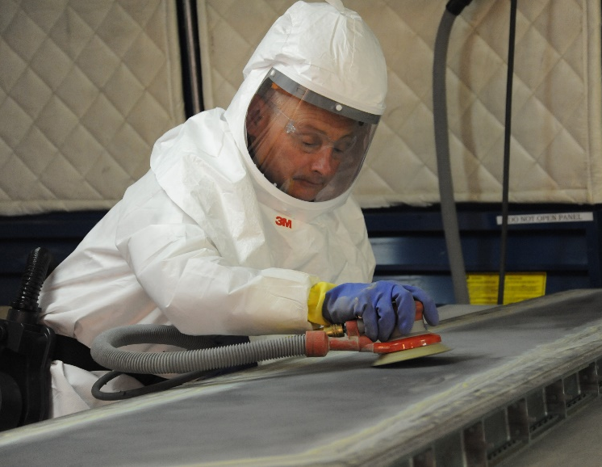
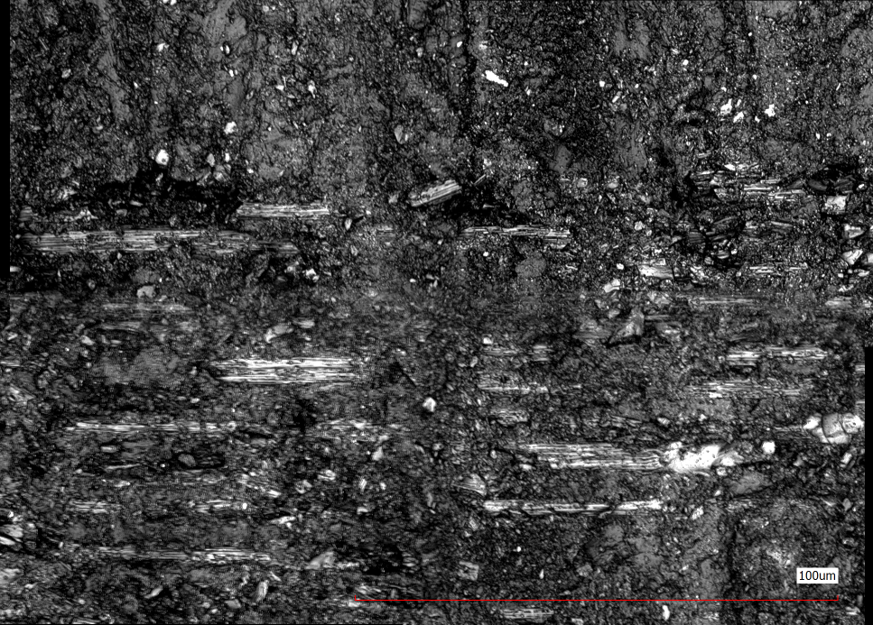
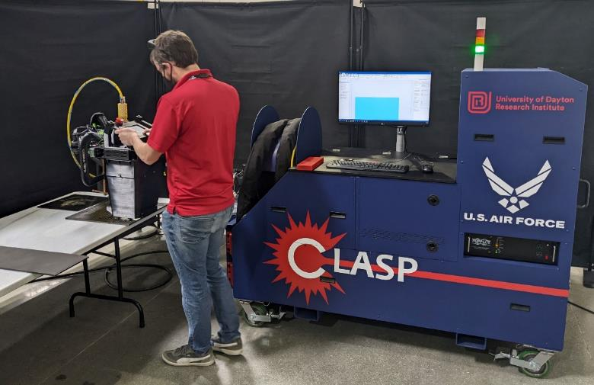
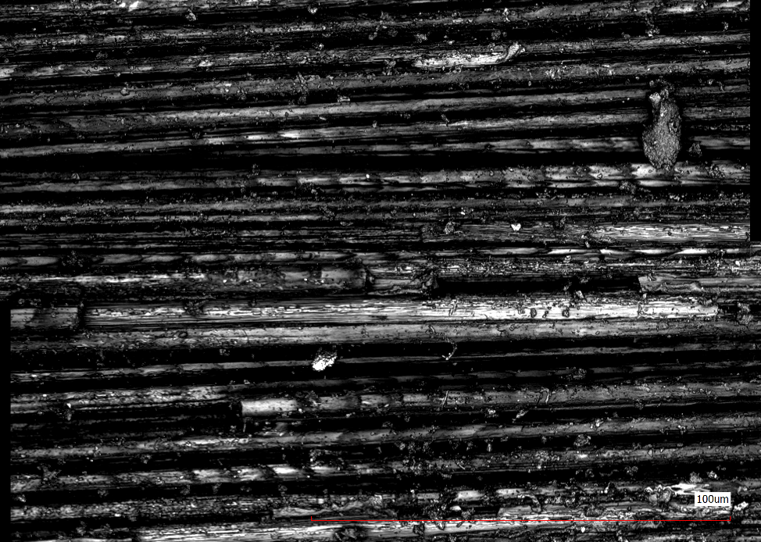
What is CLASP?
Composite Laser Ablation Surface Preparation
CLASP is an ultrafast laser, surface preparation method
Developed under AFRL ManTech Discovery Fund
Goal is to streamline the PMC bond prep process
SAND TO BLACK
CLASP
Ronnie Gadola, 574th Composite Repair Flight sheet metal mechanic, sands an F-15 torque box assembly in a new sanding booth in Bldg. 169. U. S. Air Force photo by Ray Crayton Jr
DISTRIBUTION STATEMENT A. Approved for public release: distribution unlimited. AFRL-2022-4992

Slide 7
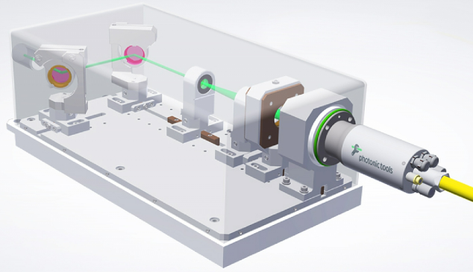
Why Now? Why this Technology?
Femtosecond lasers have scaled in power greatly over the past decade
4W was state-of-the-art in 2011
Today, commercial systems are available in 300W+
Hollow core fibers are now commercially available, allowing ultrafast pulses at the fibers end
Current commercial fiberoptic delivery technology is IR wavelength coated ONLY
It is understood that other wavelengths may provide additional benefits (532nm, 355 nm)
Ongoing studies with bench-top laser systems are quantifying benefits of lower wavelength to the process
As the technology matures and market pull increases, better fibers will likely become available
More wavelengths
Higher average power
Higher pulse energies
Photonics Tools Beam launching system
DISTRIBUTION STATEMENT A. Approved for public release: distribution unlimited. AFRL-2022-4992

Slide 8
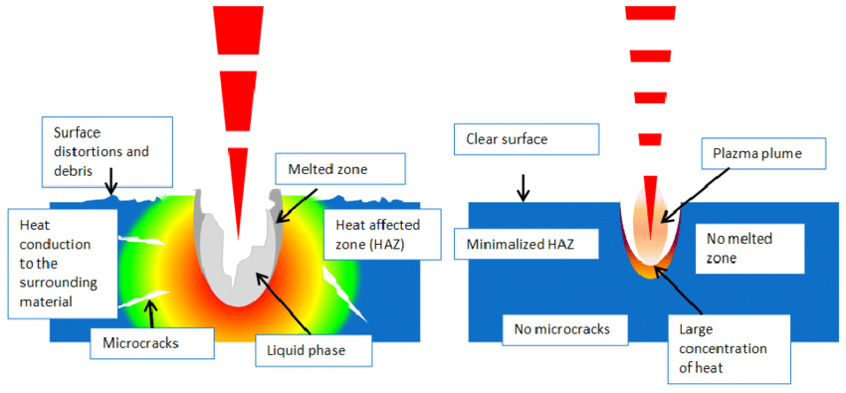
Long Pulse Laser (NS) vs Ultra Short Laser (FS)
Surface Distortions and Debris
Clear Surface
Plasma Plume
Melted Zone
Heat Conduction to the Surrounding Material
Heat Affected Zone (HAZ)
Minimalized HAZ
No Melted Zone
No Microcracks
Large Concentration of Heat
Microcracks
Liquid Phase
DISTRIBUTION STATEMENT A. Approved for public release: distribution unlimited. AFRL-2022-4992

Slide 9
Experimental Setup
Set plate at angle Θ°
Run process
Gather data
Calculate Z offset
Correlate with hatch marks (and thermal data)
Beam
Z + dz
Θ
Fixture
(Z) Focal Plane
Test Specimen
Z - dz
Fixture
Fixture
DISTRIBUTION STATEMENT A. Approved for public release: distribution unlimited. AFRL-2022-4992

Slide 10
Global Thermal Analysis
Intensities Relative
Able to define “athermal” ablation range
Helps make smart decisions for laser parameters
DISTRIBUTION STATEMENT A. Approved for public release: distribution unlimited. AFRL-2022-4992

Slide 11
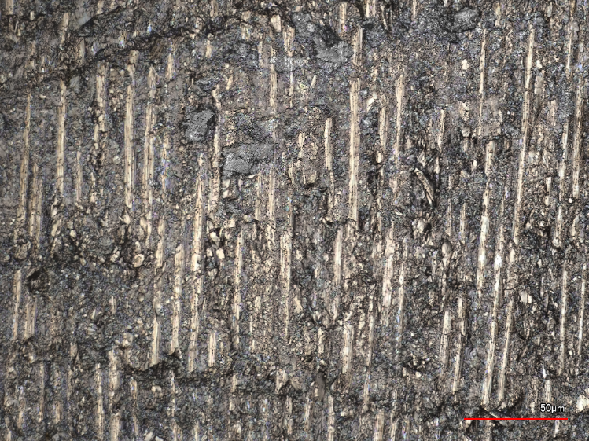
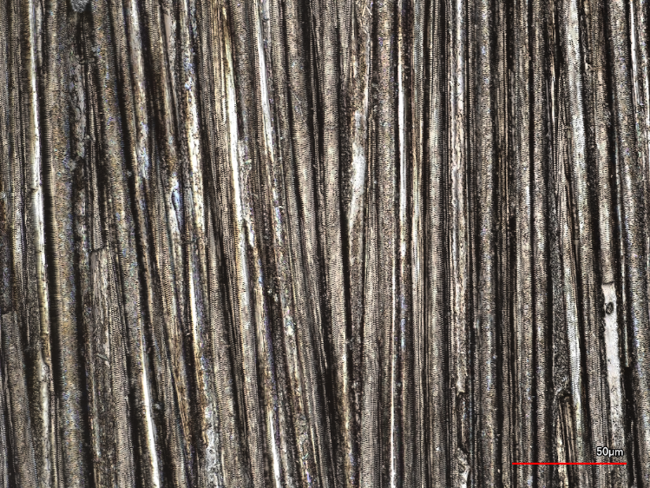
Confocal data: Sand to Black vs CLASP
Sand to Black
CLASP
DISTRIBUTION STATEMENT A. Approved for public release: distribution unlimited. AFRL-2022-4992

Slide 12
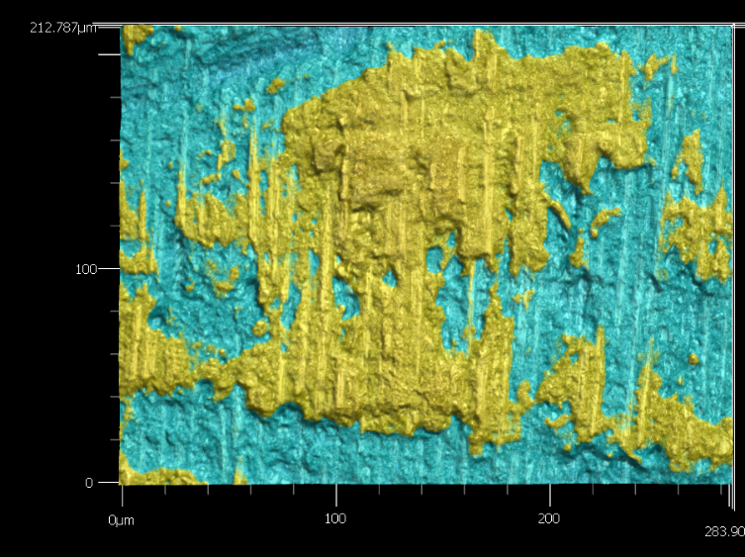
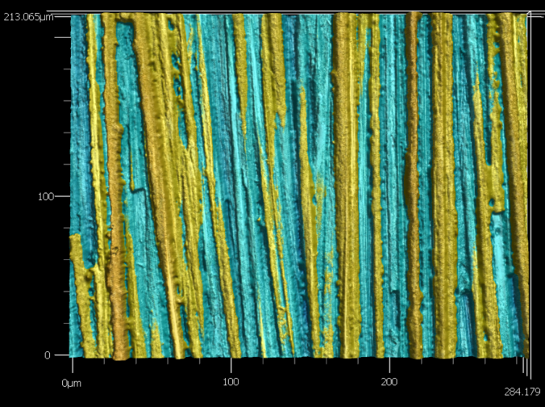
Confocal data: Sand to Black vs CLASP
Sand to Black
CLASP
DISTRIBUTION STATEMENT A. Approved for public release: distribution unlimited. AFRL-2022-4992

Slide 13
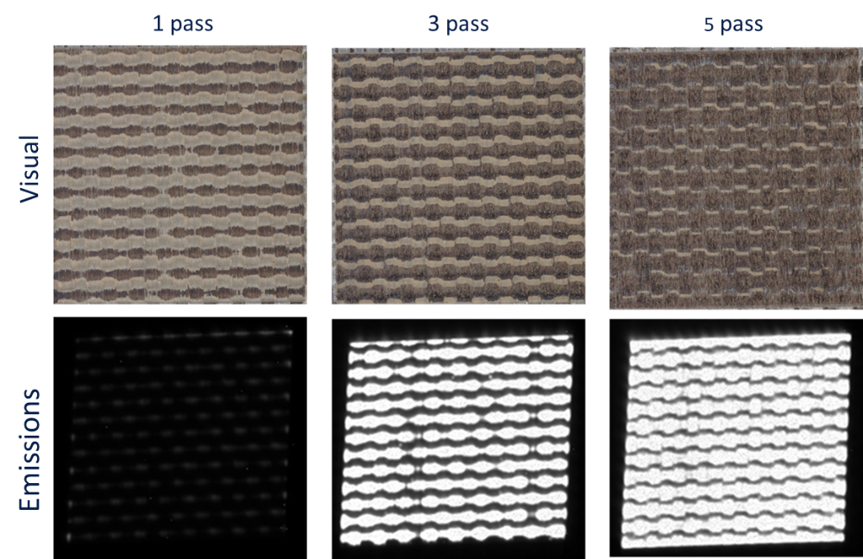
Tape PMC Emissions QA Study
Viewing emissions of the Carbon Fiber
Can see where resin remains with higher contrast than visual
Useful for fast closed loop feedback
Enables less damage and makes a more efficient process!
DISTRIBUTION STATEMENT A. Approved for public release: distribution unlimited. AFRL-2022-4992

Slide 14
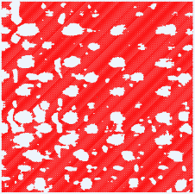
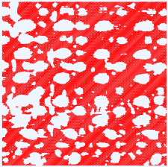
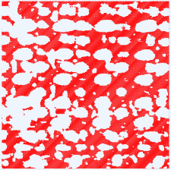
Closed Loop Processing
DXF files with vectors in DMC software
Taking data from the emissions, feed a dxf for the next pass
Reduces processing time up to 50% depending on number of passes
Homography required to correct for lens distortion
1 Pass
2 Passes
3 Passes
4 Passes
5 Passes
Emissions data filtered
DISTRIBUTION STATEMENT A. Approved for public release: distribution unlimited. AFRL-2022-4992

Slide 15
CLASP Cart Timeline
Bench-top demonstration
CLASP Cart Rev 1
CLASP Cart Rev 2
DISTRIBUTION STATEMENT A. Approved for public release: distribution unlimited. AFRL-2022-4992

Slide 16
CLASP Cart-Rev 3 April 2022
Enabling technologies
20W Femtosecond Laser
Up to 20m Hollow Core Fiber
Key Features
Operator Safety interlocks
Galvanometer based end effector
6”x6”x6” focal range
In-situ cameras
HEPA processing exhaust
System Maturation
System is deployed to a manufacturing facility
Commercialization effort with Albers Aerospace in progress
DISTRIBUTION STATEMENT A. Approved for public release: distribution unlimited. AFRL-2022-4992

Slide 17
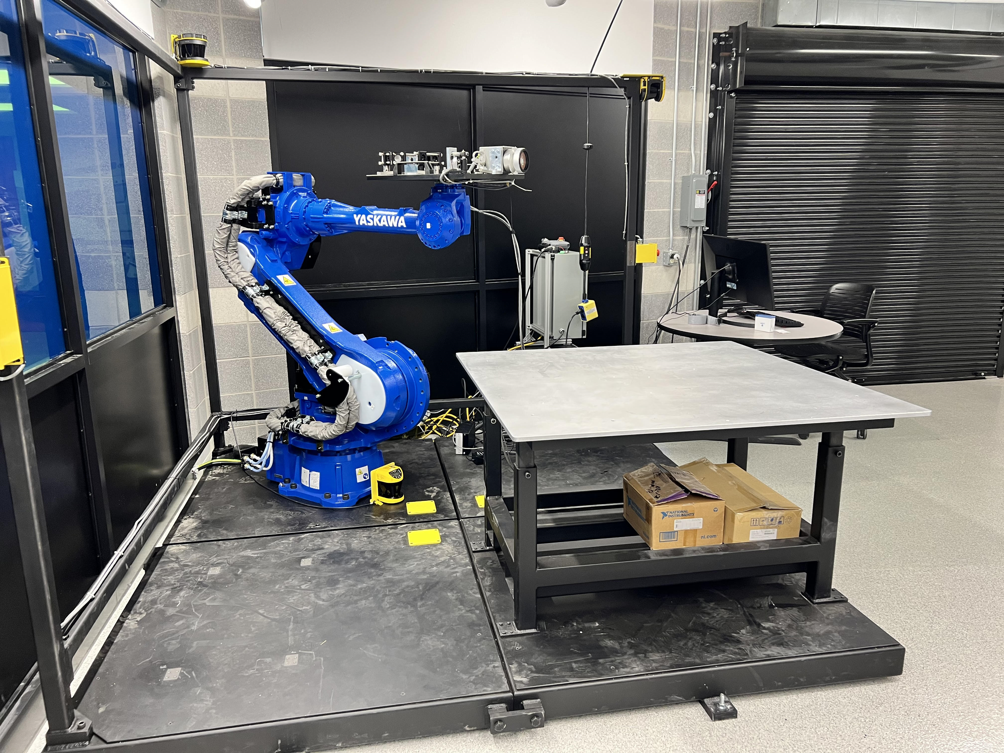
Broadening Application Spaces
What are our customers asking for?
More power/faster processing
Targeting large area processing (50ft+)
Robotic | Gantry Integration
More fiber coupling options
UV, higher power/energy capability, more flexible/durable
Lighter weight
Handheld processing / Small form factor lasers
New Areas of interest
Coating removal (advanced coating systems, paint, etc…)
Coating surface prep (ceramic/metal)
Broad area surface functionalization
Contamination remediation
DISTRIBUTION STATEMENT A. Approved for public release: distribution unlimited. AFRL-2022-4992

Slide 18
Next Steps
Continued Advanced Integration
Robotic
Large Gantry
Improved Sensing
Surface Mapping
Custom emissions cameras
Spectroscopy (LIPSS)
Thermal
Diversify Applications Space
Focusing in Aerospace
DISTRIBUTION STATEMENT A. Approved for public release: distribution unlimited. AFRL-2022-4992

Slide 19
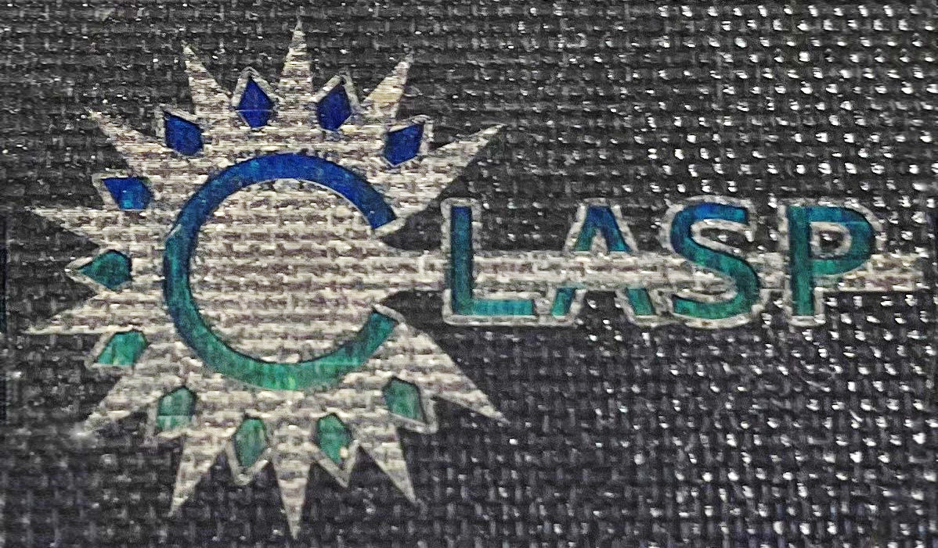
Questions?
Jimmy John
Laser Research Engineer | Laser Manufacturing Technology Development
Additive Manufacturing Technology Development Group
Structural Materials Division
James.John@udri.udayton.edu

