Slide 1
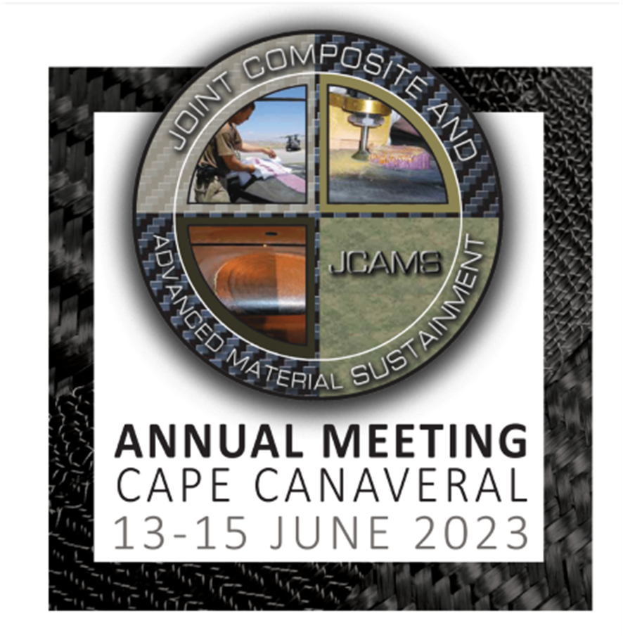
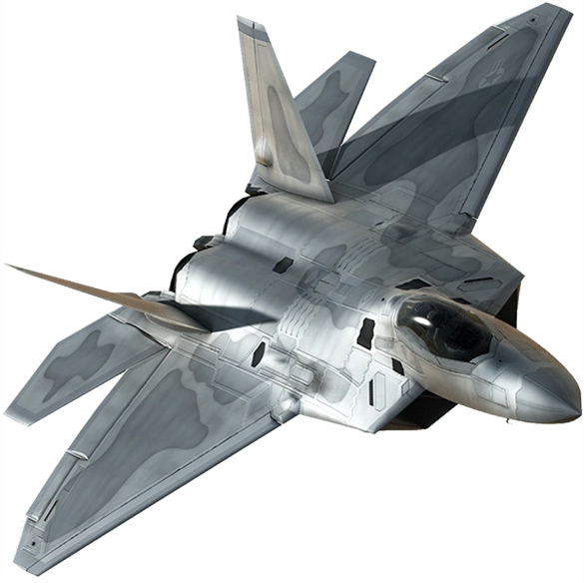
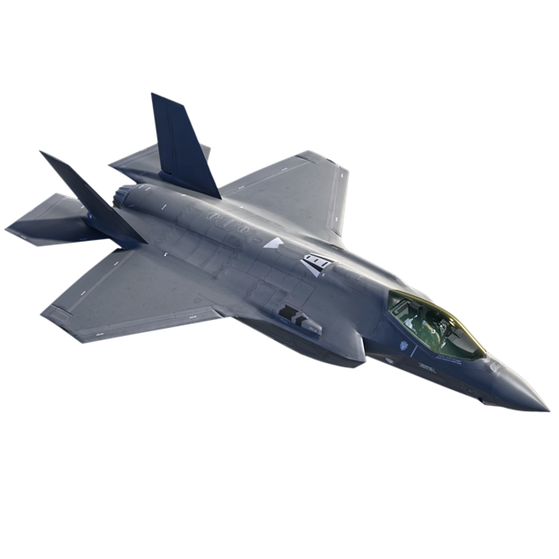
Composite Technology in the workforce

Slide 2
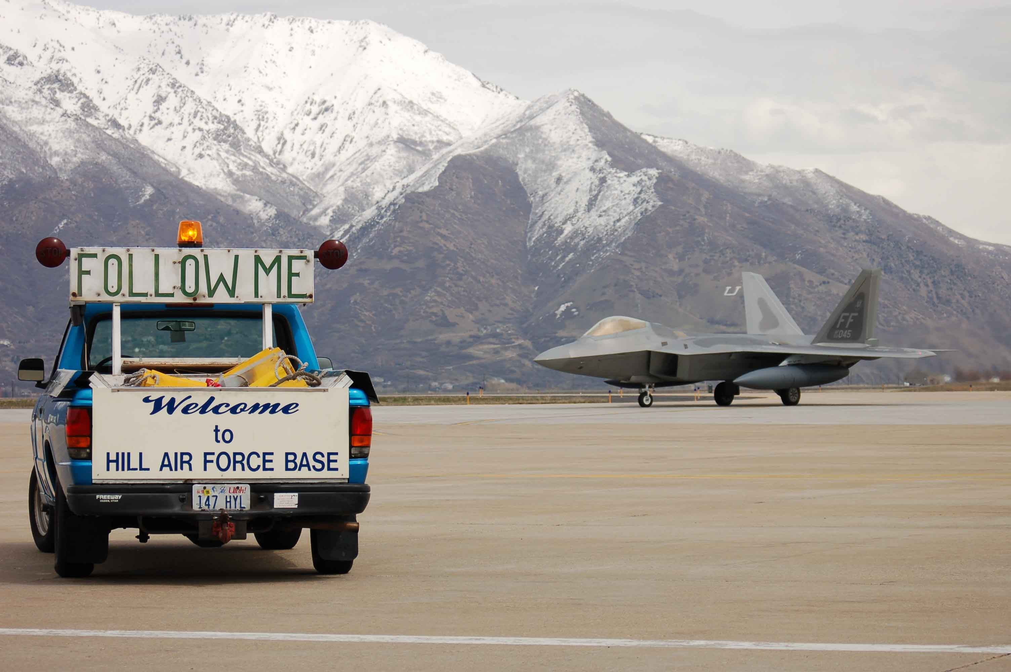
OO-ALC Training
Brett Wiggill brett.wiggill@us.af.mil
Adam Hinrichs adam.hinrichs.1@us.af.mil

Slide 3
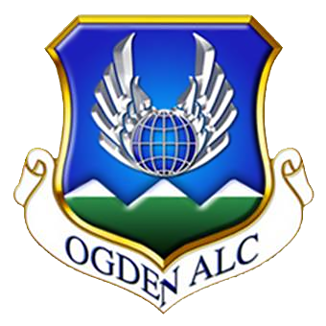
OO-ALC Technical Instructor Lead
Brett Wiggill
Brett Wiggill
OO-ALC/OBHC
Hill AFB, Utah 84056-5234
801-586-7956 DSN 586-7956
brett.wiggill@us.af.mil
Notes:
All of these defect situations will be covered by studying the course content. Some directly, some indirectly.
If the processes are followed, the likelihood of these defects will decrease.
The processes are the results of years of testing and continued development to define “best practices” that result in the most good holes per application. Good drilling is much more than a specification can provide. It is technique that has been honed and improved over the years by the best mechanics in hundreds of different situations. This class is a culmination of their tips, tricks and techniques for CONSISTENTLY producing good holes.

Slide 4
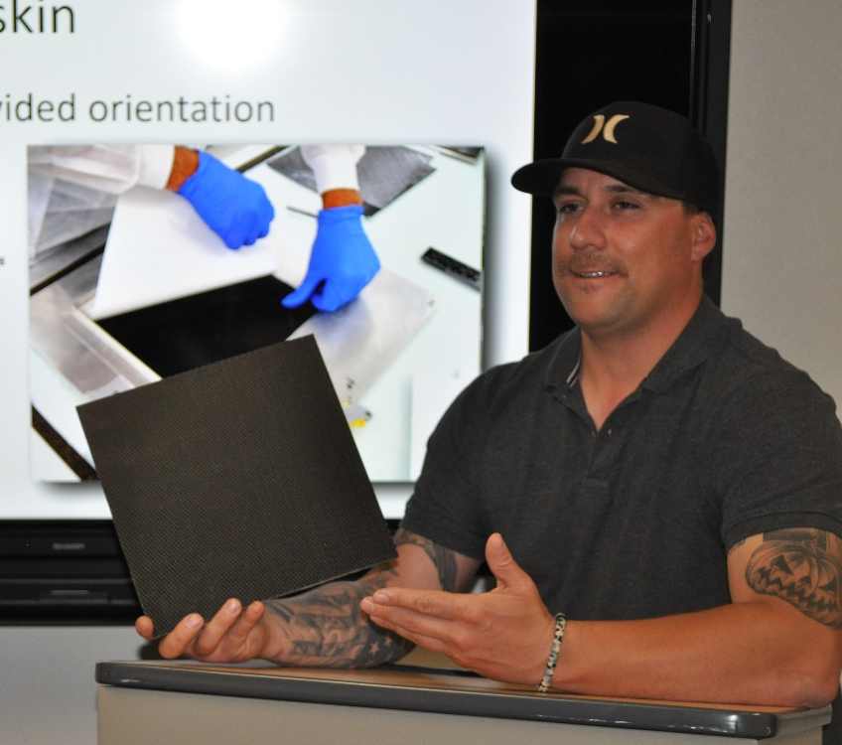
OO-ALC Composite Instructor
Adam Hinrichs
Adam Hinrichs
OO-ALC/OBHC
Hill AFB, Utah 84056-5234
801-586-0094 DSN 586-0094
adam.hinrichs.1@us.af.mil
Notes:
All of these defect situations will be covered by studying the course content. Some directly, some indirectly.
If the processes are followed, the likelihood of these defects will decrease.
The processes are the results of years of testing and continued development to define “best practices” that result in the most good holes per application. Good drilling is much more than a specification can provide. It is technique that has been honed and improved over the years by the best mechanics in hundreds of different situations. This class is a culmination of their tips, tricks and techniques for CONSISTENTLY producing good holes.

Slide 5
Advanced Composite
Training
Composite Training at Hill AFB
Conducted for Air Force Material Command by the Center Training Office
Our goal is to provide initial and advanced training for depot technicians
Current workload: C-130, F-16, A-10, F-22, B-2, and F-35 Aircraft

Slide 6
Advanced Composite
Training
Current Training Courses
Advanced Composite Level 1
Introductory principles, materials, terminology, and entry-level hands-on projects (40 hrs)
Advanced Composite Level 2
Intermediate principles, 10 hands-on projects to complete (100 hrs)
Notes:
There is only one click for both classes to populate

Slide 7
Advanced Composite
Training
Topics Covered in Level 1
Introduction to composites
How composites are manufactured
How composites are repaired
How composites are cured
How composites are tested
Three hands on projects

Slide 8
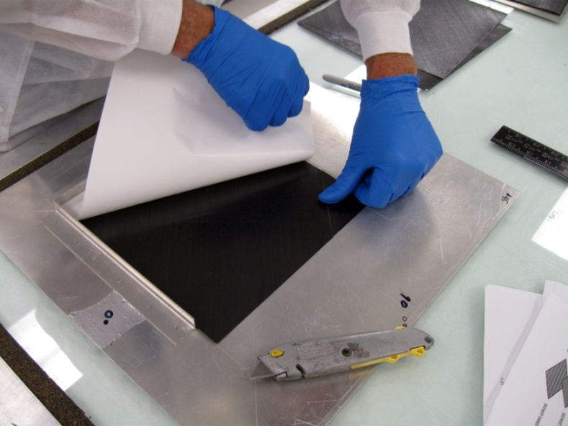
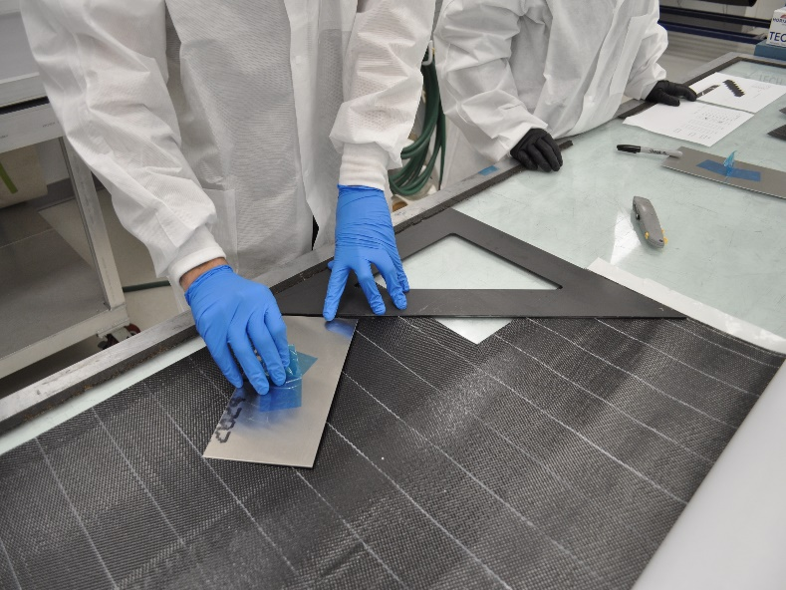
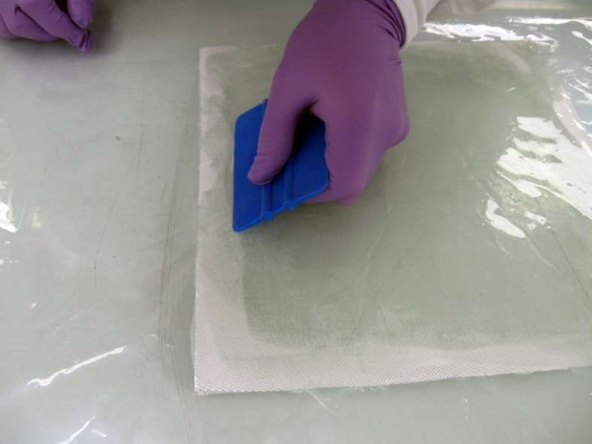
Advanced Composite
Training
Projects Completed in Level 1
Uni-directional graphite laminate layup
Satin woven graphite laminate layup
Cutting and laying up satin woven materials with emphasis on warp direction
Fiberglass wet layup panel

Slide 9
Advanced Composite
Training
Topics Covered in Level 2
Review of Advanced Composite Principles
Composite Repair Principles
Level 2 Projects

Slide 10
Advanced Composite
Training
Projects Completed in Level 2
Metal Sandwich Structure
Metal Partial Core Repair
8-Ply Graphite Skin
Composite Sandwich Structure
Full Core Repair
Graphite Scarf Repair
Wet Layup Manufacture
Wet Layup Repair
Fiberglass scarf
Drill and Fill
Symmetrical Bagging Techniques

Slide 11
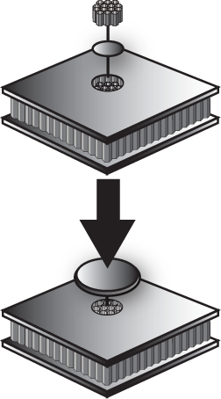
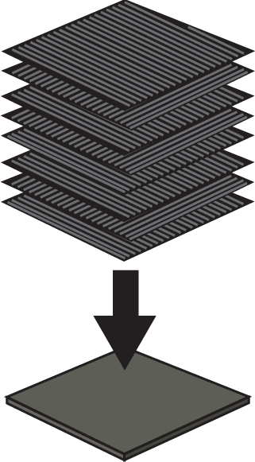
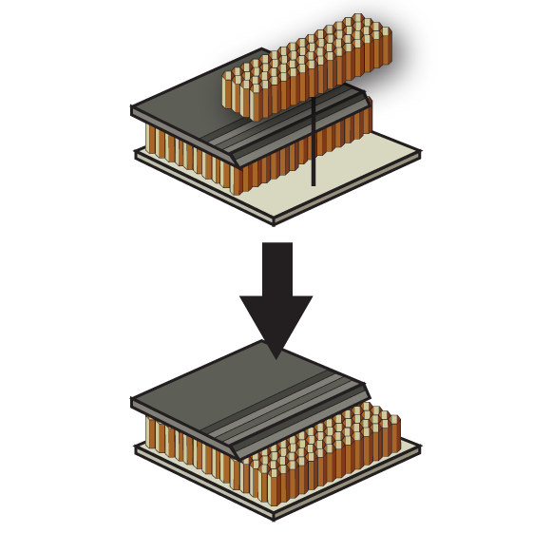
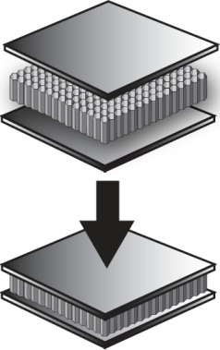
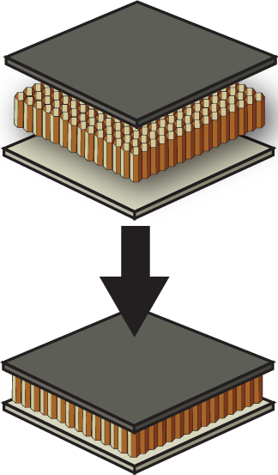
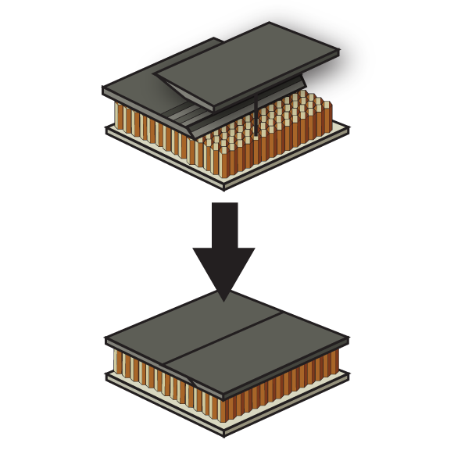
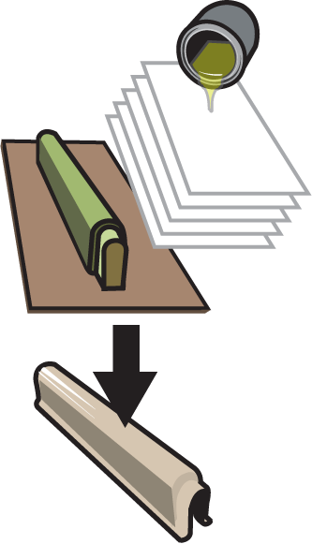
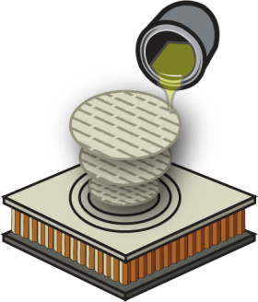
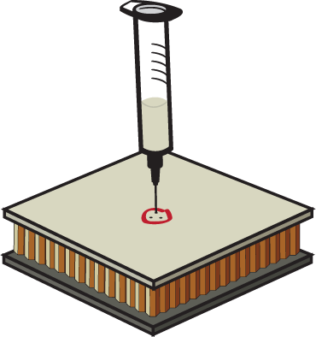
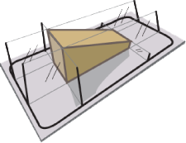
Advanced Composite
Training
Projects Completed in Level 2

Slide 12
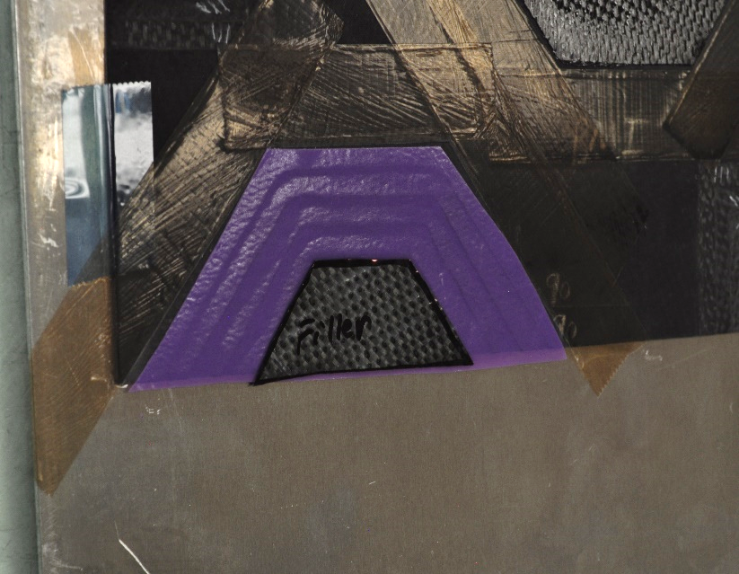
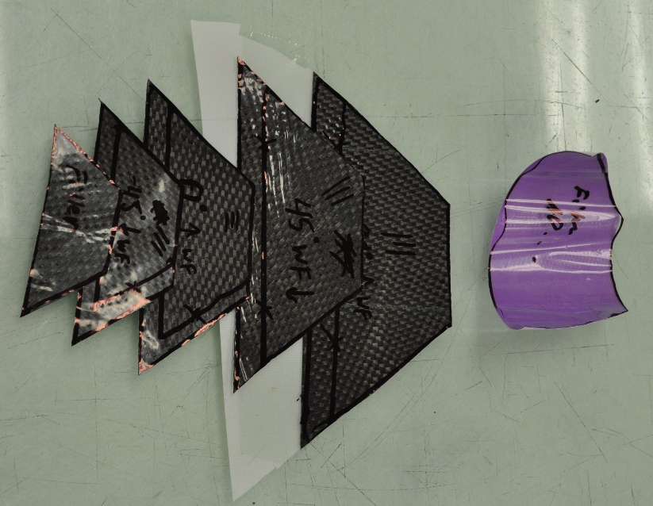
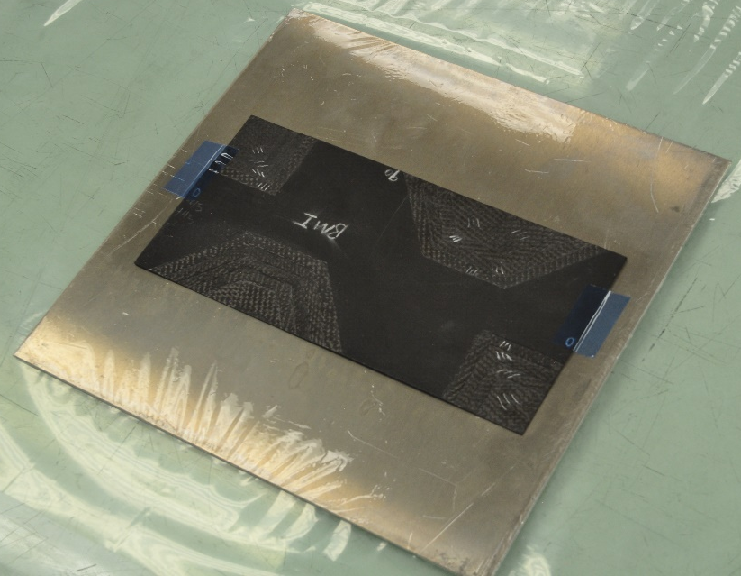
Advanced Composite
Training
Future Projects in Level 2
Projects in development
Scarf repair
Cut and lay-up materials for repair
Matching material type, fiber orientation and warp direction

Slide 13
Radome Composite
Repair Process
Topics Covered in Radome Repair
Wet Layup Manufacture
Wet Layup Repair
Fiberglass scarf
Drill and Fill
MHPMAS0289300JT 6 hours

Slide 14
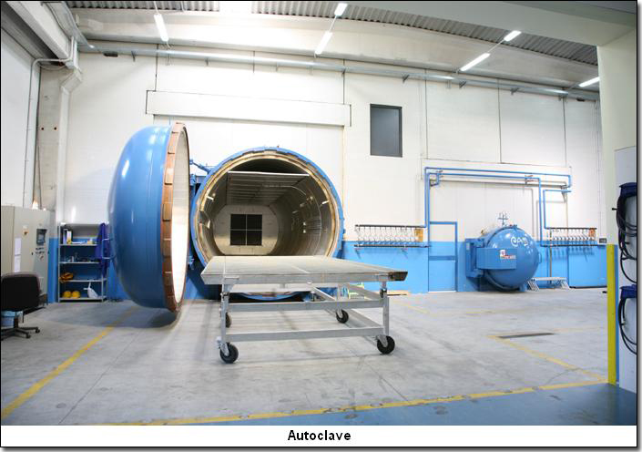
Autoclave Theory
and Operation
Topics Covered in Autoclave
Autoclave Basics
Pre-Cook Procedures
Recipe Writing
Cook Procedures
Post-Cook Procedures
Solutions to Problems
Menu screen
Autoclave Theory & Op MHPEQU9800800SU 32 hours
Autoclave Operator Refresher Part II MHPMAS0323400SU 8 hours

Slide 15
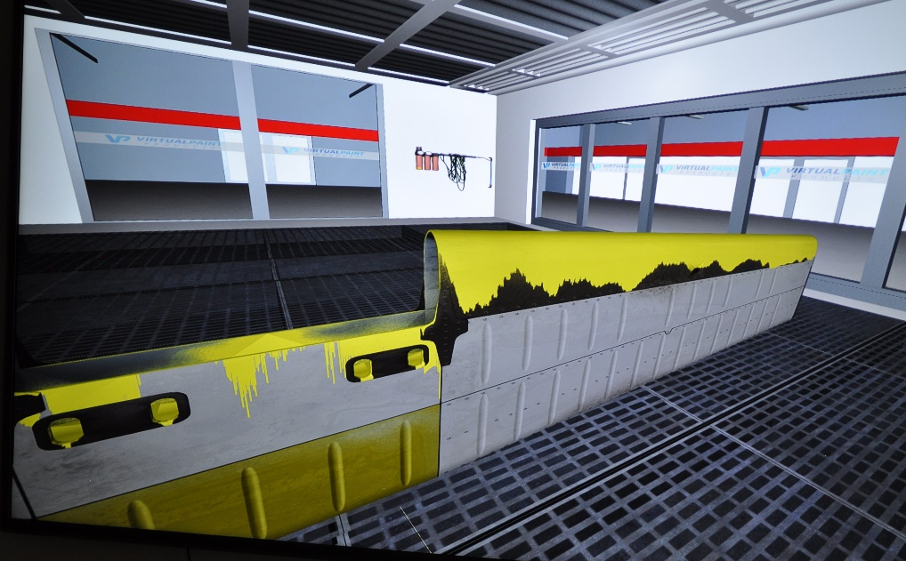
Air Force Spray
Painters Training
Topics Covered in Spray Painters
Masking and Demasking
Surface Preparation
Basic Coatings Knowledge
Preparation of Coatings
Spray Application Equipment
Spray Equipment Setup
Spray Application Techniques
Cleaning and Maintaining Spray Equipment
Application of Aerospace Primers and Topcoats
Stencil and Decal Application
Coatings Defects, Problems and Repair

Slide 16
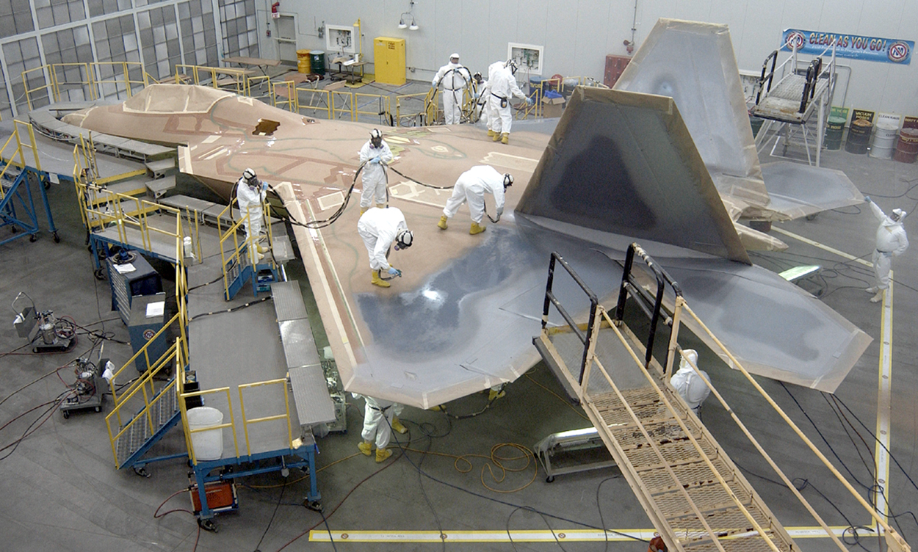
F-22 Basic
Low Observable
Topics Covered in F-22 Basic LO
Security
F-22 Overview
Safety
Principles of LO
Panel Removal & Installation
Groundplane
General Coating Considerations
General Surface Preparation
Blueprints
Masking
Primers
Gap Filling and Surface Smoothing
Specialty Coatings
RAM Sheet & Boots
Spray RAM
Topcoats
Topcoat Video
F-22 Panel Locations

Slide 17
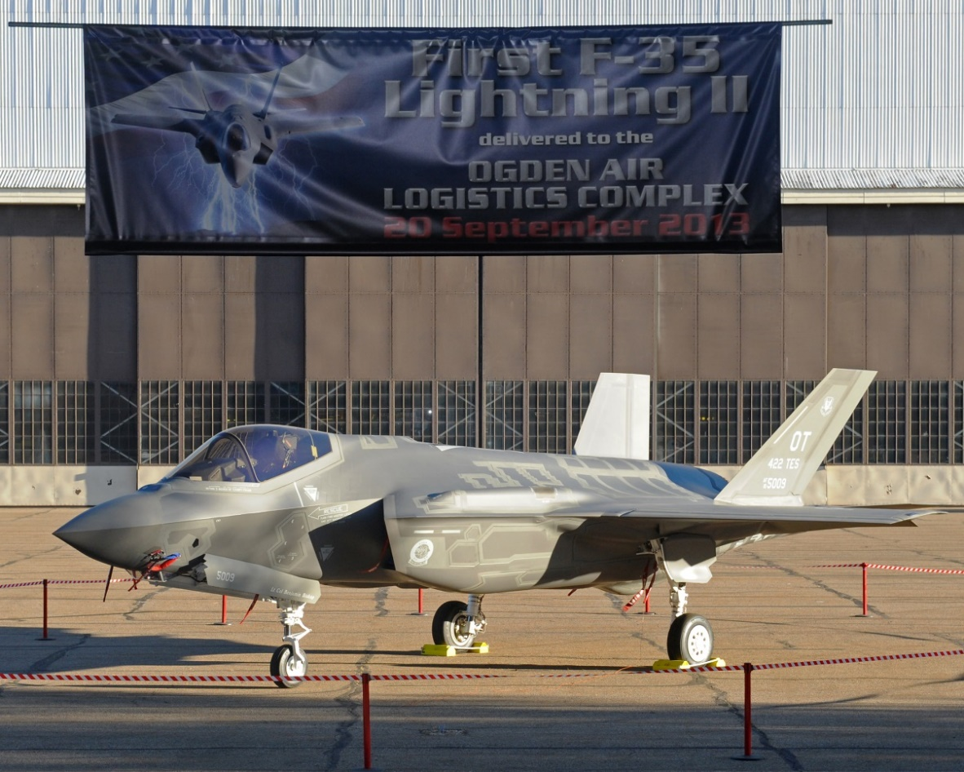
F-35 LO Removal
and Restoration
Topics Covered in F-35 LO
F-35 Overview
Stealth
Safety
Principles of LO
Planform Alignment
Engineering Drawings
Depot Coatings Integration
Panel Removal
Surface Preparation
Primers
Edge Boot Installation
Boot Drilling
Boot Gap Filling
Conductive Fairing Repair
Fastener Fill
Intro to Gap Fill
Gap Fill
Masking
Topcoat Spray
Final Finish Inspection

Slide 18
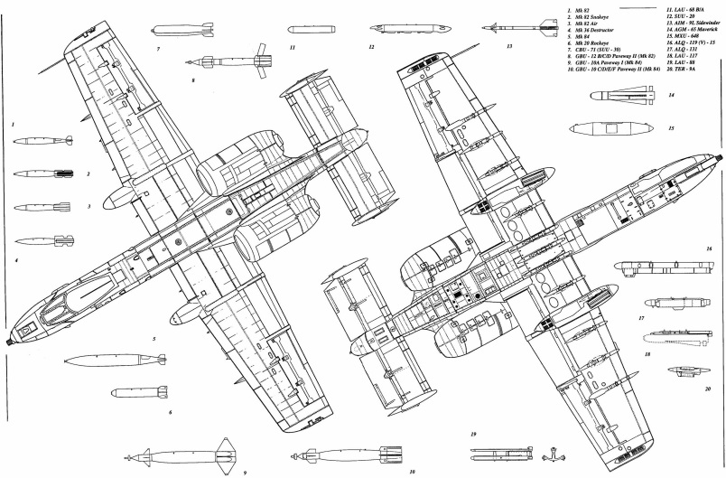
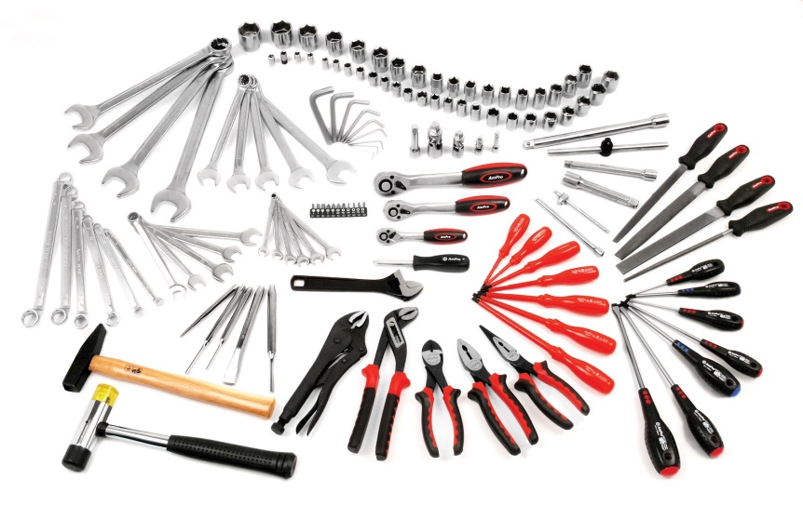
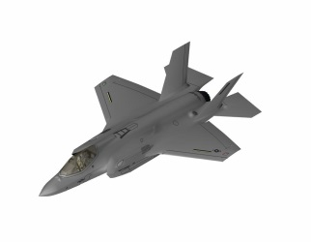
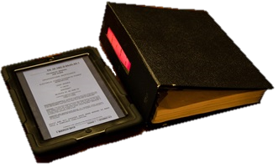
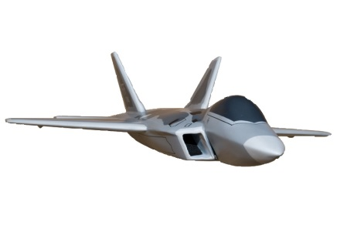
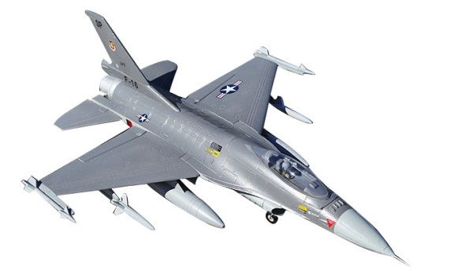
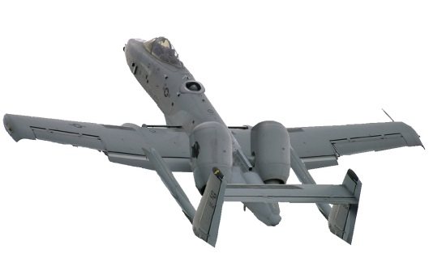
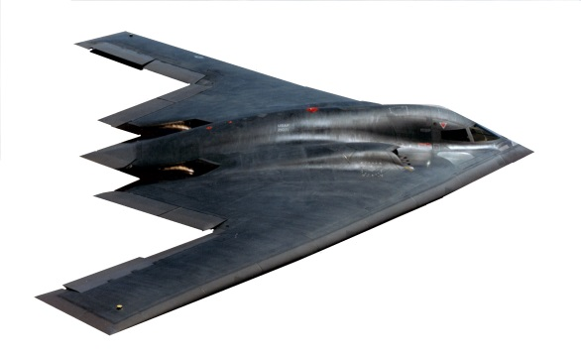
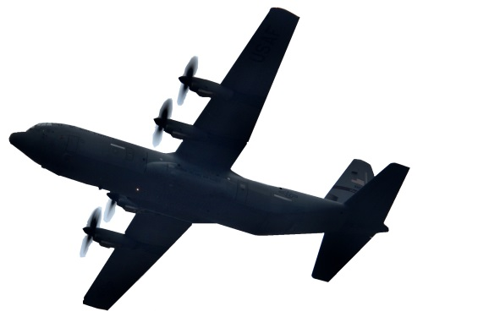
Additional Technical Skills
Training provided by HAFB

Slide 19
Common Sheetmetal
Defects
Manual Drill/Ream/Countersink Top 5 Defects
Hole Size
Hole Location/Edge Distance
Countersink/Fastener Flushness
Tool Marks
Hole Missing/Extra
#1, #2 and #3 make up nearly a third of all defects!
#1 and #2 alone make up approximately 25% of the
overall nonconformance costs!
Notes:
All of these defect situations will be covered by studying the course content. Some directly, some indirectly.
If the processes are followed, the likelihood of these defects will decrease.
The processes are the results of years of testing and continued development to define “best practices” that result in the most good holes per application. Good drilling is much more than a specification can provide. It is technique that has been honed and improved over the years by the best mechanics in hundreds of different situations. This class is a culmination of their tips, tricks and techniques for CONSISTENTLY producing good holes.

Slide 20
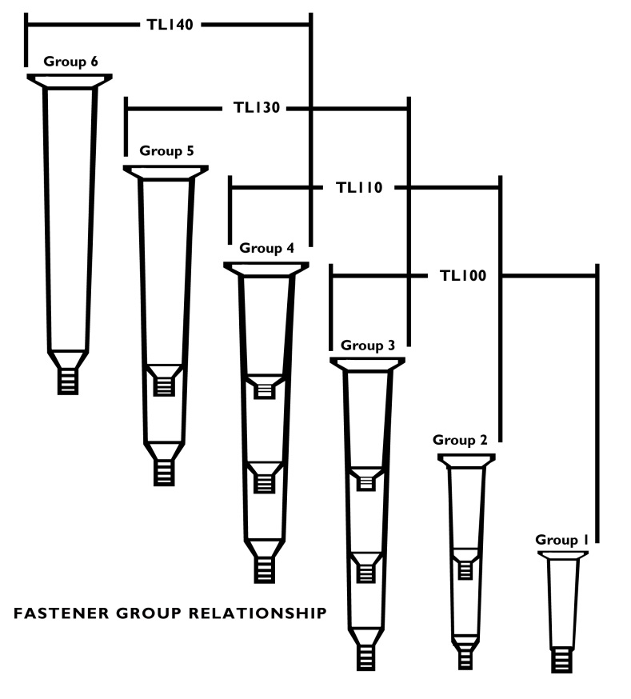
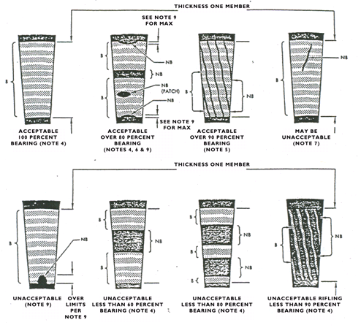
Taper-Lok Fasteners
Training
Topics Covered in Taper-Lok Fasteners Training
Fastener Identification and Tool Selection
Fastener removal and installation

Slide 21
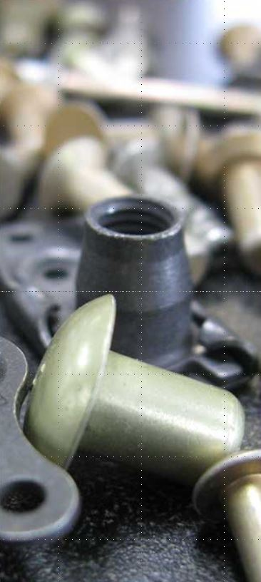
Repair Fasteners
for Composites
Topics Covered in Fasteners for Composites
Safety
Technical Instructions
Aircraft Materials
Blueprints
Shop Math
Fastener Layout
Drill and Countersink
Practical Application Projects

Slide 22
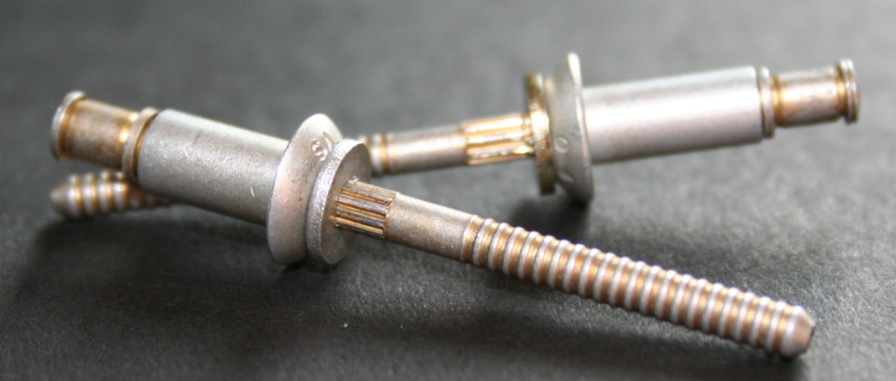
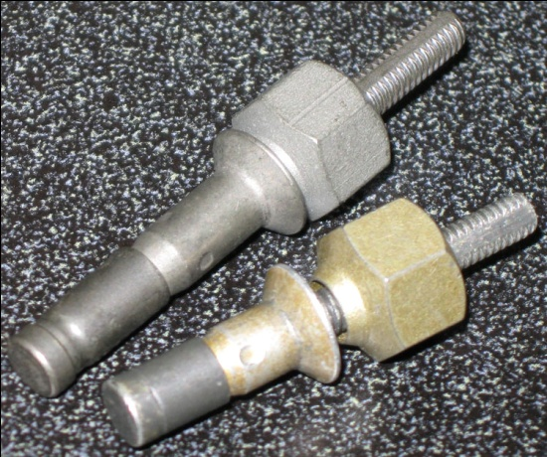
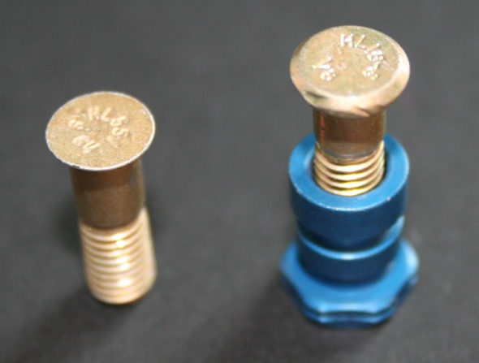
Repair Fasteners
for Composites
MS Blind Bolts Fasteners
Cherrymax Fasteners
Nut plates
Hi-Lok / Eddie Bolt Fasteners
Visu-Lok / Composi-Lok / Jo-Bolt

Slide 23
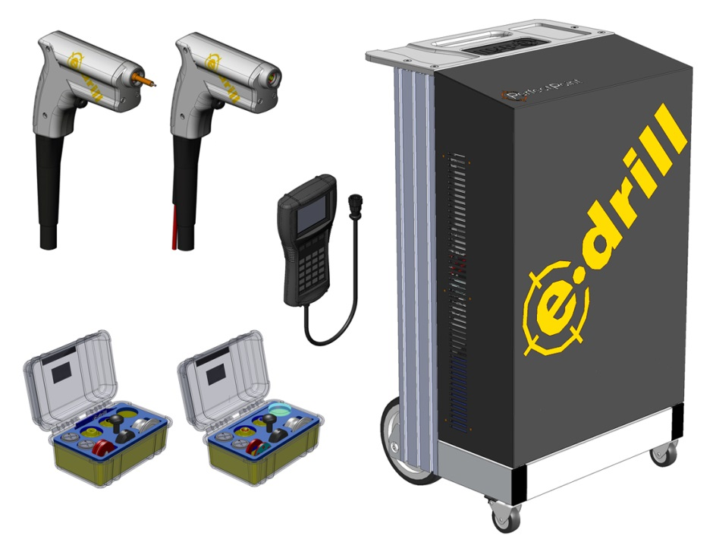
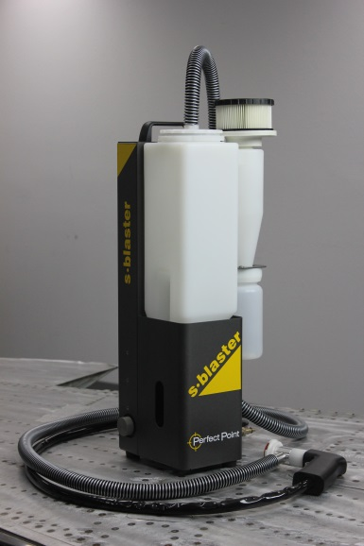
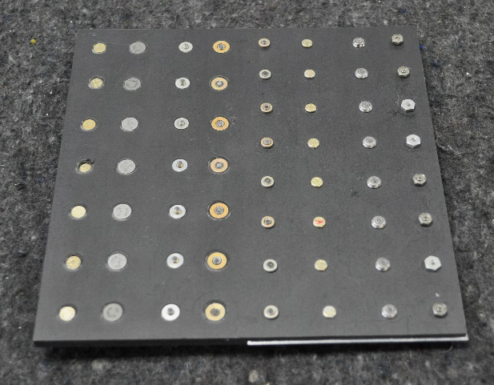
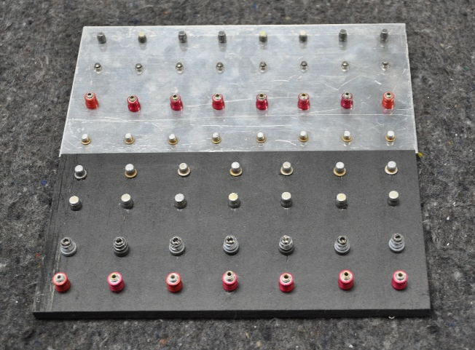
Repair Fasteners
for Composites

Slide 24
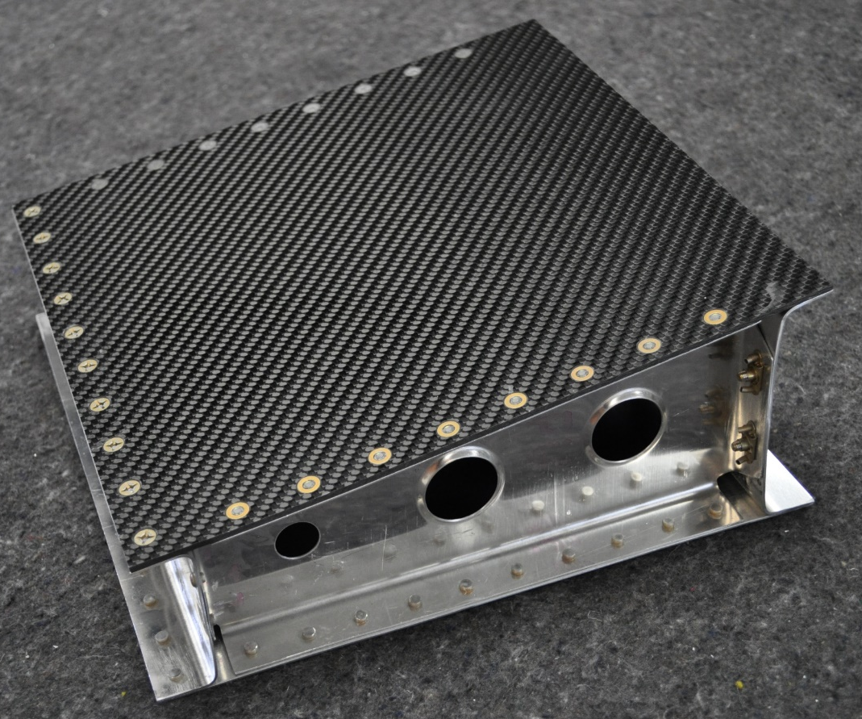
Intro Aircraft
Structural Repair
Topics Covered in Structural Repair Intro
Shop Safety
Aircraft Terminology
Tech Orders
Metal Properties and Corrosion
Sheet Metal Tools
Sheet Metal Fasteners and Layout
Shop Math
Metal Layout
Drilling, Countersinking, and Riveting
Practical Application Projects

Slide 25
Aircraft Structural
Repair
Topics Covered in Aircraft Structural Repair
Shop Safety
Glossary
Tech Orders
Blueprints
Metal Properties and Corrosion
Special Tools
Special Fasteners
Forming Machines and Metal Forming
Shop Math
Rivet Layout
Radius Bends
Drill-Countersinking-Riveting

Slide 26
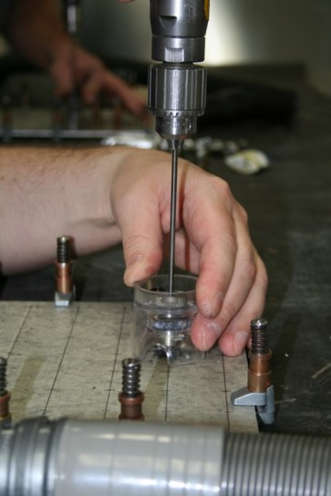
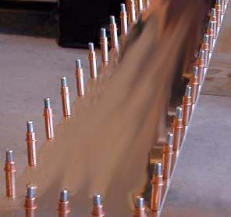
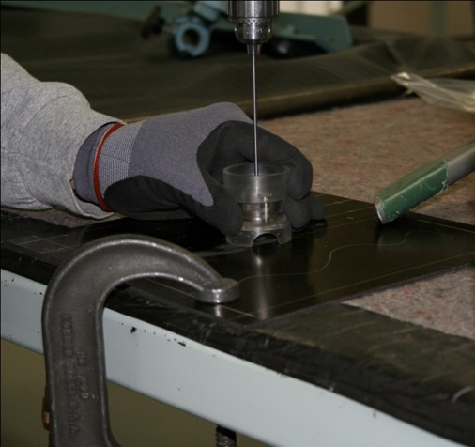
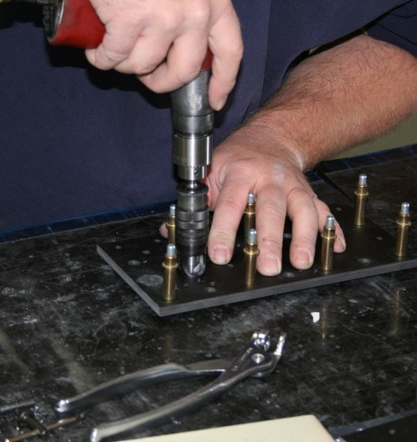
Aircraft
Structural Repair

Slide 27
Aircraft
Structural Repair
Hill Yeah, We Do That!

Slide 28
Questions??
Hill AFB Technical Skills Training POC’s
Brett Wiggill
brett.wiggill@us.af.mil
Adam Hinrichs
adam.hinrichs.1@us.af.mil

