Slide 1
Water Contact Angle Measurement Devices & Implementations of this Technology
14 June 2023
Presented to: JCAMS 2023
Presented by: Jared Gunsky
Release Number 23-0011

Slide 2
Use and Disclosure
DISTRIBUTION STATEMENT A: Approved for public release. Distribution is unlimited.
Release Number 23-0011

Slide 3
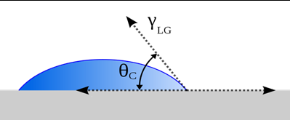
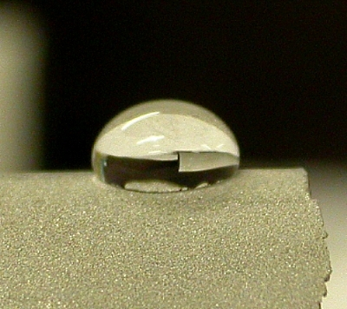
What is a Water Contact Angle Measurement?
Notes:
Determined by the angle formed from the interface between the surface of a material and a liquid droplet (typically water). 3 phase contact point, where the liquid-gas interface meets the solid-liquid interface.

Slide 4
Why is WCA Measurement Useful?
Quantifies:
(1) Wettability
(2) Surface characteristics of a solid material
Enables the optimization of surface treatments and coatings for various applications
Notes:
A technique used to quantify the wettability and surface characteristics of a solid material (contamination being a big one).
Essentially allowing researchers and engineers to assess a surface’s wetting behavior and adhesion potential.

Slide 5
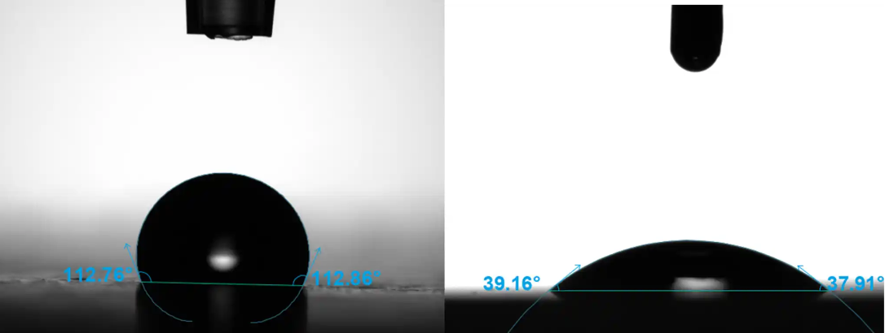
Theory Behind WCA Measurements
Based on the theory of interfacial tension and wetting phenomena.
1. Hydrophobic
2. Hydrophilic
3. Superhydrophobic
Notes:
When a liquid droplet comes into contact with a solid surface, three different types of wetting can occur:
1. Hydrophobic: The liquid droplet forms a compact shape with a large contact angle. This suggests a low affinity between the liquid and the solid surface.
2. Hydrophilic: The liquid droplet spreads out, exhibiting a small contact angle. This indicates a high affinity between the liquid and the solid surface.
3. Superhydrophobic: The liquid droplet forms a nearly spherical shape with a very high contact angle, often exceeding 150 degrees. This indicates an extremely low affinity and excellent water repellency.
The contact angle is measured at the three-phase boundary where the liquid, solid, and air meet. By analyzing the contact angle, we can assess the wetting behavior and surface energy of the material. This information is crucial for understanding adhesion, spreading, and other interfacial phenomena, enabling the optimization of surface treatments and coatings for various applications.

Slide 6
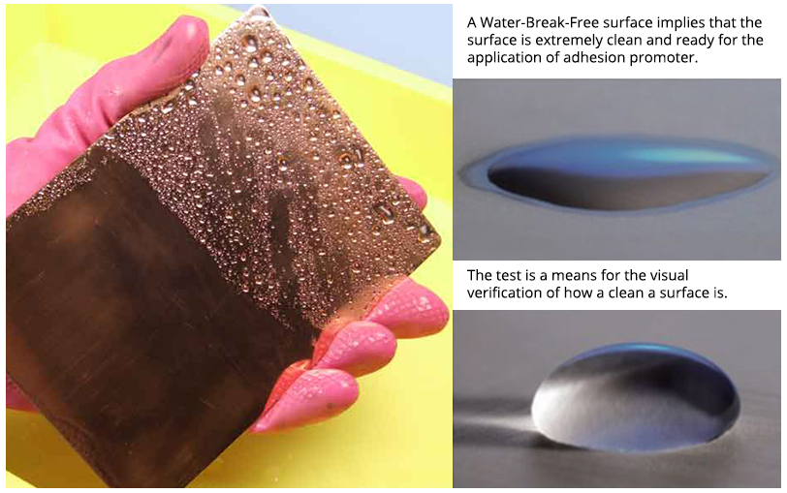
Methods Prior to WCA Measurement
“Water Break-Free” or “Break Free Surface” Test
Assess vs Quantify
Notes:
Water contact angle measurement is closely related to the water break free test, which is used to assess surface cleanliness and wettability. The water break free test involves placing a water droplet on a surface and observing how it spreads or beads up.
If the surface is clean and has high wettability, the water droplet will spread out uniformly, forming a thin film without any distinct boundaries. This indicates good surface cleanliness and wetting characteristics.
However, if the surface is contaminated or has low wettability, the water droplet will bead up, resisting spreading. This behavior is attributed to the presence of contaminants, hydrophobic coatings, or poor surface preparation.

Slide 7
Industry Use of WCA Measurements
1. Surface Coatings and Adhesion:
2. Material Science and Engineering
3. Pharmaceuticals and Biotechnology
4. Aerospace and Automotive Industries
5. Electronics and Microelectronics
Notes:
By utilizing water contact angle measurement devices, researchers and industry professionals can gain insights into surface properties, optimize processes, improve product performance, and enhance the understanding of interfacial phenomena across various sectors.

Slide 8
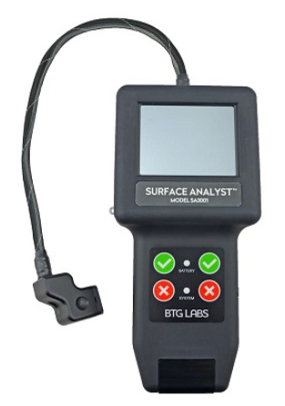
Types of WCA Devices
Desktop Laboratory Devices
Handheld Portable Devices
Notes:
There is an expansive range of WCA devices all with varying drop application and analyzing technologies.
Without going into specifics, there are two categories of WCA devices commercially available: 1 Laboratory devices (desktop) and 1 portable devices
Portable devices are what we have been focusing our testing on as they are lightweight/easy to handle and provide reliable and repeatable results.
Provide some notable differences in the technology.

Slide 9
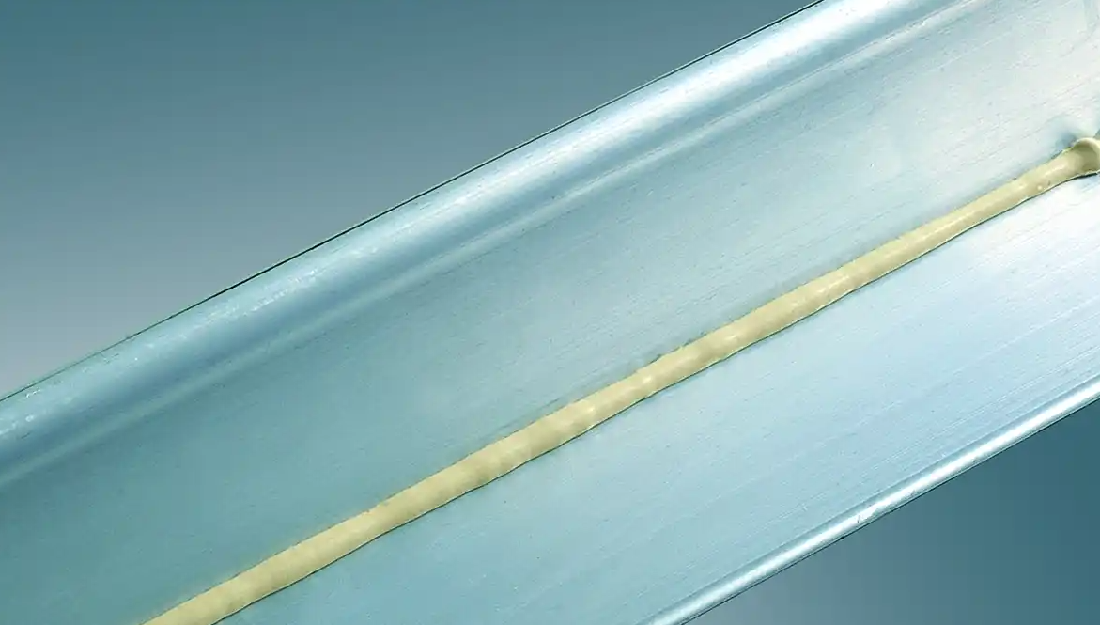
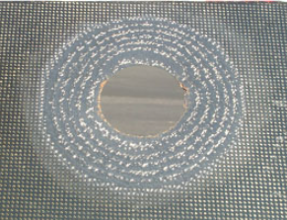
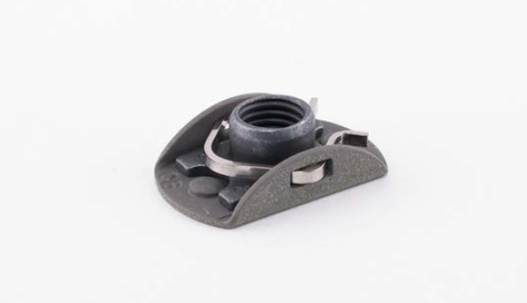
USN Need for WCA Devices
Adhesively bonded joints
Aluminum bonding
Bonded nut plates
Composite bonding
Notes:
USN has an interest in quantifying surface cleanliness prior to bonding

Slide 10
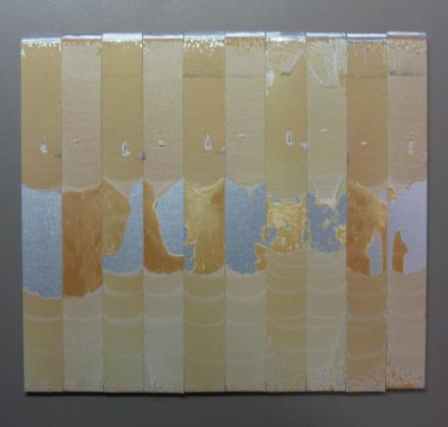
Bonding with Contamination
Surface Preparation steps are critical and if performed incorrectly, contaminants left on the surface can be detrimental to bondline integrity.
Common Contaminants that can affect bondline:
Sanding Residue
Paint Overspray
Hydraulic Fluid
Lubrication Oil
Aircraft Grease
Jet Fuel

Slide 11
Aluminum Bonding
Bonded aluminum repairs are performed on a number of naval aircraft platforms
There is currently no quantitative process for determining a pass/fail of the surface preparation.
Water break free test is the only quality check currently available to maintainers.
Sanding of Aluminum Surface
Application of Sol-Gel
Application of Bond Primer
Notes:
In-service Naval fleet maintainers perform surface preparation procedures for structural bonded repairs on aluminum aircraft structures yet have no quantitative method to determine the quality of their surface preparation prior to bonding.
There are no current remedial actions to a failed break free test

Slide 12
Aluminum Bonding Continued
Laboratory testing concluded the Brighton Science SA 3001 to be effective in detecting contaminates on aluminum surfaces prior to bonding
420 test coupons over four different studies incorporated into pass/fail analysis.
Includes Lap Shear, WCET, and DCB data.
Over 9300 water contact angle measurements analyzed.
A Dem/Val is underway at FRCW, MALS-11, & FRCNW
Real world use, data, and feedback from I-level maintainers

Slide 13
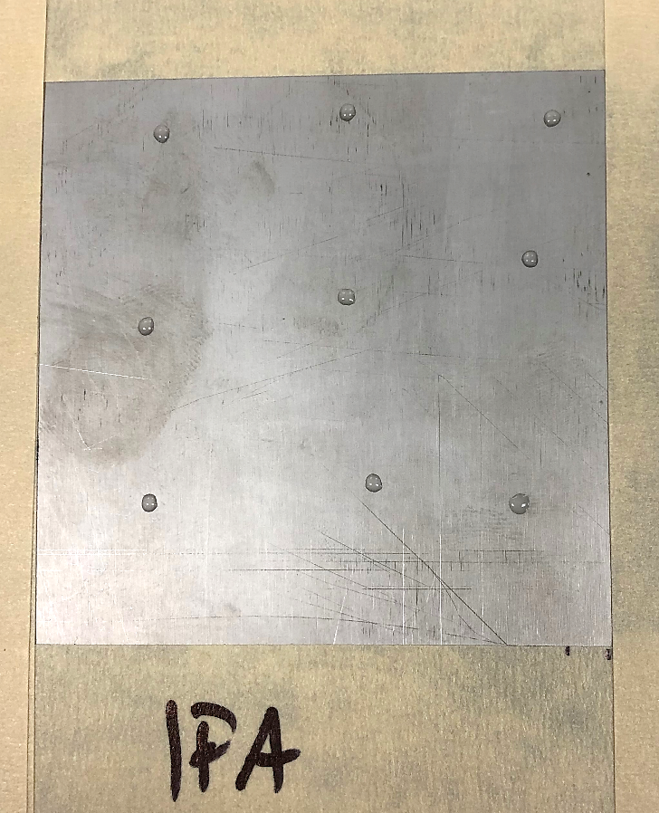
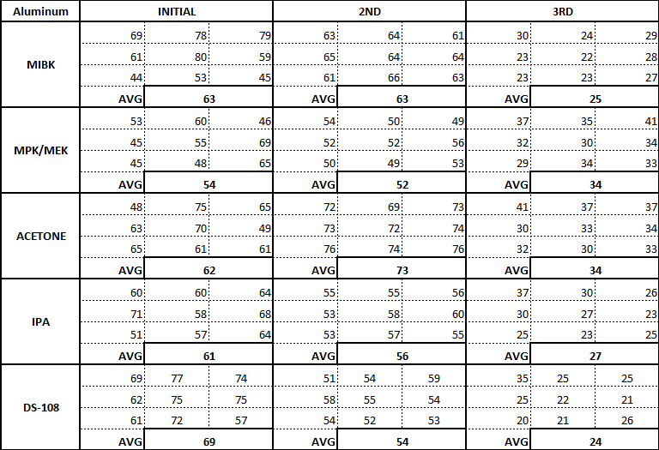
Bonded Nut Plates
The Brighton Science Surface Analyst 3001 unit was utilized in a cleaning solvent down selection experiment at FRCSE.
Five different solvents were compared, MIBK, MPK, Acetone, IPA, and DS-108, in an effort to provide the best options for in-field bonded nutplate repair/surface preparation instructions.
Based on this phase of the experiment on metallic substrates, MIBK, Isopropyl Alcohol, and DS-108 would be the solvents chosen to continue on to the next phase.
Figure 1: Example of “Initial” SA reading test set-up on aluminum panel
Figure 2: Common bonded nutplate material combinations
Notes:
Phase 1 testing did not include the removal of specific contaminants.
Phase 1 testing incorporated an SA reading prior to any cleaning (initial), after a bulk solvent wipe cleaning step (2nd), and a final reading after a precision cleaning step that concluded with a dry wipe (3rd)., to mimic local instructions for surface preparation of structural adhesive bonds.

Slide 14
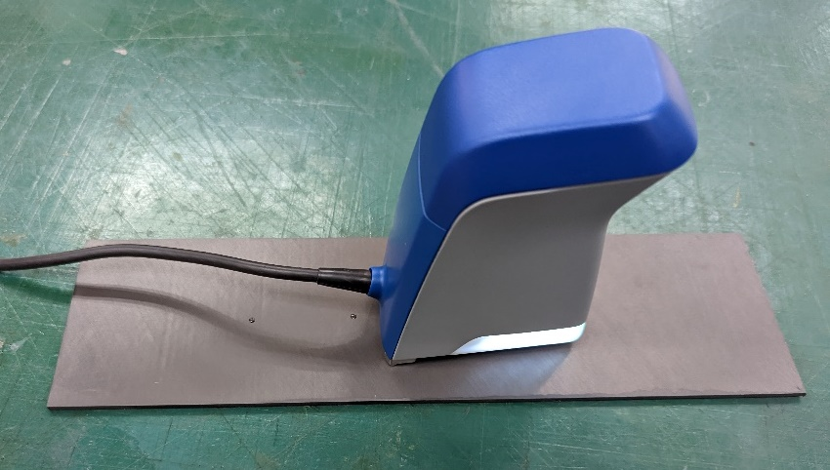
Composite Bonding
Currently executing comparative laboratory testing between the Brighton Science SA 3001 and the SITA SurfaSpector.
Correlate detection of contaminates to observed decreases in bond strength
Testing on 3 Gr/Epoxy laminates commonly used on Naval aircraft:
IM7 UD/977-3
AS4 UD/977-3
AS4 5HS/977-3

Slide 15
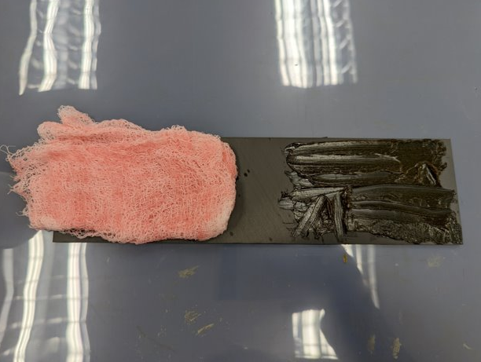
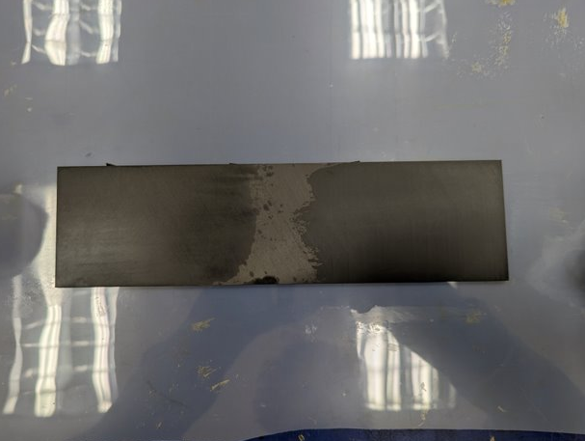
Composite Bonding Continued
Contaminates:
MIL-PRF-83282 Hydraulic Fluid
MIL-G-8132 Grease
Clean: 30°- 45°
MIL-PRF-83282 Hydraulic Fluid: 50°- 65°+
MIL-G-8132 Grease: 70°- 80°+

Slide 16
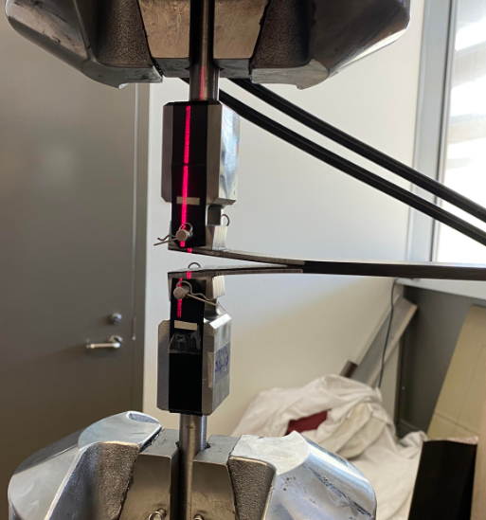
Composite Bonding Continued
WCA measurements are taken after sanding/dry wipe composite surface prep
Double lap shear testing at room temp and in hot/wet conditions
Dual cantilever beam testing at room temperature

Slide 17
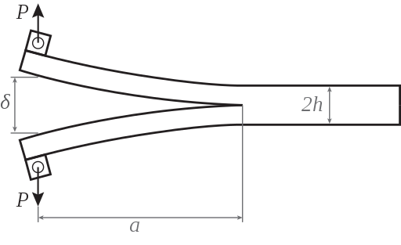
Calculating Crack Growth
1. DCB Testing: Compliance Beam Based Method (CBBM)
Material properties required:
$E_{c}:$ Corrected flexural modulus of the substrate
µ : Shear modulus of the substrate
Recorded data during testing:
Specimen width (b)
Specimen thickness (h)
Force (P)
External displacement between the two loads points (δ)
→ Mathematical model
→
→ the equivalent crack length $a_{CBBM}$
Simpler determination crack length, based on analytical basis

Slide 18
Verification
DCB Testing: Compliance Beam Based Method (CBBM)
Notes:
This demonstrated how good the CBBM analysis correlates with manual measurements

Slide 19
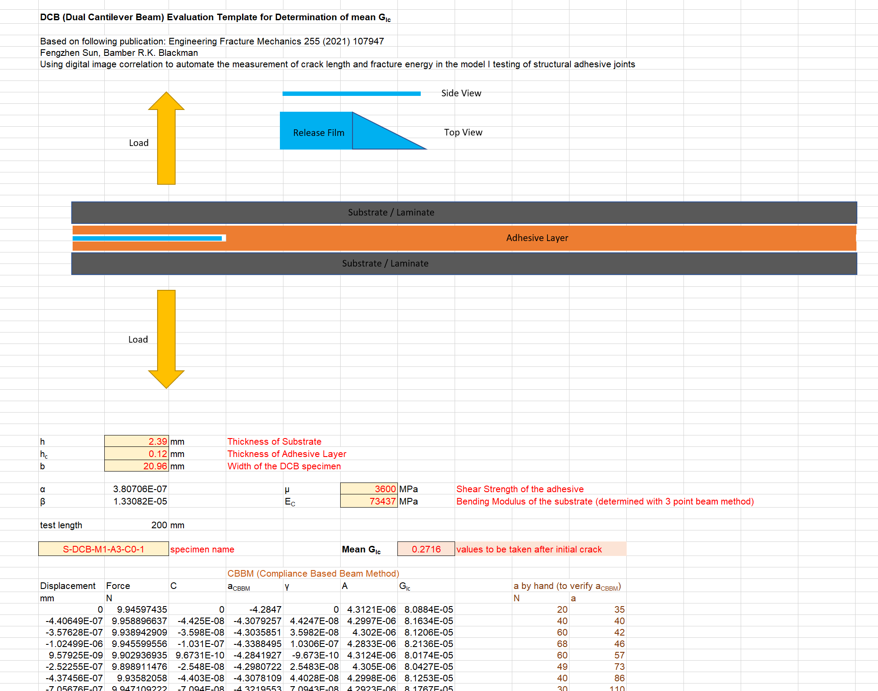
Excel Tool
Excel tool for Compliance Beam Based Method (CBBM) establisehd

